Slide 1
Block Ciphers Data Encryption Standard
Dr. Xinyue Zhang
Assistant Professor
Department of Computer Science
Kennesaw State University
Marietta, GA, USA

Slide 2
Background
Two Main Types of Symmetric Encryption
Stream ciphers
Block ciphers
Key difference
Stream ciphers encrypt data one bit or byte at a time
Block ciphers encrypt fixed-size blocks

Slide 3
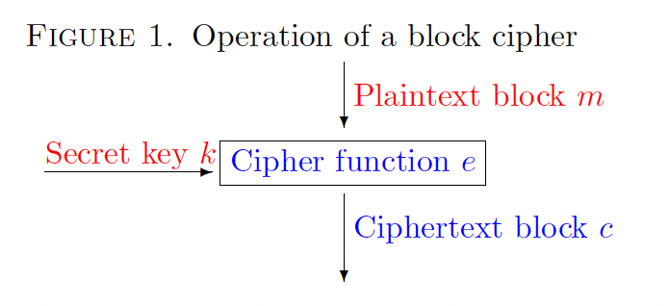
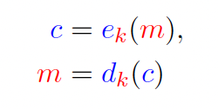
Block Cipher
Block Cipher
Deterministic function
Fixed-size input block
Fixed-size output block
Controlled by a secret key
• m is the plaintext block,
• k is the secret key,
• e is the encryption function,
• d is the decryption function,
• c is the ciphertext block.

Slide 4
Design Goal of a Block Cipher
Security Objective
Ciphertext should look random
Small change in plaintext → large change in ciphertext
Relationship between plaintext and ciphertext should be hard to infer
Key property: Avalanche effect
P = 01001101 10110010
P' = 01001101 10110011
C = 11001010 00101101
C' = 00110101 11010010
(many bits differ)
Encrypt by
Block Cipher

Slide 5
How to Build a Block Cipher
How do we build a block cipher?
2 basic operations (by Claude Shannon)
Confusion:
Relationship between plaintext & ciphertext is obscured.
Ex: Substitution table
Diffusion:
The influence of one each plaintext bit is spread over many ciphertext bits.
Ex: Permutation

Slide 6
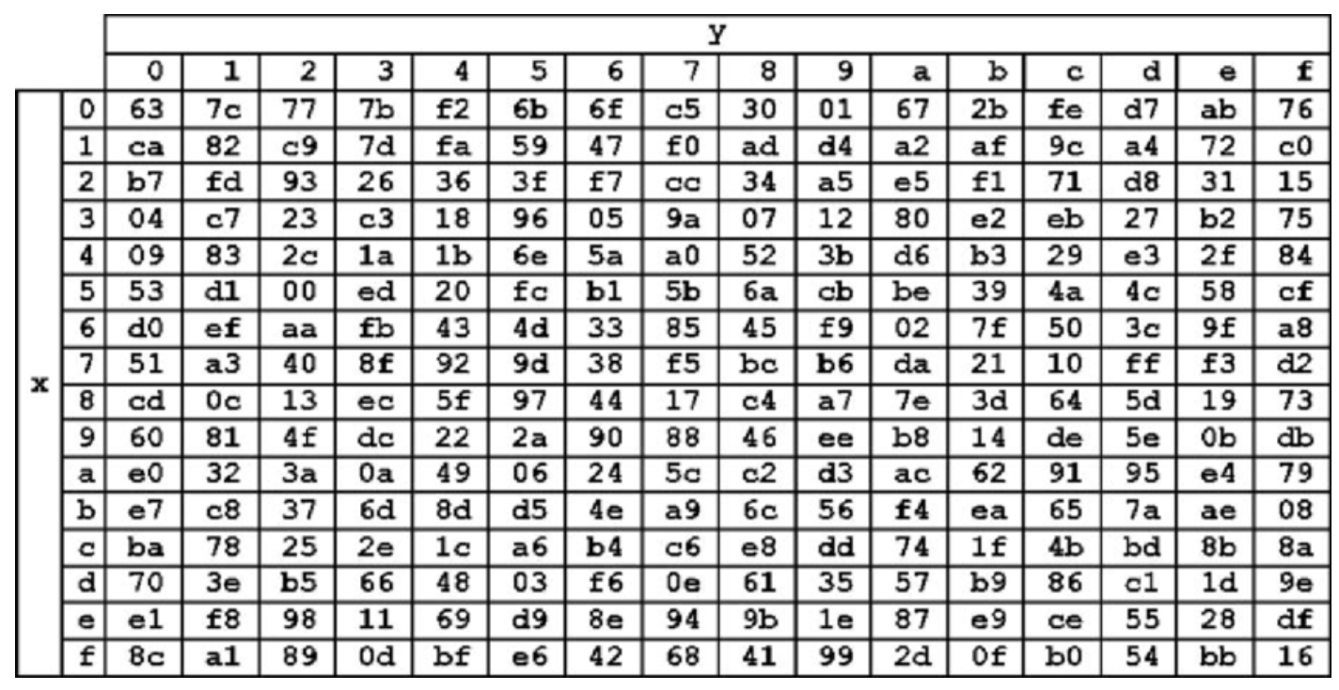
Confusion
Obscures relationship between key and ciphertext
Achieved using substitutions
Makes key influence complex and nonlinear

Slide 7
Diffusion
P1 = 0010 1011
P2 = 0000 1011
Block Cipher
C1 = 1011 1001
C2 = 0110 1100
Single bit of plaintext changes
Many bits of ciphertext change

Slide 8
Product Ciphers
Plaintext
Confusion
Alternates confusion and diffusion
Repeated multiple times (rounds)
Security emerges from iteration
Diffusion
(each layer
=
one round)
Confusion
Diffusion
Ciphertext

Slide 9
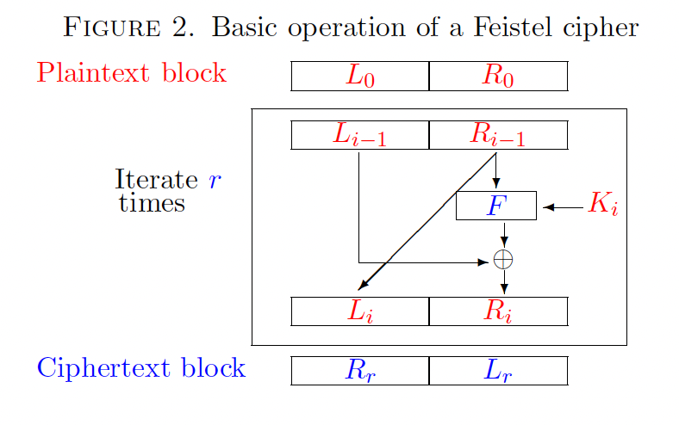
Feistel Structure
Input block split into two halves
Round function applied to one half
Halves swapped each round
Key advantage:
Same structure for encryption and decryption
Allows non-invertible round functions
Efficient and flexible design

Slide 10
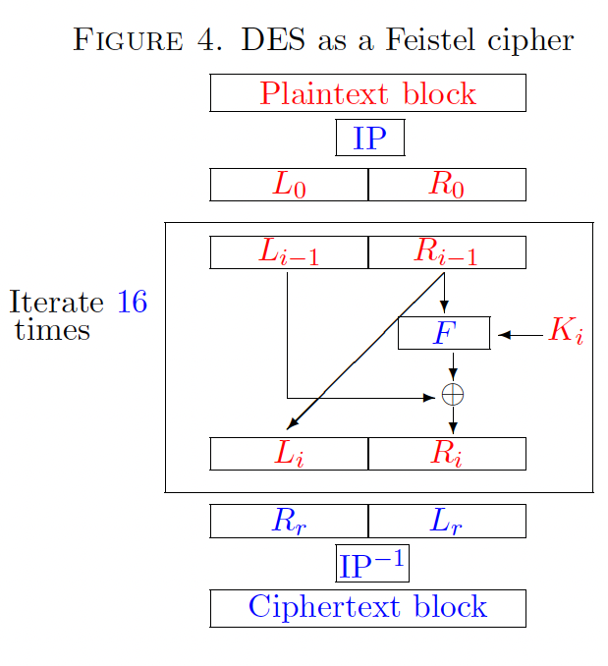
Data Encryption Standard (DES)
Facts:
Developed by IBM (1970s)
Adopted as U.S. standard in 1977
64-bit block size
56-bit key
DES Overview
16-round Feistel cipher
Each round:
Confusion via S-boxes
Diffusion via permutations
Same structure for encryption and decryption

Slide 11
Wrap-up
Today
Block cipher concept
Confusion & diffusion
Feistel structure
DES overview
Next
DES f-function
S-box design
Key schedule

