Slide 1
Data Encryption Standard
Dr. Xinyue Zhang
Assistant Professor
Department of Computer Science
Kennesaw State University
Marietta, GA, USA

Slide 2
Outline
Review
Block cipher
Confusion
Diffusion
DES
Feistel Cipher
F-function

Slide 3
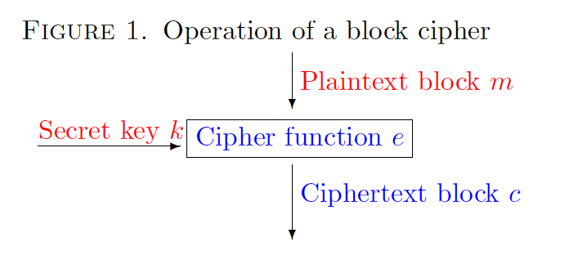
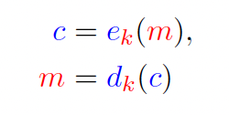
Block Cipher
Block Cipher
Deterministic function
Fixed-size input block
Fixed-size output block
Controlled by a secret key
• m is the plaintext block,
• k is the secret key,
• e is the encryption function,
• d is the decryption function,
• c is the ciphertext block.

Slide 4
Block Cipher (cont.)
How do we build a block cipher?
2 basic operations (by Claude Shannon)
Confusion:
Relationship between plaintext & ciphertext is obscured.
Ex: Substitution table
Diffusion:
The influence of one each plaintext bit is spread over many ciphertext bits.
Ex: Permutation

Slide 5
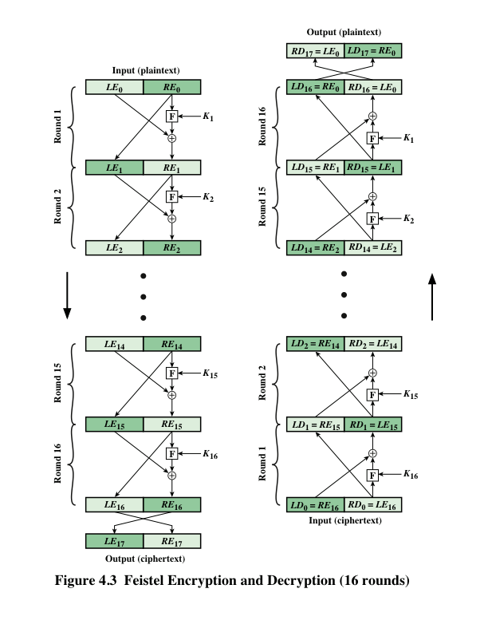
DES Encryption and Decryption
Encryption
Decryption
*Figure resource: Stallings, William. Cryptography and Network Security: Principles and Practice, 7th ed. England: Pearson Education Limited, 2017.

Slide 6
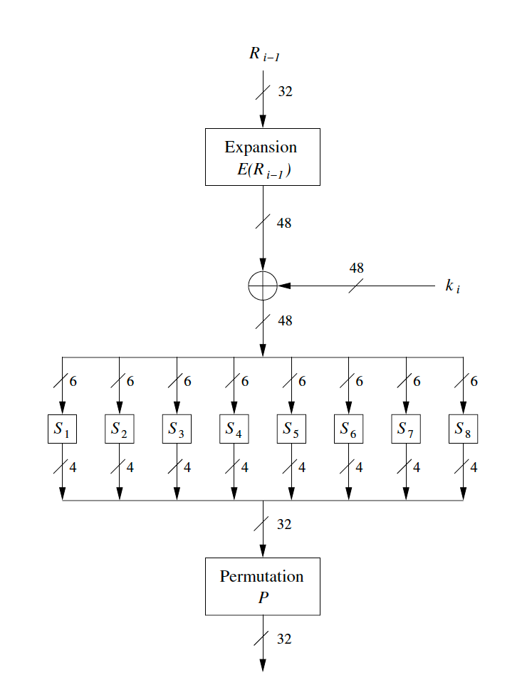
F-function
F-function:
Expansion
E-box provides diffusion
32 bits -> 48 bits
Key mixing
XOR operation
Key: 48 bits
Substitution
S-box provides confusion
Permutation
6
*Figure resource: Paar, Christof, and Jan Pelzl. Understanding cryptography. Vol. 1. Springer-Verlag Berlin Heidelberg, 2010.

Slide 7
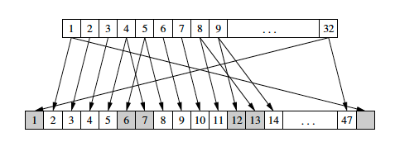
Expansion
F-function
The 32-bit input is expanded to 48 bits by partitioning the input into eight 4-bit blocks and by expanding each block to 6 bits.
The output consists of eight 6-bit (8 × 6 = 48 bits) pieces, each containing a copy of 4 corresponding input bits, plus a copy of the immediately adjacent bit from each of the input pieces to either side.

Slide 8
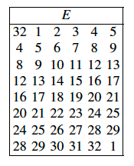
Expansion:
F-function

Slide 9
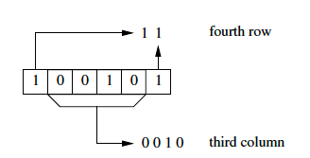
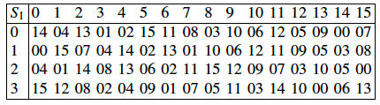
Substitution
F-function
Eight 6-bit blocks are fed into eight different substitution boxes (S-boxes)
Each S-box is a lookup table that maps a 6-bit input to a 4-bit output.

Slide 10
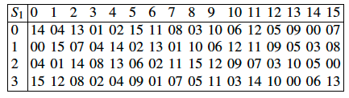
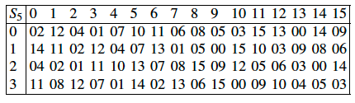
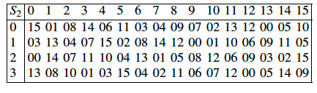
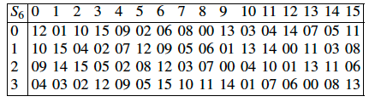
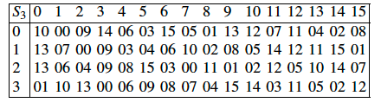
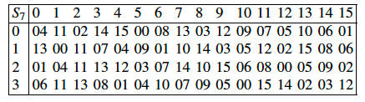
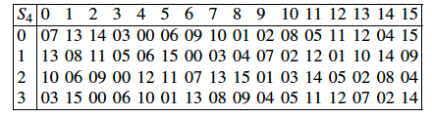
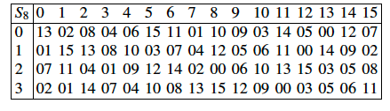
Substitution Tables

Slide 11
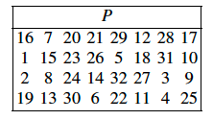
Permutation:
F-function
The 32-bit output is permuted according to the P permutation.
After permutation, the bits from the output of each S-box in this round are spread across four different S-boxes in the next round.

Slide 12
F-Function Summary

Slide 13
F-function Review
F-function Review:
Expansion
E-box provides diffusion
32 bits -> 48 bits
Key mixing
XOR operation
Key: 48 bits
Substitution
S-box provides confusion
Permutation

Slide 14
Expansion Review
F-function
The 32-bit input is expanded to 48 bits by partitioning the input into eight 4-bit blocks and by expanding each block to 6 bits.
The output consists of eight 6-bit (8 × 6 = 48 bits) pieces, each containing a copy of 4 corresponding input bits, plus a copy of the immediately adjacent bit from each of the input pieces to either side.

Slide 15
Substitution Review
F-function
Eight 6-bit blocks are fed into eight different substitution boxes (S-boxes)
Each S-box is a lookup table that maps a 6-bit input to a 4-bit output.

Slide 16
Permutation Review
F-function
The 32-bit output is permuted according to the P permutation.
After permutation, the bits from the output of each S-box in this round are spread across four different S-boxes in the next round.

Slide 17
Key Takeaways
The f-function is the core source of security in DES
It combines:
expansion
key mixing
substitution (S-boxes)
permutation
Nonlinearity comes entirely from S-boxes
Diffusion is achieved across rounds, not in a single step
The f-function itself is not invertible
Security emerges from repetition inside the Feistel structure

Slide 18
References
Some figures are from the following textbooks:
Paar, Christof, and Jan Pelzl. Understanding cryptography. Vol. 1. Springer-Verlag Berlin Heidelberg, 2010.
Stallings, William. Cryptography and Network Security: Principles and Practice, 7th ed. England: Pearson Education Limited, 2017.

