Slide 1
Data Encryption Standard Part 3: Key Schedule
Dr. Xinyue Zhang
Assistant Professor
Department of Computer Science
Kennesaw State University
Marietta, GA, USA

Slide 2
DES Overview: Putting the Pieces Together
DES at a Glance
64-bit block cipher
56-bit effective key
16-round Feistel structure
Inside each round
f-function (confusion + diffusion)
round key from key schedule
Before and After Feistel structure
Initial Permutation (IP) and Inverse Initial Permutation (IP⁻¹)
IP and IP⁻¹ do not add cryptographic security
Historical implementation choice

Slide 3
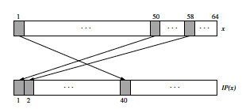
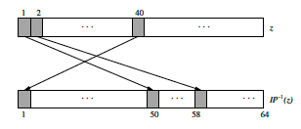
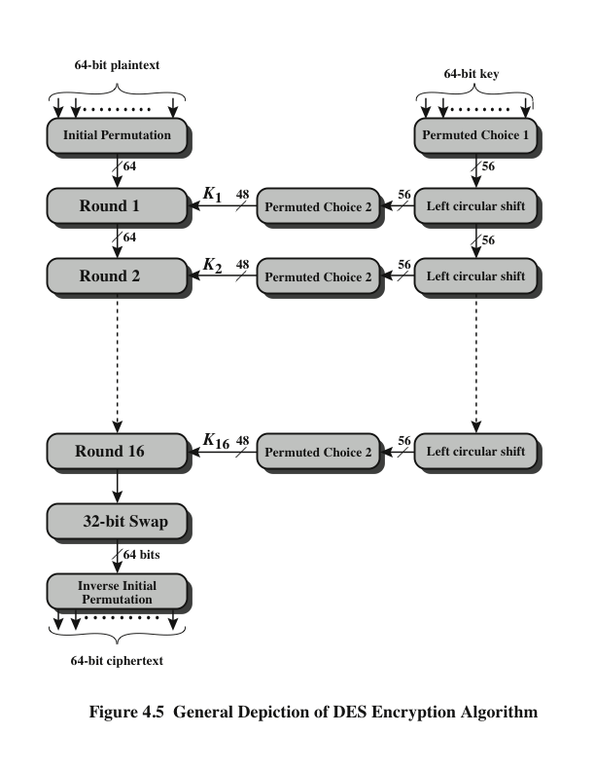
DES Overview
Initial Permutation
Final Permutation (Inverse Initial Permutation)
Key Schedule
*Figure resource: Stallings, William. Cryptography and Network Security: Principles and Practice, 7th ed. England: Pearson Education Limited, 2017.

Slide 4
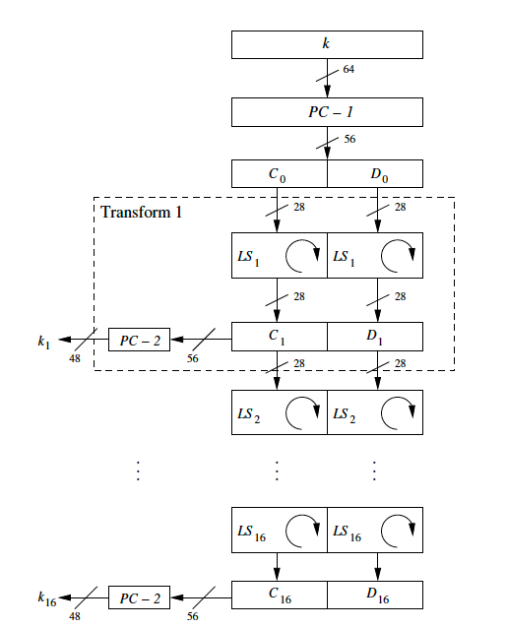
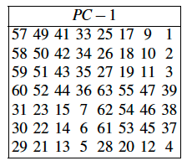
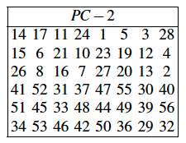
Key Schedule Overview
Key Schedule
*Figure resource: [1] Stallings, William. Cryptography and Network Security: Principles and Practice, 7th ed. England: Pearson Education Limited, 2017.
[2] Paar, Christof, and Jan Pelzl. Understanding cryptography. Vol. 1. Springer-Verlag Berlin Heidelberg, 2010.

Slide 5
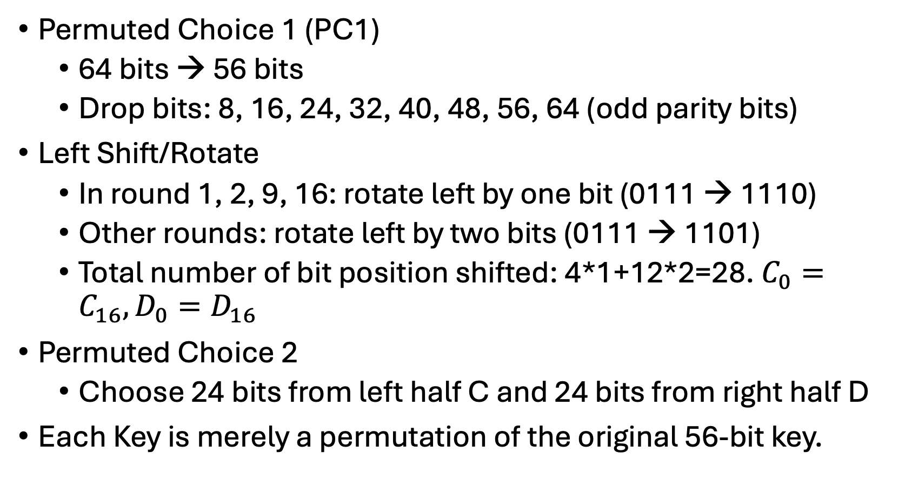
Key Schedule
Permuted Choice 1 (PC1)
64 bits → 56 bits
Drop bits: 8, 16, 24, 32, 40, 48, 56, 64 (odd parity bits)
Left Shift/Rotate
In round 1, 2, 9, 16: rotate left by one bit (0111 → 1110)
Other rounds: rotate left by two bits (0111 → 1101)
Total number of bit position shifted: 4*1+12*2=28. $C_{0}=C_{16}, D_{0}=D_{16}$
Permuted Choice 2
Choose 24 bits from left half C and 24 bits from right half D
Each Key is merely a permutation of the original 56-bit key.

Slide 6
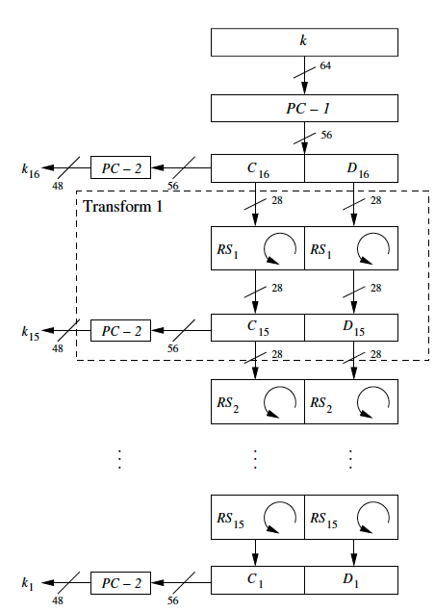
Key Schedule (cont.)
Decryption
Encryption
Decryption
Reversed Key Schedule
In each round, the key is derived via RIGHT shifts in a similar fashion.

Slide 7
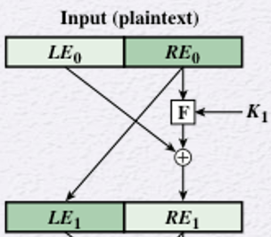
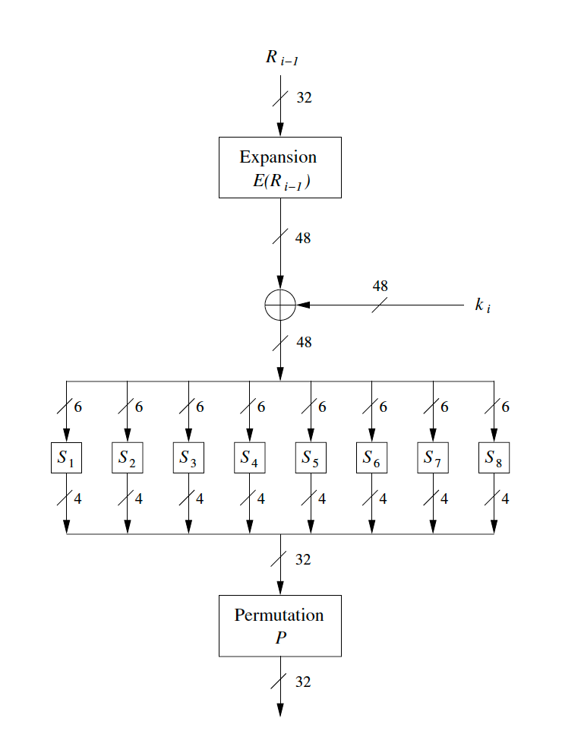
F-Function Review

Slide 8
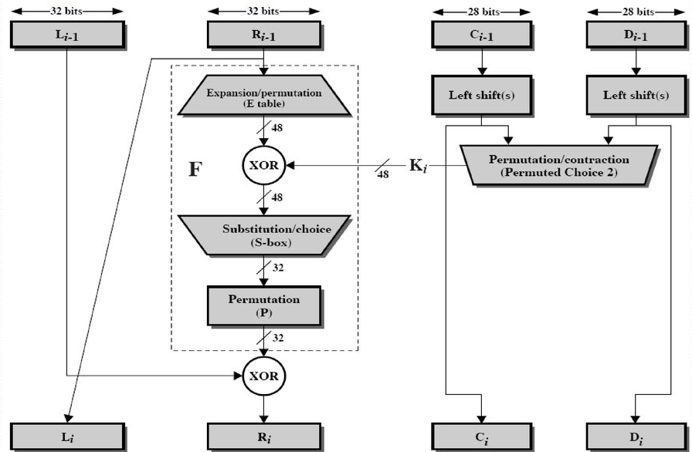
DES Workflow

Slide 9
Example
2 Rounds + Swap, F(R,K) = R^{K} mod 11, K1 = 9, K2 = 16
Plaintext = 1101 0110
What is the final ciphertext?

Slide 10
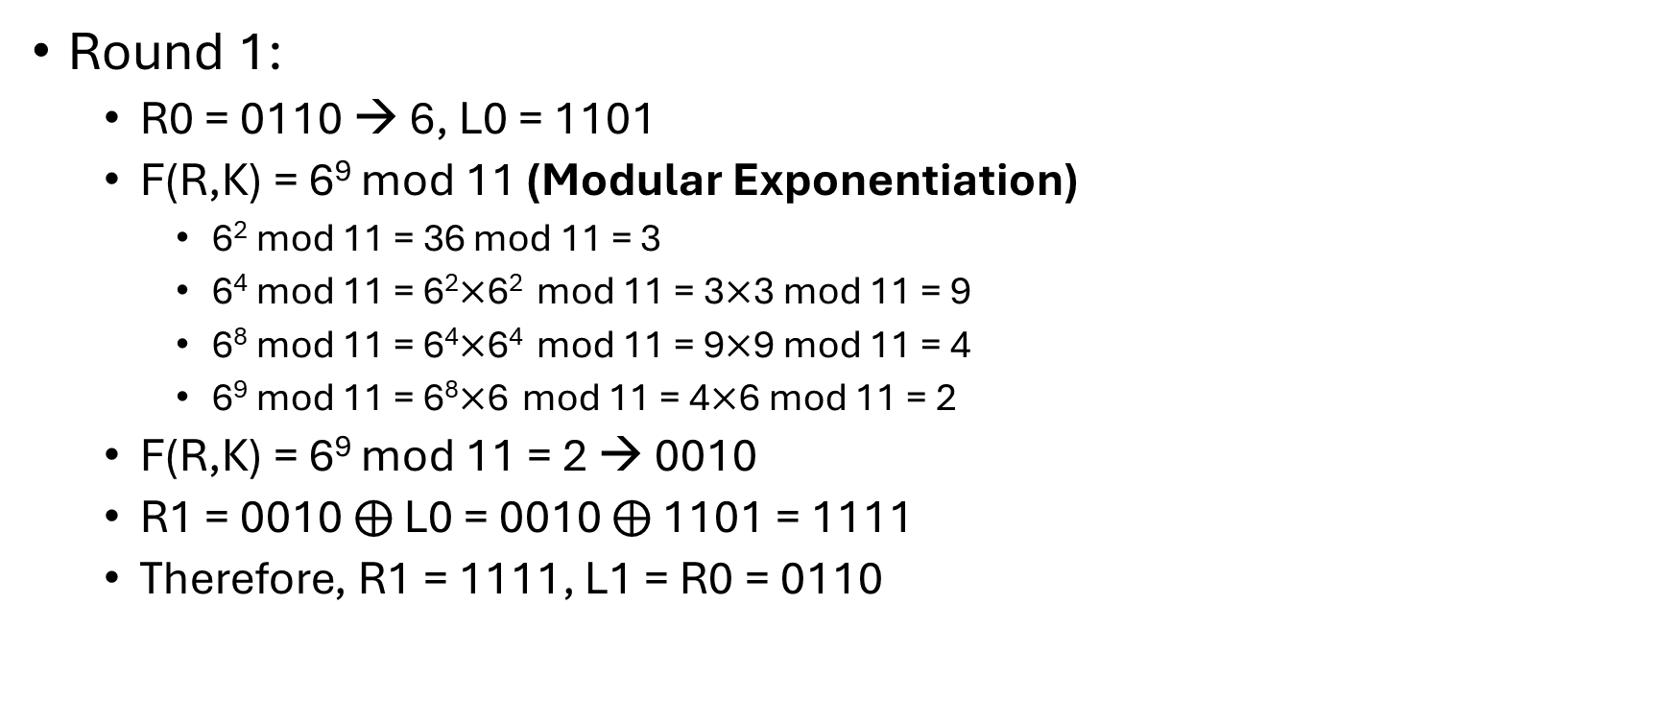
Example Solution
Round 1:
R0 = 0110 → 6, L0 = 1101
F(R,K) = 6⁹ mod 11 (Modular Exponentiation)
6² mod 11 = 36 mod 11 = 3
6⁴ mod 11 = 6²$×$6² mod 11 = 3$×$3 mod 11 = 9
6⁸ mod 11 = 6⁴$×$6⁴ mod 11 = 9$×$9 mod 11 = 4
6⁹ mod 11 = 6⁸$×$6 mod 11 = 4$×$6 mod 11 = 2
F(R,K) = 6⁹ mod 11 = 2 → 0010
R1 = 0010 $⨁$ L0 = 0010 $⨁$ 1101 = 1111
Therefore, R1 = 1111, L1 = R0 = 0110

Slide 11
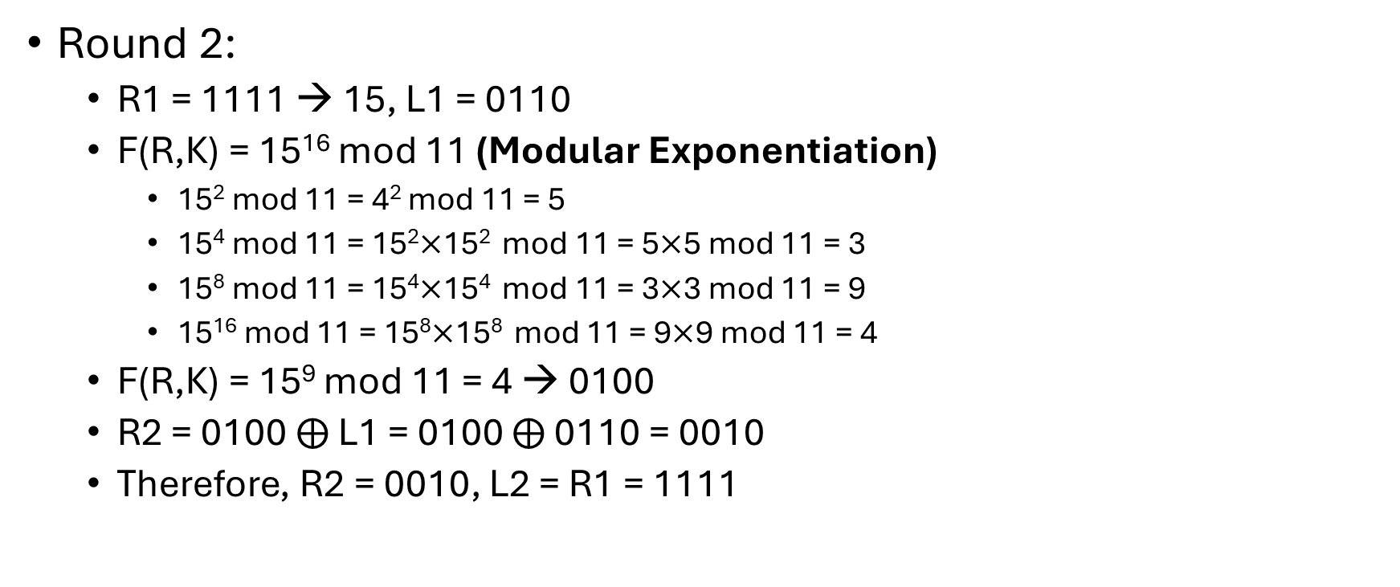
Example Solution (cont. pg2)
Round 2:
R1 = 1111 → 15, L1 = 0110
F(R,K) = 15¹⁶ mod 11 (Modular Exponentiation)
15² mod 11 = 4² mod 11 = 5
15⁴ mod 11 = 15²$×$15² mod 11 = 5$×$5 mod 11 = 3
15⁸ mod 11 = 15⁴$×$15⁴ mod 11 = 3$×$3 mod 11 = 9
15¹⁶ mod 11 = 15⁸$×$15⁸ mod 11 = 9$×$9 mod 11 = 4
F(R,K) = 15⁹ mod 11 = 4 → 0100
R2 = 0100 $⨁$ L1 = 0100 $⨁$ 0110 = 0010
Therefore, R2 = 0010, L2 = R1 = 1111

Slide 12
Example Solution (cont. pg3)
Swap:
L3 = R2 = 0010
R3 = L2 = 1111
Final ciphertext: 0010 1111

Slide 13
Review of Data Encryption Standard

Slide 14
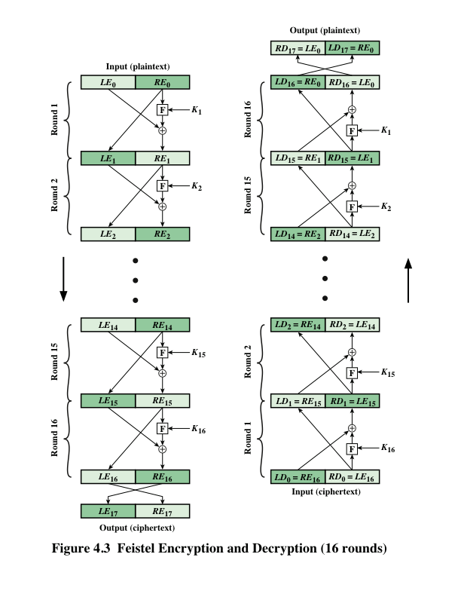
DES Structure Review
Encryption
Decryption

Slide 15
F-function
F-function:
Expansion
E-box provides diffusion
32 bits -> 48 bits
Key mixing
XOR operation
Key: 48 bits
Substitution
S-box provides confusion
Permutation

Slide 16
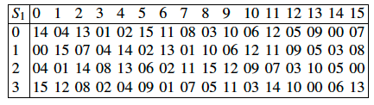
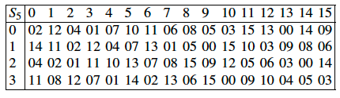
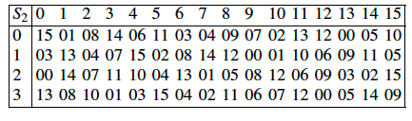
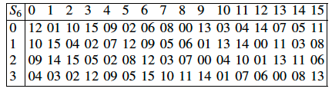
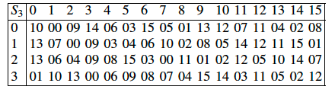
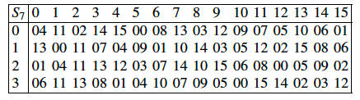
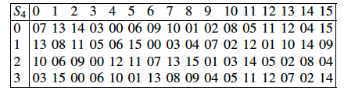
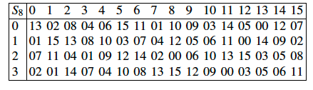
Substitution Tables

Slide 17
Key Schedule Review
Key Schedule

Slide 18
Initial/Final Permutation
Initial Permutation
Final Permutation (Inverse Initial Permutation)
Key Schedule

Slide 19
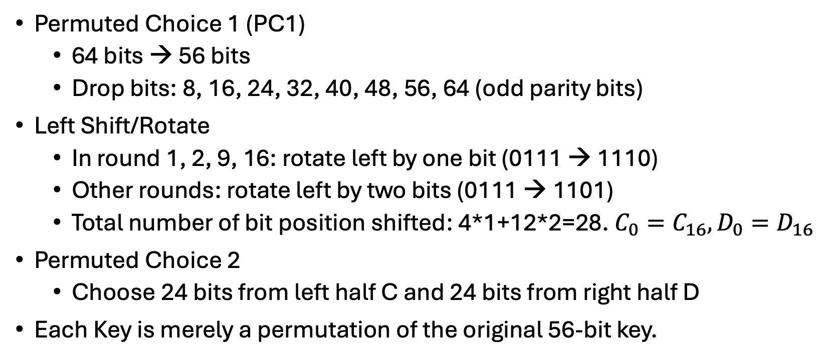
Key Schedule Steps Review
Permuted Choice 1 (PC1)
64 bits → 56 bits
Drop bits: 8, 16, 24, 32, 40, 48, 56, 64 (odd parity bits)
Left Shift/Rotate
In round 1, 2, 9, 16: rotate left by one bit (0111 → 1110)
Other rounds: rotate left by two bits (0111 → 1101)
Total number of bit position shifted: 4*1+12*2=28. $C_{0}=C_{16}, D_{0}=D_{16}$
Permuted Choice 2
Choose 24 bits from left half C and 24 bits from right half D
Each Key is merely a permutation of the original 56-bit key.

Slide 20
Key Schedule (cont.)
Decryption
Encryption
Decryption
Reversed Key Schedule
In each round, the key is derived via RIDGT shifts in a similar fashion.

Slide 21
DES Toy Example
Plaintext: 1001 1100 0010 0111
Key: 1111 0011 0001 1000
Two rounds
What will be the ciphertext?

Slide 22
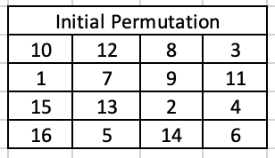
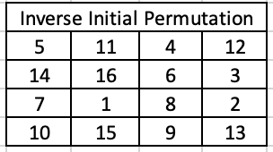
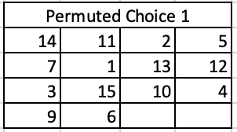
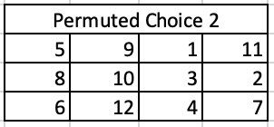
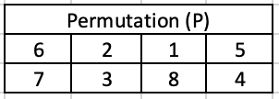
DES Toy Example Details
Plaintext: 1001 1100 0010 0111
Key: 1111 0011 0001 1000
Two Rounds

Slide 23
Example – Key Schedule Solutions
Key schedule:
Original key: 1111 0011 0001 1000
After PC-1: 0010 1111 1001 00 (14 bits)
Round 1:
C₀ = 0010 111, D₀ = 1100 100
Left shift: C₁ = 0101 110, D₁ = 1001 001
PC-2: 1001 1001 1010(This is the first key, K₁.)
Round 2:
Left shift: C₂ =1011 100, D₂ = 0010 011
PC-2: 1010 0110 0010(This is the first key, K₂.)

Slide 24
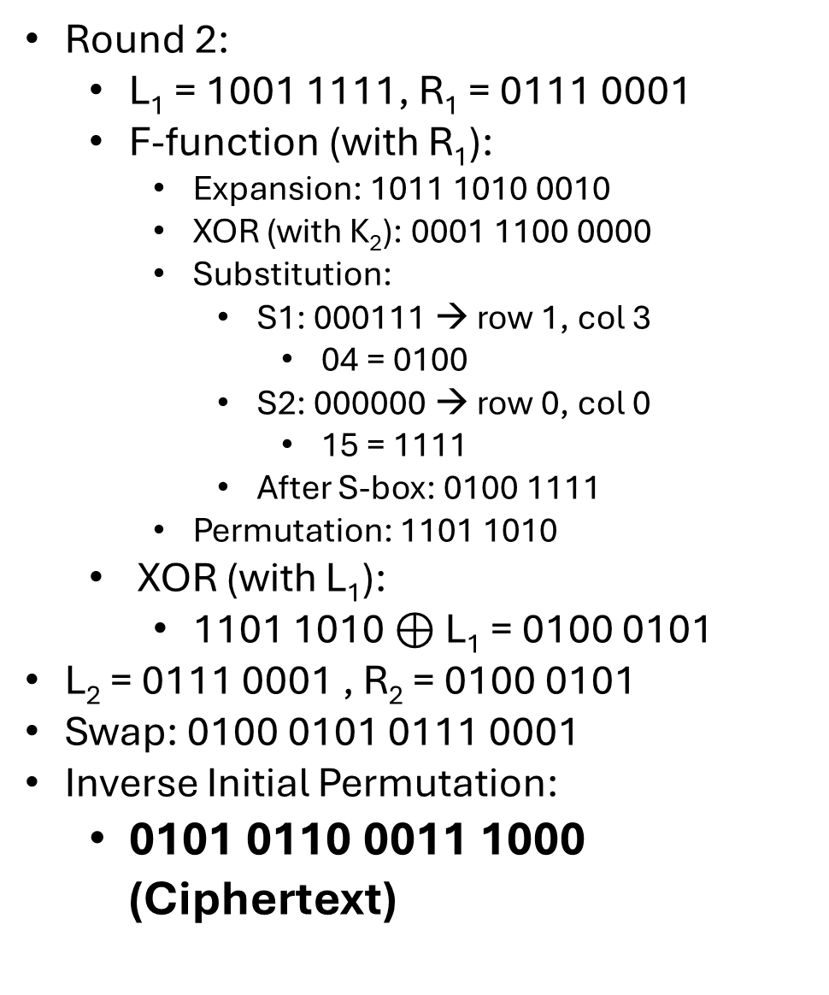
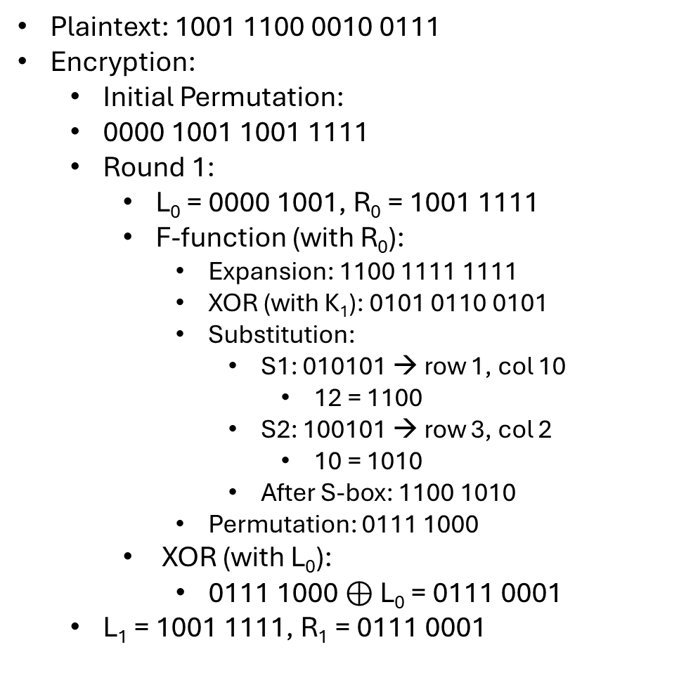
DES Toy Example Solutions
Round 2:
L₁ = 1001 1111, R₁ = 0111 0001
F-function (with R₁):
Expansion: 1011 1010 0010
XOR (with K₂): 0001 1100 0000
Substitution:
S1: 000111 → row 1, col 3
04 = 0100
S2: 000000 → row 0, col 0
15 = 1111
After S-box: 0100 1111
Permutation: 1101 1010
XOR (with L₁):
1101 1010 $⊕$ L₁ = 0100 0101
L₂ = 0111 0001 , R₂ = 0100 0101
Swap: 0100 0101 0111 0001
Inverse Initial Permutation:
0101 0110 0011 1000 (Ciphertext)
Plaintext: 1001 1100 0010 0111
Encryption:
Initial Permutation:
0000 1001 1001 1111
Round 1:
L₀ = 0000 1001, R₀ = 1001 1111
F-function (with R₀):
Expansion: 1100 1111 1111
XOR (with K₁): 0101 0110 0101
Substitution:
S1: 010101 → row 1, col 10
12 = 1100
S2: 100101 → row 3, col 2
10 = 1010
After S-box: 1100 1010
Permutation: 0111 1000
XOR (with L₀):
0111 1000 $⊕$ L₀ = 0111 0001
L₁ = 1001 1111, R₁ = 0111 0001

Slide 25
DES Summary
What DES Is
Symmetric block cipher
64-bit block size
56-bit effective key
16-round Feistel cipher
How DES Works
f-function provides nonlinearity
Key schedule generates round keys
Limitations of DES
Short key length (56 bits)
Vulnerable to brute-force attacks
Superseded by modern standards
Why We Study DES
Foundational block-cipher design
Influences modern ciphers (e.g., AES)

