Slide 1
Finite Fields
Dr. Xinyue Zhang
Assistant Professor
Department of Computer Science
Kennesaw State University
Marietta, GA, USA

Slide 2
Fields
A binary operation is a calculation that combines two elements to produce another element, such as addition, subtraction, multiplication, vector addition, matrix multiplication, etc.
A field is a set 𝐹 equipped with two binary operations, Addition (+) and Multiplication (·). Such that the following properties hold:
Properties of Addition (𝐹, +): For all 𝑎,𝑏,𝑐 ∈ 𝐹:
(1) Closure: 𝑎+𝑏 ∈ 𝐹
(2) Associativity: (𝑎+𝑏)+𝑐=𝑎+(𝑏+𝑐)
(3) Additive Identity: There exists 0∈𝐹 such that 𝑎+0=𝑎.
(4) Additive Inverse: For every 𝑎∈𝐹, there exists −𝑎∈𝐹 such that 𝑎+(−𝑎)=0.
(5) Commutativity: 𝑎+𝑏=𝑏+𝑎

Slide 3
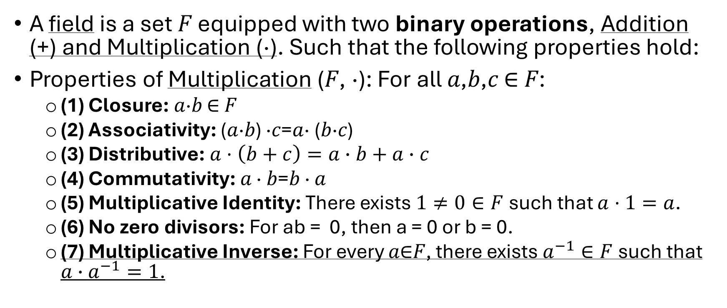
Fields – Multiplication Properties
A binary operation is a calculation that combines two elements to produce another element, such as addition, subtraction, multiplication, vector addition, matrix multiplication, etc.
A field is a set 𝐹 equipped with two binary operations, Addition (+) and Multiplication (·). Such that the following properties hold:
Properties of Multiplication (𝐹, ·): For all 𝑎,𝑏,𝑐 ∈ 𝐹:
(1) Closure: 𝑎·𝑏 ∈ 𝐹
(2) Associativity: (𝑎·𝑏) ·𝑐=𝑎· (𝑏·𝑐)
(3) Distributive: $a·\left(b+c\right)=a∙b+a∙c$
(4) Commutativity: 𝑎 · 𝑏=𝑏 · 𝑎
(5) Multiplicative Identity: There exists $1≠0∈F$such that $a·1=a$.
(6) No zero divisors: For ab = 0, then a = 0 or b = 0.
(7) Multiplicative Inverse: For every 𝑎∈𝐹, there exists $a^{−1}∈F$such that ${a∙a}^{−1}=1$.

Slide 4



Fields – Multiplication Properties (cont.)
Properties of Multiplication (𝐹, ·): For all 𝑎,𝑏,𝑐 ∈ 𝐹:
(7) Multiplicative Inverse: For every 𝑎∈𝐹, there exists $a^{−1}∈F$such that ${a∙a}^{−1}=1$.
A field is a set where addition and multiplication behave like ordinary arithmetic, and every nonzero element has a multiplicative inverse.
✅ Positive Example: Real Numbers $ℝ$
Closed under +, −, ×, ÷ (except division by 0)
0 is additive identity
1 is multiplicative identity
Every nonzero number has a multiplicative inverse
Conclusion: $ℝ$ is a field.
❌ Negative Example: Integers $ℤ$
Closed under +, −, ×
NOT closed under division
Example: $1÷2∉ℤ$
Conclusion: $ℤ$ is NOT a field.

Slide 5
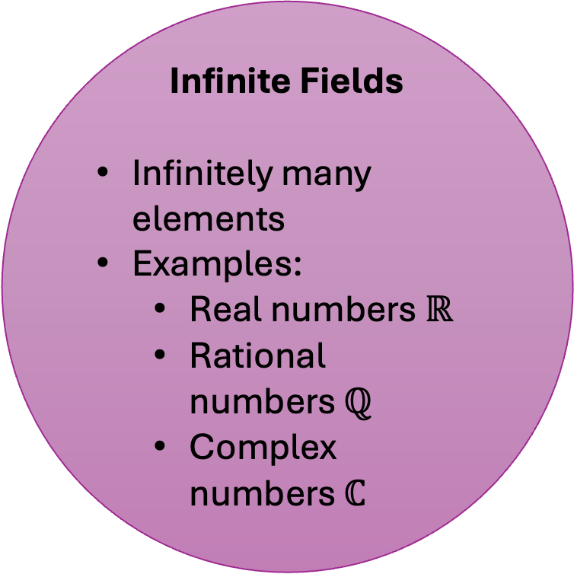
Types of Fields
Infinite Fields
Infinitely many elements
Examples:
Real numbers $ℝ$
Rational numbers $ℚ$
Complex numbers $ℂ$
Finite Fields
Finite number of elements
Also called Galois Fields (GF)
Used in cryptography

Slide 6

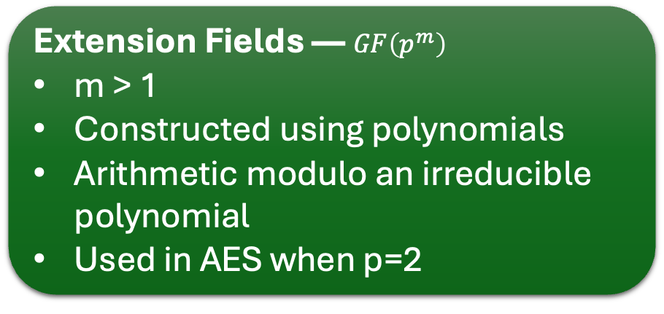

Finite Fields Types
Theorem (Key Fact):
A finite field exists only if its size is: $p^{m}$.
where:
$p$ = prime number
$m$ = positive integer
Prime Fields — $GF\left(p\right)$
p is prime
Elements: {0,1,...,p−1}
Arithmetic modulo p
Same as $ℤ_{p}$
Extension Fields — $GF\left(p^{m}\right)$
m > 1
Constructed using polynomials
Arithmetic modulo an irreducible polynomial
Used in AES when p=2

Slide 7
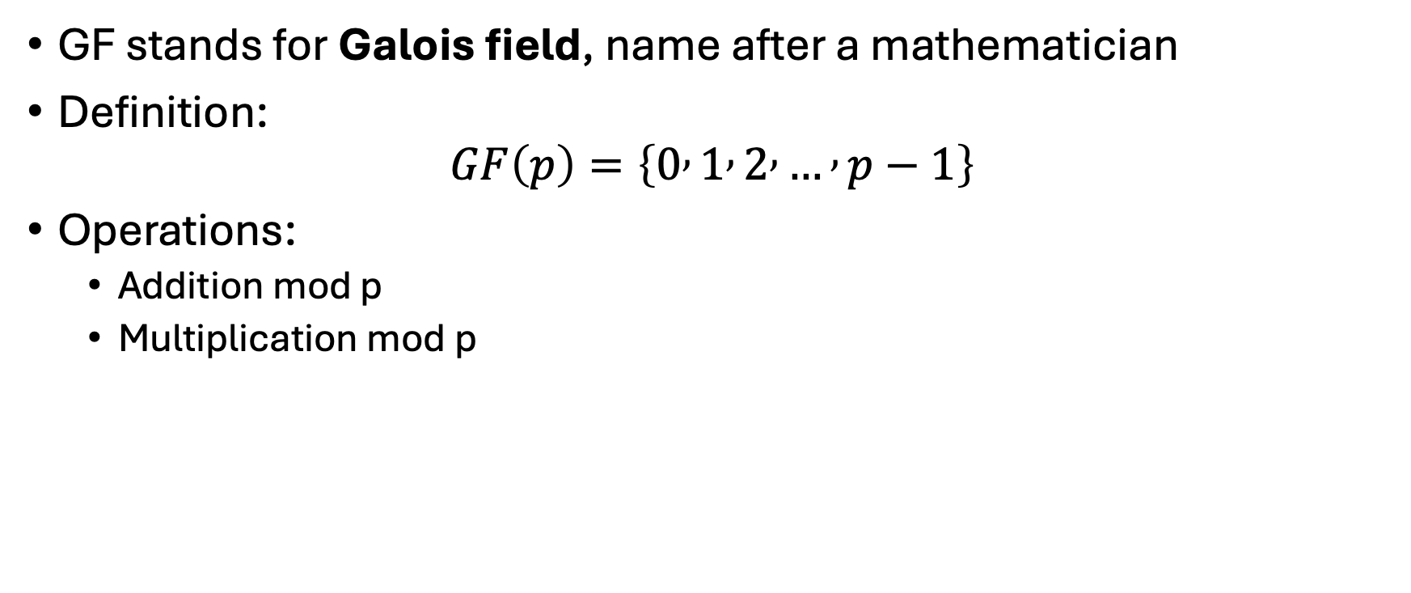
Finite Fields: GF(p)
GF stands for Galois field, name after a mathematician
Definition:
$$GF\left(p\right)=\left\{0 , 1 , 2 , … , p−1\right\}$$
Operations:
Addition mod p
Multiplication mod p

Slide 8
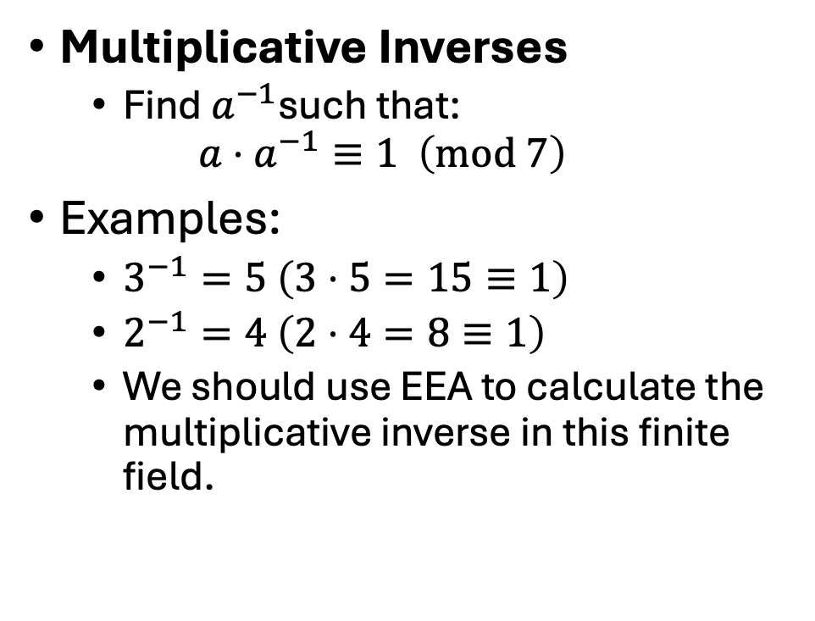
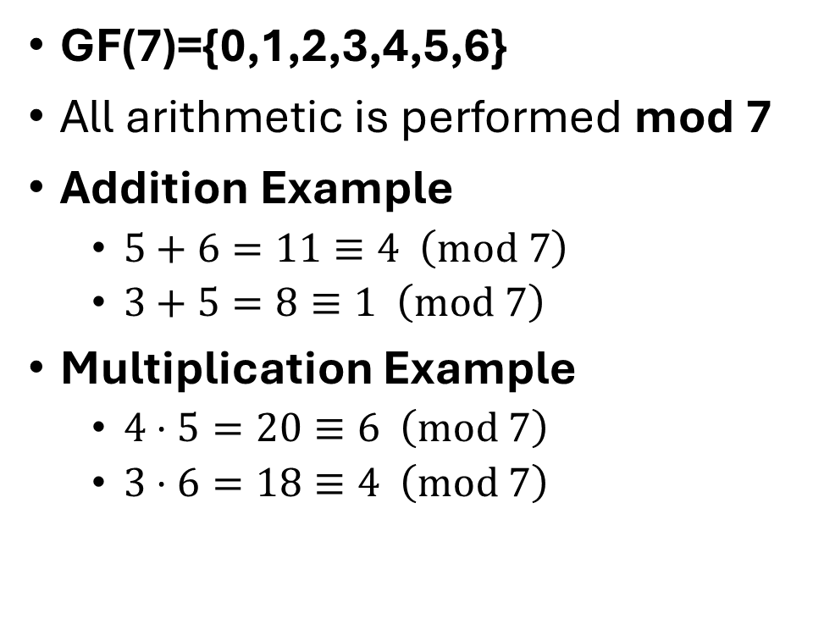
GF(p) Example
GF(7)={0,1,2,3,4,5,6}
All arithmetic is performed mod 7
Addition Example
$5+6=11≡4 \left(mod 7\right)$
$3+5=8≡1 \left(mod 7\right)$
Multiplication Example
$4⋅5=20≡6 \left(mod 7\right)$
$3⋅6=18≡4 \left(mod 7\right)$
Multiplicative Inverses
Find $a^{−1}$such that:
$$a⋅a^{−1}≡1 \left(mod 7\right)$$
Examples:
$3^{−1}=5 \left(3⋅5=15≡1\right)$
$2^{−1}=4 \left(2⋅4=8≡1\right)$
We should use EEA to calculate the multiplicative inverse in this finite field.

Slide 9
Finite Fields: GF(p^{m})
Finite fields only exist if they have p^{m} elements. m is always a positive integer.
Example:
1. There is a finite field with 11 elements. GF(11)
2. There is a finite field with 81 elements. GF(81)=GF(3⁴)
3. There is a finite field with 256 elements. GF(256)=GF(2⁸)
4. There is NOT a finite field with 12 elements. GF(12)=GF(2² * 3)
Especially important in Crypto: GF(2^{m})

Slide 10

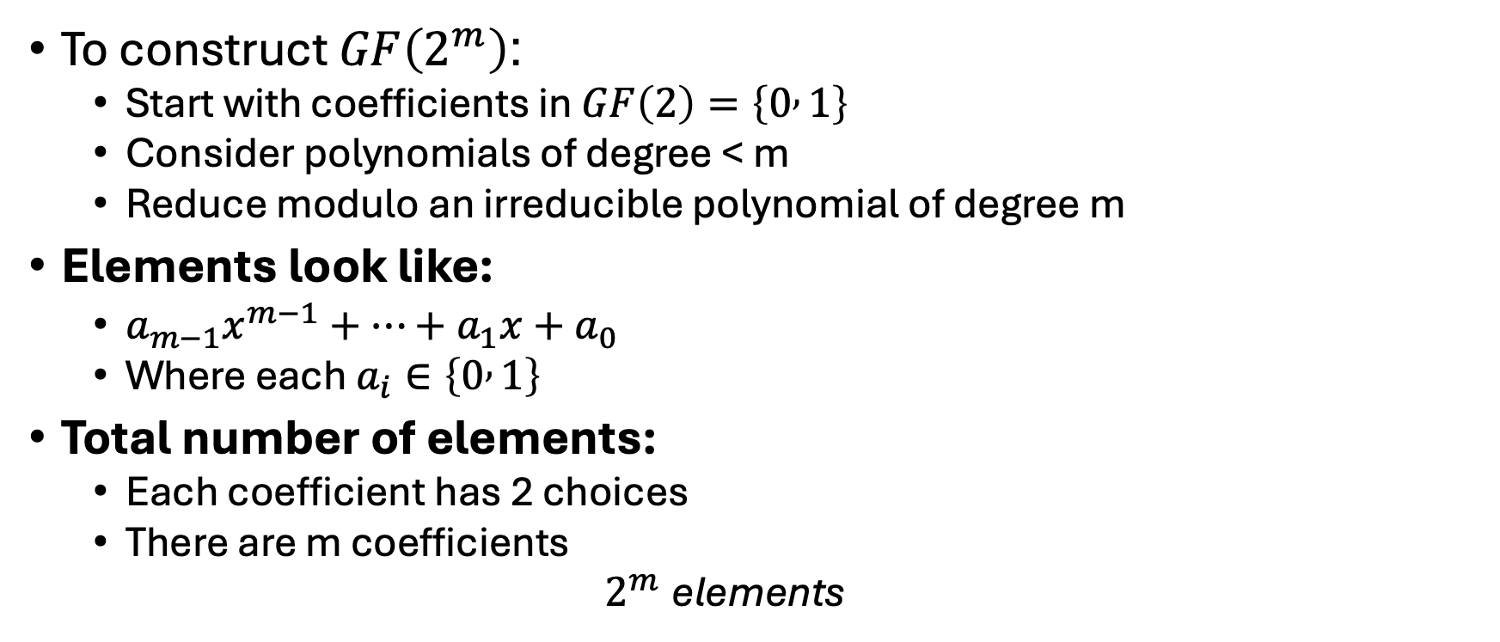
Elements of $GF\left(2^{m}\right)$
To construct $GF\left(2^{m}\right)$:
Start with coefficients in $GF\left(2\right)=\left\{0 , 1\right\}$
Consider polynomials of degree < m
Reduce modulo an irreducible polynomial of degree m
Elements look like:
$a_{m−1}x^{m−1}+⋯+a_{1}x+a_{0}$
Where each $a_{i}∈\left\{0 , 1\right\}$
Total number of elements:
Each coefficient has 2 choices
There are m coefficients
$$2^{m} \text{elements}$$

Slide 11
Why GF(2^{m}) is Important
When p = 2:
Coefficients are 0 or 1
Addition = XOR
Efficient for hardware/software
AES uses: GF(2⁸)

Slide 12


Polynomial Arithmetic in $GF\left(2^{m}\right)$ - Addition
Addition
Add coefficients modulo 2 (XOR)
Example in $GF\left(2^{3}\right)$:
$$\left(x^{2}+x+1\right)+\left(x^{2}+1\right)$$
=
$$x$$
Another example:
$\left(x^{2}+x\right)+\left(x+1\right)$
= $x^{2}+2x+1$
= $x^{2}+1$

Slide 13

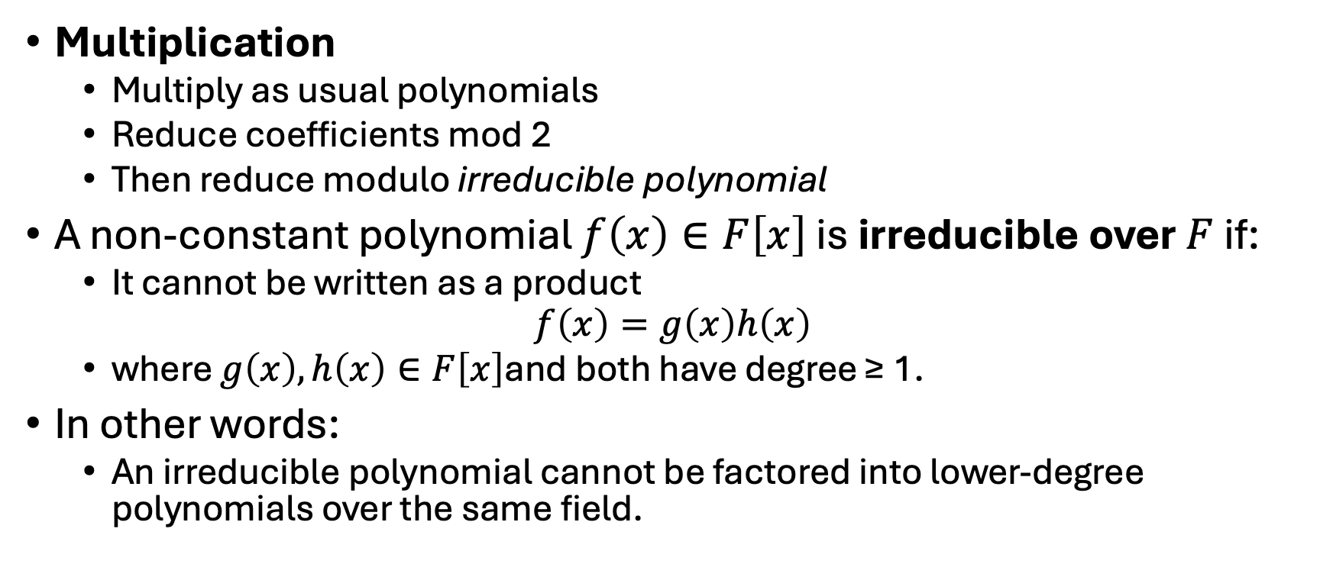
Polynomial Arithmetic in $GF\left(2^{m}\right)$ - Multiplication
Multiplication
Multiply as usual polynomials
Reduce coefficients mod 2
Then reduce modulo irreducible polynomial
A non-constant polynomial $f\left(x\right)∈F\left[x\right]$ is irreducible over $F$ if:
It cannot be written as a product
$$f\left(x\right)=g\left(x\right)h\left(x\right)$$
where $g\left(x\right),h\left(x\right)∈F\left[x\right]$and both have degree ≥ 1.
In other words:
An irreducible polynomial cannot be factored into lower-degree polynomials over the same field.

Slide 14

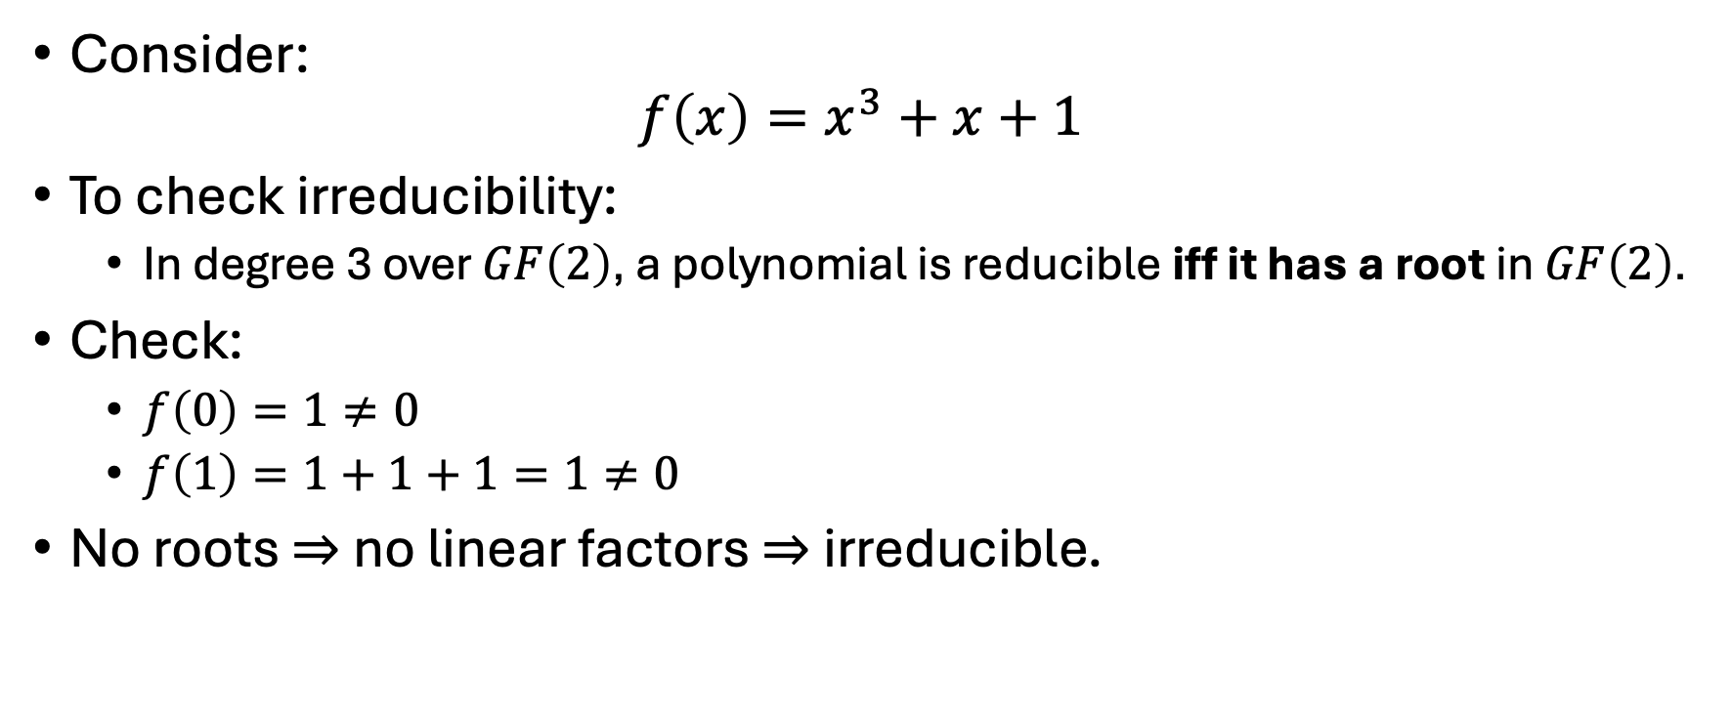
Irreducible Polynomial in $GF\left(2^{3}\right)$
Consider:
$$f\left(x\right)=x^{3}+x+1$$
To check irreducibility:
In degree 3 over $GF\left(2\right)$, a polynomial is reducible iff it has a root in $GF\left(2\right)$.
Check:
$f\left(0\right)=1≠0$
$f\left(1\right)=1+1+1=1≠0$
No roots ⇒ no linear factors ⇒ irreducible.

Slide 15

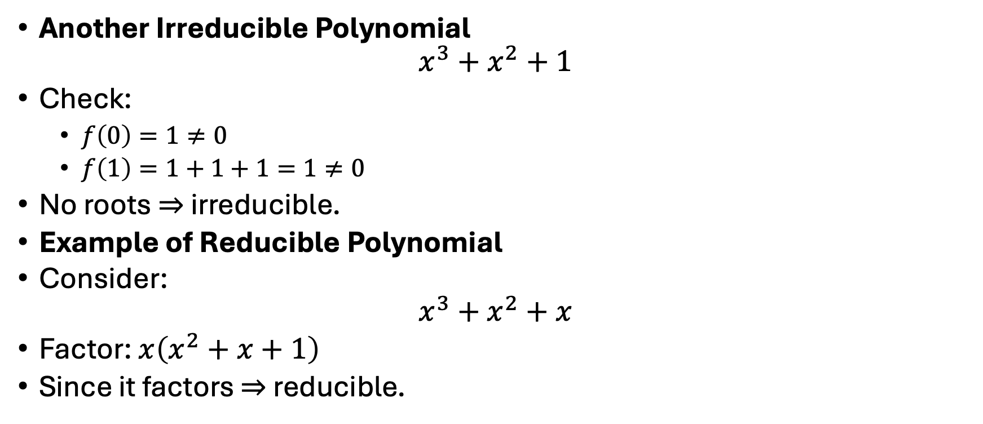
Irreducible Polynomial in $GF\left(2^{3}\right)$ (cont.)
Another Irreducible Polynomial
$$x^{3}+x^{2}+1$$
Check:
$f\left(0\right)=1≠0$
$f\left(1\right)=1+1+1=1≠0$
No roots ⇒ irreducible.
Example of Reducible Polynomial
Consider:
$$x^{3}+x^{2}+x$$
Factor: $x\left(x^{2}+x+1\right)$
Since it factors ⇒ reducible.

Slide 16

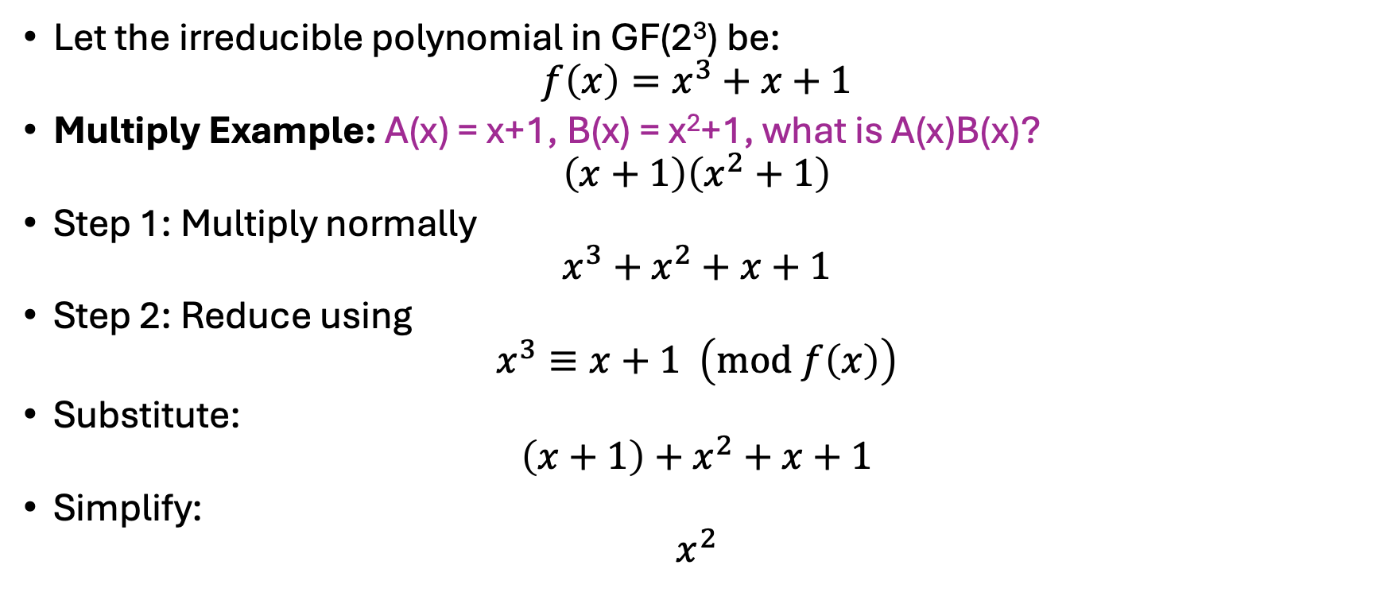
Polynomial Arithmetic in $GF\left(2^{m}\right)$ - Example
Let the irreducible polynomial in GF(2³) be:
$$f\left(x\right)=x^{3}+x+1$$
Multiply Example: A(x) = x+1, B(x) = x²+1, what is A(x)B(x)?
$$\left(x+1\right)\left(x^{2}+1\right)$$
Step 1: Multiply normally
$$x^{3}+x^{2}+x+1$$
Step 2: Reduce using
$$x^{3}≡x+1 \left(mod f\left(x\right)\right)$$
Substitute:
$$\left(x+1\right)+x^{2}+x+1$$
Simplify:
$$x^{2}$$

Slide 17
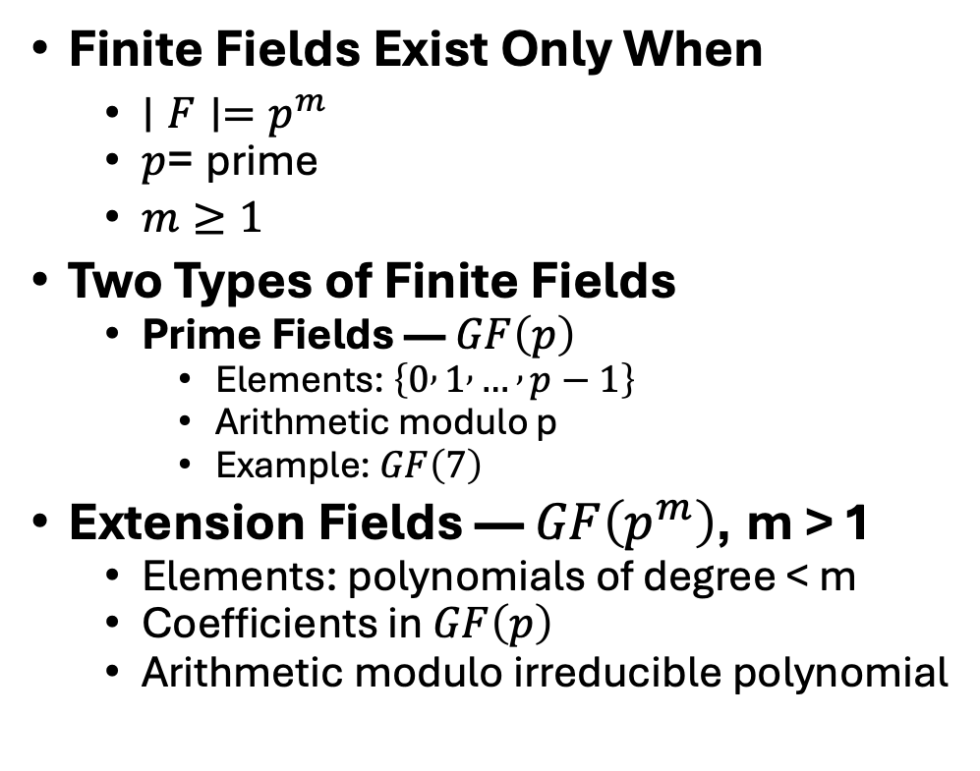
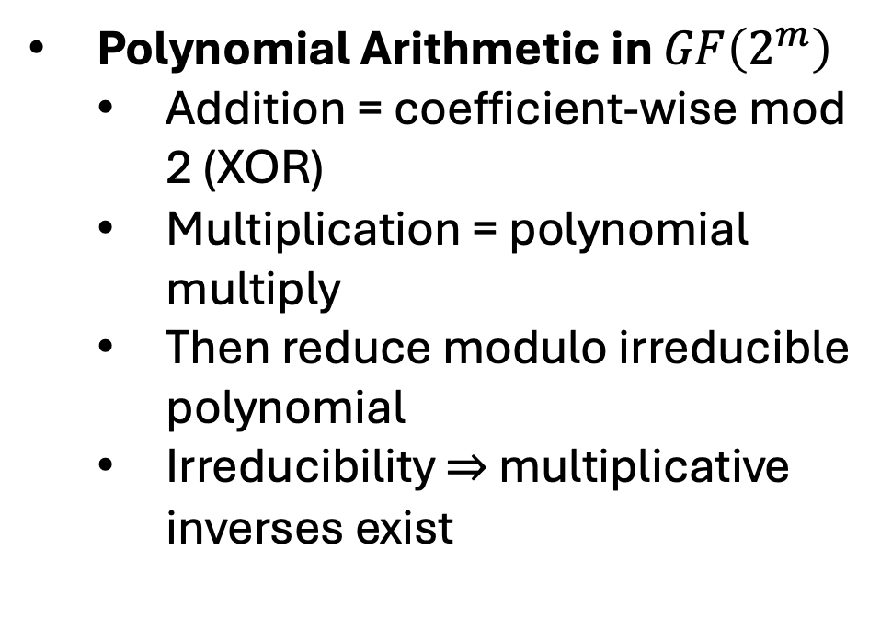
Summary
Finite Fields Exist Only When
$∣F∣=p^{m}$
$p$= prime
$m≥1$
Two Types of Finite Fields
Prime Fields — $GF\left(p\right)$
Elements: $\left\{0 , 1 , … , p−1\right\}$
Arithmetic modulo p
Example: $GF\left(7\right)$
Extension Fields — $GF\left(p^{m}\right)$, m > 1
Elements: polynomials of degree < m
Coefficients in $GF\left(p\right)$
Arithmetic modulo irreducible polynomial
Polynomial Arithmetic in $GF\left(2^{m}\right)$
Addition = coefficient-wise mod 2 (XOR)
Multiplication = polynomial multiply
Then reduce modulo irreducible polynomial
Irreducibility ⇒ multiplicative inverses exist

