Slide 1

Group Project Two Using Pumpkin Seeds Data
By Xinyue Yan and Ross Carter

Slide 2

Importing Required Libraries
import pandas as pd
import numpy as np
import matplotlib.pyplot as plt
%matplotlib inline
import seaborn as sns
import plotly.graph_objects as go
import missingno as ms
# Disable warnings
import warnings
warnings.filterwarnings('ignore')
import sklearn

Slide 3



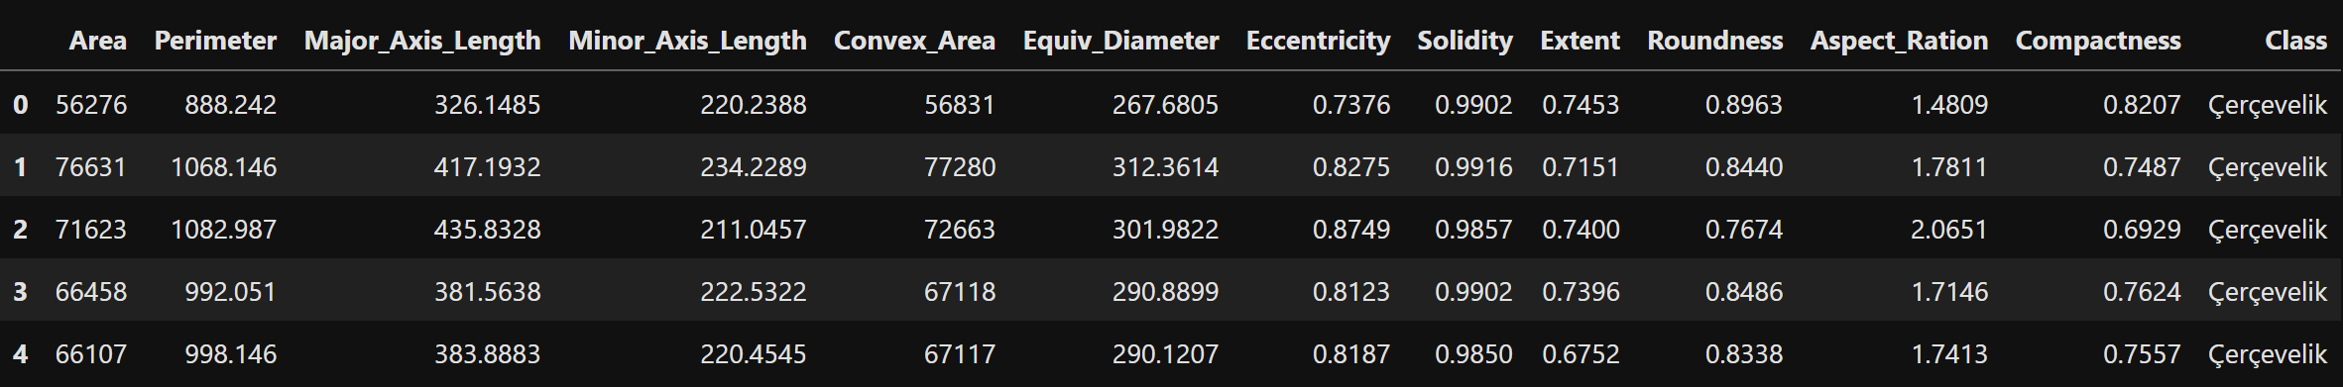
Reading Data Frame
df = pd.read_excel('Pumpkin_Seeds_Dataset.xlsx')
df.head()

Slide 4
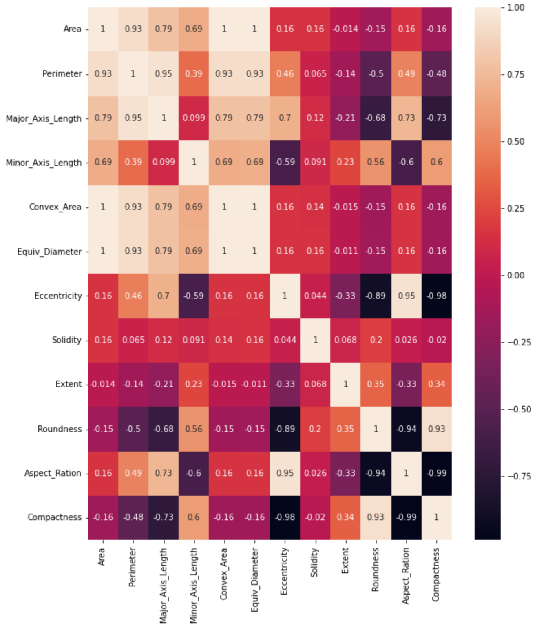
Seaborn Correlation Heat Map
sns.heatmap(df.corr(),annot=True)

Slide 5
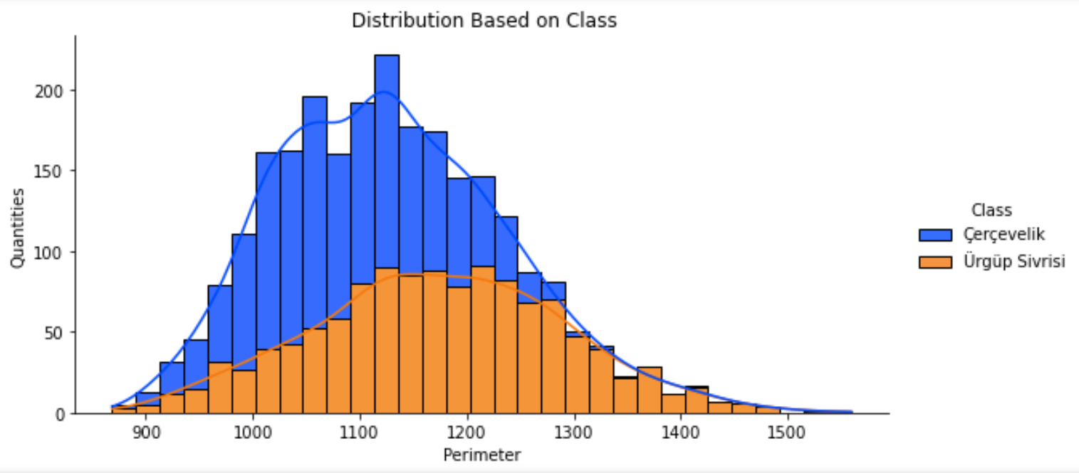
Distribution Plot

Slide 6

Data Preprocessing & EDA
Null Variables
Zero null variables
Duplicates
Zero duplicate variables
Value Counts
Çerçevelik- 1300
Ürgüp Sivrisi- 1200

Slide 7

Scaled Data
Scaled Data is necessary for a machine learning model. Otherwise, it might behave badly if individual features do not somewhat look like standard normally distributed data.
To achieve this standardization, we use sklearn.
Next, we fit the standardized data to the data frame resulting in the following

Slide 8
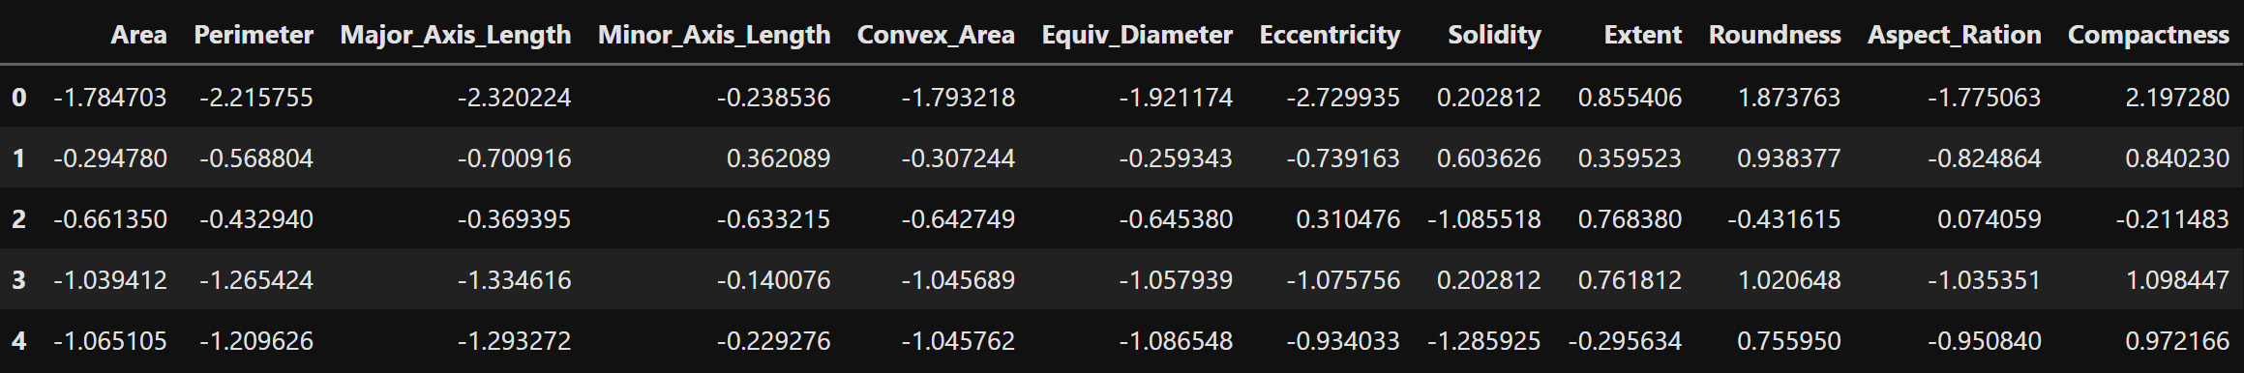
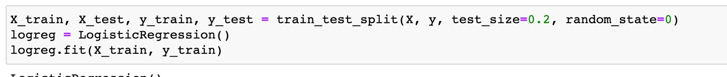
This is data after scaled
Splite Data

Slide 9


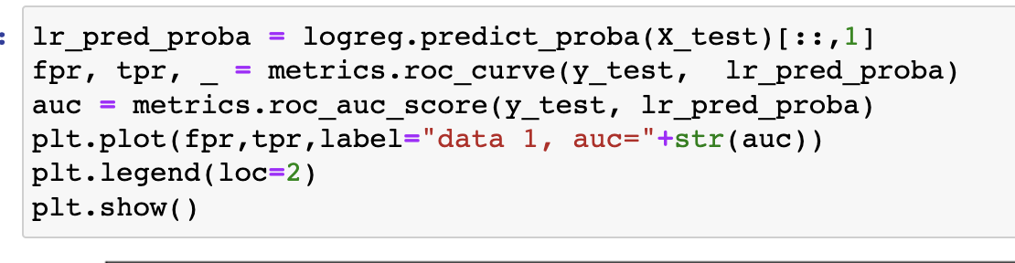
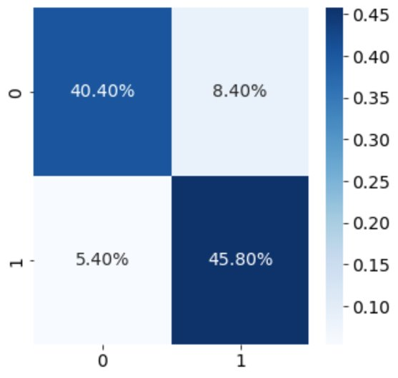
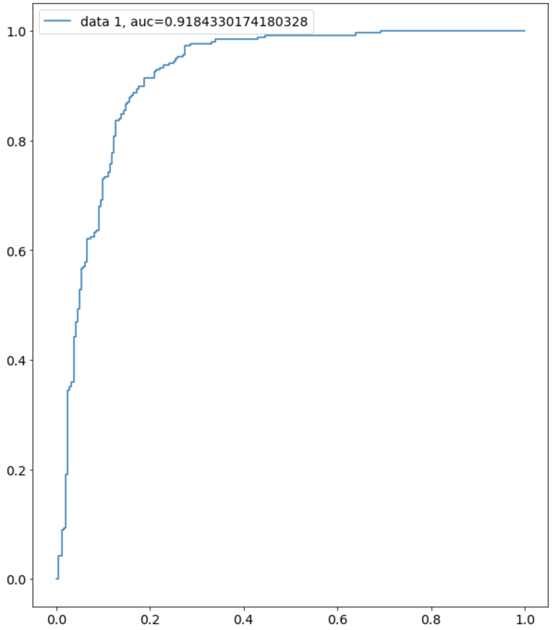
Results comparison
Logistics Regression
Because I use the probabilities, the AUC% is a bit higher than hard classification AUC%

Slide 10
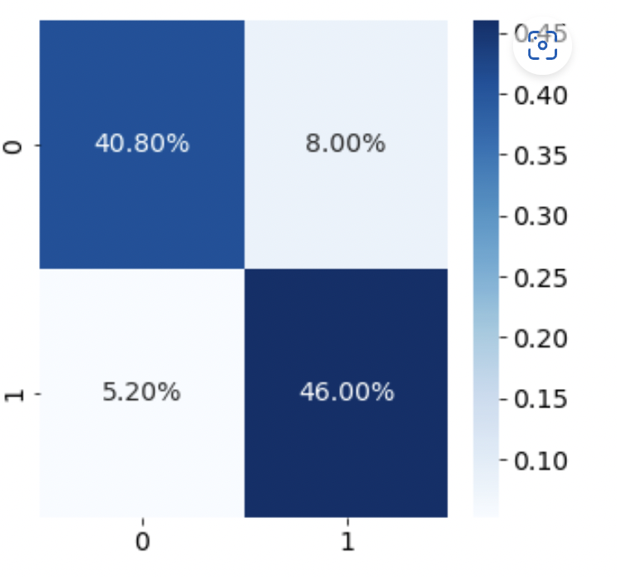
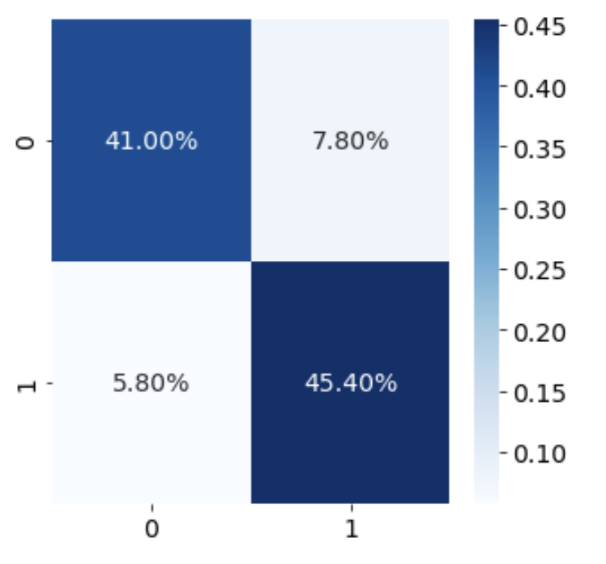
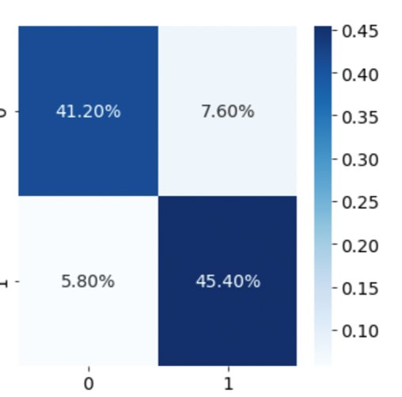
Results comparison
fine-tune hyper-parameters by OPTUNA
Random Forest
Random Forest
Cat Boost

Slide 11
Results comparison
 | Logistics Regression | Random Forest | Cat Boost | fine-tune hyper-parameters by OPTUNA | MLP
Precision | 0.845 | 0.852 | 0.853 | 0.857 | 0.848
Recall | 0.895 | 0.898 | 0.887 | 0.887 | 0.914
F1_score | 0.869 | 0.875 | 0.870 | 0.871 | 0.880

Slide 12
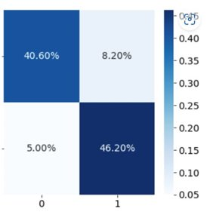
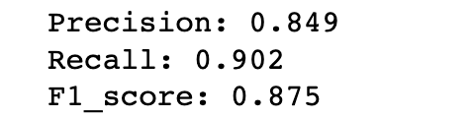
Get ensembled prediction
ensemble_prob = (cb_prob + rf_prob + mlp_prob)/3

Slide 13
CONCLUSION
In this case , we have the highest F1-score BY using fine-tune hyper-parameters by OPTUNA methods

