Slide 1



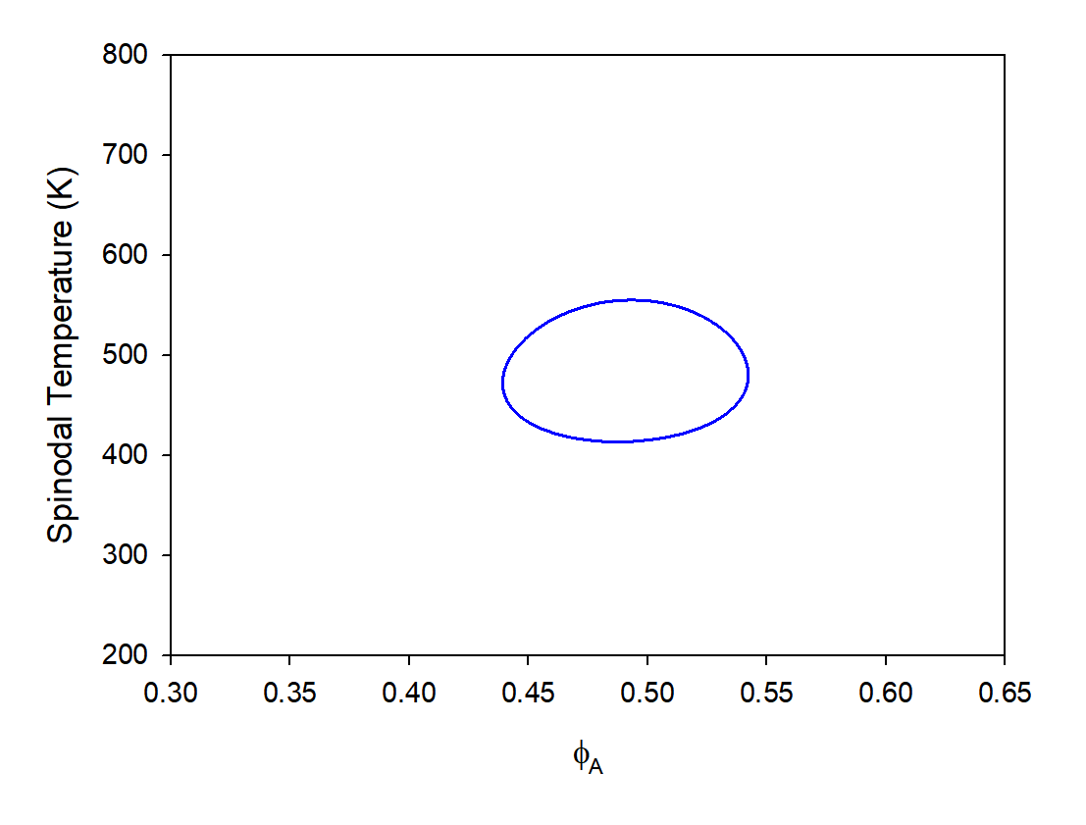
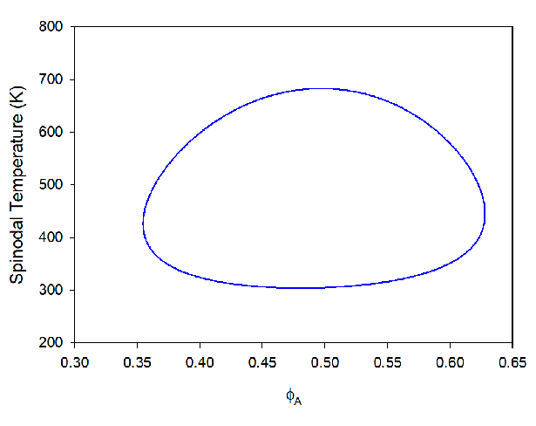
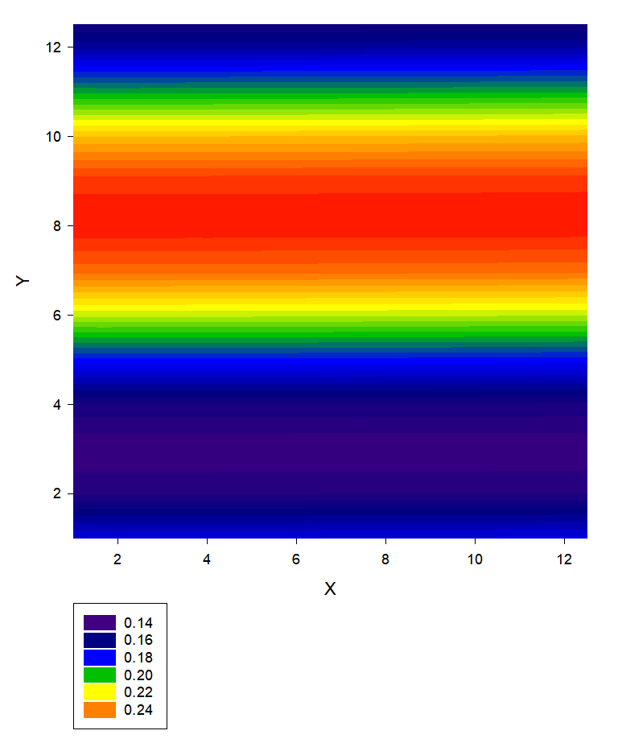
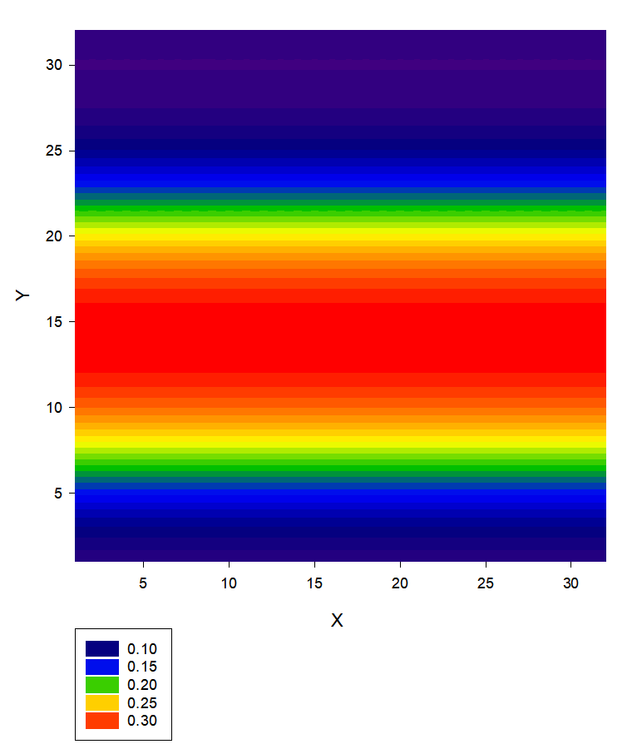
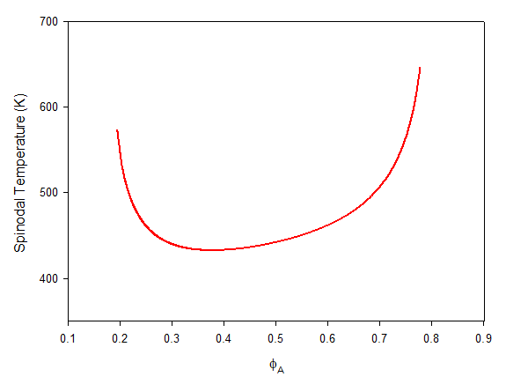
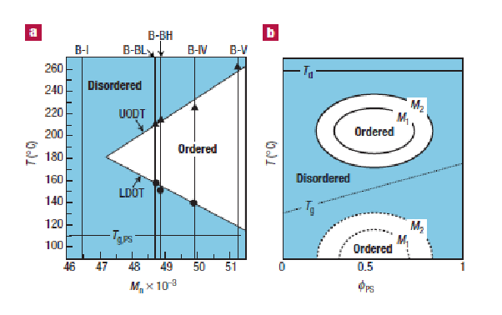
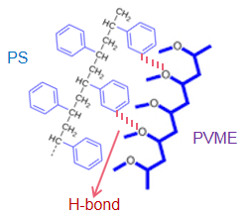
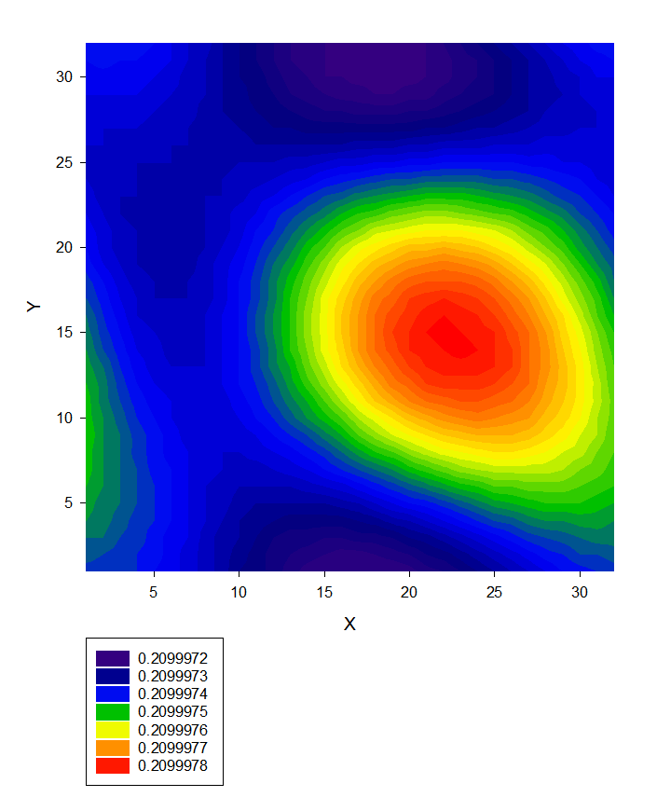
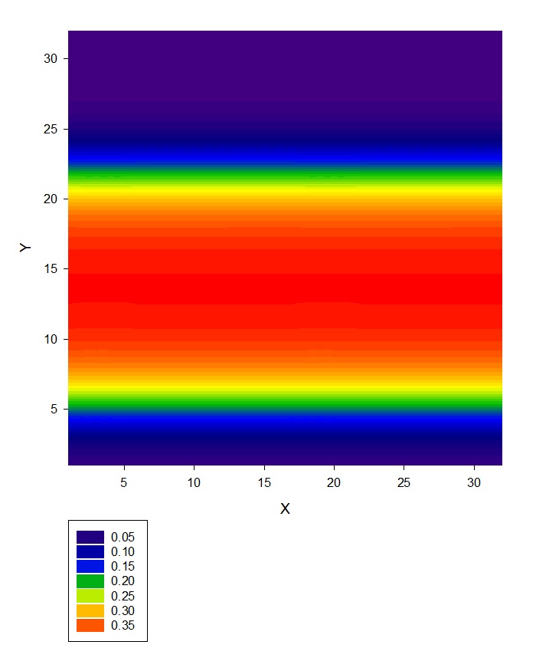
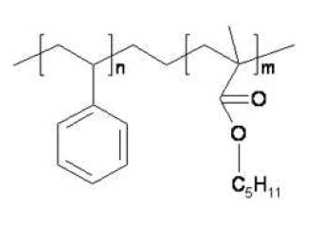
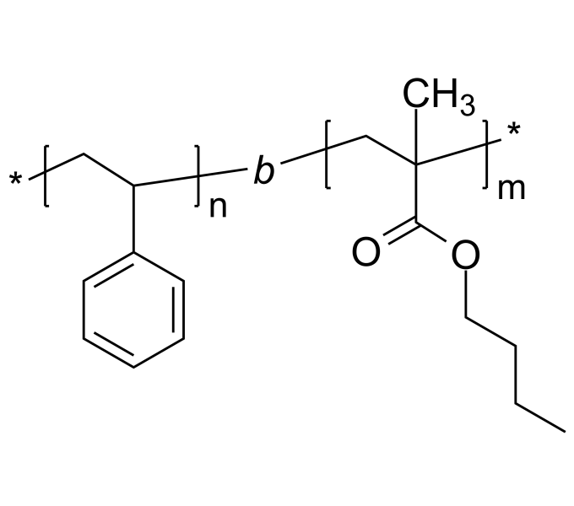
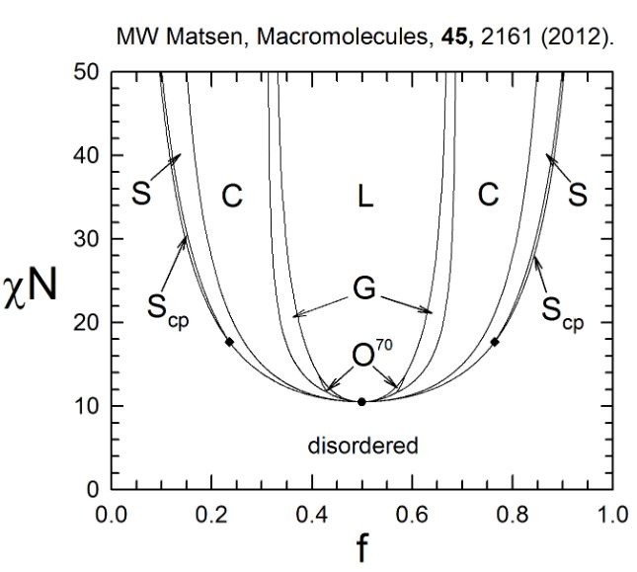
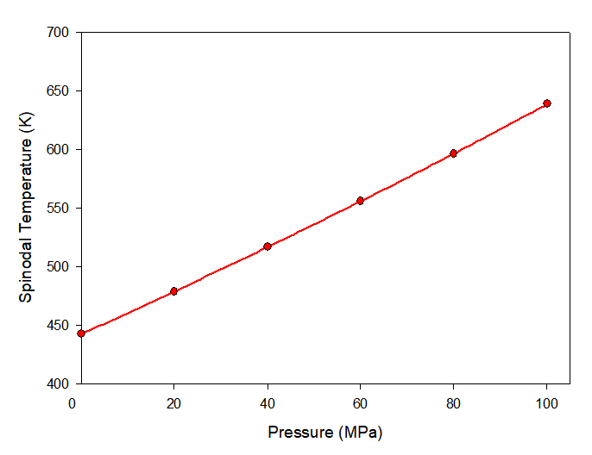
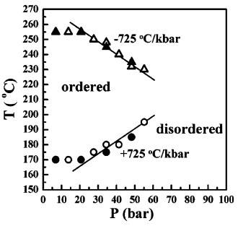
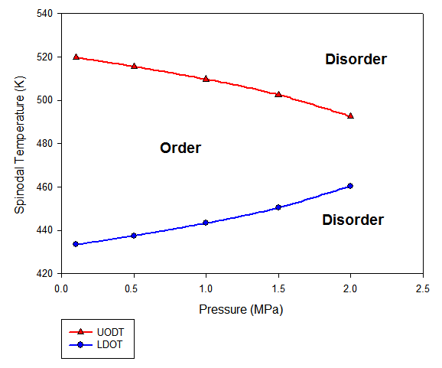
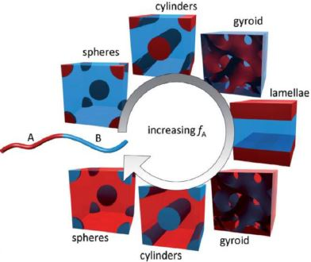
Design of stimuli-responsive materials from a diblock copolymer
with association between dissimilar monomers
MINGGE ZHAO, XINYUE ZHANG, JUNHAN CHO*
*DEPARTMENT OF POLYMER SCIENCE AND ENGINEERING, DANKOOK UNIVERSITY
*CORRESPONDENCE:JHCHO@DANKOOK.AC.KR
Abstract
Results and Discussion
Recently, stimuli-responsive materials have drawn tremendous attention due to their structures and properties and also due to their smart responses to changes in surrounding environment. In this work, we suggest the design of such materials based on associating A-b-B diblock copolymers. The free energy for the copolymer in the bulk state is first obtained as the perturbed hard sphere chains subject to adhesive potential between dissimilar monomers. Through Gaussian thread approach, the free energy functional is formulated to include effective local interactions from the excess equation of state. The random-phase approximation and self-consistent field analyses are to be readily elicited from the functional. It is demonstrated using these field approaches that the manipulation of disparity in self contact interactions and thermoreversibility of association can yield a variety of nasoscale mesophases upon cooling, heating, pressurization, and depressurization. In addition, micellization and reverse micellization in the solutions of the copolymer in selective solvents are to be probed via the manipulation of cross contact interactions and association. We will also discuss the applicability of such smart materials to various areas.
Associating A-b-B diblock copolymer melts
Spinodals from RPA and density profiles from SCFT
Loop-forming A-b-B at ξ = 0.996515
T=480K
Φ_{A}=0.49
(started from LAM)
xL=yL=~9.7
Loop-forming A-b-B at ξ = 0.99632
As the ξ approaches 1, the phase separation tendency is reduced and the loop becomes smaller.
The copolymer is ordered inside the loop and disordered outside the loop.
T=480K
Φ_{A}=0.45
xL=yL=~3.8
Introduction
Background
T=400K
xL=yL=~3.8
Disorder
Ps-b-P(n-butyl MA)
T=500K
xL=yL=~3.8
◈ Stimuli-responsive polymers
◈ Origin of LDOT of associating
A-b-B diblock copolymers system
Polystyrene-b-poly(n-pentyl methacrylate)
Poly(styrene)-b-poly(n-butyl methacrylate)
Originated from polar bonds such as H-bonds
Theory
Since the density has hardly changed, it is disorder.
N_{A}=557.2455, N_{B}=557.6841
a_{τ}=0.01468, ξAP=0.9879
Du Ryu, Yeol, et al. "Closed-loop phase behaviour in block copolymers." Nature materials 1.2 (2002): 114-117.
◈ Random-phase approximation and Self-consistent field theory
Dependence of UODT and LDOT on pressure
Unconnected polar interactions
Reduction in Pressure due to polar bonding is described by the contact probability
Ps-b-P(n-butyl MA)
Ps-b-P(n-pentyl MA)
10
9
8
7
6
1
2
Polar interaction between i and j spheres
whose association is signified by
3
4
5
T sensitivity
Free energy
Polar bonding
Hard sphere chain
Dispersion energy
The effective RPA interaction field is
given by the excess chemical potential
Experimental:
Ryu, Du Yeol, et al. "Effect of hydrostatic pressure on closed-loop phase behavior of block copolymers." Physical review letters 90.23 (2003): 235501.
Conclusion
Using random phase approximation and self-consistent field theory, the phase behaviors of associating diblock copolymer melts have been studied.
The thermal reversibility of polar bonds between dissimilar blocks affects the phase behavior of stimuli-responsive polymer systems.
Manipulating interactions and thermoreversibility yields various mesophases and the potential applications of smart materials are discussed.
Acknowledgment：National Research Foundation of Korea (Basic Science Research Program)
♦ ♦ ♦ ♦ ♦ ♦ ♦ ♦ ♦ ♦ ♦ ♦ ♦ ♦ ♦ ♦ ♦ ♦ ♦ ♦ ♦ ♦ ♦ ♦ ♦ ♦ ♦ ♦ ♦ ♦ ♦ ♦ ♦ ♦ ♦

