Slide 1


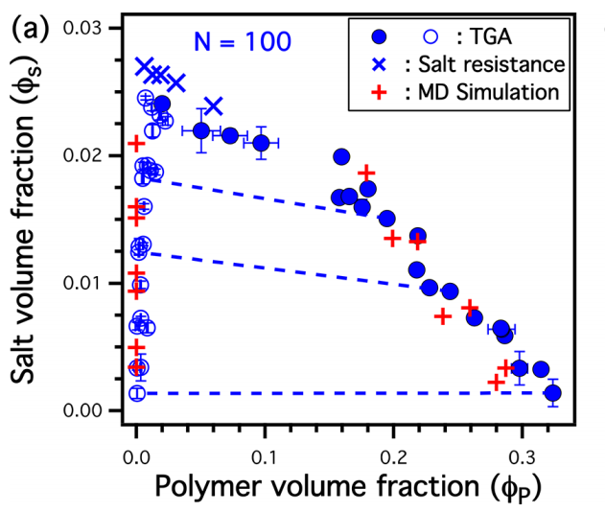
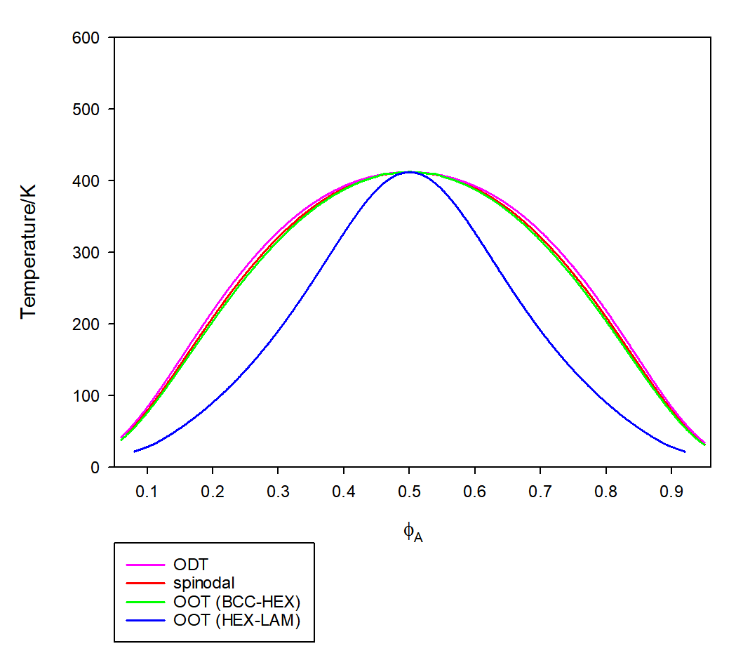
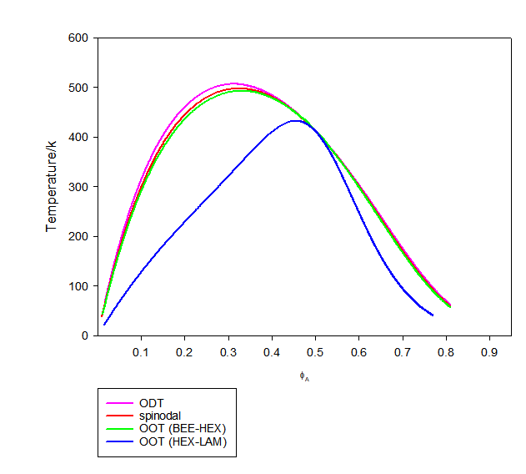
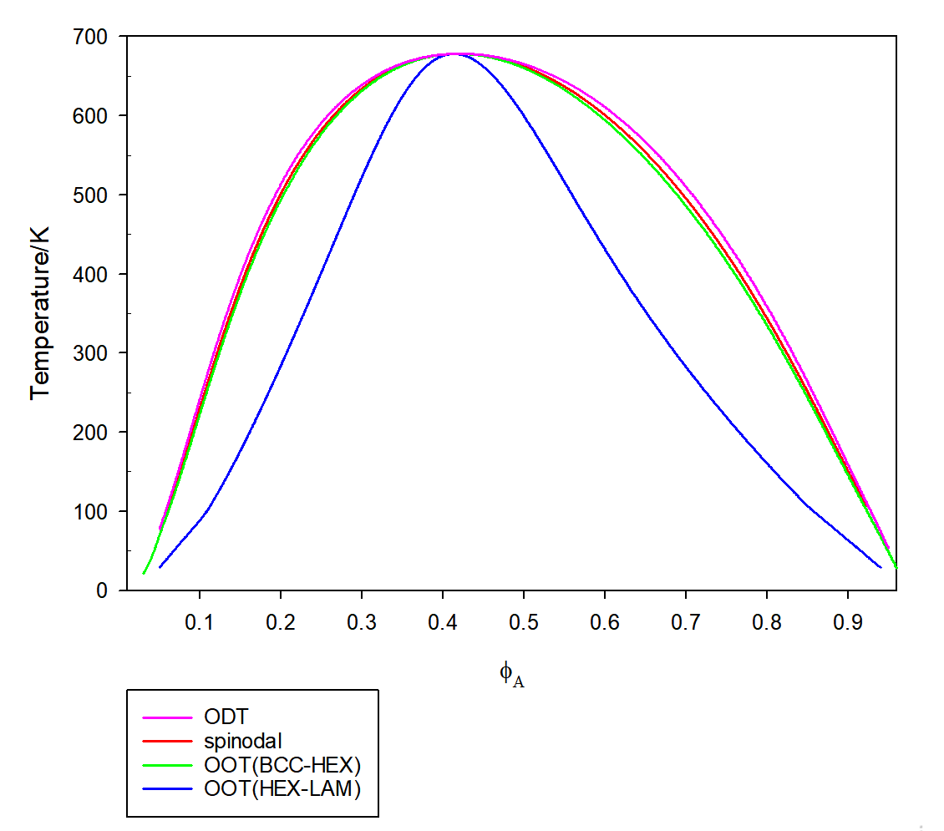
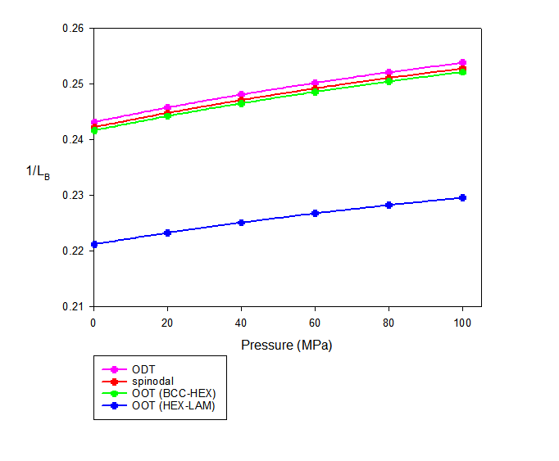
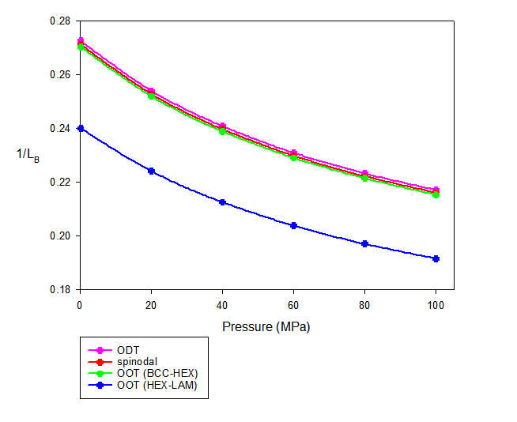
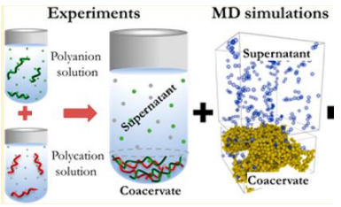
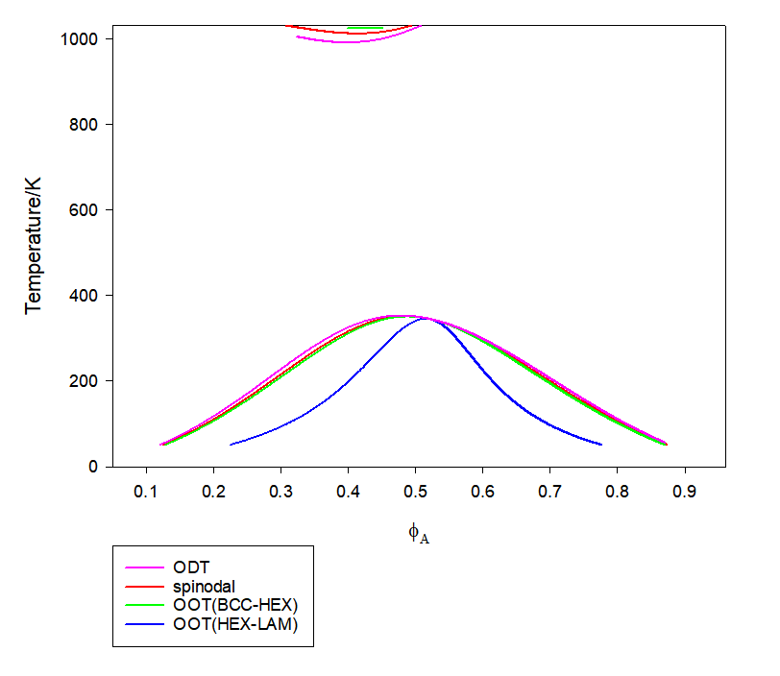
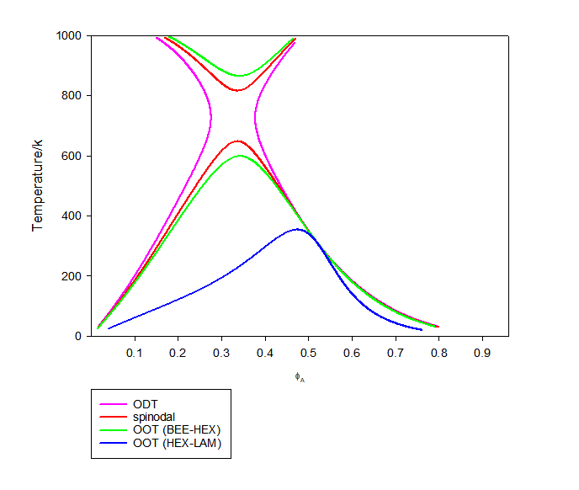
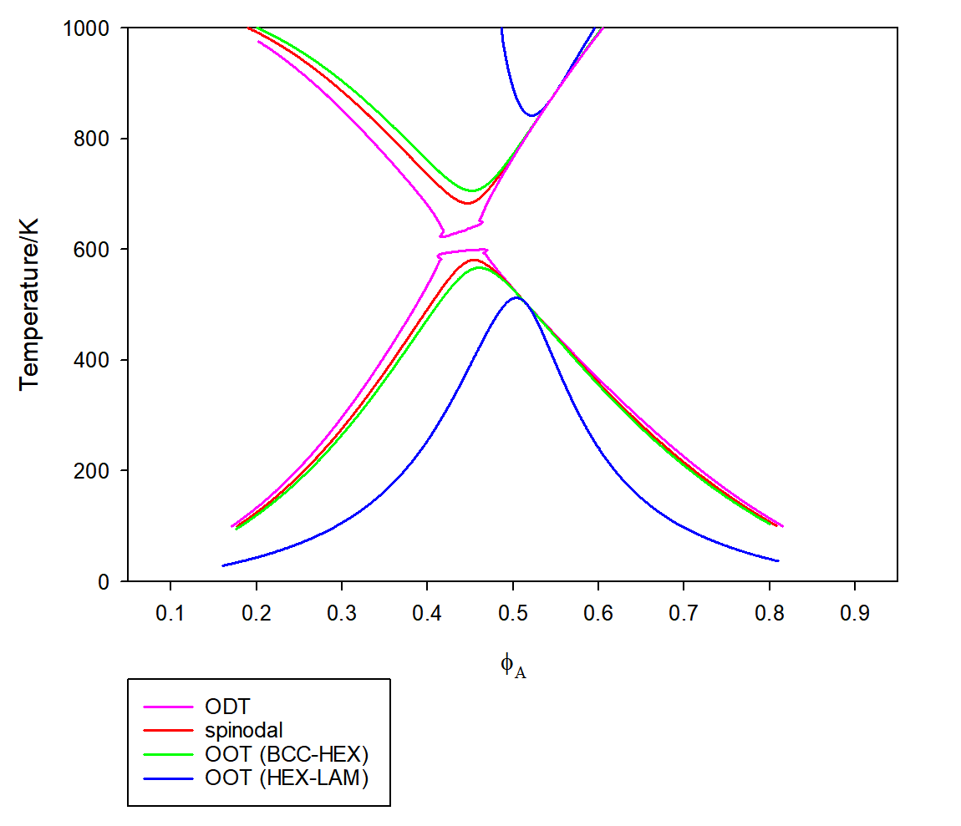
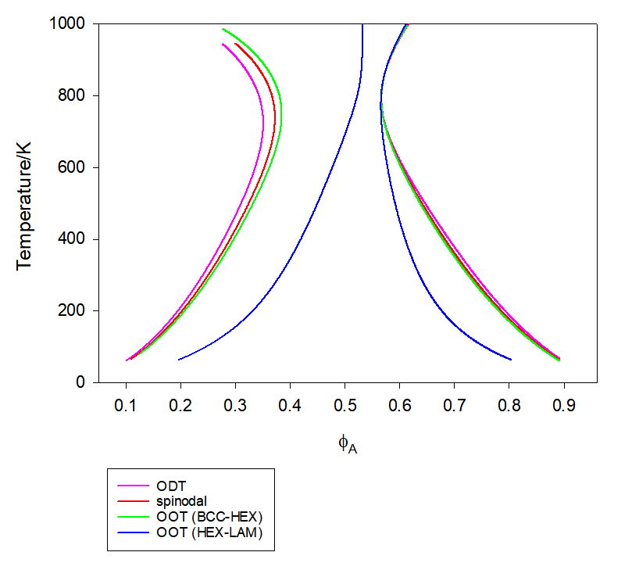
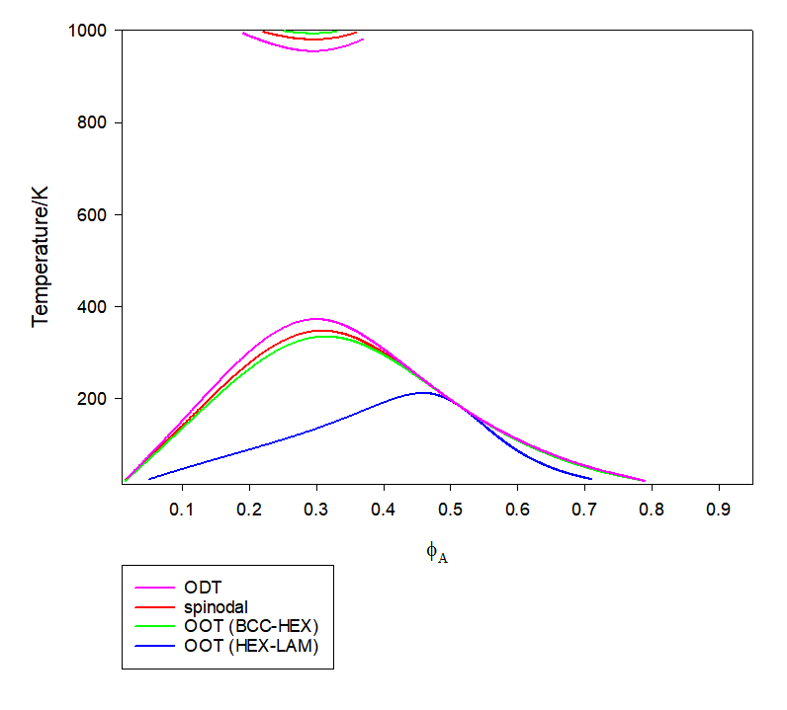
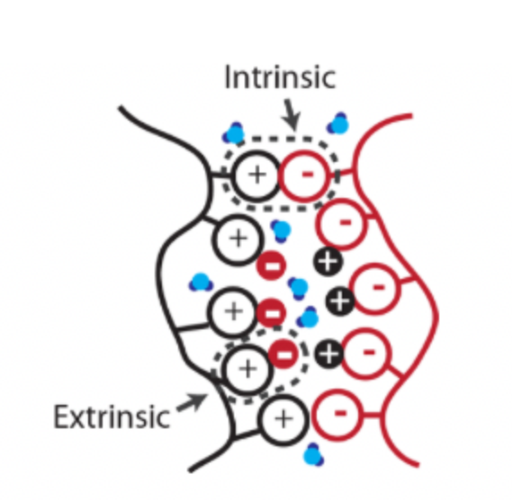
Phase behaviors of a weakly charged stoichiometric polyanion/polycation blend with asymmetry in chain sizes and van der Waals interactions
Xinyue Zhang，Mingge Zhao, Junhan Cho
* Department of Polymer Science and Engineering, Dankook University
*Correspondence: jhcho@dankook.ac.kr
Abstract
A study on the phase behaviors of a salt-free stoichiometric blend from weakly charged polyanions and polycations has been performed. A free energy functional for the blend is formulated as the sum of Gaussian contribution and effective interaction terms, whose local part is given by the excess equation of state for the blend and nonlocal part through Coulomb interactions. Then, the Landau free energy expansion is obtained as a series in component density fluctuations. Using the Landau energy, the blends with asymmetry in chain sizes and van der Waals interactions are probed at various charge fractions to analyze their nanoscopic phase separation due to global electroneutrality. The location of continuous transition and mesophase formation not only upon cooling but also upon heating are deeply investigated. In addition, the control of the equilibration of mesophases through pressurization is discussed in the viewpoint of designing stimuli-responsive structural materials from the polyelectrolyte blends.
Keywords: Phase behavior ,Landau Energy , Weakly charged polyelectrolyte mixture
Complex coacervation
Theory
Landau theory combined with Liquid State Theory
Free E:
Landau Free Energy:
Model system: Hard-sphere
Results and Discussion
Barotropic (Symmetries)
Baroplastic (Asymmetries)
Pressure dependence of various ordering transitions for the asymmetry blend
Weakly charged blends can exhibit a diverse range of phase behaviors as a result of the interplay between the charges on the particles and the attractive forces between them (dispersion interactions).
Solution of a pair of ions with opposite charges=
--->complex coacervate phase + dilute supernate phase
A polymer electrolyte with opposite charges can undergo phase separation, resulting in the formation of a polymer complex with a high polymer density coacervate phase coexisting with a polymer-dilute supernatant phase. The separation is induced by the electrostatic attraction between polyanions (PA) and polycations (PC). Contrary to popular belief, salt ions are preferentially distributed in the supernatant phase, and the slope of the tie line between the two phases is typically negative.
:average charge fraction
:charge fractions of PA chains
Analogous to those observed in some molten block copolymers.
complex coacervate phase
Barotropic
Baroplastic
-Barotropic:
-Baroplastic:
supernate phase
suppressed by bulk modulus:
As the pressure of the system , the bulk modulus . is suppressed by the bulk modulus and therefore decreases.
Li, Lu, et al. Macromolecules 51.8 (2018): 2988-2995.
Found a problem.
The missing excess chemical potential prevents us from accurately predicting it using VO theory.
Therefore
Microphase separation due to global electroneutrality.
The connectivity of chains and the excluded volume are fundamental elements that accurately describe the phase behavior of polymer electrolyte solutions in all theories.
-The slope and asymmetry of the phase diagram are caused by the fixed charge fractions of PA chains.
-Analogous to typical diblock copolymer melts---->ODT from disorder to BCC,spinodals,OOT from BCC to HEX
Monotonically increase upon pressurization
Are suppressed by pressure
Overbeek, J. Th G., and M. J. Voorn. Journal of Cellular and Comparative Physiology 49.S1 (1957): 7- 26
towards longer chain length
Conclusion
Based on the theory of integral equations for hard-sphere chains with Coulombic interactions, Landau free energy can be obtained for weakly charged PA/PC blends. The excluded volume and connectivity of charged chains in the system are taken into account.
We analyzed the effect of the charge ratio on the phase behavior of polymer electrolyte mixtures. It was found that the order of phase separation is similar to that of block copolymers.
Blends exhibit continuous transitions or critical points (CPs) at a certain composition due to differences in chain sizes or varying self-dispersion interactions between PA and PC, which results in an asymmetrical distribution.
The discovery creates opportunities to produce functional materials with desired properties using polymer blends with weak charges.
Repulsertive term
(hare sphere chain)
Dispersion Enegy
Introduction
Complex Coacervation of polyelectrolytes
Polyelectrolytes
Ion-ion interactions
Contribution due to ion-ion connectivity
1.It can be found everywhere in the biology.
--->It is helpful to understand biological processes.
= amplitude for j-density fluctuations
As the length of the chain increases, the boundary of the phase separation widens.
2.There are many fields of application.
(e.g.)--->Energy materials, solution additives, food, pharmaceuticals, coatings....
Gaussian
non-local
local
Training Program Components
3.Huge challenge
(why?)--->There are many influencing factors.
Strong interconnectedness.
System: consists of a hard-sphere chain mixture of polyanions (PA) and polycations (PC).
Bhattarai, A.; Ghimire, Y.Polyelectrolyte. Encyclopedia. (accessed on 26 May 2022).
-
+
The transition lines are very close at around = ∼0.58, and magnifying the phase diagram reveals that the CP is lost.
Acknowledgment: National Research Foundation of Korea (Basic Science Research Program)

