Slide 1



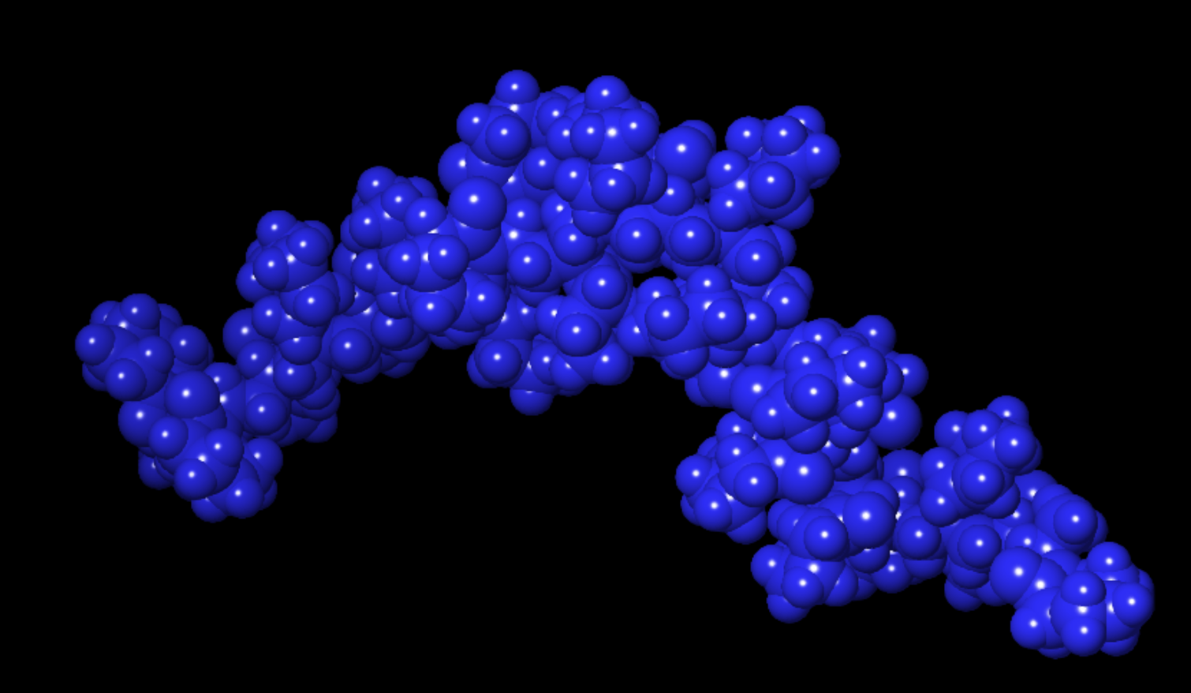
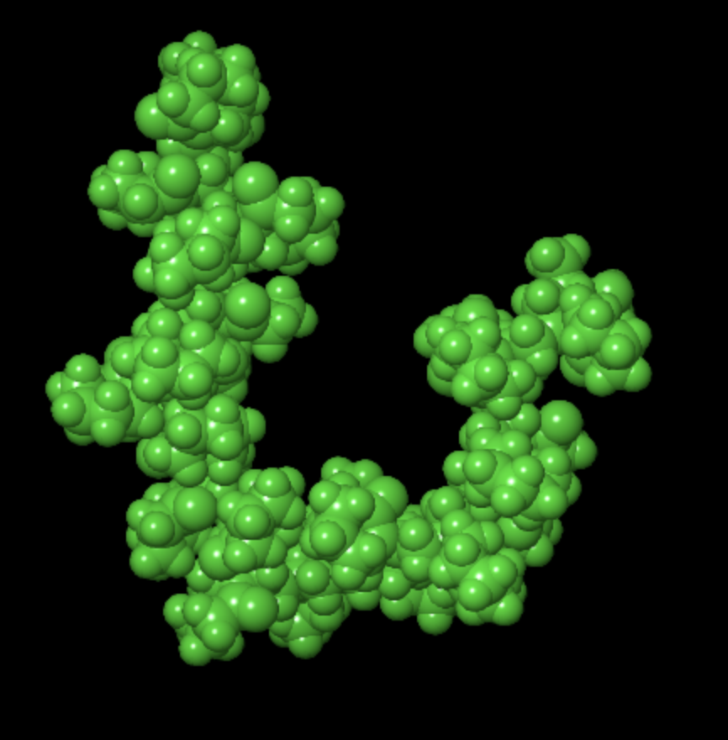
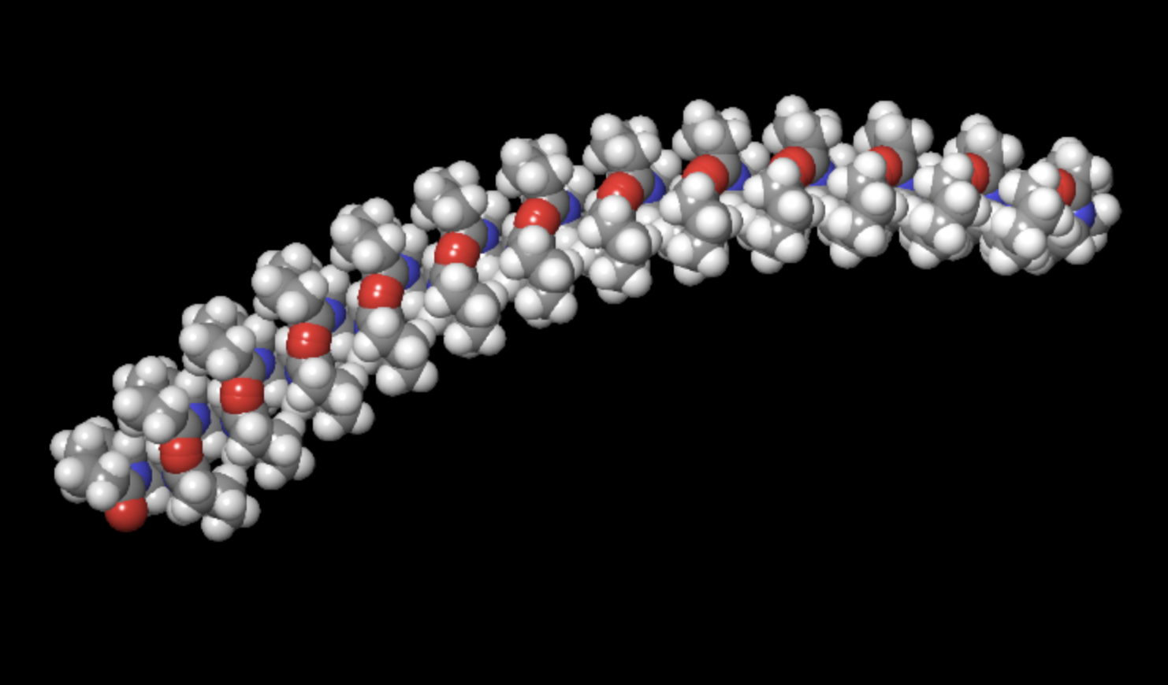
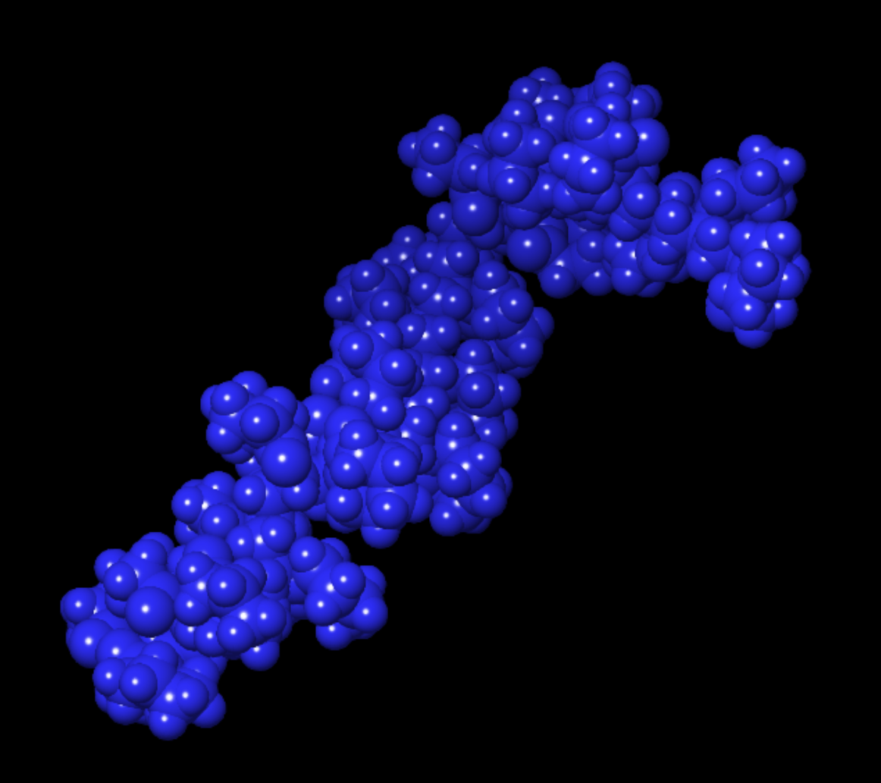
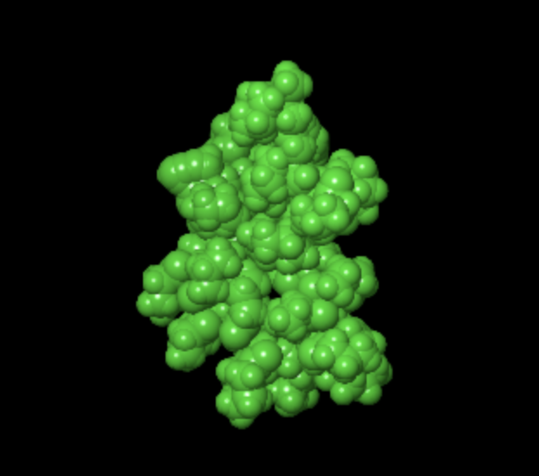
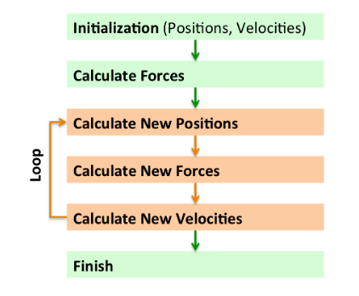
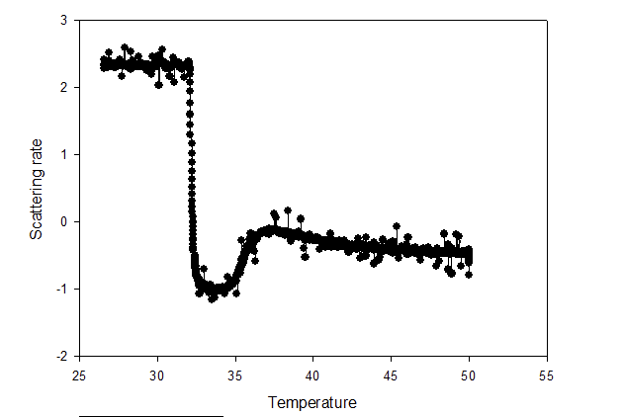
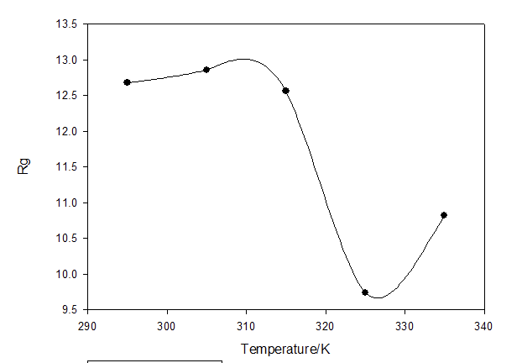
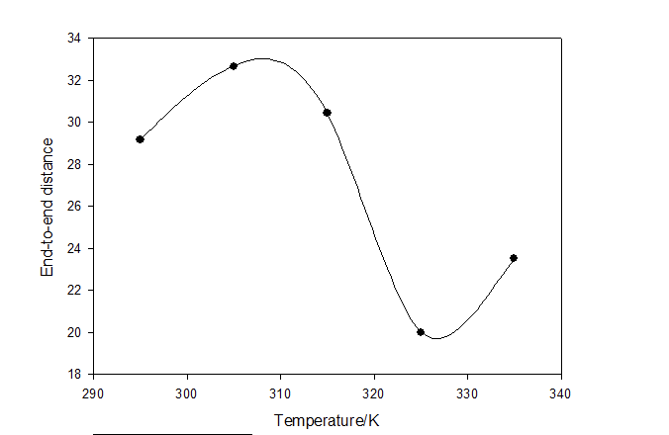
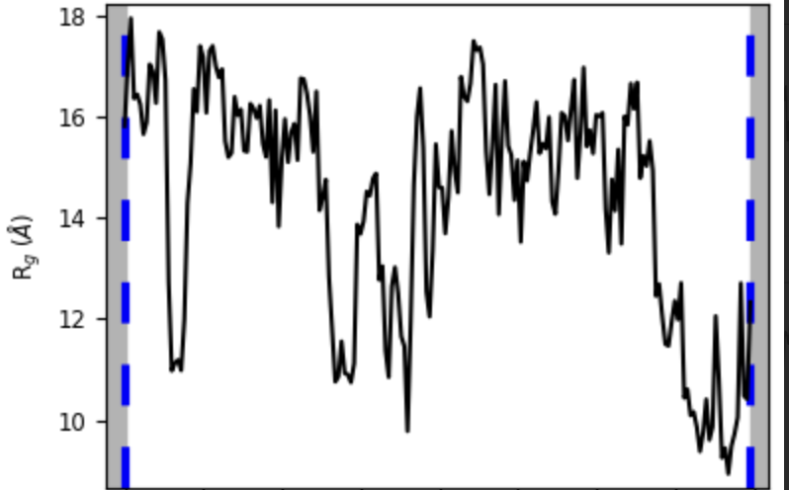
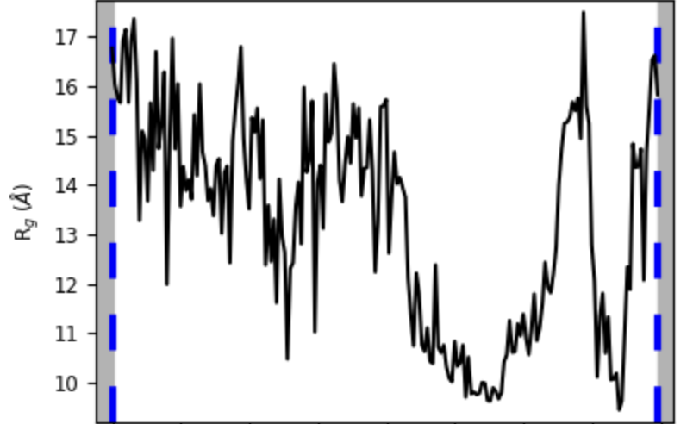
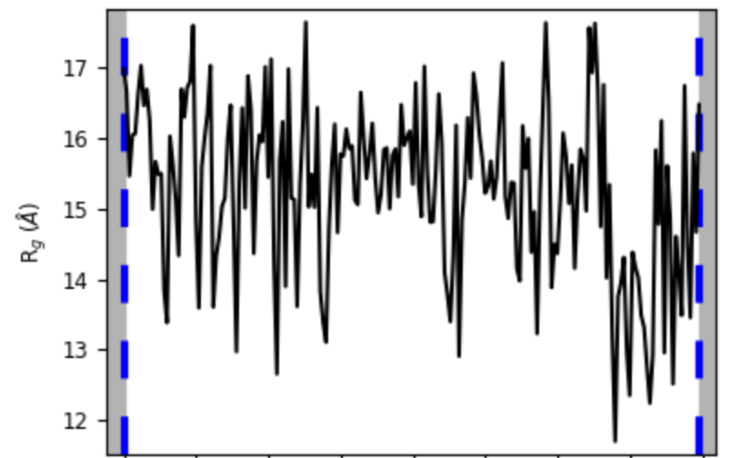
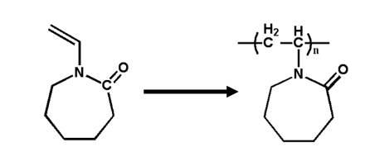
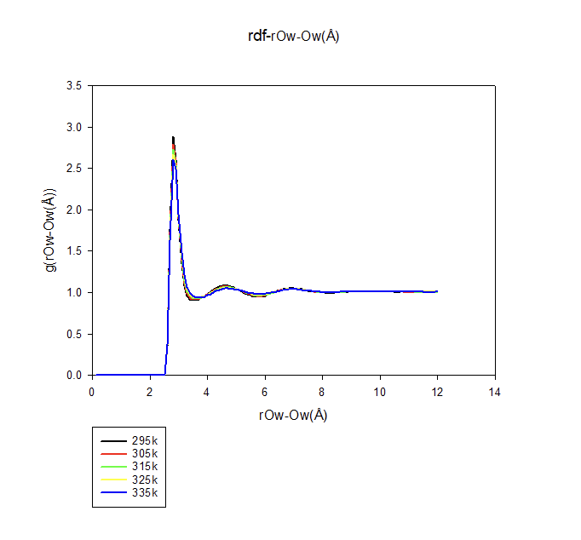
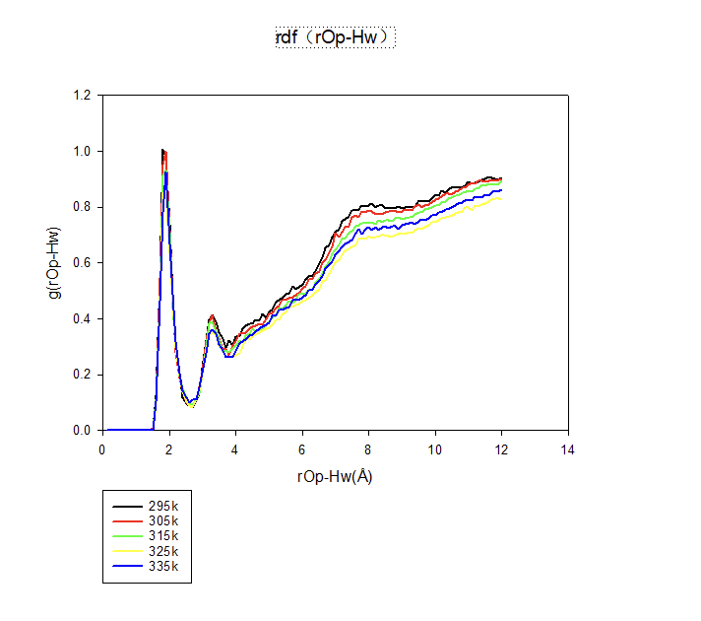
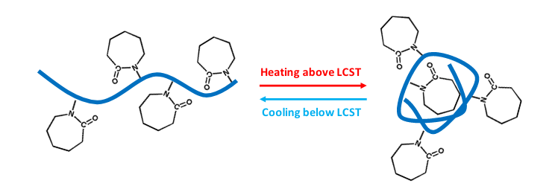
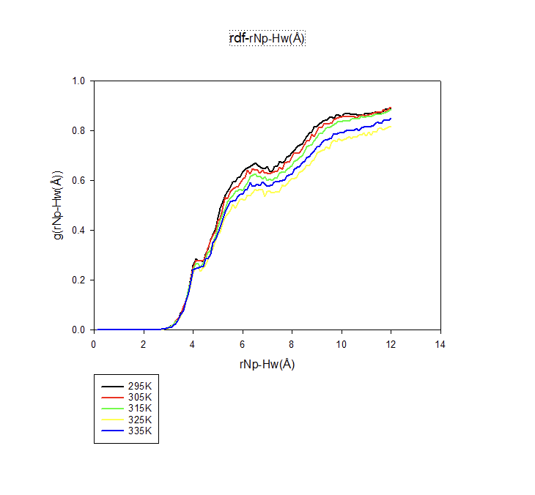
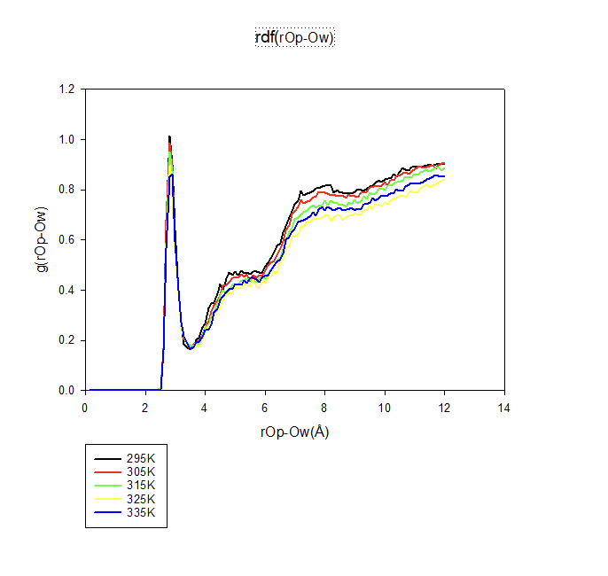
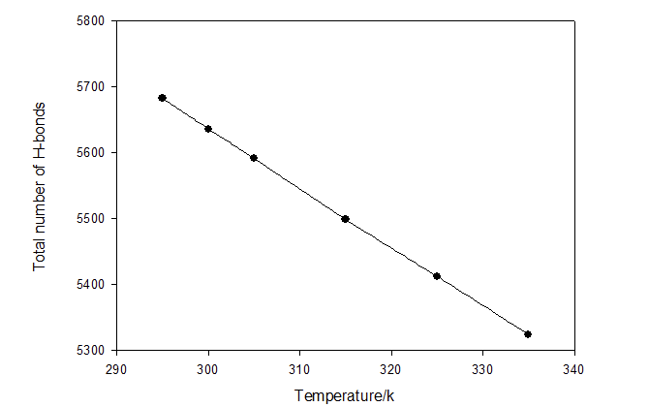
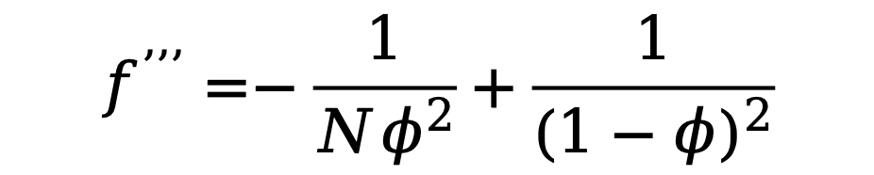
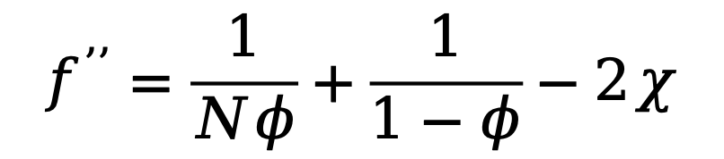
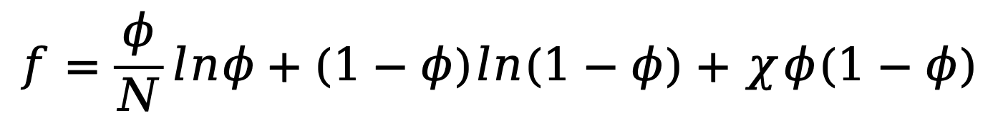
Molecular Dynamics Simulation Study of the LCST Phase Transition Behavior of a Single PNVCL Chain in Aqueous Solution
Xinyue Zhang，Mingge Zhao, Junhan Cho
* Department of Polymer Science and Engineering, Dankook University
*Correspondence: jhcho@dankook.ac.kr
Abstract
This study investigates the temperature-dependent LCST phase behavior of a single poly(N-vinylcaprolactam) (PNVCL) chain in aqueous solution using molecular dynamics (MD) simulations. As a thermoresponsive polymer, PNVCL is widely applied in biomedical and smart material fields, with its LCST behavior being especially relevant near physiological temperatures.
MD simulations were performed using the OPLS-5 force field with temperature intervals of 10 K. Structural changes and phase behavior were analyzed through radius of gyration (Rg), hydrogen bonding, and radial distribution functions (RDF). Visual analysis further revealed temperature-driven interactions between PNVCL and water molecules.
These findings provide insights into the microscopic mechanism of PNVCL’s phase transition and offer theoretical support for its practical applications.
Keywords: PNVCL, Phase Behavior, Simulation, Molecular Dynamics，Lower Critical Solution Temperature, Molecular dynamics simulation
Flory-Hggins Theory ---(type1)
$$f=\frac{φ}{N}lnφ+(1−φ)ln(1−φ)+χφ(1−φ)$$
$$f^{’’}=\frac{1}{Nφ}+\frac{1}{1−φ}−2χ$$
$$f^{’’’}=−\frac{1}{Nφ^{2}}+\frac{1}{{(1−φ)}^{2}}$$
Results and Discussion
Visualization section
295K 1ns
295K 200ns
PNVCL:25mer ----1 chain
N_{water}:4200
wt%:4.4wt%
tacticity: syndiotactic
force field :OPLS5
simulation time:200ns
Introduction
335K 1ns
335K 200ns
Introduction to Molecular Dynamics(MD) Simulation
The visualization clearly shows the transition of PNVCL from a linear to a globular conformation.
The schematic workflow of MD simulation
Molecular dynamics (MD) simulation is a computational method used to investigate the dynamic behavior of atoms and molecules in nanoscale systems. By numerically solving Newton’s equations of motion, it provides time-resolved atomic trajectories, enabling the analysis of structural and thermodynamic properties. MD has become an essential tool in materials science and molecular research, offering insights into processes that are often challenging to observe experimentally.
Light scattering experiments + MD simulations
PNVCL(4.4wt%)
radius of gyration
Both light scattering experiments and MD simulations indicate that phase separation occurs around 305 K.
Sun, Xiaoquan. Structure and Property of Polymers and Biopolymers from Molecular Dynamic Simulations. University of Arkansas, 2018.
end-to-end distance
300K Rg
305K Rg
315K Rg
Introduction of Poly(N-vinyl caprolactam)
Synthetic route of PVCL via free radical polymerization from N-vinylcaprolactam(VCL)
Advantages:
1.Exhibits LCST behavior near body temperature in water.
2.Biocompatible and suitable for biomedical use.
3.Polymerization can be controlled via free-radical methods.
Challenge:
Controlled polymerization of NVCL is difficult due to its distinct properties, making copolymerization with other monomers more complex.
A significant decrease in the radius of gyration is observed at 305 K.
Radial distribution functions + H-bond
Based on the peak position and sharpness, the interaction between water molecules and carbonyl oxygen is significantly stronger. The RDF results indicate that hydrogen bonding plays a crucial role in the phase separation process of PNVCL.
Sun, Xiaoquan. Structure and Property of Polymers and Biopolymers from Molecular Dynamic Simulations. University of Arkansas, 2018.
H-bonds
It can be observed that the total number of hydrogen bonds decreases with increasing temperature.
Theory
OPLS-5 Force Field
Conclusion
Both the addition of polarizability and new metals features are encompassed in a new model termed OPLS5
The OPLS5 functional form is given by:
Light scattering results confirmed that phase separation occurs in PNVCL aqueous solution at approximately 32.1 °C.
Structural analysis using Rg and RDF showed that PNVCL transitions from an extended to a globular conformation around 305 K, which is consistent with the light scattering results.
RDF analysis revealed that hydrogen bonding between PNVCL and water molecules, as well as between water molecules themselves, decreases with increasing temperature. This supports the conclusion that hydrogen bonding plays a key role in the phase separation behavior.
E = E_{OPLS} + ∑_{drudes}K_{D}(r-r_{eq})²
+∑_{metal complexes}[E_{FLucCT}+E_{AOM}+E_{Morse}]
E_{OPLS} includes bond, angle, dihedral, van der Waals, and Coulomb interactions, with modified charge site definitions.
Damm, Wolfgang, et al. "OPLS5: Addition of Polarizability and Improved Treatment of Metals." (2024).
Acknowledgment: National Research Foundation of Korea (Basic Science Research Program)

