Slide 1

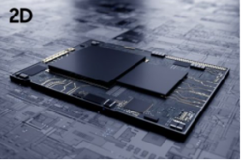
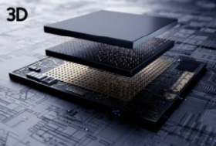
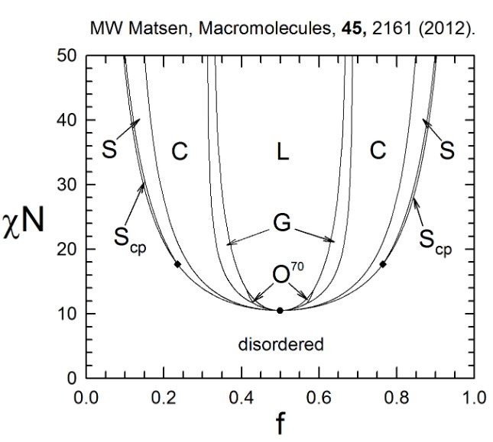
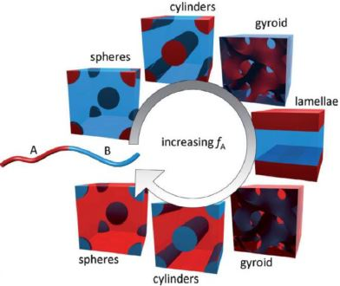
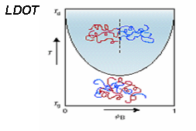
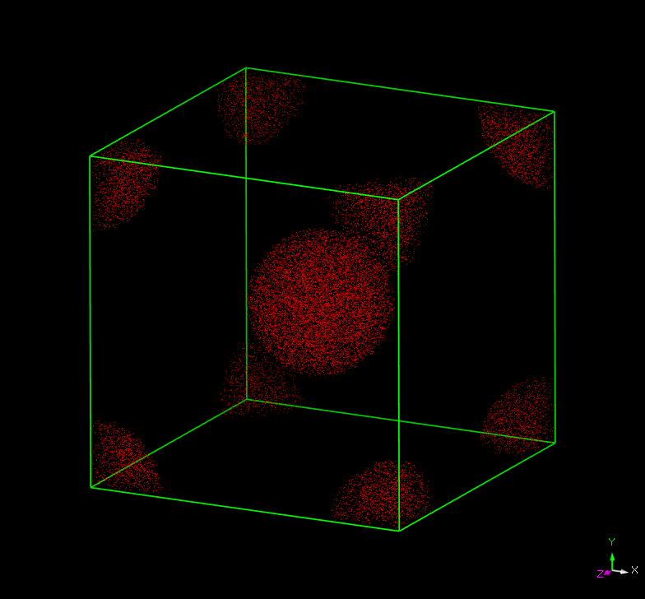
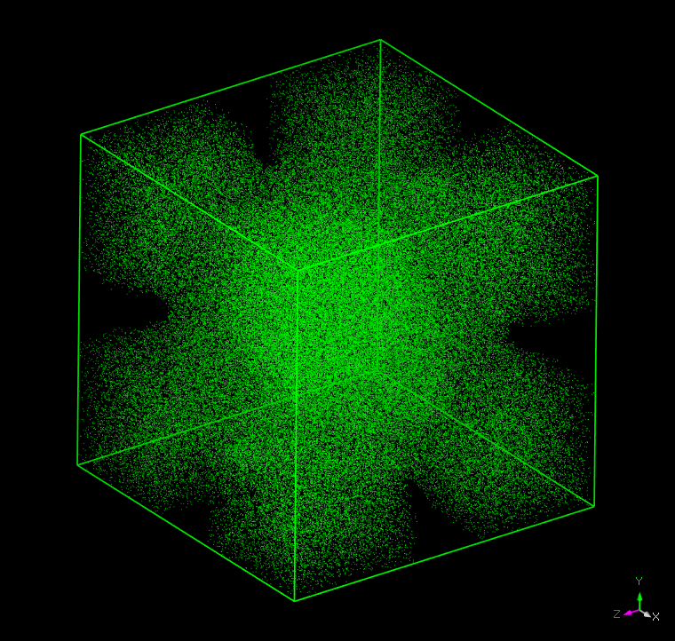
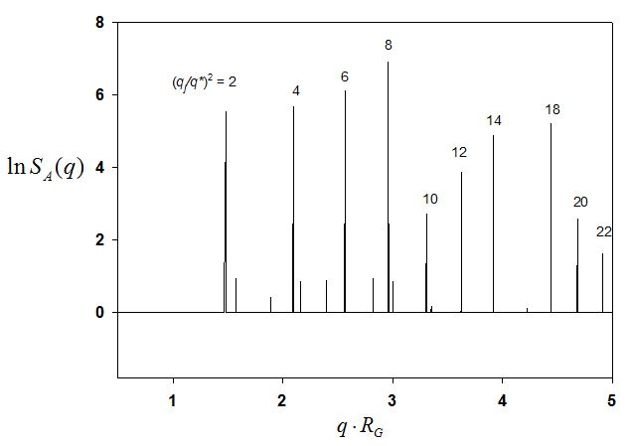
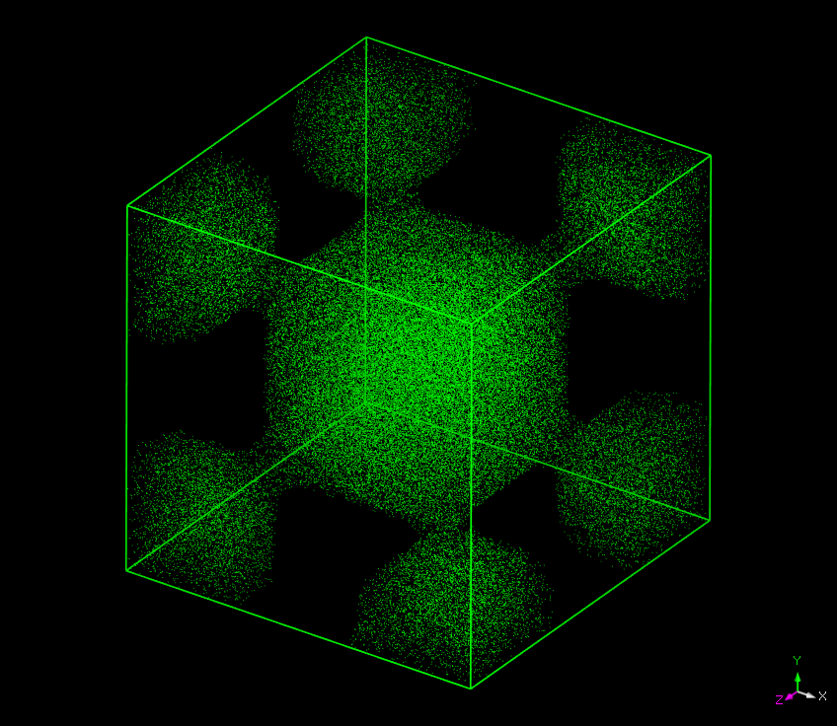
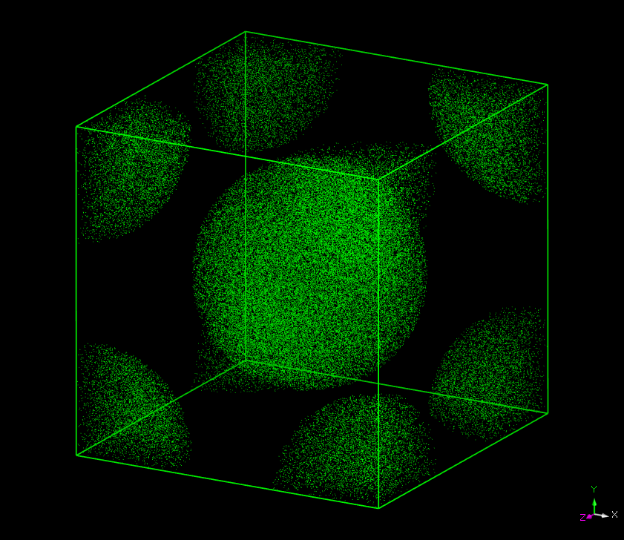
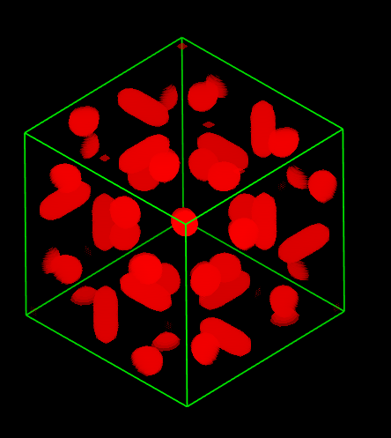
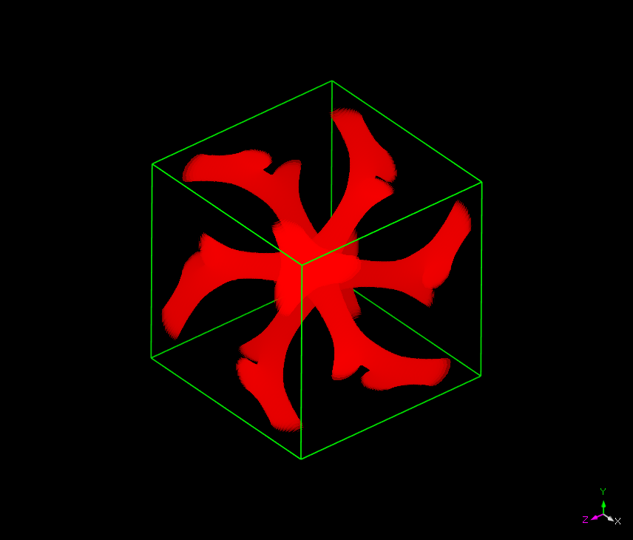
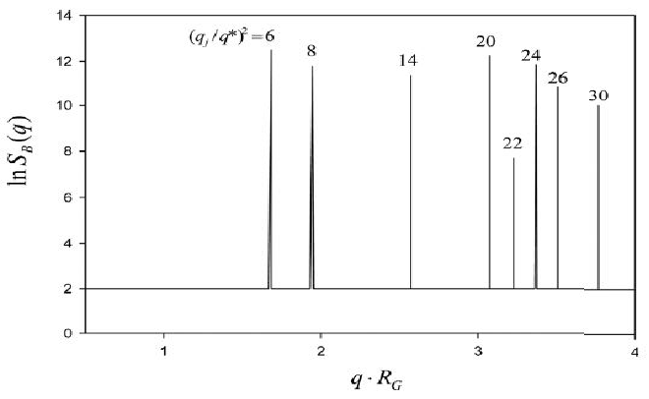
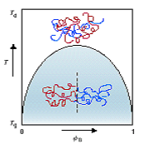
Inverted morphologies in A-B copolymer melts
with disparity in self cohesion energies
MINGGE ZHAO, XINYUE ZHANG, JUNHAN CHO*
* Department of Polymer Science and Engineering, Dankook University
*Correspondence: jhcho@dankook.ac.kr
1
Abstract
It has been found that A-B diblock copolymers with disparity in self cohesion energies between blocks can easily yield inverted mesophases, where the minor component serves as a matrix and the major component as a dispersed phase. These mesophases include the inverted HEX (hexagonally packed cylinders), BCC (body-centered cubic), and DG (double gyroids). In some situations, the morphology starting from the inverted BCC mesophase is transformed to a bicontinuous mesophase belonging to the same Im3m space group or even an Im3 mesophase of lower symmetry. The mechanism underneath these phenomena is to be discussed.
Keyword: A-B diblock copolymers, Self cohesion energies, Morphology
2
Background
3
Theory
Manufacturing semiconductors
Self-Consistent Field Theory (SCFT)
Self-cohesion energy differences between
blocks in A-B diblock copolymers
Types of ordering behavior
The "self-cohesion energy difference between blocks" in an A-B diblock copolymer refers to the variation in the cohesive forces or energies between the different blocks (A and B) within the copolymer.
This difference arises due to distinct chemical properties, hydrophobic
or hydrophilic nature, molecular structures, or other
characteristics of the A and B blocks.
In general terms, the self-cohesion energy difference between
A and B blocks can influence the microstructure and
properties of the A-B diblock copolymer.
LDOT = lower disorder to order transition temperature
▪ Upon heating disorder order
ODT = upper order to disorder transition temperature
▪ Upon cooling disorder order
Artwork by Ruzette and Mayes,
Nature Materials 2003
4
Results
A-b-B copolymer phase boundaries
Matrix inversion in ΦA=0.4
Typical A-b-B
PS-b-PVME with N=20000
Observation of inverted bicontinuous Schoen I-WP
ΦA=0.2
ΦA=0.3
Scattering peak analysis for
Im3m on a square
ΦA=0.4
ΦA=0.6
at T_{s}+3K
Red A
Blue B
5
Conclusion
More morphologies
The phase diagram of A-b-B copolymer was drawn under Landau theory,
and the evolution of various microstructures was studied using SCFT theory.
The phenomenon of matrix inversion was observed in some A-b-B systems.
The analysis of scattering peaks for the Im3m structures (BCC & I-WP)
and the Ia3d structures (double gyroid and A-dispersed Ia3d) was discussed.
A-dispersed Ia3d mesophase
ΦA=0.2
These two structures have
the identical scattering peaks for Ia3d
Double gyroid mesophase
ΦA=0.2
*
Acknowledgment
National Research Foundation of Korea (Basic Science Research Program)

