Slide 1
Multimodal Aspect-Based Sentiment Classification with Knowledge-Injected Transformer
36414050 QUAN Xinyun ゼンシンウン

Slide 2
Table Of Contents
01
02
03
04
05
Title
Innovation
Explanation
Noun explanation of the title
Improvements from existing methods
Explanation of the proposed method
Evaluation & Conclusion
Observation
Evaluation of the proposed method and Result of the evaluation
Observations and future challenges

Slide 3
01
Title
Noun explanation of the title

Slide 4
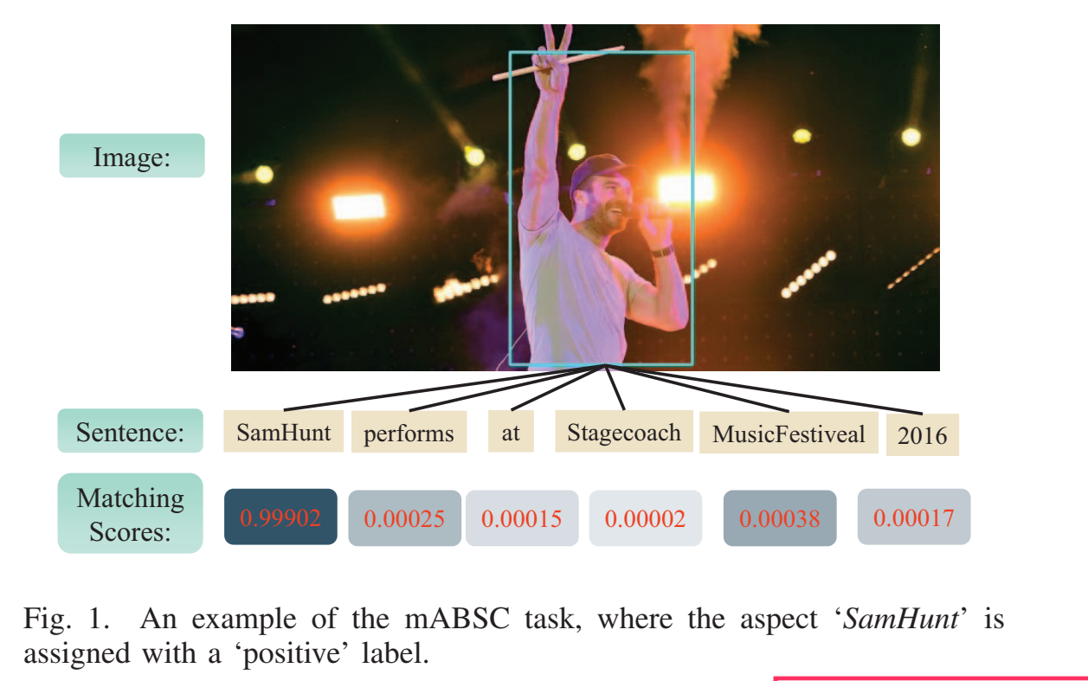
Noun Explanation
Aspect-Based Sentiment Analysis?
Sentiment Analysis:
User‘s attitude reflected by the sentence. （Positive—Neutrality—Negative）
Aspect-Based Sentiment Analysis:
Attitude toward ones of entities in the sentence. （Positive—Neutrality—Negative）
“The decor is not special at all but their amazing food makes up for it”
Aim: Convenient for owner to pay special attention to or improve a certain aspect
Multi-model Aspect-Based Sentiment Classification?
Multi-model:
Not only analyze by text but also picture, etc.

Slide 5
Noun Explanation
Knowledge-injected Transformer?
Getting information not only from the context, but also from outside.
e.g. Knowledge Graph or Prepared Model or Outside Resources.
Much like RAG acts on LLM:
Provide my self-information form and ask LLM questions about me.

Slide 6
02
Innovation
Improvements from existing methods

Slide 7
Existing method
Whole sentence
Whole Picture
features
features
Sentiment polarity
Positive/Neutrality/Negative

Slide 8
Disadvantage of existing method
Disadvantage 1:
Insufficient data causes the model to learn incorrect correlations.
Training set is not enough,
Causing the Transformer model to overfit to the training set and learn the wrong correlations
Disadvantage 2:
Ignoring the valuable fine-grained information.
Generate features with the whole picture → coarse-grained visual features
Generate features with meaning objects in the picture →fine-grained visual features

Slide 9
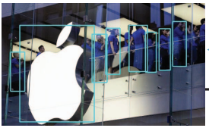
Innovation
Improvement 1:
KNIT (Knowledge-Injected Transformer)
Let the transformer model not only establish correlations based on the given training set,
but also directly use external data to confirm correlations
Improvement 2:
Fine-grained visual features
First identify the meaningful objects in the image
convert them into features

Slide 10
03
Explanation
Explanation of the proposed method

Slide 11
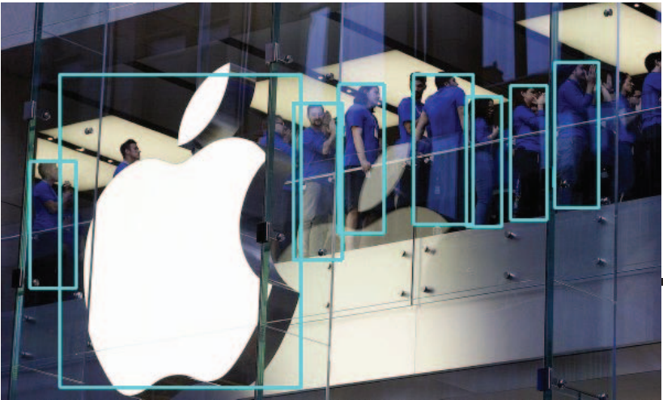

Explanation
Injected knowledge:
syntactic dependency information (Stanza)
Injected knowledge:
correlation between object and word (CLIP)
Knowledge-Injected
Delete influence from irrelative context
Delete influence from irrelative objects
@ Apple @ is now almost twice as valuable as the next biggest company on Earth
BERT
Textual features
Reflecting Multi-hop Relations
adjust each word’s features by combining the correlation between words and words
Matrix P
Transformer
Rejected Textual features contain influence from context
Two things done by Transformer
Features of @Apple@
Rejected Textual features contain influence from objects
adjust each word’s features by combining the correlation between words and objects
Linear & Softmax
objects
[0,1]
$$\hat{y}$$
Visual features
Positive/Neutrality/Negative
Mask R-CNN model that applies RoIAlign
Fine-grained visual features

Slide 12
04
Evaluation and Result
Evaluation of the proposed method and Result of the evaluation

Slide 13
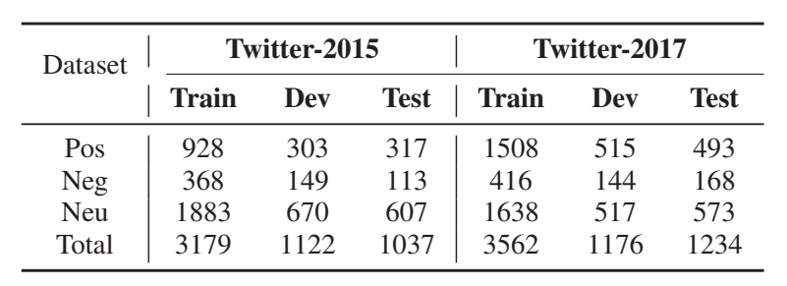
Evaluation

Slide 14
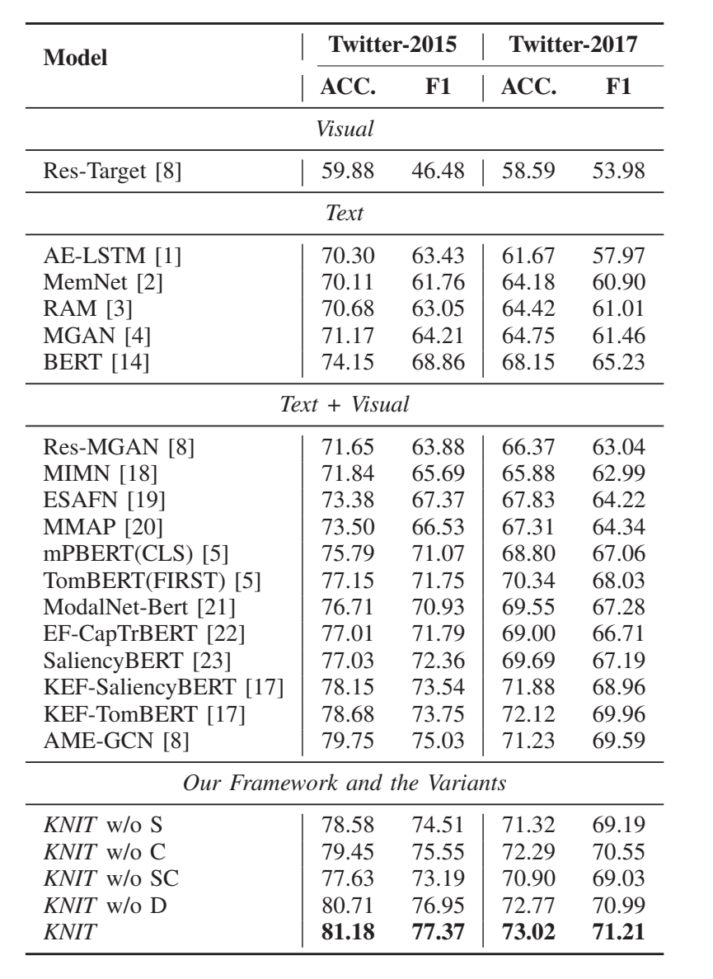
Result
Past best model on Twitter2015: AME-GCN
KNIT: ACC(accuracy): ↑1.8% F1: ↑3.1%
Past best model on Twitter2017:KEF-TomBERT
KNIT: ACC(accuracy): ↑1.2% F1:↑1.8%
ACC = (TP + TN) / (TP + TN + FP + FN)
F1 = 2 * (Precision * Recall) / (Precision + Recall)

Slide 15
05
Observation
Observations and future challenges

Slide 16
Observation
Further utilization of external knowledge
Considering more types of external knowledge, such as common-sense knowledge or knowledge from other fields, may further improve the performance of the model.
In-depth study of cross-modal relations
Further explore more complex interactions between text and images to better understand and utilize these relationships.
More complex model structure
Research more advanced or complex model structures to address the challenges in multimodal sentiment analysis.

Slide 17
Thanks!
Do you have any questions?

Slide 18
Resources

