Slide 1
Predicting Cardiovascular disease
AceR
2019/12/3

Slide 2
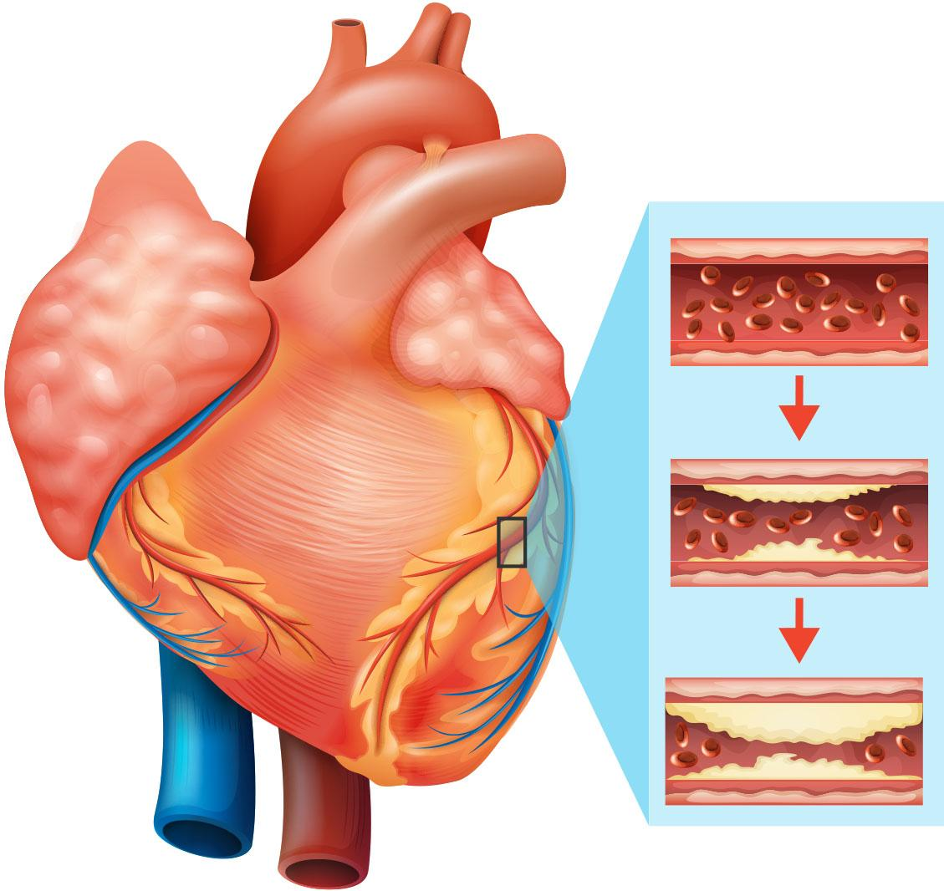
Cardiovascular disease (CVD)
Disorders related to the heart and blood vessels
Cause:
Fatty plaque builds up on the inner walls of the blood vessels which prevent prevents blood flowing to the heart
Risk factor:
Unhealthy diet, obesity, physical inactivity, tobacco use and harmful use of alcohol
Notes:
Such as heart attack and stroke

Slide 3
Cardiovascular Disease dataset
Kaggle: https://www.kaggle.com/sulianova/cardiovascular-disease-dataset
70000 observations with 12 variables
Variables | Type
Age | Int
gender | Factor
height | Num
weight | Num
ap_hi/low (blood pressure) | Factor
cholesterol | Factor
gluc | Factor
smoke | Factor
alco | Factor
active | Factor
cardio | Factor
Notes:
Our dataset is download from Kaggle

Slide 4
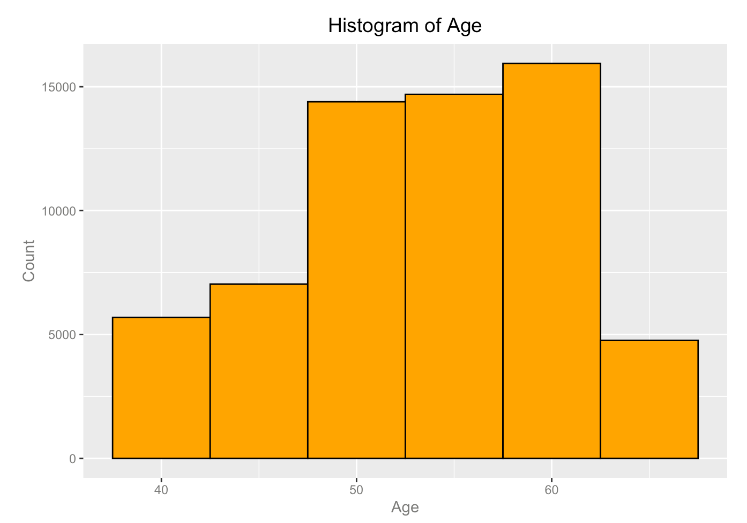
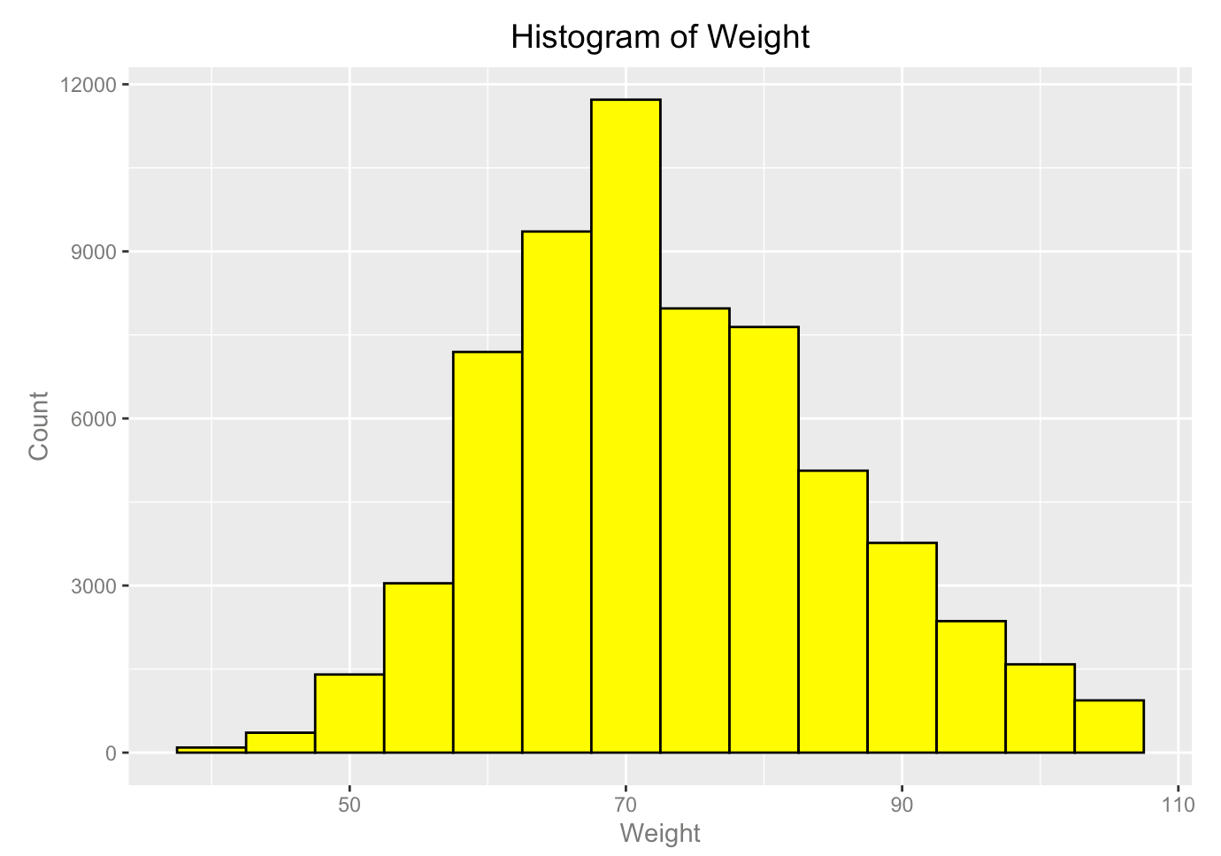
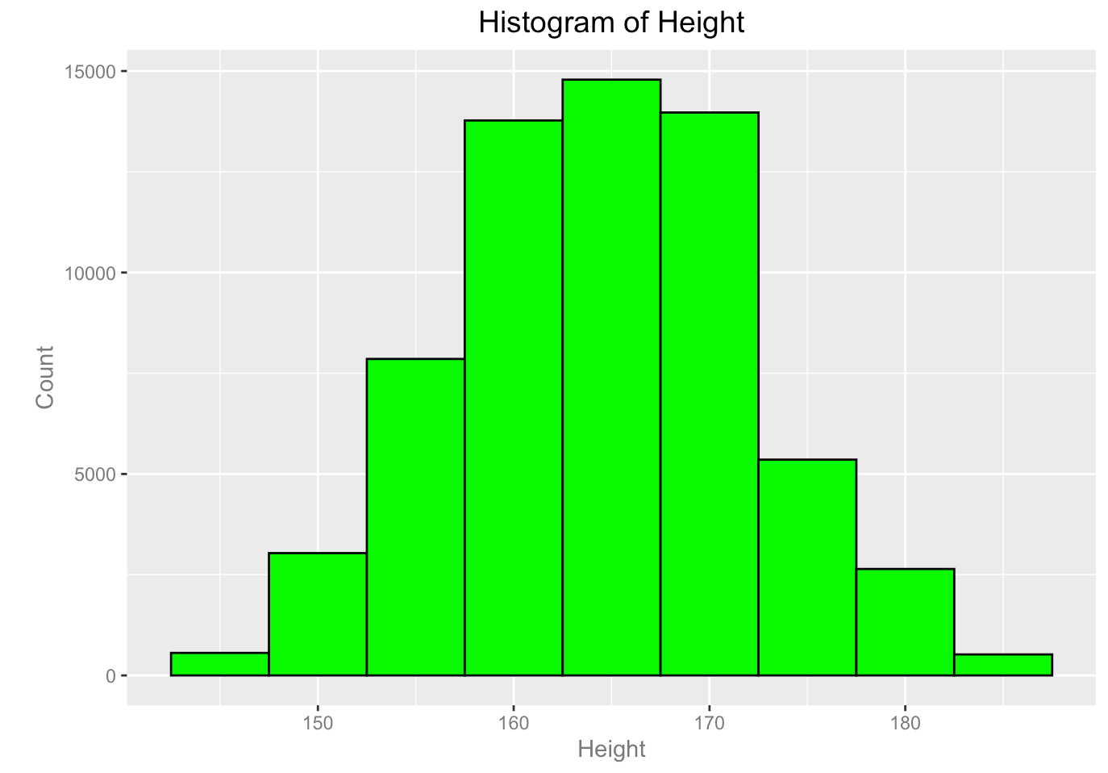
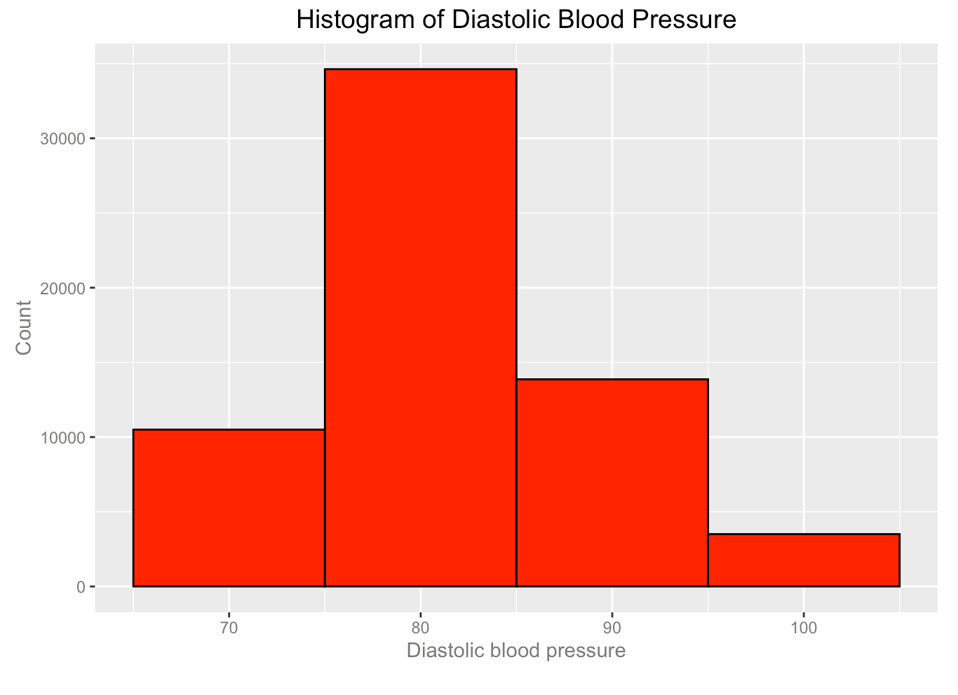
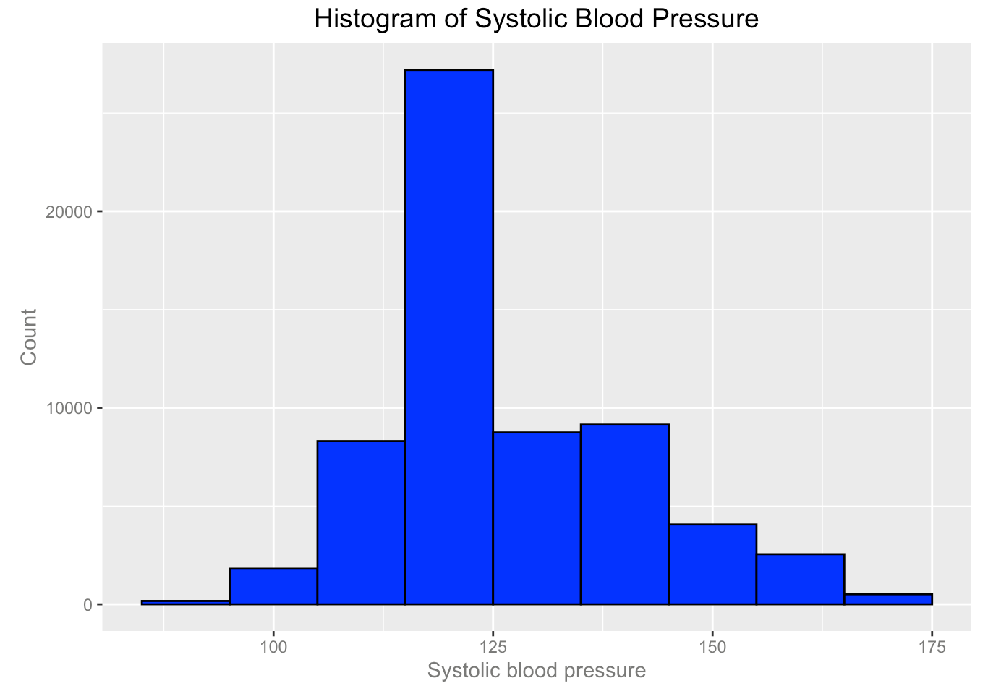
Data processing
Drop age<35
Drop outliers for height, weight, ap_hi, and ap_low
Notes:
For data processing,
Since age is days, we change it to years,
Drop age below 35 because there are only few observation for age<35
Drop negative value for blood pressure
These are the histogram plot of each variables after processing

Slide 5
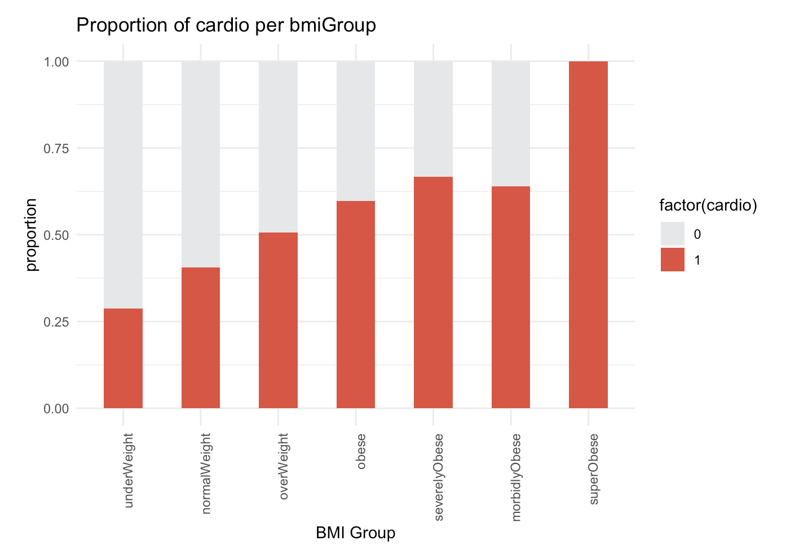
BMI value as predictors for cardiovascular diseases
Notes:
So we further calculating the BMI value and waist value for predicting CVD.
The plot on the left showed that as the BMI level increase, the risk of CVD is also increased.
Since studies have shown that a waist circumference over 95cm in men and 88cm in women is associated with elevated cardiovascular risk.
So we set these parameter as a cutoff for analysis. The plot on the right showed that the people over cutoff parameter has higher risk of CVD in both gender.

Slide 6
Summary from Part1
BMI values have a higher correlation with cardiovascular disease
Other factors such as smoking, age, gender, blood glucose level, and alcohol use are also associated with the risk of cardiovascular diseases
Model building and evaluation

Slide 7
What are the risk factors of cardiovascular diseases? Are all the variables correlated to the development of cardiovascular disease?
Smart Question

Slide 8
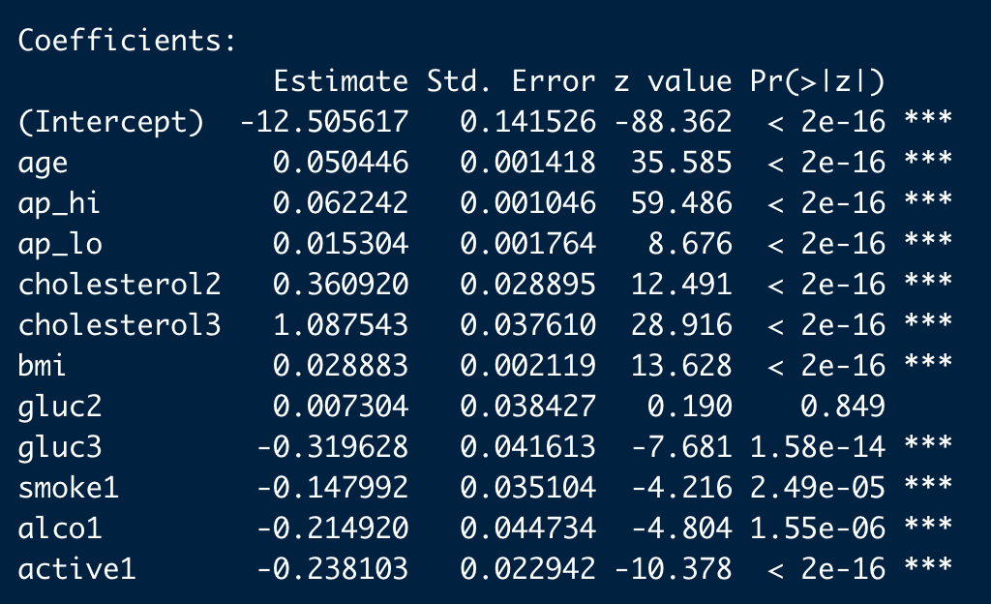
logistic regression model Glm() function
All the coefficients are found significant (small p-values) except gluc2. Age, ap_hi, ap_lo, cholesterol, bmi, glucose have positive effects on cardio diseases, while glucose, smoke, drinking alcohol and do exercise have negatively affect on cardio diseases. These are reasonable results and confirms our common beliefs.

Slide 9
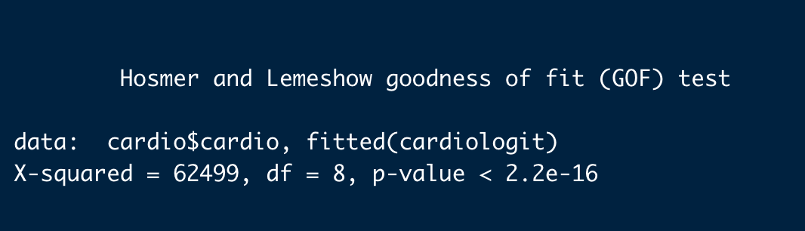
Model evaluation
Hosmer and Lemeshow test
p-value is smaller than 0.05. This indicates the model is a good fit

Slide 10
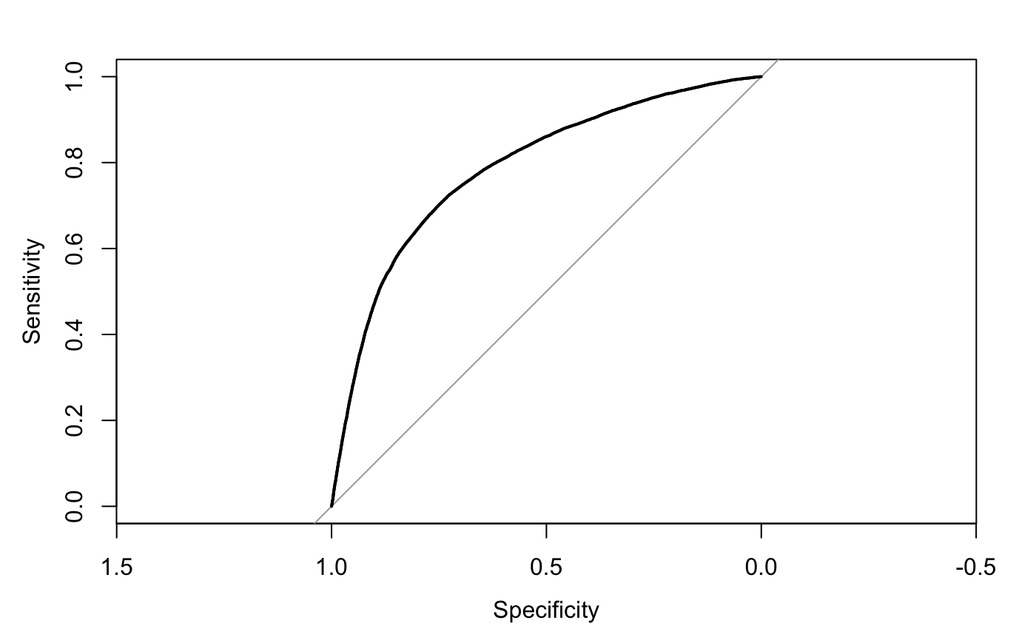
Model evaluation
ROC curve and AUC
We have here the area-under-curve of 0.787, which is slightly less than 0.8. This test evaluates the model as a not so good fit.

Slide 11

Model evaluation
McFadden evaluation
McFadden value is 0.1890877,
about 18.9% of the variations in cardio is explained by the explanatory variables in the model.

Slide 12
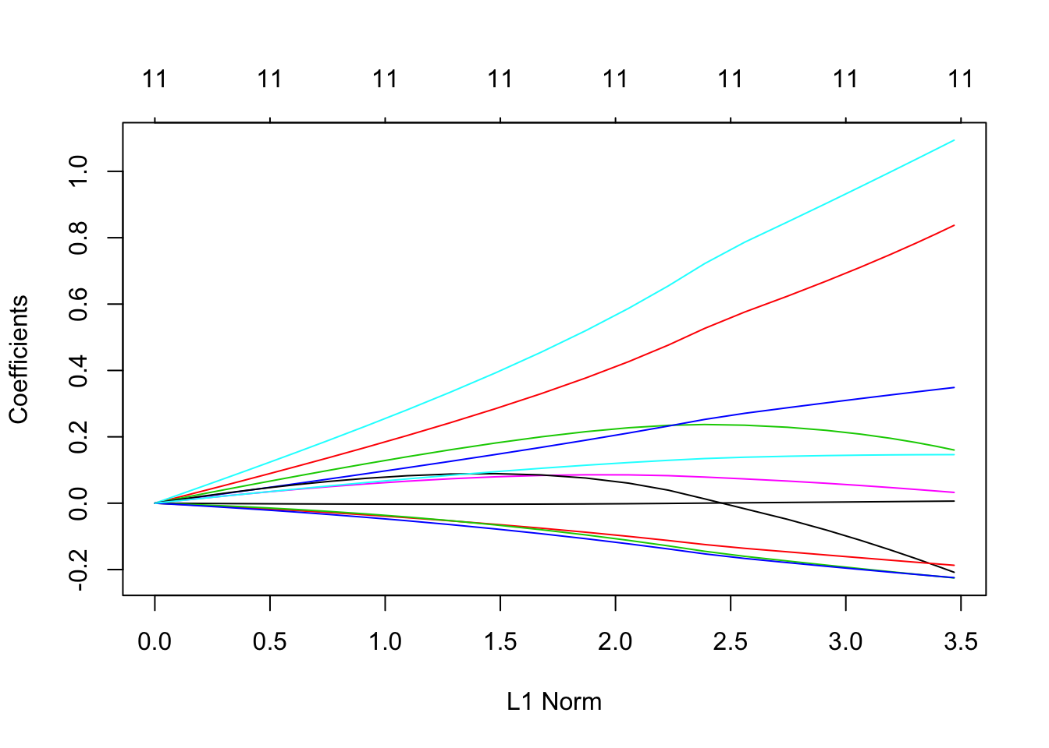
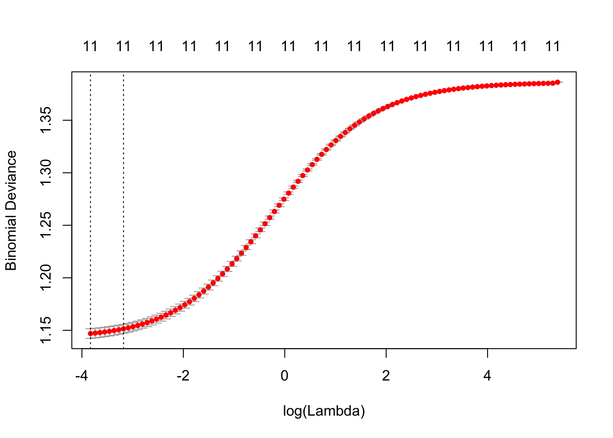
Ridge Regression
Regularization minimizes overfitting
The best λ for Ridge regression is almost 0, which gives the least square fit. All the coefficiences are used.

Slide 13
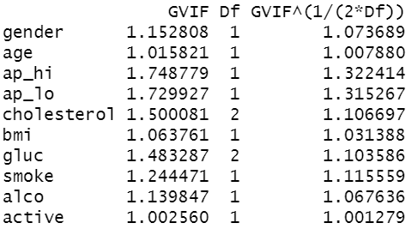
GVIF to check collinearity
GVIF: polynomial variables, variables require more than 1 coefficient and thus more than 1 degree of freedom
For one-coefficient terms VIF equals GVIF.
The rule: GVIF<2, equals a VIF of 4 for one-coefficient variables.
Collinearity is not a problem

Slide 14
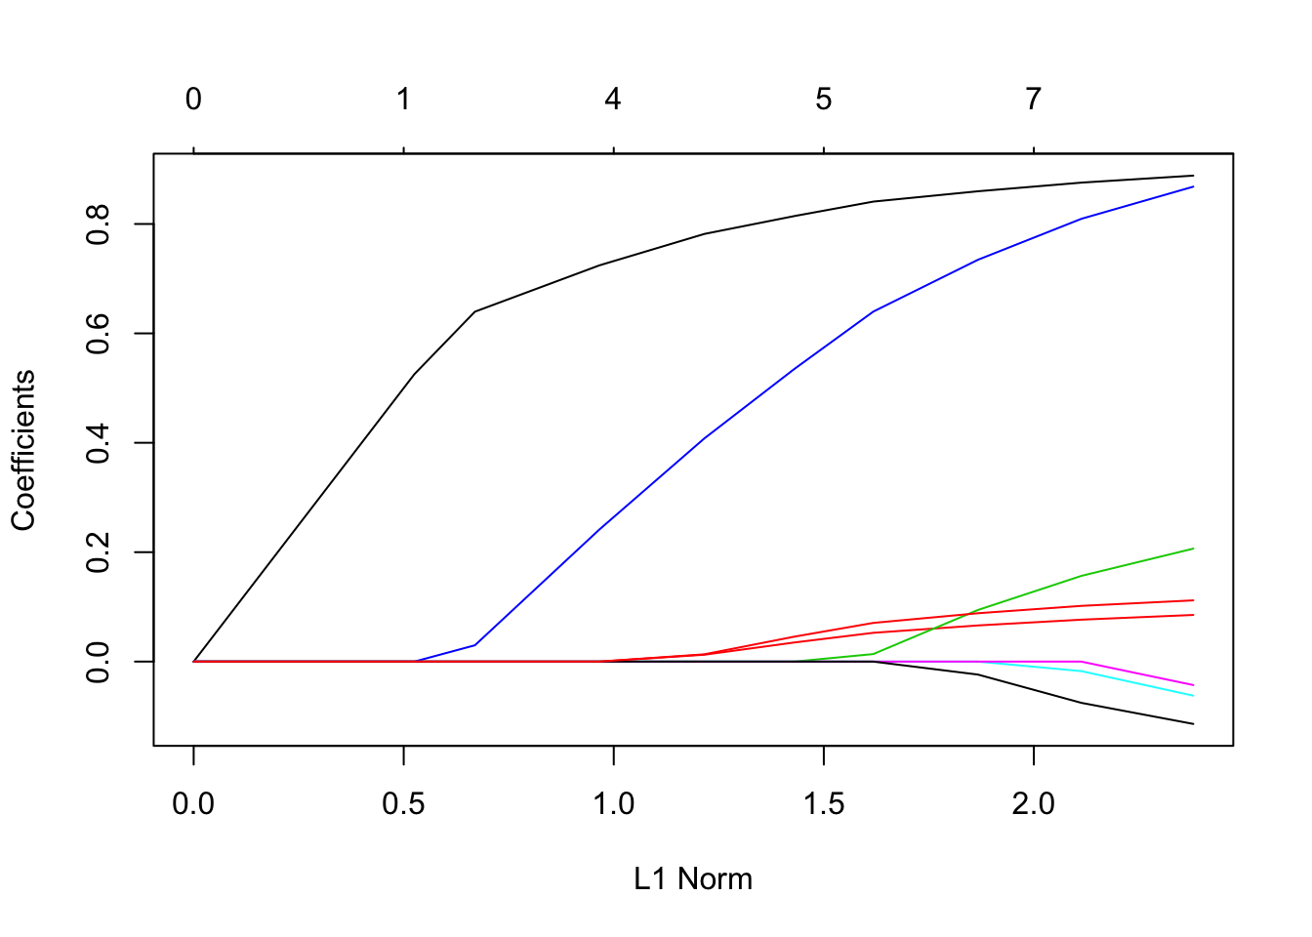
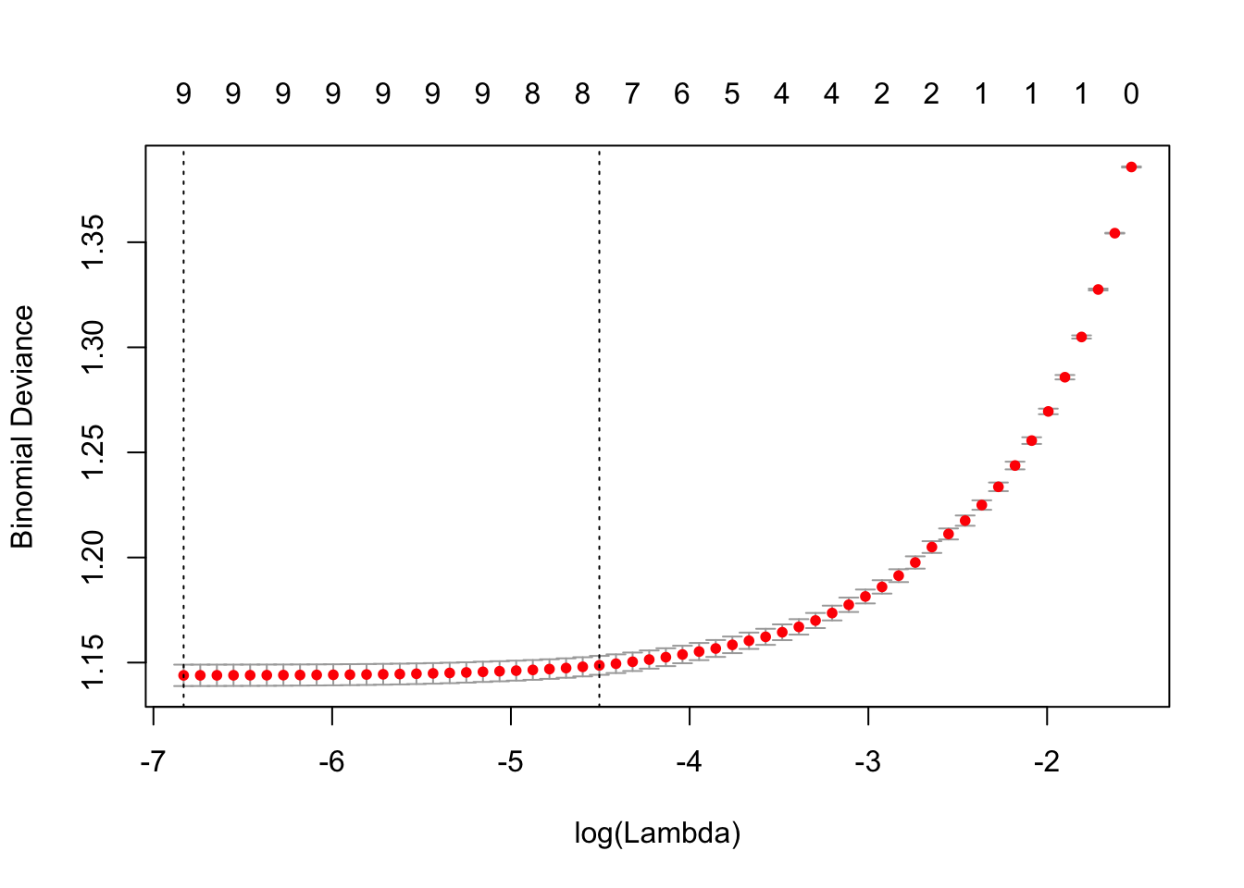
Lasso regression
The best λ for Lasso regression is almost 0, which gives the least square fit and agrees with Ridge Regression. However, the coefficients of gender and gluc are 0, so dropped to avoid overfitting and this result match with the p-value calculated from full model of logistic regression

Slide 15
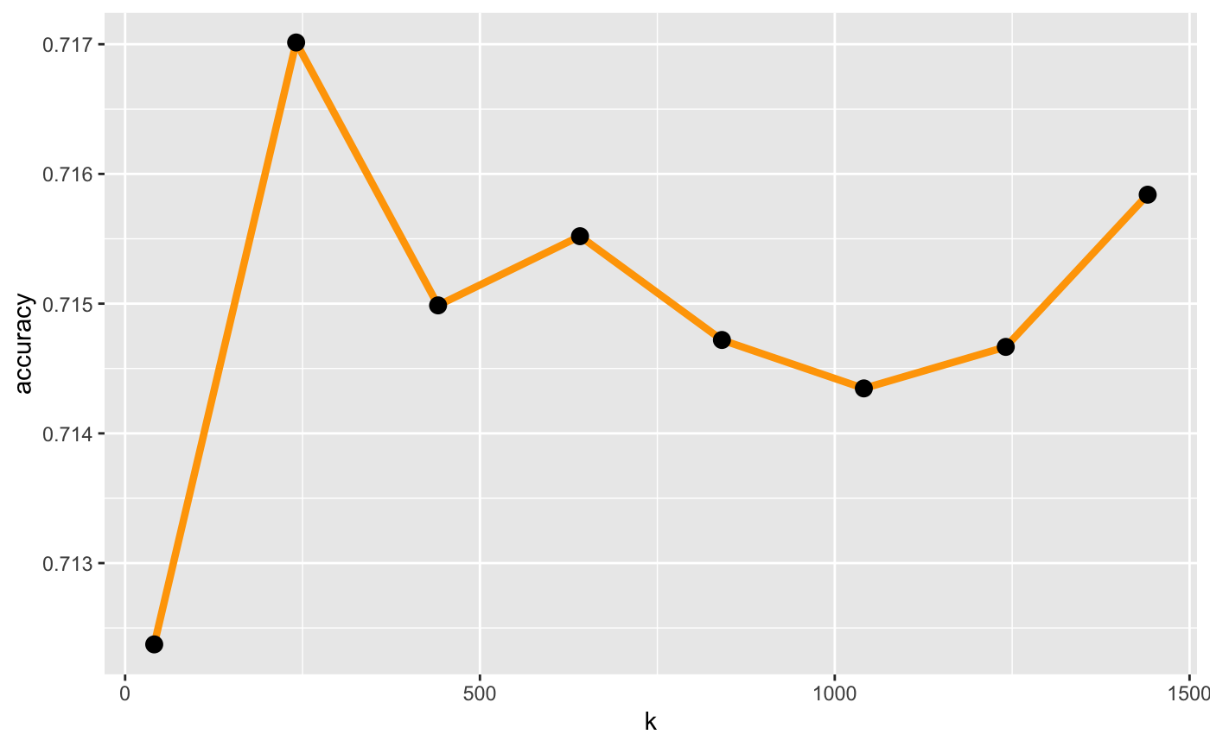
K-Nearest Neighbor
Large k: Less sensitive to noise (particularly class noise)- Better probability estimates for discrete classes - Larger training sets allow larger values of k.
Small k: Captures fine structure of problem space better - High variability in decision boundaries (more complex models) - May be necessary with small training sets.
K value | accuracies
40 | 71.3%
250 | 71.8%
1575 | 71.6%
The peak is around 250, we would like to zoom into k around 250

Slide 16
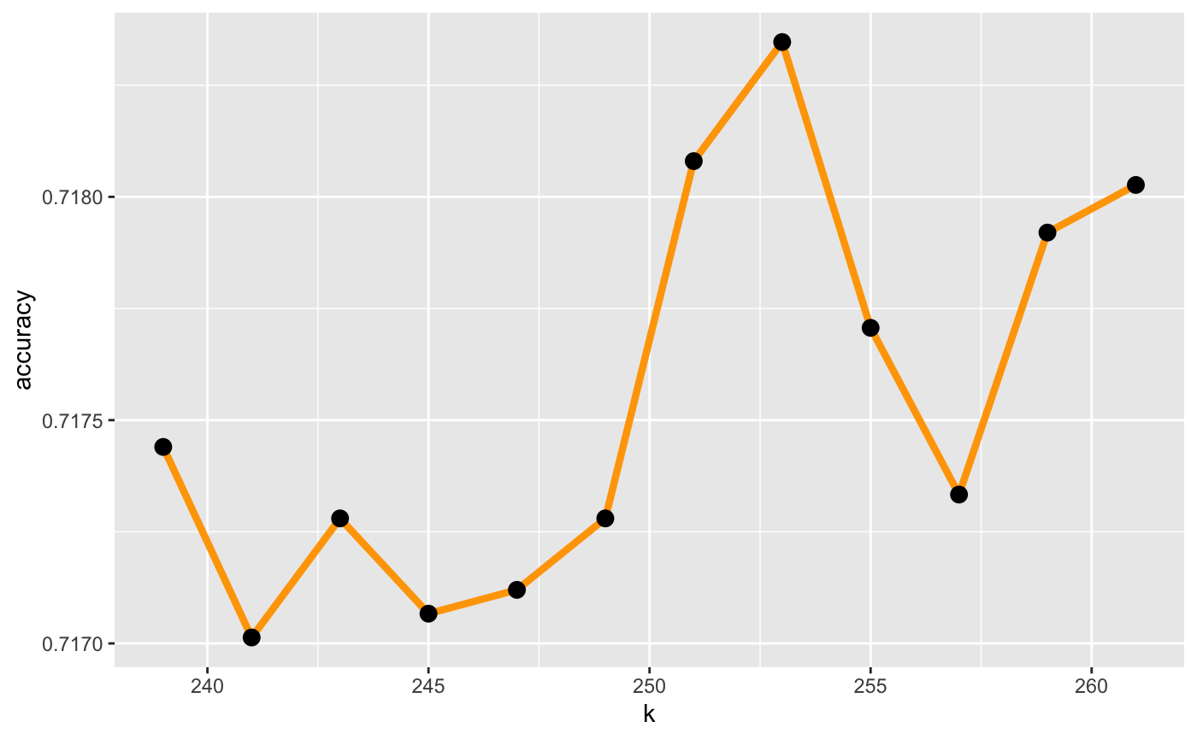
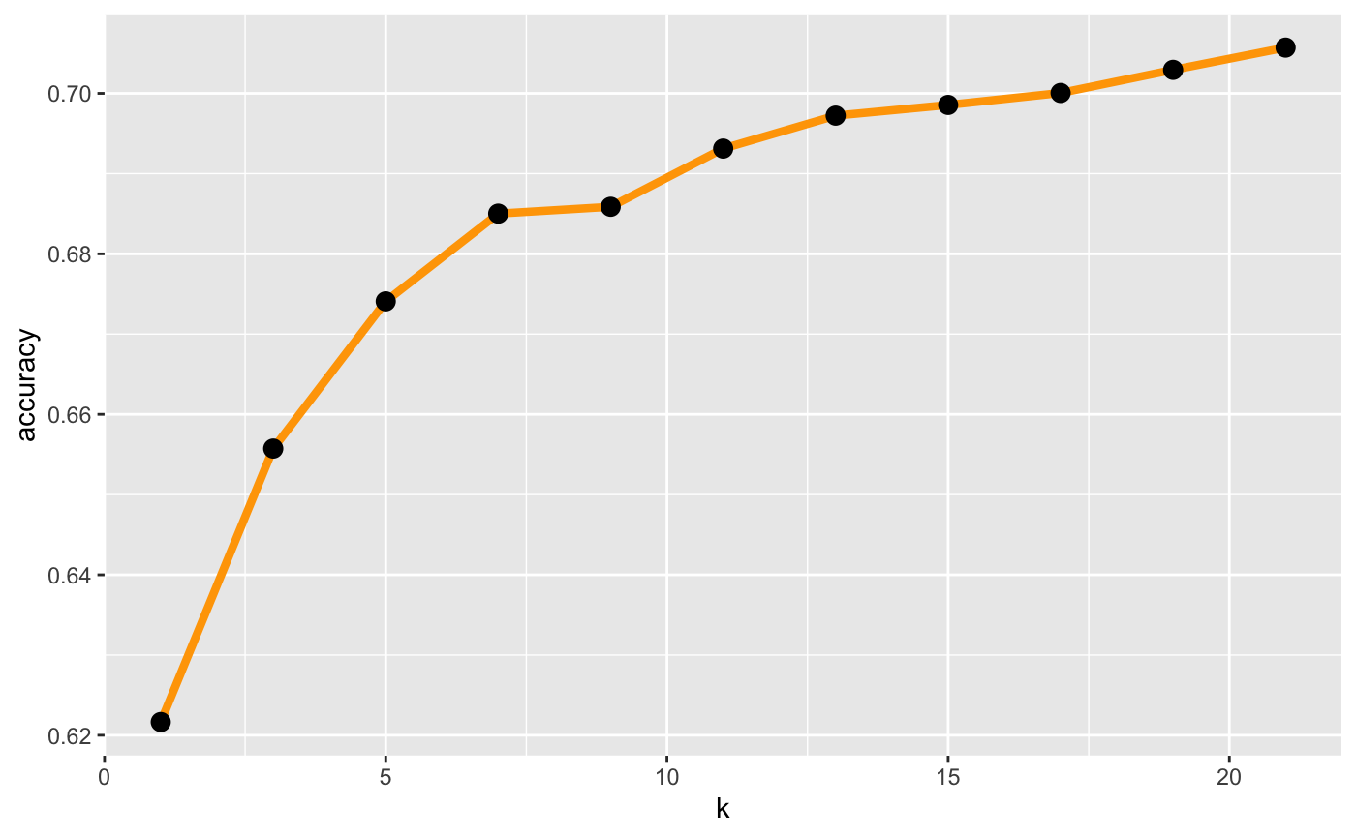
Selecting the correct "k"
253-nearest neighbors has the best accuracy. However, it requires great amount of calculation
7-nearest neighbors is a efficient choice because that's the greatest improvement in predictive accuracy
253-nearest neighbors is a good choice, however, 7-nearest neighbors is a efficient choice

Slide 17
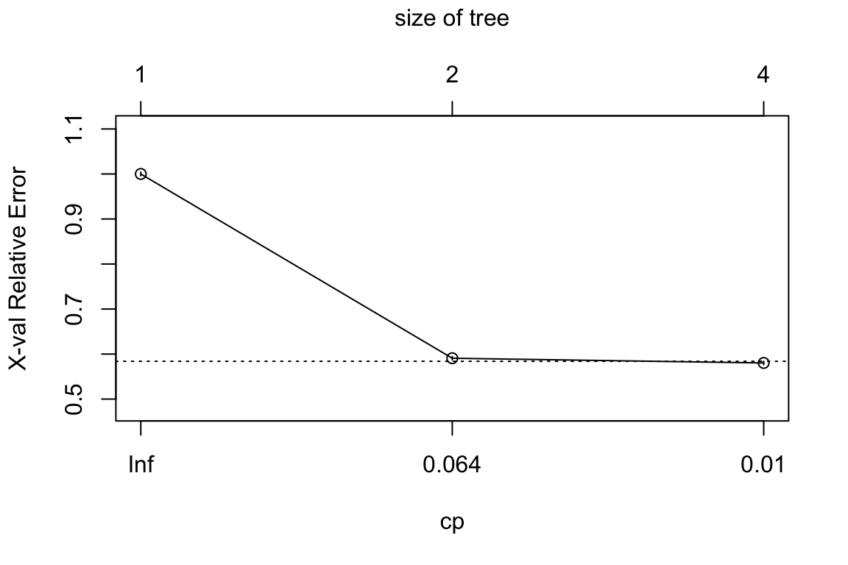
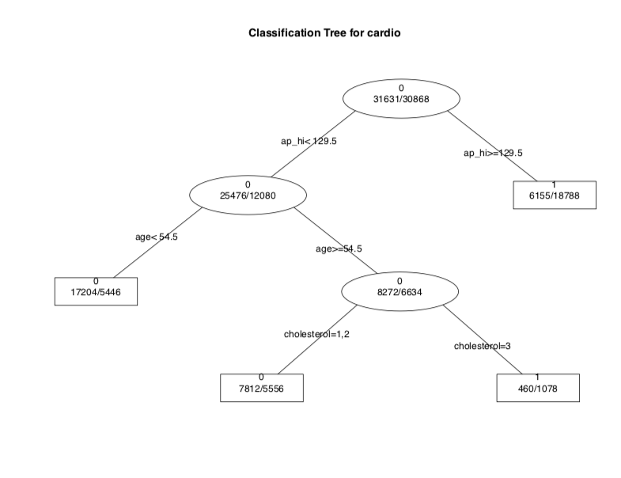
Decision Tree
Cross Validation resuts
Avoid overfitting the data based on the cp(complexity parameter).

Slide 18
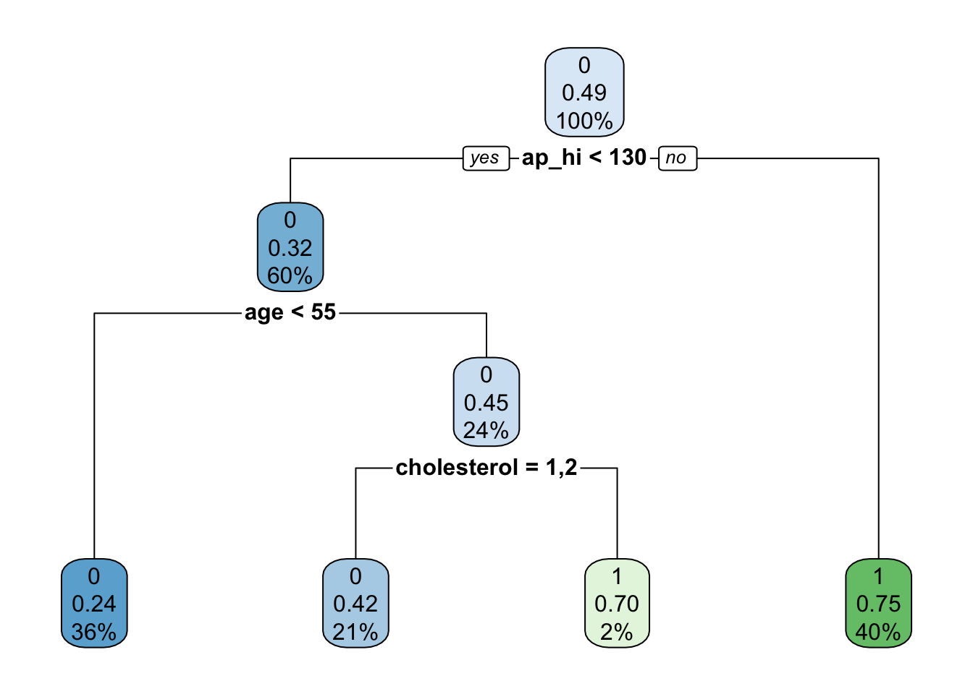
Decision Tree
To validate which variable will mostly cause cardiovascular diseases

Slide 19
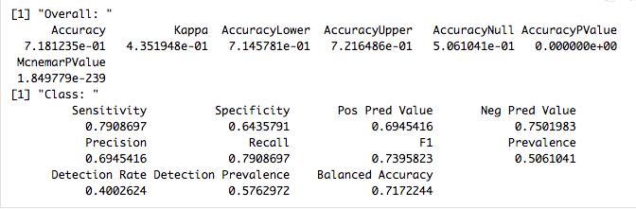
Decision Tree
The overall accuracy is 71.81%

Slide 20
Summary
Classification algorithm
Logistic Regression
Linear Regression
K-Nearest Neighbors
Decision Tree
Ridge Regression
Lasso Regression

Slide 21
Summary
Logistic Regression：
a machine learning method for solving binary (0 or 1) problems, which is used to estimate the likelihood of something.
Hosmer-Lemeshow test
AUC - ROC curve
McFadden’s R²

Slide 22
Summary
Ridge Regression and Lasso Regression:
Because overfit is an extremely common issue in many machine learning problems, there are different approaches to solving it. The main concept behind avoiding overfit is simplifying the models as much as possible.
The difference between ridge regression and Lasso regression is that ridge regression introduces the L2 norm penalty term, and Lasso regression introduces the L1 norm penalty term.
the biggest advantage of Lasso regression is that the features are sparse. Many θs can be changed to 0, which reduces the calculation of eigenvalues ​​and selects the more important features to avoid overfitting. At the same time, because the ridge regression requires all θ to exist, the calculation amount Lasso regression will be much smaller than the ridge regression. Also, if the sample has many eigenvalues, Lasso is better than Ridge.

Slide 23
Summary
K-Nearest Neighbors
By calculating the distance from each training sample to the sample to be classified and taking the K training samples closest to the sample to be classified, which category of the K samples has the majority of training samples, the sample to be classified belongs to which category.
Suitable for classification problems with large sample sizes.
Too much calculation.
For classification problems with a small sample size, misclassification will occur.
Decision Tree
A decision tree is a simple but widely used classifier that builds a decision tree from training data to classify unknown data.
No domain knowledge or parameter assumptions are required. Suitable for high-dimensional data, simple and easy to understand. A large amount of data is processed in a short time, and feasible and effective results are obtained.
For data with inconsistent sample numbers in each category, the information gain is biased toward those features with more numerical values.
Easy to overfit, ignoring correlations between attributes.

Slide 24
Summary
The regression model indicated that high level of cholesterol, blood pressure, age, and BMI are correlated with increasing risk of CVD
KNN clustering showed 253-nearest neighbors is a good choice, but 7-nearest neighbors is a efficient choice
Ridge and Lasso regression minimizes overfitting
Decision tree provided a classification system and used blood pressure, age, and cholesterol level for predicting CVD

Slide 25
References
Benjamin, E. J., Muntner, P., Alonso, A., Bittencourt, M. S., Callaway, C. W., Carson, A. P., . . . Stroke Statistics, S. (2019). Heart Disease and Stroke Statistics-2019 Update: A Report From the American Heart Association. Circulation, 139(10), e56-e528. doi:10.1161/CIR.0000000000000659
Bozeman, S. R., Hoaglin, D. C., Burton, T. M., Pashos, C. L., Ben-Joseph, R. H., & Hollenbeak, C. S. (2012). Predicting waist circumference from body mass index. BMC Med Res Methodol, 12, 115. doi:10.1186/1471-2288-12-115
Cardiovascular Disease [Web log post]. Retrieved Oct 12, 2019, from https://www.who.int/health-topics/cardiovascular-diseases/
Kathiresan, S., & Srivastava, D. (2012). Genetics of human cardiovascular disease. Cell, 148(6), 1242-1257. doi:10.1016/j.cell.2012.03.001

Slide 26
Thank You! Questions?

