Slide 1
Home Credit Default Risk Can you predict how capable each applicant is of repaying a loan?
Team Member: Xinyu Yao, Ya Liu, Kang Huang

Slide 2
1
Introduction
2
Data Preprocessing
CONTENTS
3
Exploratory Data Analysis
4
Feature Engineering
5
Model Development
6
Conclusion

Slide 3
Introduction
/01

Slide 4
Problem Description
Home Credit Group is an international consumer finance provider
Strives to broaden financial inclusion for the unbanked population by providing a positive and safe borrowing experience
Challenge: to predict their clients' repayment abilities

Slide 5
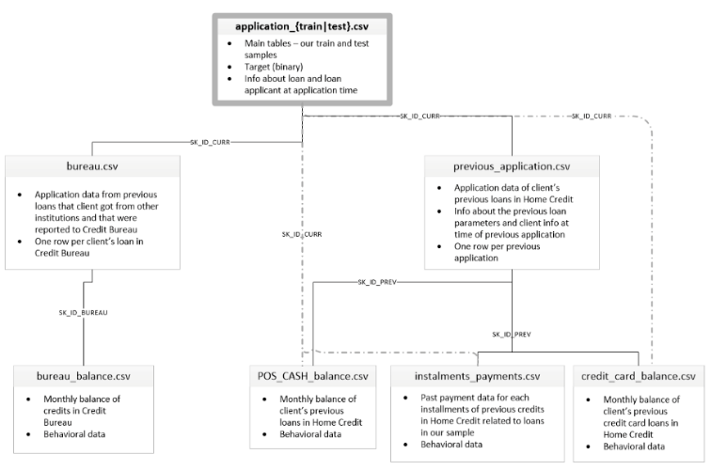
Data Description

Slide 6
Data Preprocessing
/02

Slide 7
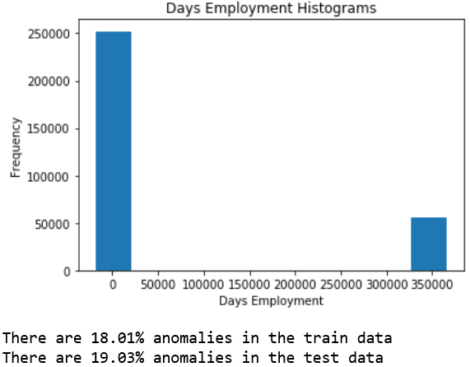
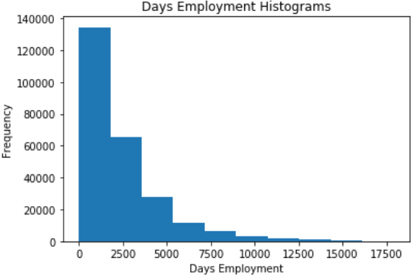
Data Preprocessing
Check anomalous data and transform them
2. Impute missing values with mean or median

Slide 8
Exploratory Data Analysis
/03

Slide 9
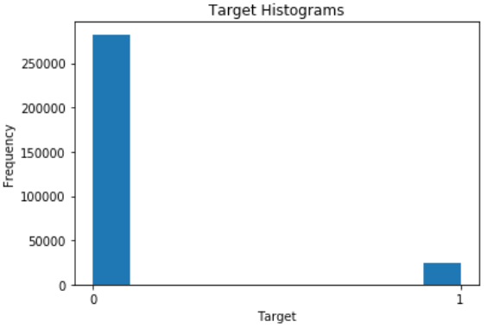
Target Histogram
Imbalanced data set
There are far more loans that were repaid on time than loans that were not repaid.
Over sampling was performed before modeling

Slide 10
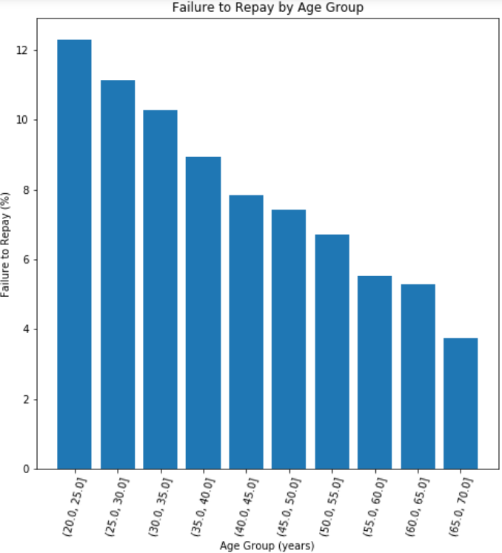
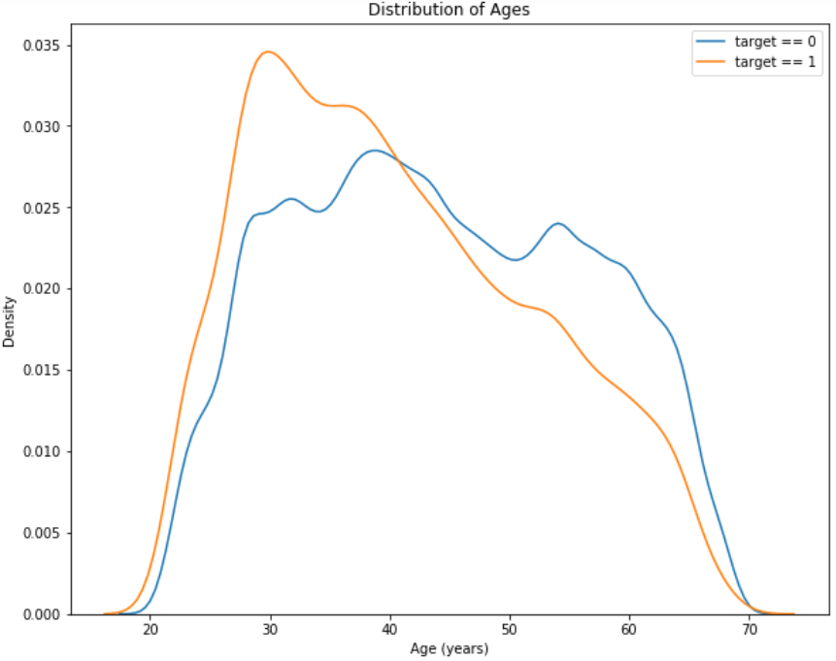
How Age Influences Target
Effect of age on target (applicant has difficulty repay the loan or not)
The target == 1 (applicant has difficulty repay the loan) curve skews towards the younger end of the range.
Younger applicants are more likely to fail repaying the loan

Slide 11
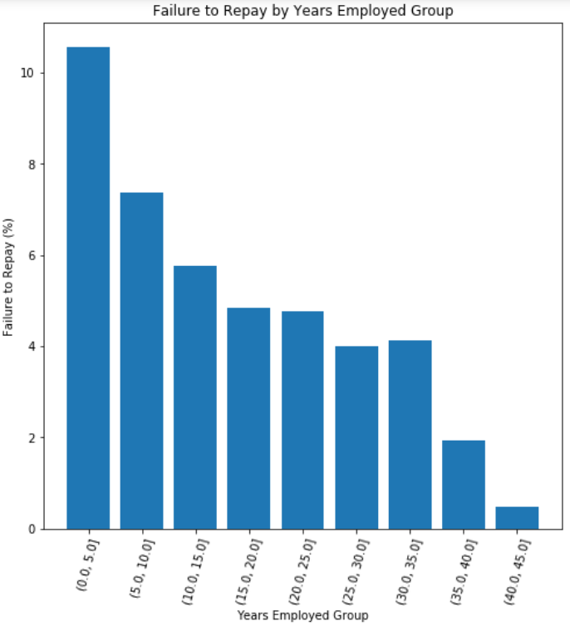
How Days Employed Influences Target
Effect of Days Employed on target (applicant has difficulty repay the loan or not)
With more years employed at the time of application, applicants have better chance to repay the loan
With years employed over 10-15 years, failure to repay (%) is below 5%

Slide 12
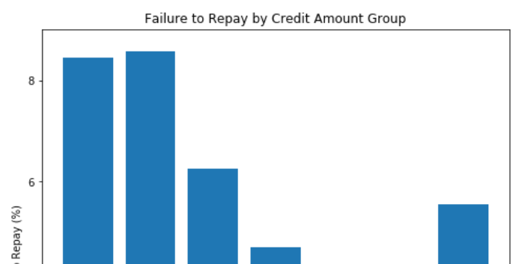
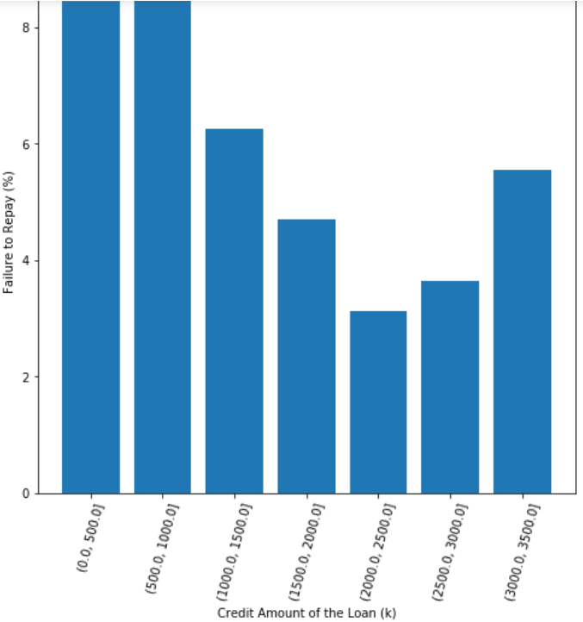
How Credit Amount Influences Target
Effect of Credit Amount on target (applicant has difficulty repay the loan or not)
Overall, larger credit amount of loan has more likely to be repaid
However, loan of credit amount over 2,500K is more likely to be failed repaid

Slide 13
Feature Engineering
/04

Slide 14
Overall Principles
There are six tables to abstract features from.
For numeric variables:
Group by id
Compute aggregation statistics, e.g., min, max, sum, mean
Merge these features we create back into the train dataset
For categorical variables:
Group by id
Compute count, count_norm instead
Merge these features back into the train dataset

Slide 15
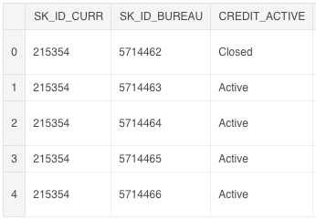
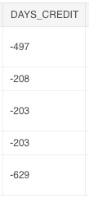
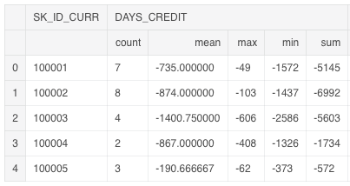
Take Bureau.csv for Example
Group by ‘SK_ID_CURR’.
DAYS_CREDIT: How many days before current application did client apply for Credit Bureau credit.
For loan with id 100001, there are 7 previous application, the mean DAYS_CREDIT is -735.
Numeric Variable

Slide 16
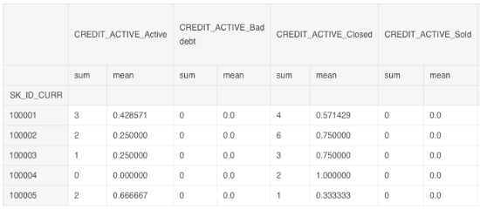
Take Bureau.csv for Example
Group by ‘SK_ID_CURR’.
CREDIT_ACTIVE: Status of the Credit Bureau (CB) reported credits.
For loan with id 100001, the count of the category, CREDIT_ACTIVE_Active, for the associated client is 3 and the normalized count is 0.43.
Categorical Variable

Slide 17

What should we do next?
We abstract features from other five tables following the same style.
In the end…
There are originally 122 features in train dataset(application.csv).
After feature engineering, there are 1,349 features in the train dataset.

Slide 18
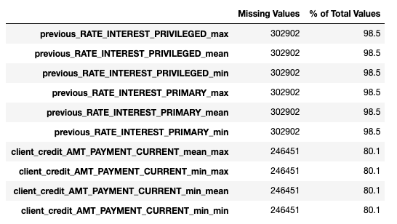
Feature Selection
Delete columns whose percentage of missing values is greater than 75%
69 columns are deleted

Slide 19
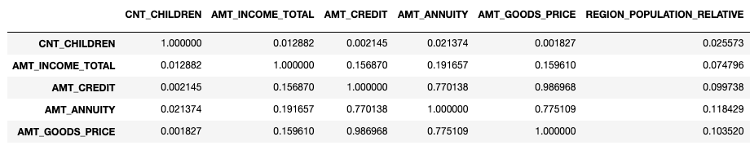
Feature Selection
Delete one of two features whose correlation is greater than 0.9.
562 columns to remove.

Slide 20
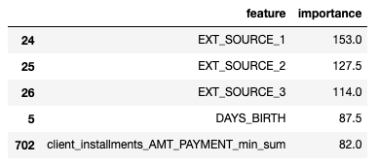
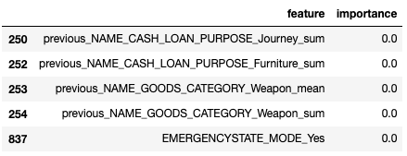
Feature Selection
Delete features whose importance score is 0.
Drop 302 features.
Delete
In the end…
122 -> 1,349 -> 536
Train dataset shape (307511, 536), test dataset shape (48744, 536)

Slide 21
Model Development
/05

Slide 22
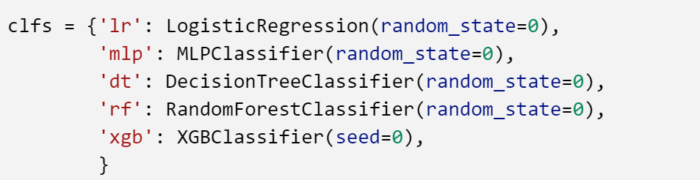
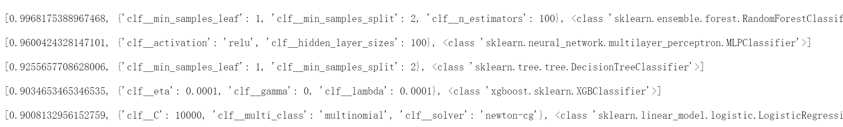
Hyperparameter tuning and model selection
Use this model to fit the whole dataset and predict the value.

Slide 23
Conclusion
/06

Slide 24
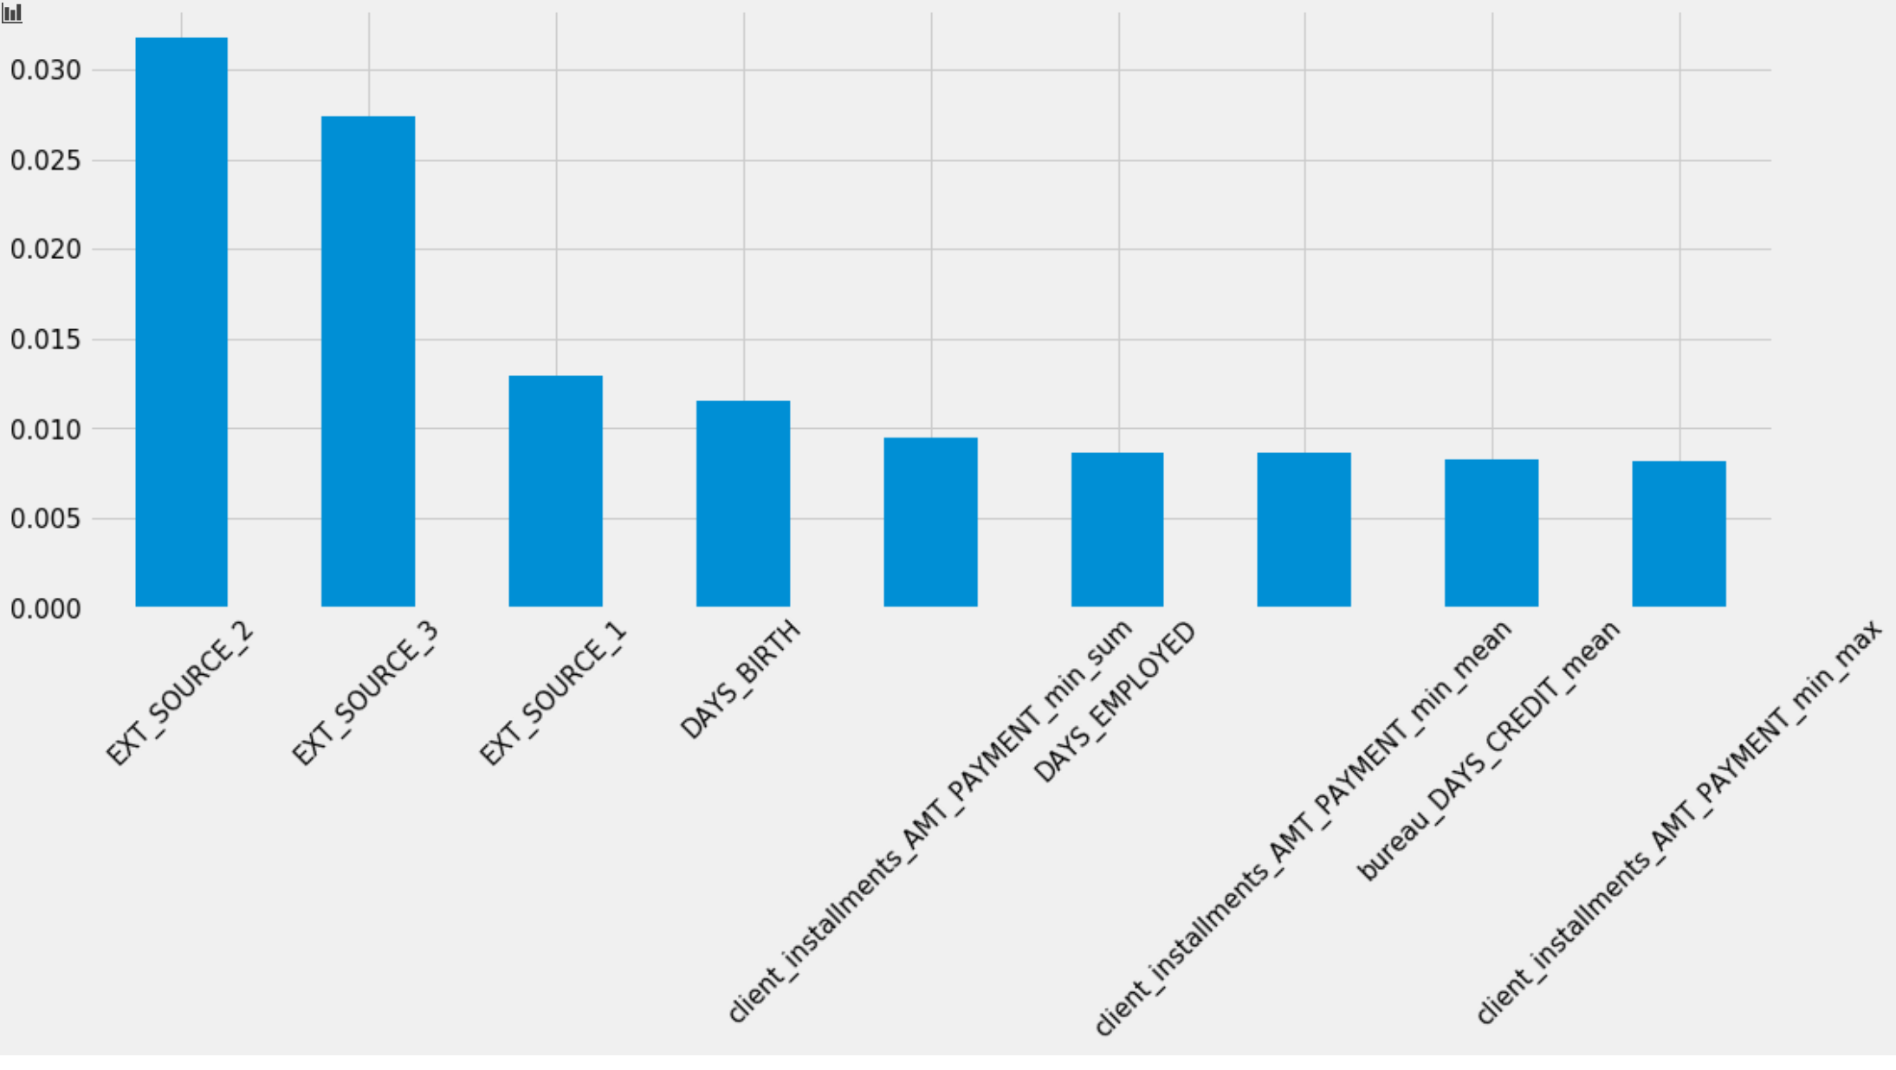
Feature importance

Slide 25
Discussion
Is the oversampling an efficient way for a large imbalanced dataset?
More knowledge about feature engineering and selection.
Balance efficiency and accuracy

Slide 26
Thanks for your listening

