Slide 1

Elo Merchant Category Recommendation
Help understand customer loyalty
Xinyu, Yao
Xiaotian, Huang
Jingya, Gao

Slide 2
Introduction
Elo
One of the largest payment brands in Brazil
Built partnerships with merchants
Offer promotions and discounts to cardholders
Do these promotions work for both consumer and merchant?
Are the promotions what customers needed?
Do merchants see repeat business?
Serve the most relevant opportunities to cardholders, by uncovering signal in customer loyalty.
Predict the target-loyalty score for each card_id

Slide 3
Description of the data set
train.csv - the training set
test.csv - the test set
historical_transactions.csv - up to 3 months historical transactions for each card_id
new_merchant_transactions.csv - two months transactions that card_id made at merchant_ids that were not visited in the historical data.
merchants.csv - additional information about all merchants / merchant_ids in the dataset.

Slide 4
Algorithms used
Cleaning algorithm: fillna, drop outliers
Data mining:
Linear Regression
Decision Tree
Random Forest
Naive Bayes
K-Nearest Neighbor
Support Vector Machine
K-Mean
AGNES
DBSCAN

Slide 5
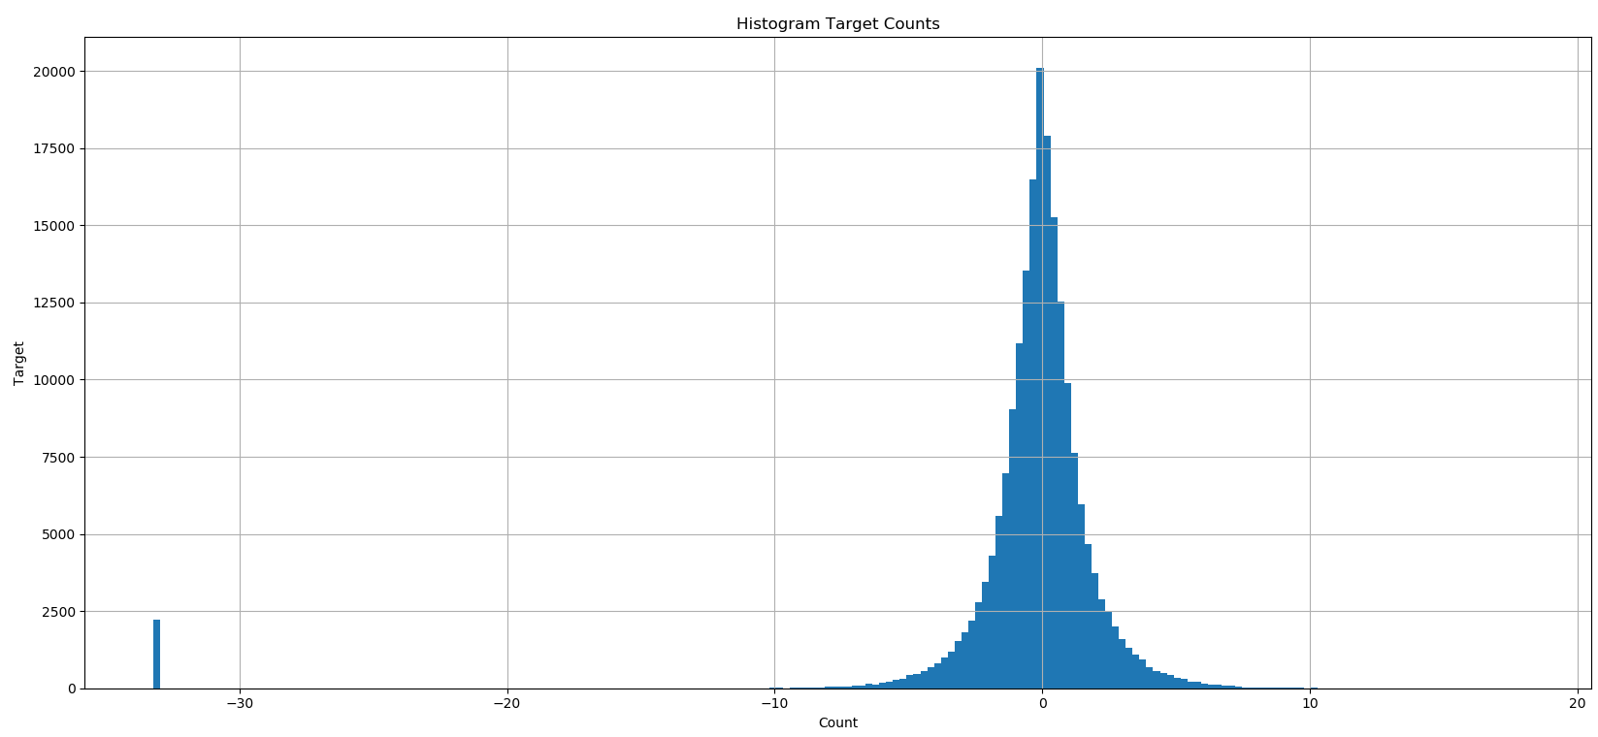
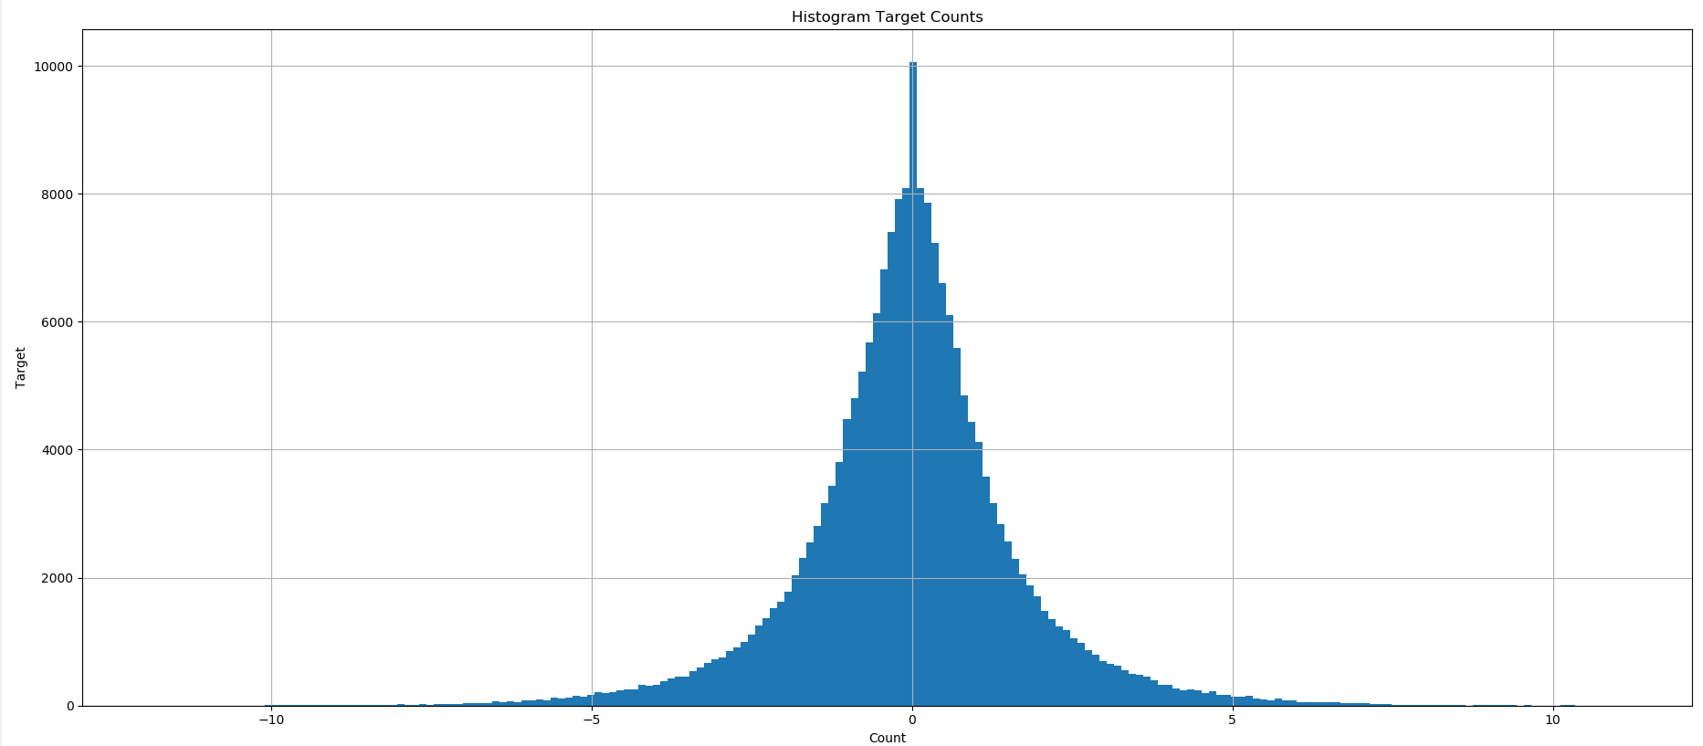
Pre-processing and Feature Engineering
Check missing values of all tables
Check unique values of columns that has na and fillna with values different from the unique values existed in those columns.
Calculated z-score of target and drop outliers whose |Z-score| > 3
Define functions that aggregate the info by grouping on card_id and month_lag
Merge all the dataframes and then to_csv

Slide 6
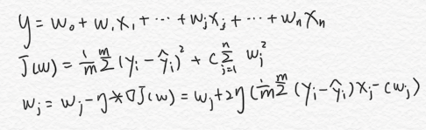
Linear Regression
Best_score (neg_mean_squared_error): -0.8982704791215965
best_params: {'estimator__eta': 0.1}
Mean_squared_error: 2.65
r2_score: 0.09

Slide 7
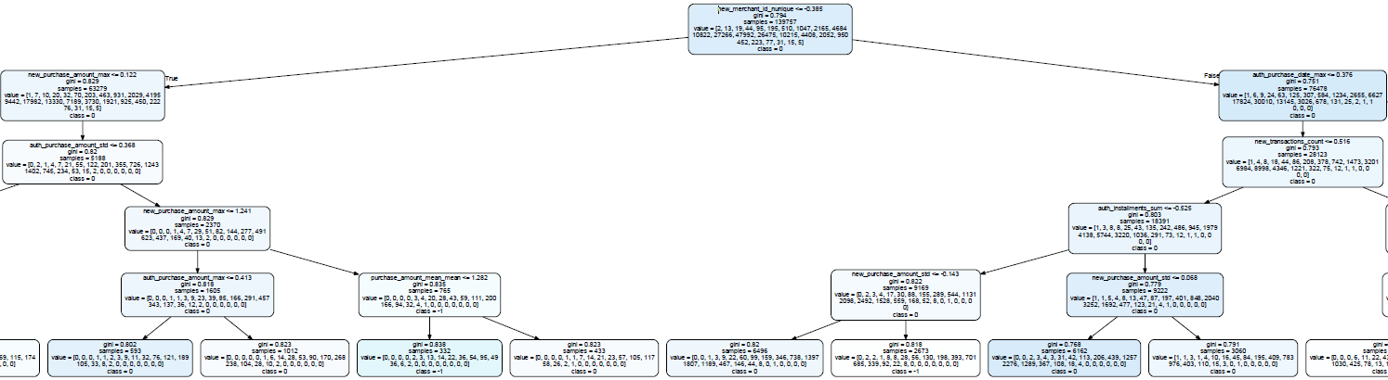
Decision Tree
'max_depth': 6, 'min_samples_leaf': 1, 'min_samples_split': 2

Slide 8
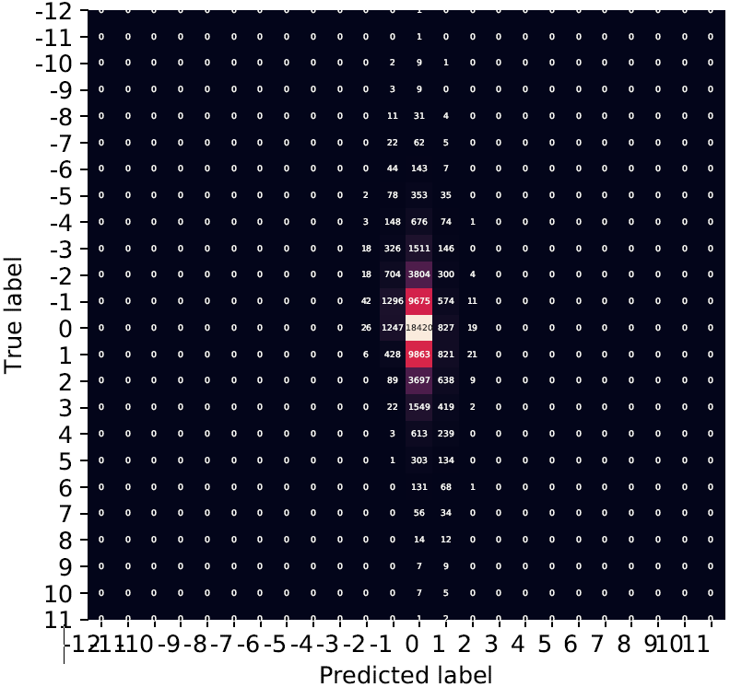
Decision Tree
Accuracy: 34.33
MSE: 2.87

Slide 9
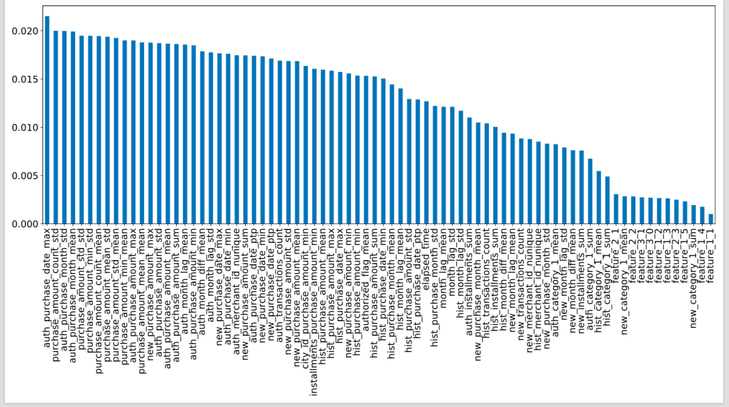
Random Forest
Features importance

Slide 10



Split data
To transform the variable from continuous variable into categorical variable, I divided integrals ranging from -12 to 12 into
· 24 groups with an interval of 1
· 6 groups with an interval of 4;
· 3 groups with an interval of 8.

Slide 11
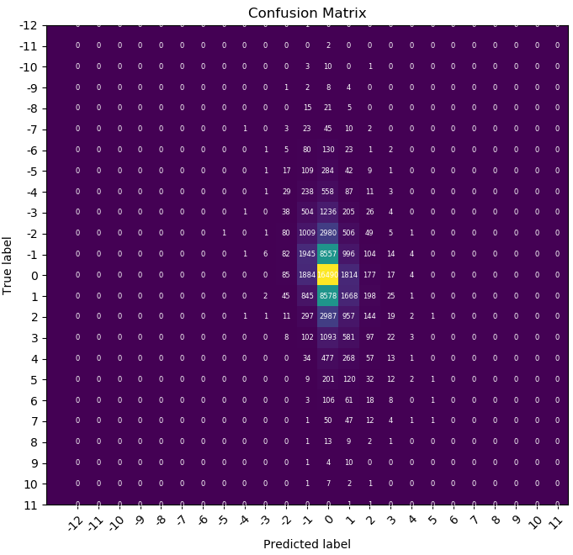
Random Forest
 | Ranging by interval 1
Accuracy: | 33.93%
Mean Squared Error : | 2.89

Slide 12
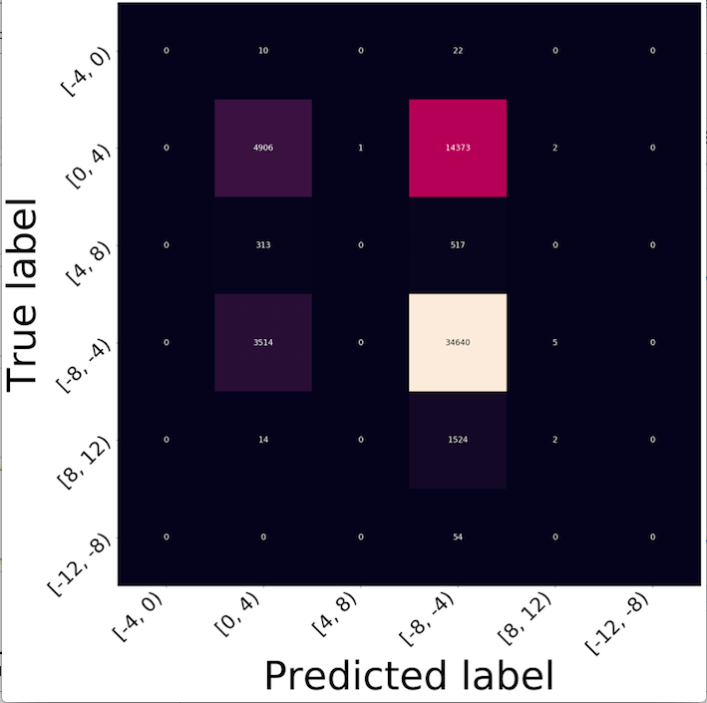
Random Forest
 | Ranging by interval 4
Accuracy: | 66.06%

Slide 13
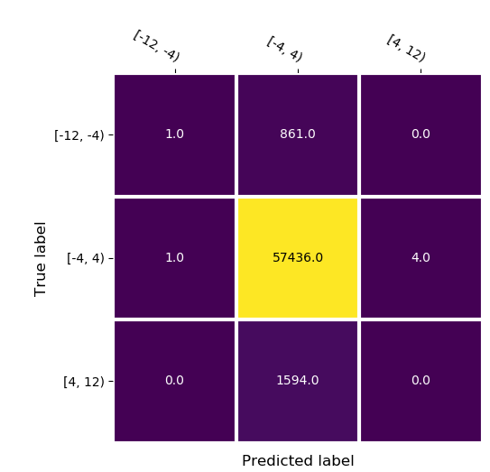
Random Forest
 | Ranging by interval 8
Accuracy: | 95.89%

Slide 14
Random Forest
 | Ranging by interval 1 | ranging by interval 4 | ranging by interval 8
Accuracy: | All features: 33.93% K features: 33.29% | All features: 66.06% K features: 65.52% | All features: 95.89% K features: 95.89%
Mean Squared Error : | All features: 2.89 K features: 2.89 | All features: 5.96 K features: 5.96 | All features: 2.63 K features: 2.63

Slide 15
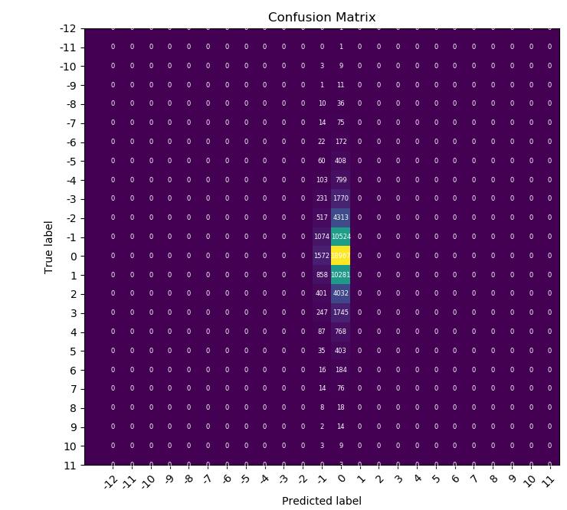
Naive Bayes
 | ranging by interval 1
Accuracy: | 33.46%
Mean Squared Error : | 3.06

Slide 16
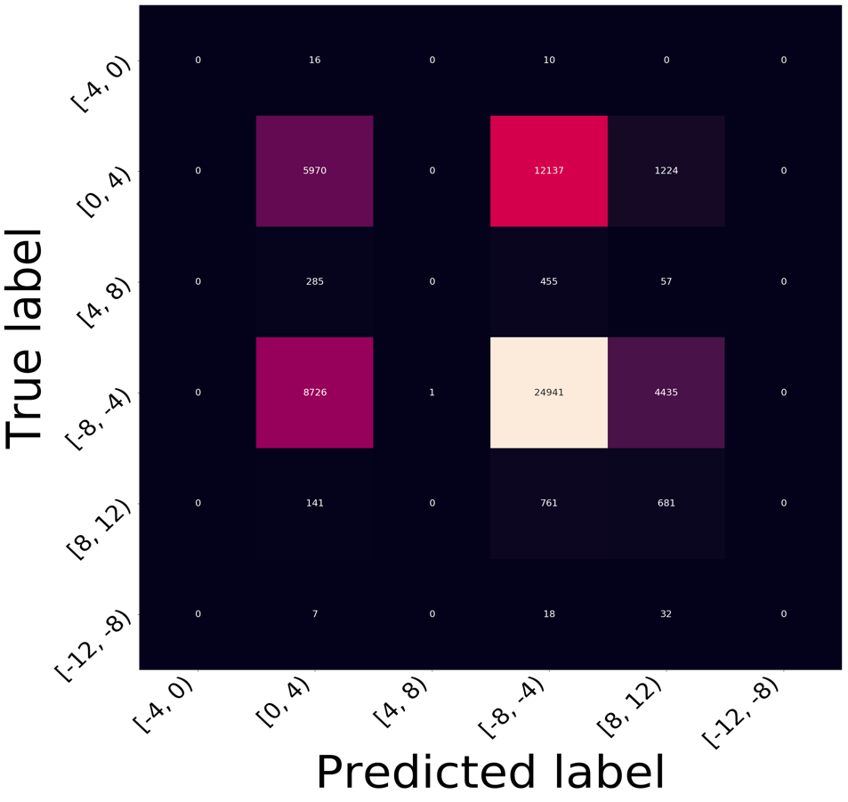
Naive Bayes
 | ranging by interval 4
Accuracy: | 52.74%

Slide 17
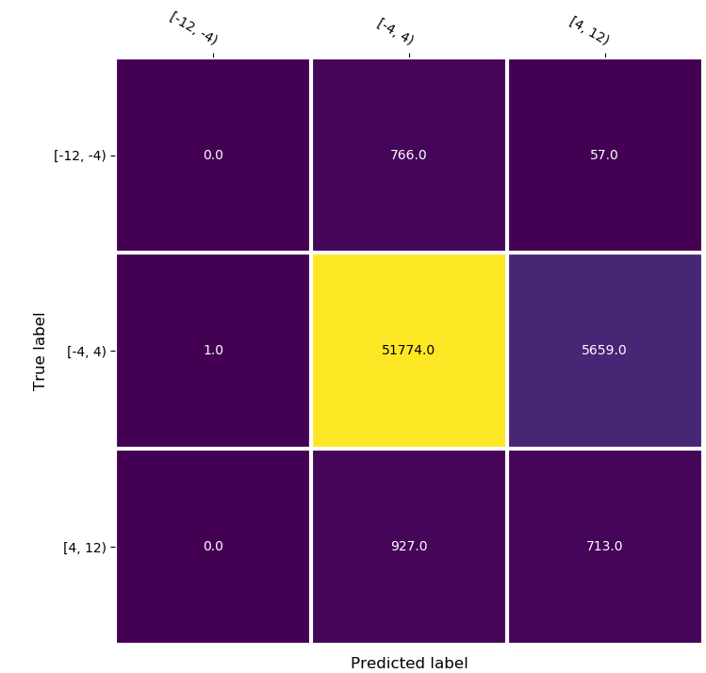
Naive Bayes
 | ranging by interval 8
Accuracy: | 87.63%

Slide 18
Naive Bayes
 | ranging by interval 1 | ranging by interval 4 | ranging by interval 8
Accuracy: | 33.46% | 52.74% | 87.63%
Mean Squared Error : | 3.06

Slide 19
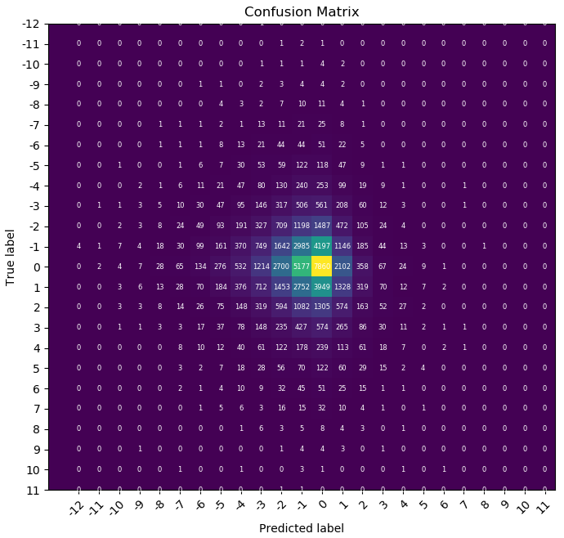
KNN
 | ranging by interval 1
Accuracy: | 22.18%
Mean Squared Error : | 5.84

Slide 20
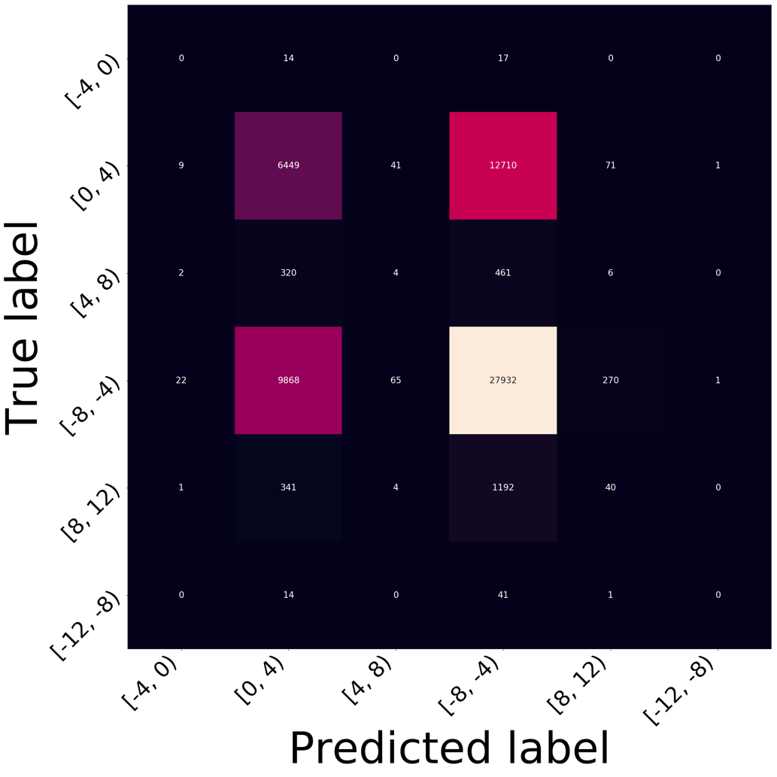
KNN
 | ranging by interval 1
Accuracy: | 56.96%

Slide 21
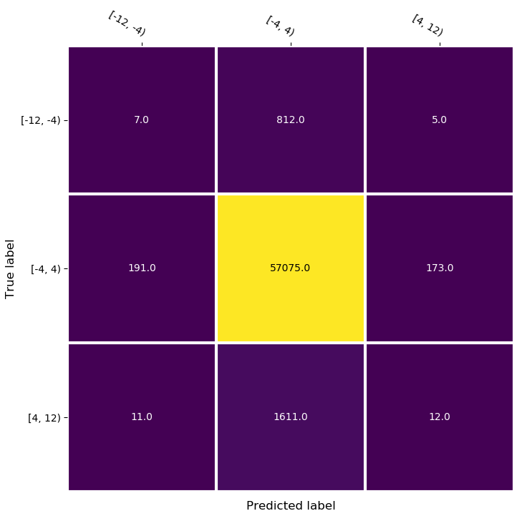
KNN
 | ranging by interval 1
Accuracy: | 95.32%

Slide 22
KNN
 | ranging by interval 1 | ranging by interval 4 | ranging by interval 8
Accuracy: | 22.18% | 56.96% | 95.32%
Mean Squared Error : | 5.84

Slide 23
Summary and conclusions
Accuracy
Decision Tree : 34.33
Random Forest : 33.85
Naive Bayes : 33.45
KNN : 22.67
Mean Squared Error (MSE):
Linear Regression : 2.65
Decision Tree : 2.87
Random Forest : 2.89
Naive Bayes : 3.06
KNN : 5.86

Slide 24
 |  | Accuracy | MSE
Decision Tree: | ranging by interval 1 | 33.43 | 2.65
Random Forest: | ranging by interval 1 | All features: 33.93% K features: 33.29% | All features: 2.89 K features: 2.89
 | ranging by interval 4 | All features: 66.06% K features: 65.52%
 | ranging by interval 8 | All features: 95.89% K features: 95.89%
KNN: | ranging by interval 1 | 22.18% | 5.84
 | ranging by interval 4 | 56.96%
 | ranging by interval 8 | 95.32%
Naive Bayes: | ranging by interval 1 | 33.46% | 3.06
 | ranging by interval 4 | 52.74%
 | ranging by interval 8 | 87.63%

Slide 25
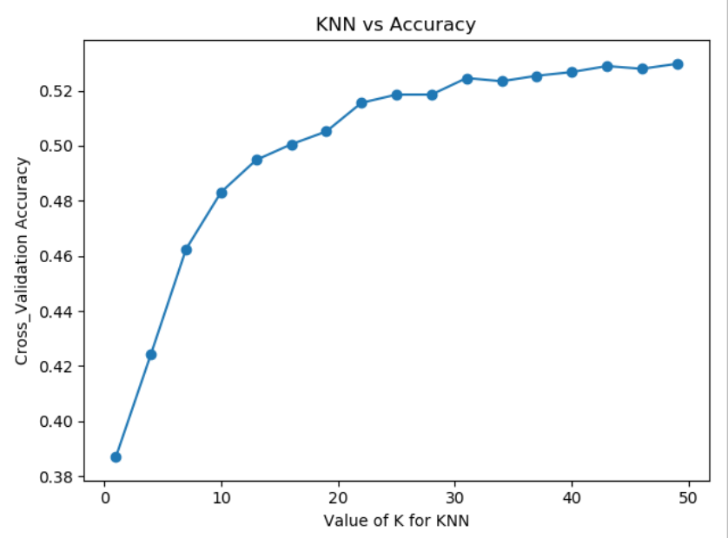
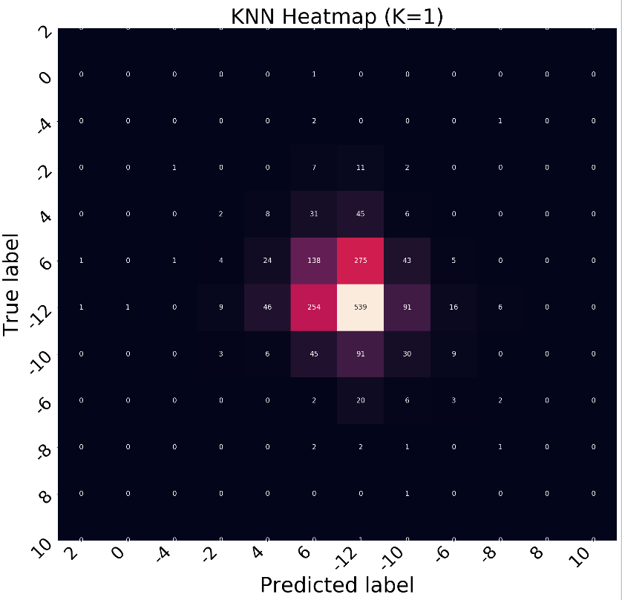
KNN

Slide 26
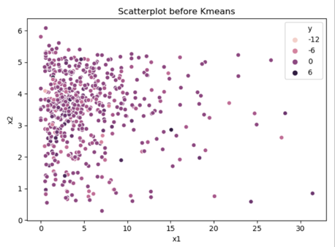
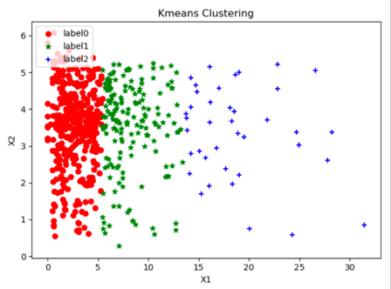
K-means
When features are selected as "purchase_amount_count_std" and "auth_purchase_month_std", scatter plots of raw data and result data after K-Means Clustering.

Slide 27
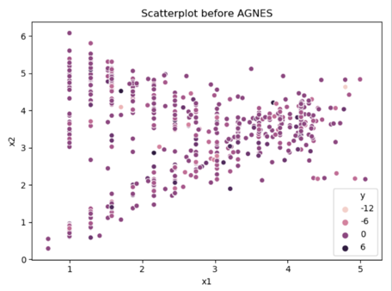
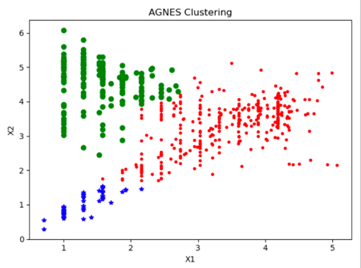
AGNES
When features are selected as "month_lag_std" and "auth_purchase_month_std", scatter plots of raw data and result data after AGNES.

Slide 28
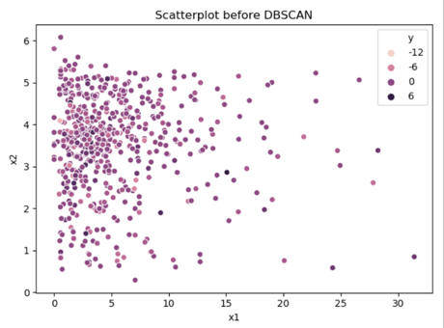
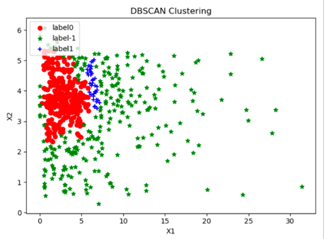
DBSCAN
When features are selected as "purchase_amount_count_std" and "auth_purchase_month_std", scatter plots of raw data and result data after DBSCAN.

Slide 29

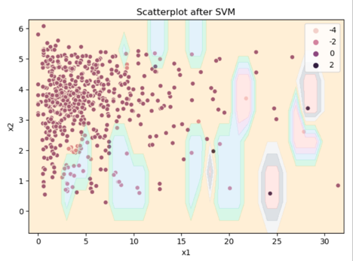
Support Vector Machine (SVM)
When features are selected as "purchase_amount_count_std" and "auth_purchase_month_std", scatter plots of raw data and result data after SVM.

Slide 30
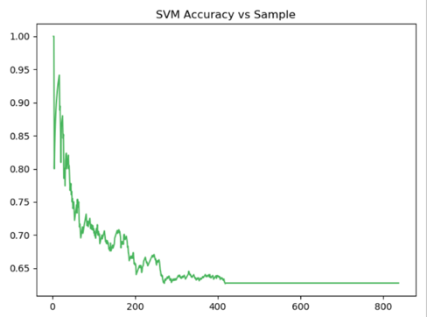
Support Vector Machine (SVM)
The chart shows the relationship between sample size and accuracy in Support Vector Machine (SVM). It can be seen from the curve that as the sample size increases, the accuracy of the SVM gradually stabilizes, and finally remains at about 62.5%.

Slide 31
References
https://towardsdatascience.com/ways-to-detect-and-remove-the-outliers-404d16608dba
Elo Merchant Category Recommendation Help understand customer loyalty. Elo. (March, 2019). Retrieved from https://www.kaggle.com/c/elo-merchant-category-recommendation

Slide 32
Thank you!
Questions?

