Slide 2
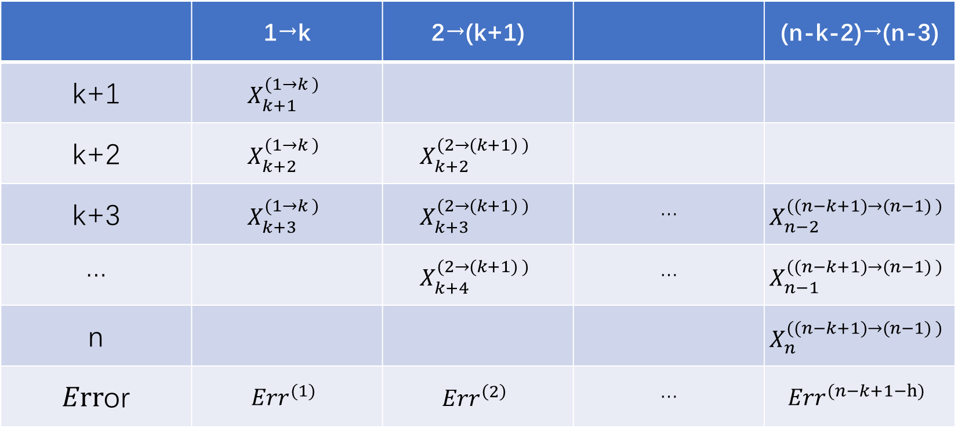
 | 1→k | 2→(k+1) |  | (n-k-2)→(n-3)
k+1 | $$X_{k+1}^{(1→k )}$$
k+2 | $$X_{k+2}^{(1→k )}$$ | $$X_{k+2}^{(2→(k+1) )}$$
k+3 | $$X_{k+3}^{(1→k )}$$ | $$X_{k+3}^{(2→(k+1) )}$$ | … | $$X_{n−2}^{((n−k+1)→(n−1) )}$$
… |  | $$X_{k+4}^{(2→(k+1) )}$$ | … | $$X_{n−1}^{((n−k+1)→(n−1) )}$$
n |  |  |  | $$X_{n}^{((n−k+1)→(n−1) )}$$
$Err$or | $${Err}^{(1)}$$ | $${Err}^{\left(2\right)}$$ | … | $${Err}^{(n−k+1−h)}$$
Train
Test

Slide 4


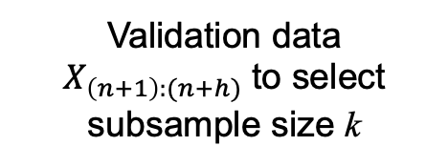
Total length of historical data = $n+h$
$X_{1}, X_{2}, … … … … … … … … … … … … … … … … … …, X_{n}, X_{n+1}, ……, X_{n+h}$
Historical data $X_{1:n}$
Validation data $X_{\left(n+1\right):(n+h)}$ to select subsample size k
$$X_{n−k+1}, X_{n−k+2}, …………………………………, X_{n}$$
Development data $X_{\left(n−k+1\right):n}$ to train a model given $k$

Slide 5
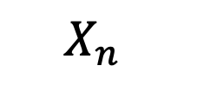
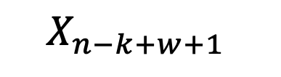
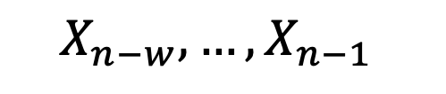
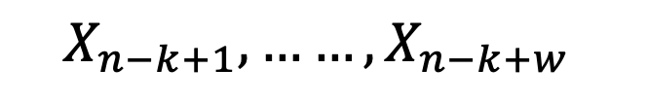

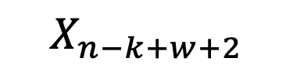
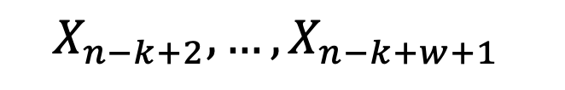
$$X_{n−k+1}, X_{n−k+2}, …………………………………, X_{n}$$
Development data $X_{\left(n−k+1\right):n}^{}$to fit AR predictive model
$$X_{n−k+1}, ……, X_{n−k+w}$$
$$X_{n−k+w+1}$$
SW 1:
Train
Test
$$X_{n−k+2},…, X_{n−k+w+1}$$
$$X_{n−k+w+2}$$
SW 2:
Train
Test
…
…
$$X_{n−w},…, X_{n−1}$$
$$X_{n}$$
S$W s=k−w:$
Train
Test

Slide 6






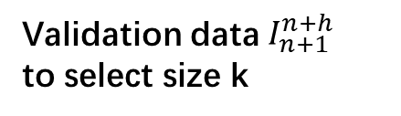



Total length of generated data = $n+h$
$X_{1}, X_{2}, ………………………………………………, X_{n}, X_{n+1}, ……, X_{n+h}$
Historical data $I_{1}^{n}$
Validation data $I_{n+1}^{n+h}$
to select size k
$$X_{n−k+1}, X_{n−k+2}, …………………………………, X_{n}$$
Development data $I_{n−k+1}^{n}$to select model AR(p) given k
$$X_{n−k+1}, ……, X_{n−k+p_{m}}$$
$$X_{n−k+p_{m}+1}$$
Row 1:
Train
Test
$$X_{n−k+2},…, X_{n−k+p_{m}+1}$$
$$X_{n−k+p_{m}+2}$$
Row 2:
Train
Test
…
…
$$X_{n}$$
$$X_{n−p_{m}},…, X_{n−1}$$
R$ow {k−p}_{m}$:
Train
Test

