Slide 1

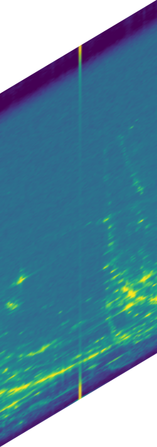
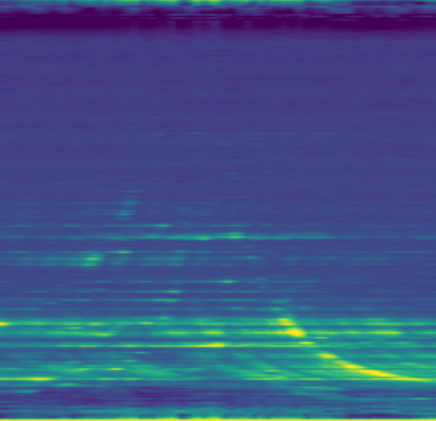

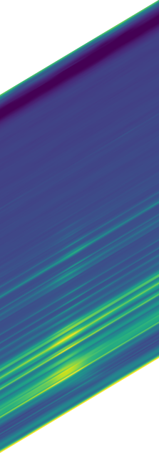
Overall RADE dual-view processing and detection
CURRENT MODEL7
Four-axis radar tensor → three-view RAD and RAE cubes → independent encoders → encoded-feature fusion → shared detector
4-D INPUT
MULTI-VIEW TENSORS
DUAL ENCODERS
FUSION + DECODING
OUTPUT
RAD tensor
AD view
mean over E
4-D RADE tensor
RD view
RAD encoder
Swin–FPN
Detection output
placeholder
RA view
CenterPoint
[R, A, D]
encoded
concat + fusion
decode
RAE tensor
independent weights
decoder
Elevation
mean over D
AE view
heatmap + box regression
Doppler
Range
shared latent
final visualization to be revised
Azimuth
RE view
RAE encoder
Swin–FPN
RA view
[R, A, E]
Real paired data: K-Radar 5/00240 · paired random selection, seed 42 · linear-power mean projections. Every visible cube surface uses the same colormap and display-normalization rule.
RAD surfaces: RA front · RD side · AD top. RAE surfaces: RA front · RE side · AE top. Four-axis glyph adapted from 4DR P2T Fig. 2; artwork is original.

