Slide 1


Sentiment Analysis --Three Chosen Automobile Companies
Ziming Ping (zp584)
Tingyu Yang (ty2069)
Xinyu Zhao (xz2671)

Slide 2
Introduction
Basic idea
NLP-TEXTBLOB
Public attitudes towards 3 famous automobile companies in the USA
Twitter API

Slide 3
Introduction &
Necessary Steps
Clean up the raw data
NLP model to calculate the polarity and subjectivity of each meaningful word (TextBlob)
define a kind of metric to calculate the sentiment scores
every Positive tweet +2 points; every Neutral tweet +0.5 point; every Negative tweet -2 points
create a word cloud

Slide 4
Task Performance Process
Selection of the top 3 automobile companies
Mazda USA
Buick
Ford

Slide 5
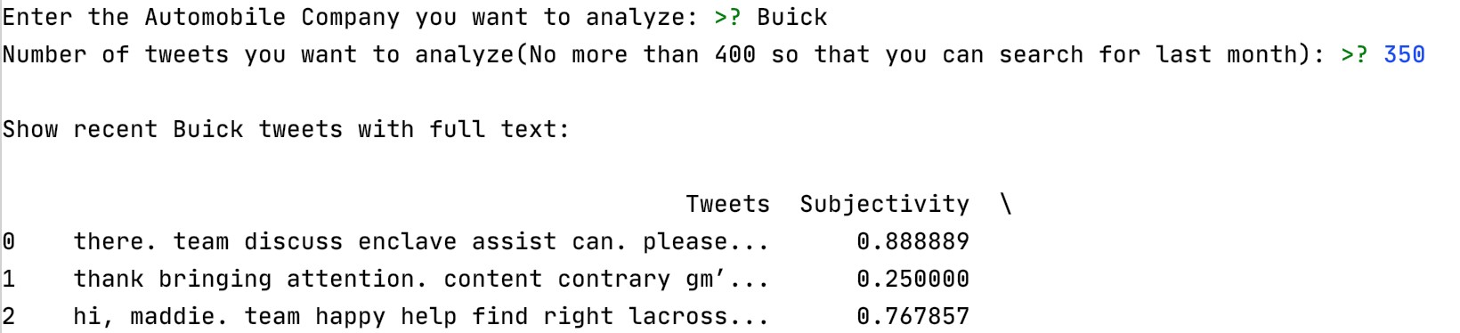
Task Performance Process

Slide 6
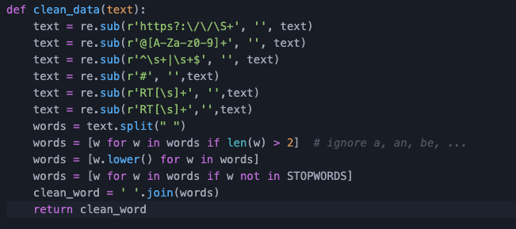
Task Performance Process

Slide 7
Task Performance Process
importing TextBlob package
add the corresponding subjectivity and polarity into the previous DataFrame and display the Scatter diagram.
set the scoring rule that Positive—gain 2 points, Neutral-gain 0.5 point and Negative lose 2 points in order to calculate the total scores of the specific company

Slide 8
Task Performance Process
generate the relevant graph regarding to the score results
generate the graph of scores of this company

Slide 9
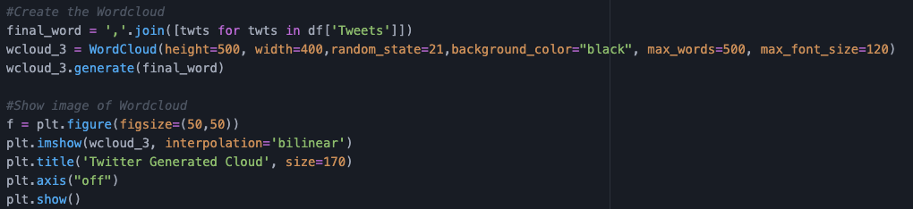
Task Performance Process-WORD CLOUD

Slide 10
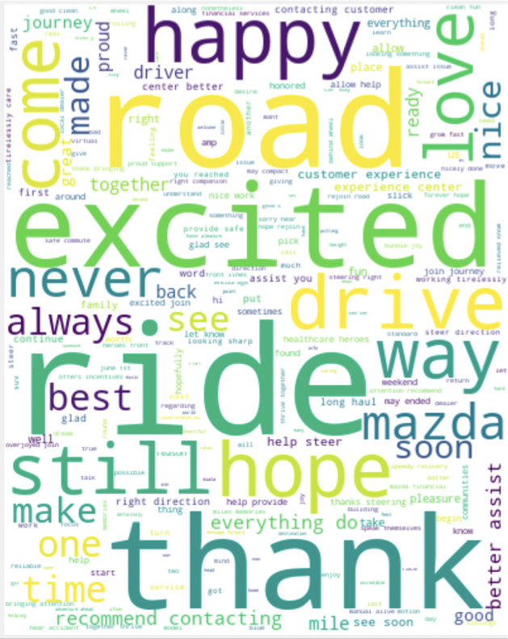
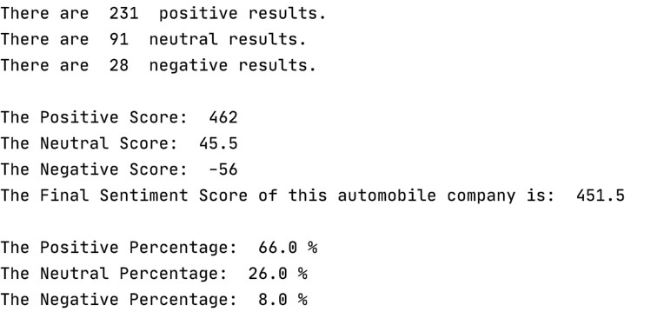
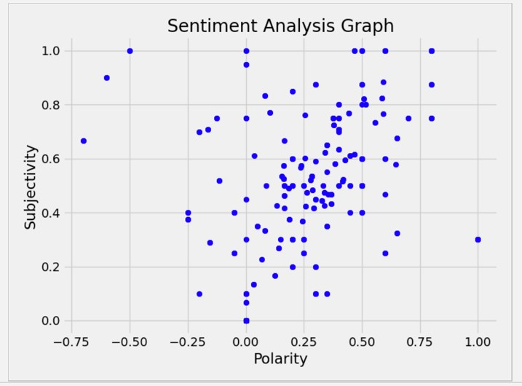
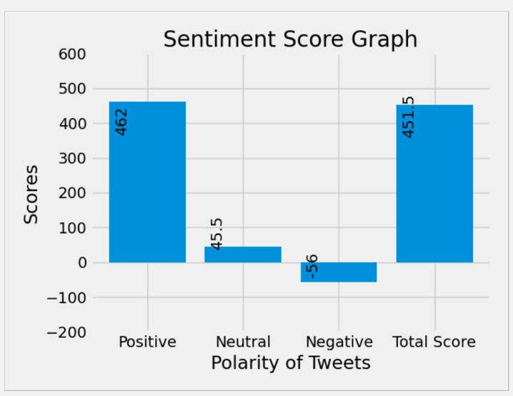
Scores, Graphs Word Cloud
Mazda USA—451.5 points

Slide 11
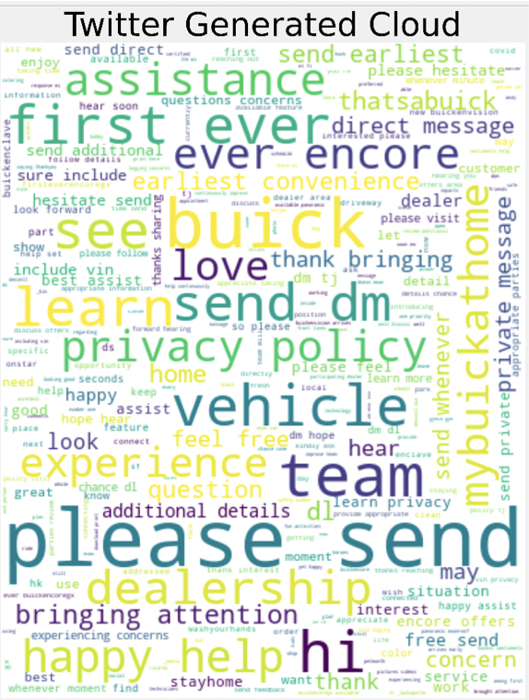
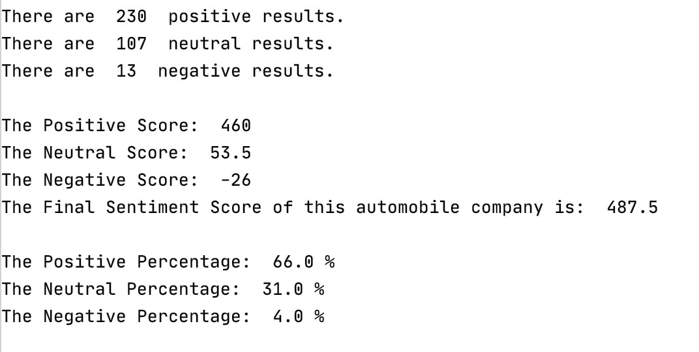
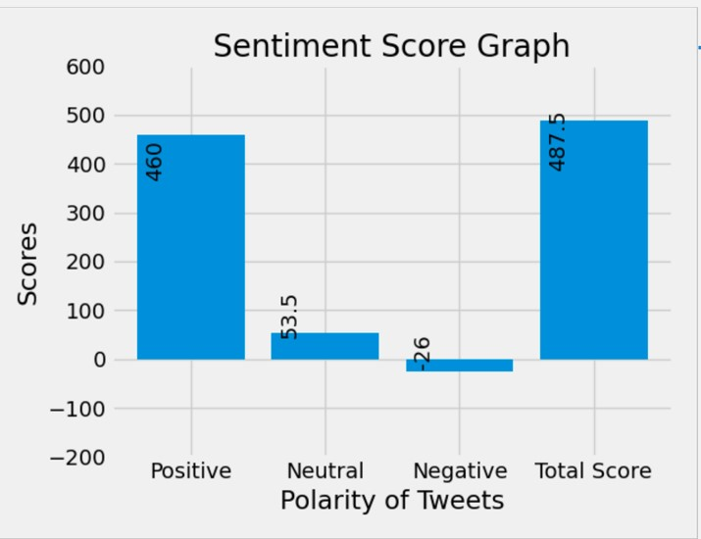
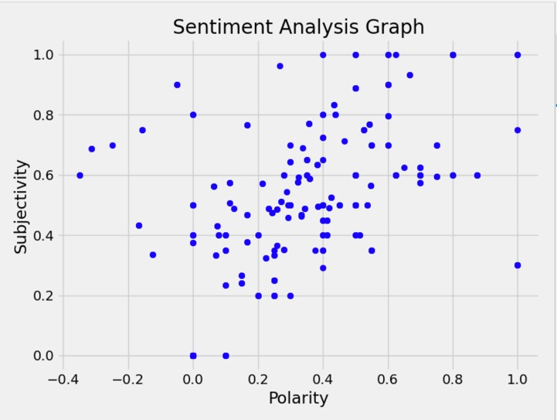
Scores, Graphs Word Cloud
Buick—487.5 points

Slide 12
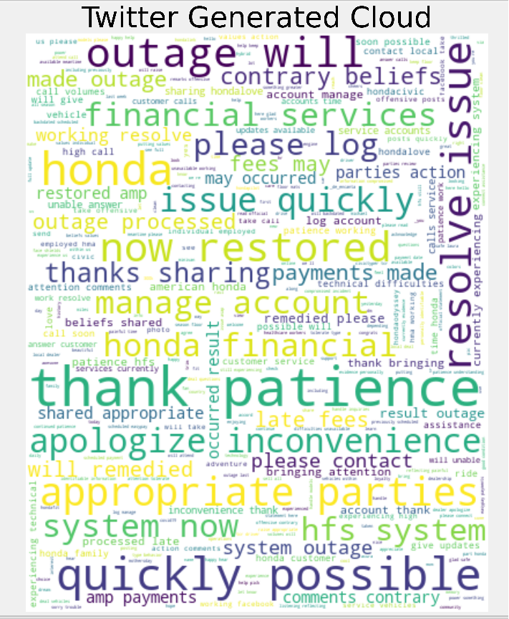
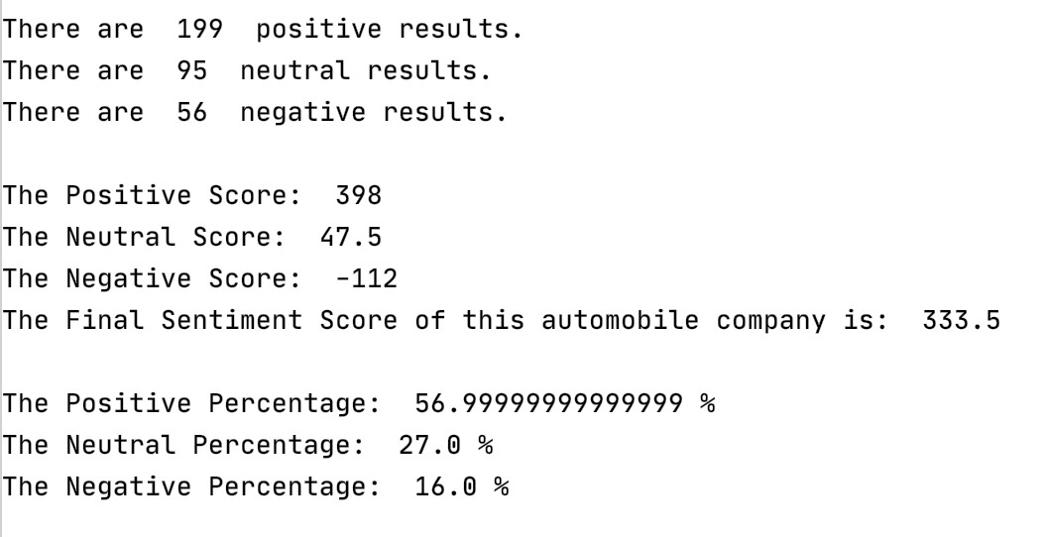
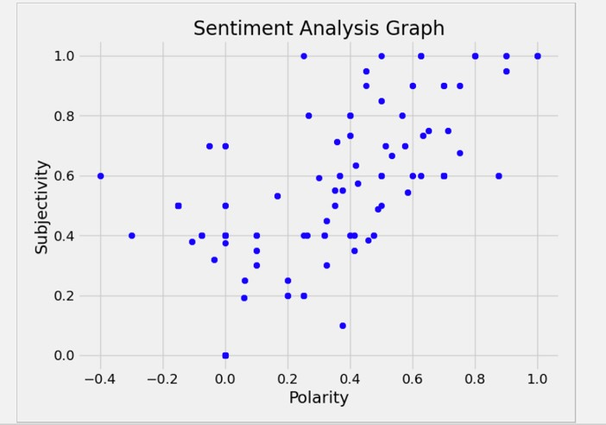
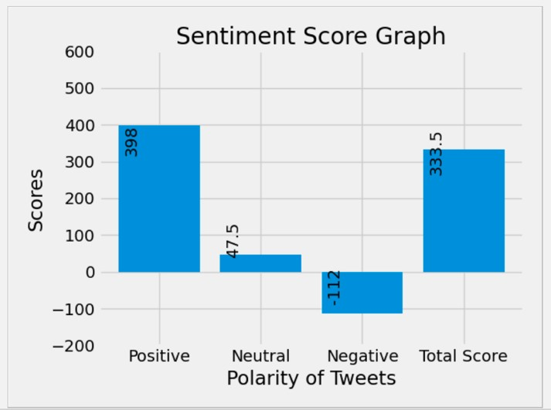
Scores, Graphs Word Cloud
Ford—333.5 points

Slide 13
Analysis & Conclusion
Sensitivity refers to the ability to designate each tweet in the samples with as positive.
A higher sensitive result means that this tweet tends to become more positive compared to other samples showing a lower sensitive number.

Slide 14
Analysis & Conclusion
Our scoring rules basically depends on the results of polarity
If the company comes out more positive results and less negative results and it can gain more scores.

Slide 15
Company’s Strategy Analysis:
Buick and Mazda show a much better sentiment figure than Ford, at least on Twitter
successfully build up their reputation by offering good services
Ford usually brings more issues or bad experience to its customers
improve their customer service and build a much better population to the public.

Slide 16
Reference
Twitter API Documentation. (2010). Docs | Twitter Developer. https://developer.twitter.com/en/docs/twitter-api
Jain, S. (2020, December 8). Natural Language Processing for Beginners: Using TextBlob. Analytics Vidhya. https://www.analyticsvidhya.com/blog/2018/02/natural-language-processing-for-beginners-using-textblob/
Hsu, S. (2018, September 11). Introduction to Data Science: Custom Twitter Word Clouds. Medium. https://medium.com/@shsu14/introduction-to-data-science-custom-twitter-word-clouds-704ec5538f46

Slide 17
Thank You
Ziming Ping (zp584)
Tingyu Yang (ty2069)
Xinyu Zhao (xz2671)

