Slide 1
Ozone Layer/Ozone Pollution Analyze
597 Final Project
Team member: Xinze Fan, Dezhou Chen

Slide 2
Introduction & Background
What is ozone layer:
Ozone layer is a thin layer of gas at the stratosphere which protect us from the uv light radiation. The ozone layer hole will increase the rate of skin cancer morbidity.
The main cause of ozone depletion:
human activity
solar cycle
climate changing
volcanoes activity
Ozone pollution:
The ozone is only a protection when they are in the stratosphere. When it's getting close to the surface of the ground, it is a type of toxic pollution instead.

Slide 3
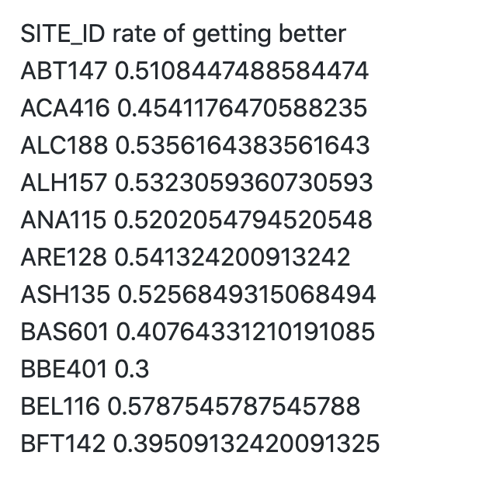
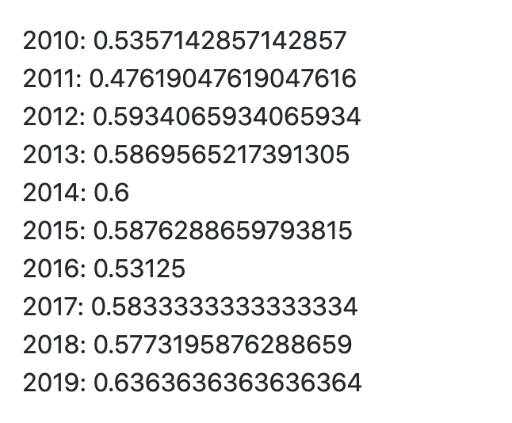
Hypothesis 1: water will reduce the ozone pollution in the air
Precipitation:
Like how CO2(carbon dioxide) participates in the cycle of atmospheric circulation, ozone pollution has chemical reaction with water either. So we will analyze how the ozone pollution change with the rainfall.

Slide 4
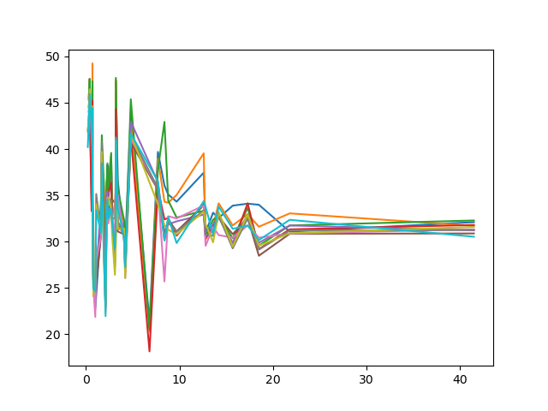
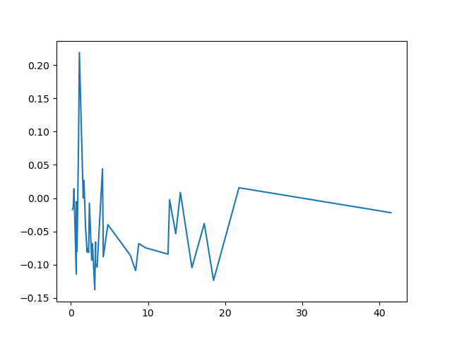
Water coverage:
If there are lots of water acting as a buffer solution, will these ozone pollution have more time to participate the circulation instead of causing acid rains or other damage.
Average Ozone pollution match with each states’ water coverage rate
Average ozone pollution growth rate with the states’ water coverage

Slide 5
Hypothesis 2: volcanoes eruption will increase the ozone pollution
Some data is not available :
eg: Hawaii (2018)
nearest sites
Pollution travel :
Wind blow
Distance between sites are large
no expecting significant change on all sites

Slide 6
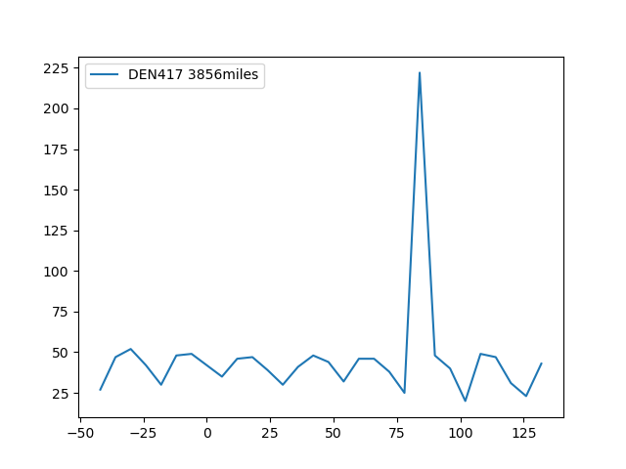
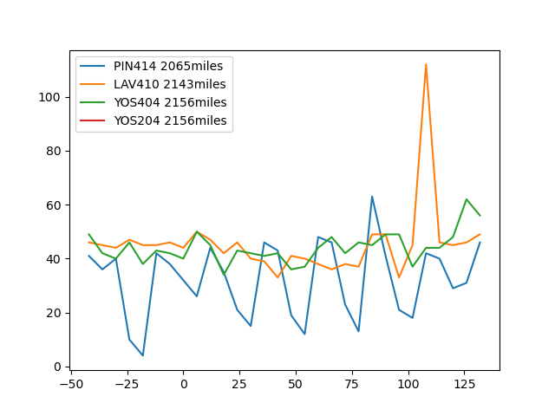
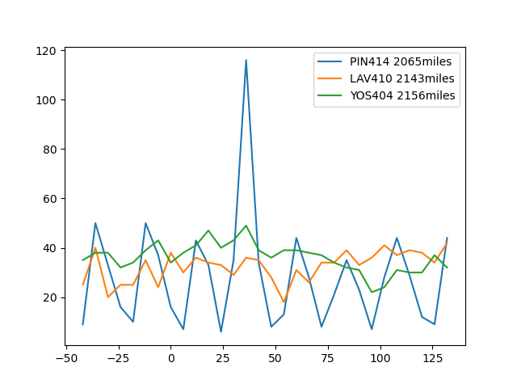
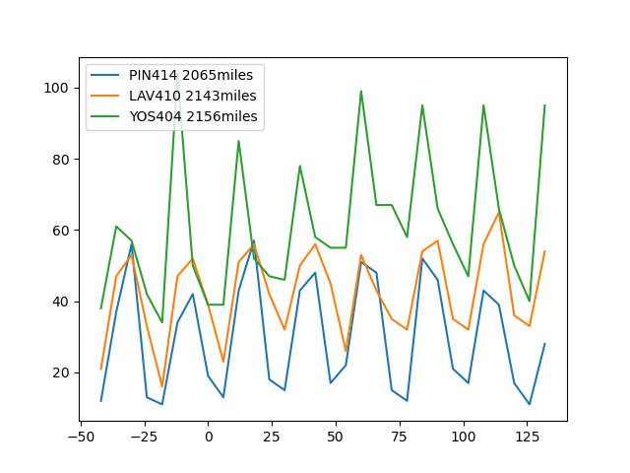

Slide 7
Hypothesis 3 - Main Purpose & Inspiration
How total ozone mean in recently five years in total on average (from 2015-2019) compare among all states in 12 months
Are these any observations while comparing between months and ozone mean within five years respectively? If so, what are these?

Slide 8
Hypothesis 3
We may expect a seasonal trend over all states regarding to ozone mean in total from Year 2015 - Year 2019

Slide 9
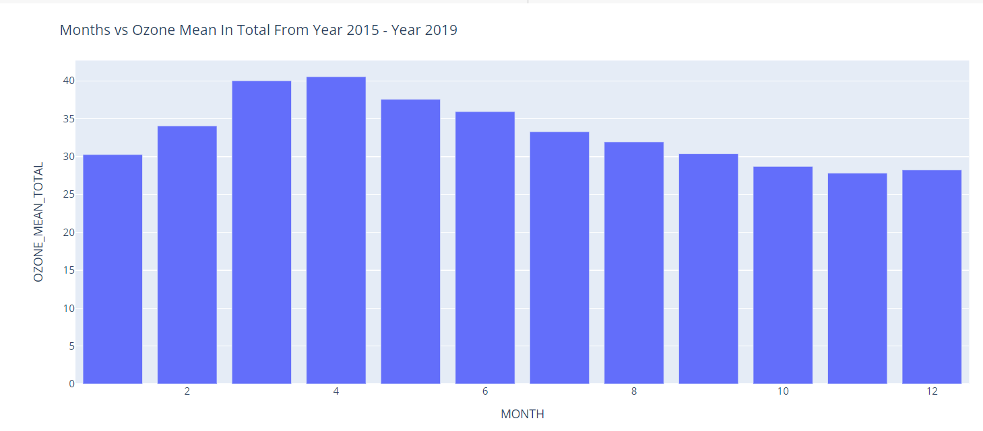
Hypothesis 3

Slide 10
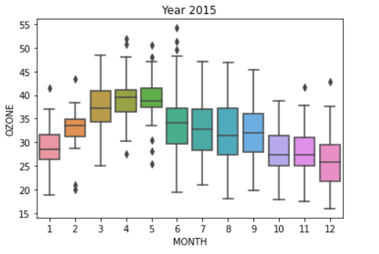
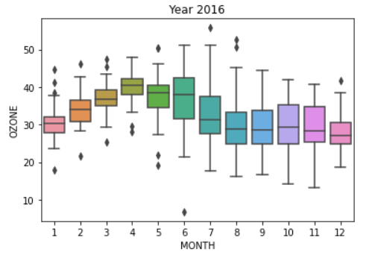
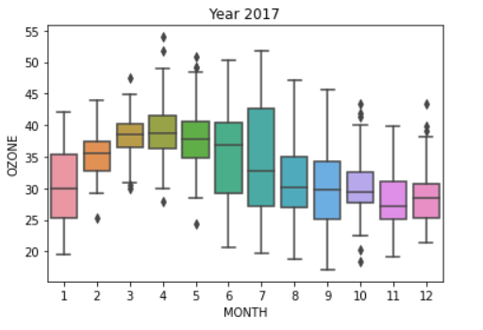
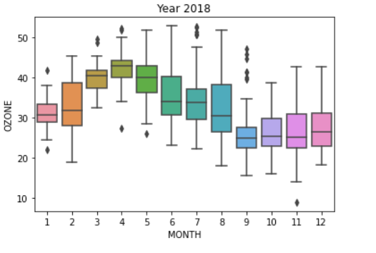
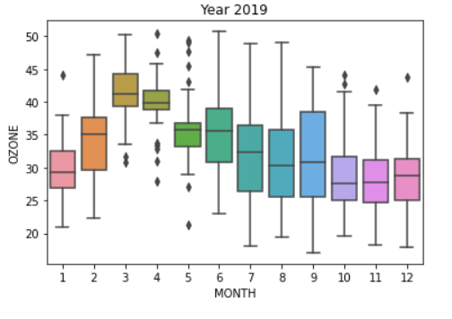
Hypothesis 3

Slide 11
Hypothesis 3 - Conclusion
From the plot above, the statistical result shows that there exists a trend such that ascending from January to April and descending from April to December regarding to Ozone mean in total. This match each boxplot trend for month and ozone mean from 2015 - 2019 respectively.

Slide 12
Hypothesis 4 - Main Purpose & Inspiration
How ozone mean in total compare to four different regions which are Midwest, Northeast, South and West from Year 2015 - Year 2019 in total on average
How ozone mean compare to four different regions within five years respectively
Any extreme observations regarding to certain states in each year

Slide 13
Hypothesis 4
We expect a trend over regions for overall five years from 2015 - 2019
We expect certain pattern over regions while comparing each year respectively

Slide 14
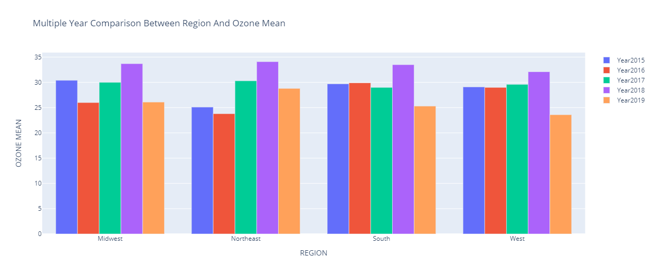
Hypothesis 4

Slide 15
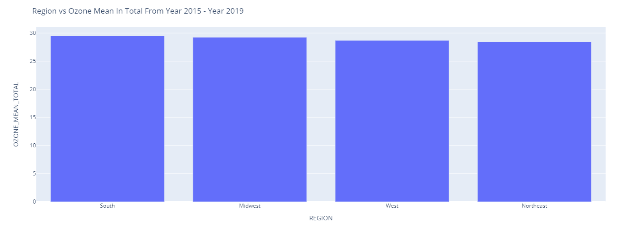
Hypothesis 4

Slide 16
Hypothesis 4 - Conclusion
In the perspective of comparing ozone mean of four regions each year respectively, the statistical result tells us that there exists a pattern such that ozone mean of 2018 is higher than that of other years in each of region. In the perspective of comparing ozone mean in total of regions, the statistical result tells that there exists a trend in descending order regarding ozone mean in total in five years: South > Midwest > West > Northeast

