Slide 1
DSO560
Final Project
Universal Studio
Team member: Li Huang, Xiangyu Huang, Mingqian Sun, Xinzhu Zhang, Yuan Xin

Slide 2
Agenda
Problem Statement
Context
Business Problems
Dataset description
Methodology
Preprocessing
Sentimental Analysis: Logistics Regression & RNN
Trend Analysis: Topic Modeling & TF-IDF
Implementation & ROI Analysis

Slide 3
Problem Statement

Slide 4
Context
For years, Universal Studios Theme parks have welcomed countless visitors and accumulated vast amount of reviews. While it is a time-consuming and inefficient to manually going through and classify reviews submitted, we need to automate some of the process so that we could consume much more information, locate customer complaints, improve our service and enhance customer satisfaction in a much faster pace.
We’ve collected 5w+ customers reviews from Trip Advisor website ranging from 2010 to 2021. By analyzing the text, build models and algorithms, our main goal is to improve customer satisfaction. Along the way we need to answer two main questions:
How should we determine which reviews are negative/positive?
What are reasons customers dislike/like Universal studios?

Slide 5
Business problems
We try to help Universal Studios solve the following problems based on the dataset:
How should we determine which reviews are negative/positive?
Sentiment Analysis: Logistic Regression & RNN
Build classification models to help Universal Studios analyze sentiments (positive/negative) of the reviews from other sources when there are no ratings assigned
What are reasons customers dislike/like Universal studios?
Trend Analysis: Topic Modeling & TF-IDF
Help Universal Studios identify and improve weaknesses, maintain competence & determine marketing strategies/selling points

Slide 6
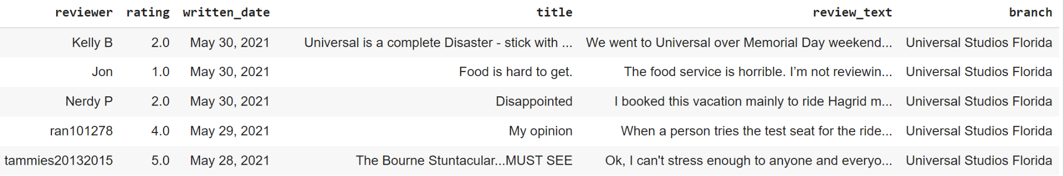
Dataset Description
The dataset includes 50,000+ reviews of 3 Universal Studios branches (Florida, Singapore, Japan), posted by visitors on the Trip Advisor website ranging from Feb 2010 to May 2021.
Column Description:
reviewer: account name of the reviewer
rating: rating from the reviewer, from 1 (unsatisfied) to 5 (satisfied)
written_date: date of the review
title: the title of the review
review_text: review made by the visitor
branch: location of Universal Studios

Slide 7
Methodology

Slide 8
Data Preprocessing
Steps | Actions | Reasons
1 | Rough cleaning | To make texts lower case, remove unuseful punctuations, extract numbers out and group together for potential future use, remove extra whitespace
2 | Remove emojis | Emojis do not provide additional information in our dataset based on observation
3 | Find top 100 frequent words and create customized stopwords | Find most frequent words and manually check for unuseful words, combining with SpaCy default stopwords to make ad hoc stopwords for our dataset

Slide 9
Data Preprocessing - Cont
Steps | Actions | Reasons
4 | Word tokenize, lemmatize and remove stopwords using spaCy | Remove stopwords, lemmatize and word tokenize
5 | Find top 15 collocations and treat each collocation as one token | Collocations such as ‘Harry Potter’/’Fast Pass’ are set phrases and better be treated as one token
6 | Final cleaning | Final clean on unuseful punctuations, etc.
7 | Word embedding by Word2Vec | To create word embedding

Slide 10
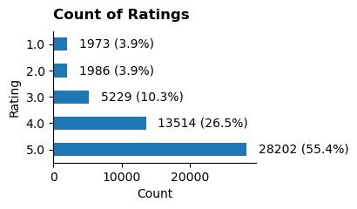
Sensitive Analysis
Assumptions:
Rating less than or equal to 3 are Negative reviews
Rating greater than 3 are Positive reviews
Original Datasets:
81.9% positive vs 19.1% negative
Use Case: predict sentiment for reviews with no ratings

Slide 11
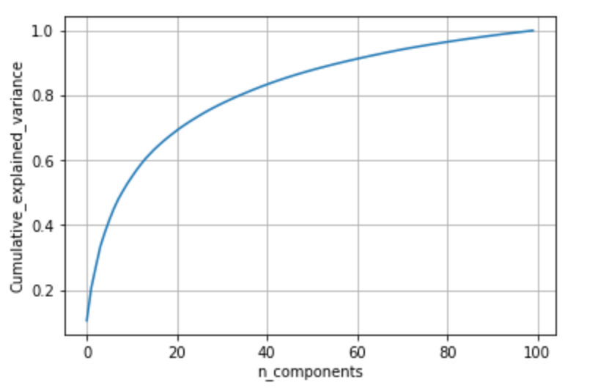
Model - Logistic Regression
The goal is to build Logistic Regression classification model for future use - output sentiments (positive/negative) of the reviews from other sources when there are no ratings assigned.
Reduce dimensions from 300 to 40 using PCA
Determine # of dimensions by computing cumulative explained variance (over 80% explained variance covered)
Build Logistic Regression
Use cross validation to evaluate model
Model performance - mean accuracy: 0.863; mean Rocauc: 0.861
Greater than pure guess of positive reviews (81.9%)
Decent model that can be used for future in business
Determine dimensions

Slide 12
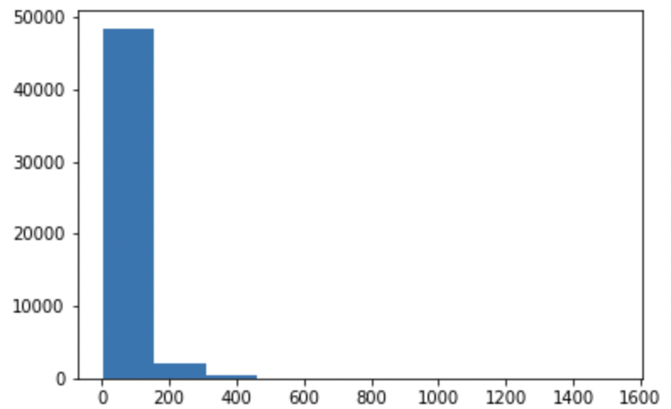
Model - RNN
Build Simple Recurrent Neural Network Model to predict sentiment of the texts by outputting a binary classification result
Model Building
Pad Length = 250
Number of tokens = 7000
Embedding Size = 100
Apply Glove.6b.100d txt as pretrained embedding
Model Performance
About 83% accuracy rate
Greater than pure guess of positive reviews (81.9%)
Decent model that can be used for future in business
Histogram for determining pad length
Y-axis: # docs
x-axis: # of tokens for each document

Slide 13
Trend Analysis - Topic Modeling
Topic modeling helps identify major topics discussed in customer reviews. The topics extracted can be used as a roadmap for the marketing department to determine the focus of their marketing campaigns/ advertisements.
Model building:
TF-IDF (ngram=(2,2))+NMF Model(n_componnts=5)
Bert (model=all-minilm-l6-v2, umap,HDBSCAN)
Top Topics Identified:
Harry Potter
Express Pass
Jurassic Park
Roller Coaster

Slide 14
Trend Analysis - TF-IDF
The TF-IDF model aims to identify top reasons for customer dissatisfaction/ satisfaction, which helps universal studio to locate problems and make improvements to increase customer loyalty. In addition, highlights in positive reviews can also help determine marketing strategies.
Steps:
Divide reviews into negative (rating≤3) and positive (rating=5) groups Note: For future dataset that does not include ratings, we could use the result from Sentiment Analysis to group reviews
For each group, random sample 1000 records Note: if the dataset is large and memory is not large enough, we recommend random sampling instead of using the entire dataset
Find the most 50 frequent bags of words (BOW) using TF-IDF method
Repeat step 2 and 3 several times, and manually select BOWs that appear to be issues/highlights E.g. “ticket overprice compare attraction”, “long waiting time ride”, “staff negative rude sarcastic”, “good food great atmosphere”, “hogwarts express island adventure”, “halloween horror night october”
Identify reviews that contain those BOWs to infer the percentage of customer covered
Notes:
In this specific analysis, we only consider 5 as positive reviews since there are nearly 3w 5-rating reviews. We consider 4 as neutral, in order to get more targeted result.

Slide 15
Trend Analysis - TF-IDF Results
Negative Reviews |  |  |  | Positive Reviews
 | # Reviews | % Reviews Among Negative Reviews | % Reviews Among All Reviews |  | # Reviews | % Reviews Among Positive Reviews | % Reviews Among All Reviews
Issue A: Long Wait Time | 733 | 7.978% | 1.440% | Highlight A: Popular attractions | 584 | 2.071% | 1.147%
Issue B: Overprice | 47 | 0.512% | 0.092% | Highlight B: Food and Hotel | 384 | 1.362% | 0.574%
Issue C: Rude Staff | 9 | 0.098% | 0.018% | Highlight C: Horror Night | 195 | 0.684% | 0.379%
Notes:
In this specific analysis, we only consider 5 as positive reviews since there are nearly 3w 5-rating reviews. We consider 4 as neutral, in order to get more targeted result.

Slide 16
Implementation & ROI Analysis

Slide 17
Implementation Roadmap
{
Long Wait Time
Recommendation:
1. Fix and improve issues identified from topic modeling and sentiment analysis;
2. Create additional questions in customer reviews/surveys relative to issues/weaknesses identified from algorithm models to continuously track the performance after modification
Business Roadmap
Identify Top Negative issues
Overprice
Topic Modeling
TF-IDF Scores
Identify Negative & Positive Reviews
Rude Staff
Problem Solving & Optimization
Sentiment Classification
{
Horror Night
Recommendation:
Continuously maintain competence/strengths and determine key selling points for marketing campaigns through trend analysis to attract new customers & increase customer retention rate
TF-IDF Scores
Identify Top Positive highlights
Popular Attractions
Note: % related reviews among all reviews (i.e. the percentage of customers related to a specific issue/highlight) could be used as a metric, and its change between certain period could be used as an indicator of whether certain practice is effective.
Food and Hotel

Slide 18
ROI Analysis
ROI=Net Profit/Investment
Net Profit = Annual Rev * (1 + )
Investment = Annual Cost + Solution (i.e. building models) + Maintenance - Operational savings
Assumptions:
The customer review base is representative of the actual Universal customer base
Solving long wait time, overprice and rude staff will boost revenue from those customers by respectively 30%, 20%, 10%
We use the average annual revenues and cost from 2018-2020 as the base to calculate ROI
Model hyperparameter tuning and multiple running on dataset of all kinds of sources required $1.6 million, and the model will be updated on a weekly basis
The maintenance and management of the system will incur about $5000 cost per month
6 hours of labor can be saved per week by using the model, therefore about 6hr/40 hr= 15% cost can be saved
% Customer affected by long wait time * (1 + % revenue boost by solving) +
% Customer affected by overprice * (1 + % revenue boost by solving) +
% Customer affected by rude staff * (1 + % revenue boost by solving)
Notes:
Data Solution + Modeling Fees: AWS cloud management analysis: 10000 or 5000 Per month, 120000 or 60000 Per year
Reference:
https://searchengineland.com/google-seo-news-google-algorithm-updates
https://www.comparably.com/companies/universal-studios/salaries/computer-programmer
https://towardsdatascience.com/speed-up-nlp-for-data-science-79eb819326f7
https://arxiv.org/pdf/2004.08900.pdf
https://www.smartsheet.com/content-center/product-news/automation/workers-waste-quarter-work-week-manual-repetitive-tasks
https://www.cmcsa.com/static-files/0ff6a41f-c1ff-4c25-b07e-4ec8424907cf

Slide 19
ROI Analysis - Cont
Net Profit
$4,487 Million = Average Revenue = (5683 + 5933 + 1846) / 3
$84 Million = Average Revenue * 1.44% of the customers affected by long wait time * (1 + 30%)
$4.95 Million = Average Revenue * 0.092% of the customers affected by overprice *(1 + 20%)
$0.59 Million = Average Revenue * 0.018% of the customers affected by rude staff * (1 + 10%)
Investment
$3,031 Million = Average Cost = (3228 + 3478 + 3228) / 3
$78 Million = Solution = $1.5 Million * 365 / 7
$1.44 Million =Maintenance = $ 0.12 Million * 12
$ 454.65 Million = Operational = 15% * Average Cost
ROI = (4,487 + 84 + 4.95 + 0.59) / (3,031 + 78 + 1.44 - 454.65) = 1.72
Notes:
Data Solution + Modeling Fees: AWS cloud management analysis: 10000 or 5000 Per month, 120000 or 60000 Per year.
Reference:
https://searchengineland.com/google-seo-news-google-algorithm-updates
https://www.comparably.com/companies/universal-studios/salaries/computer-programmer
https://towardsdatascience.com/speed-up-nlp-for-data-science-79eb819326f7
https://arxiv.org/pdf/2004.08900.pdf
https://www.smartsheet.com/content-center/product-news/automation/workers-waste-quarter-work-week-manual-repetitive-tasks
https://www.cmcsa.com/static-files/0ff6a41f-c1ff-4c25-b07e-4ec8424907cf

Slide 20
Next Steps
How to reduce the workload when processing much larger dataset in real business?
Cache intermediate/previous result
Use generator comprehension to replace for loop
Group data into different categories
More detailed analysis suggestion
Analyze different branches separately
Analyze issues/hilights of positive/negative reviews under different topics
Output each topic with description in a few sentences
Using more customized word embedding model(e.g. build own embedding)
Try More topic-modeling specific mode such as poison factor analysis
Build models to predict ratings for unrated comments
Better prioritize tasks for customer service team
Spot malicious comments with deliberately wrong ratings

Slide 21
Appendix

Slide 22
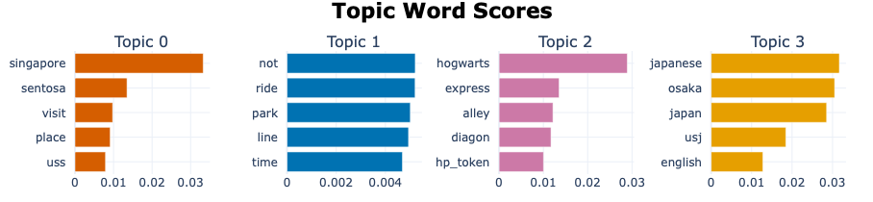
Bertopic modelling
We also used the transformer model for topic modelling as it includes attention module and are able to incorporate context and sequence. However, while nram of (1,1) provide good results, it fails to provide interpretable outcome. We tried to incorporate ngram to 2 or 3. The model does not generate good results. However, the model can at least provide us with some information and nice visualization. So we include those output in the appendix for your interest.
Visualization of Top 4 topics with each of the top words and probabilities.

Slide 23
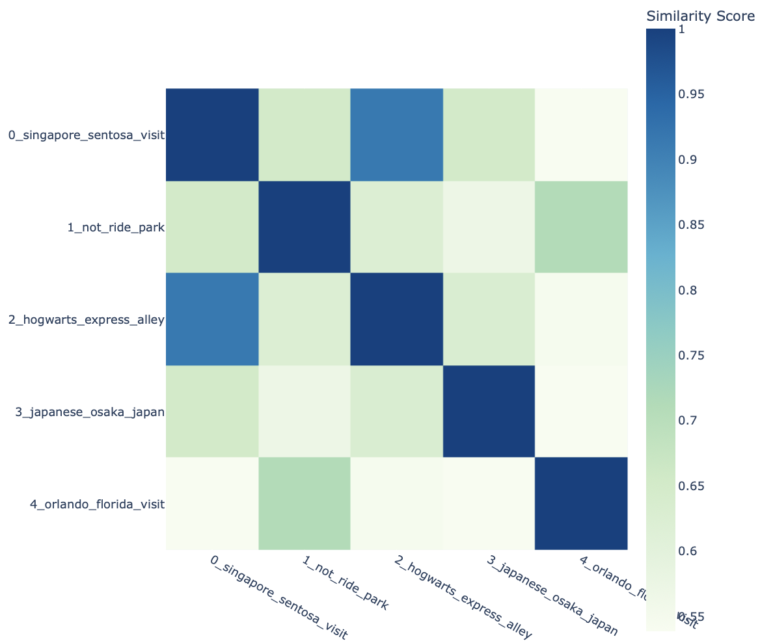
Bertopic modelling
Tuned parameters:
Pretrained language models: 'distilbert-base-nli-mean-tokens','all-MiniLM-L6-v2'
Ngram range: (1,1) to (3,3)
Umap to reduce dimensionality
HDBSCAN to cluster documents
Bertopic also calculate similarity between each topic , and the visualization makes us easy to see how they are correlated,with darker colors means more similarity.

