Slide 1
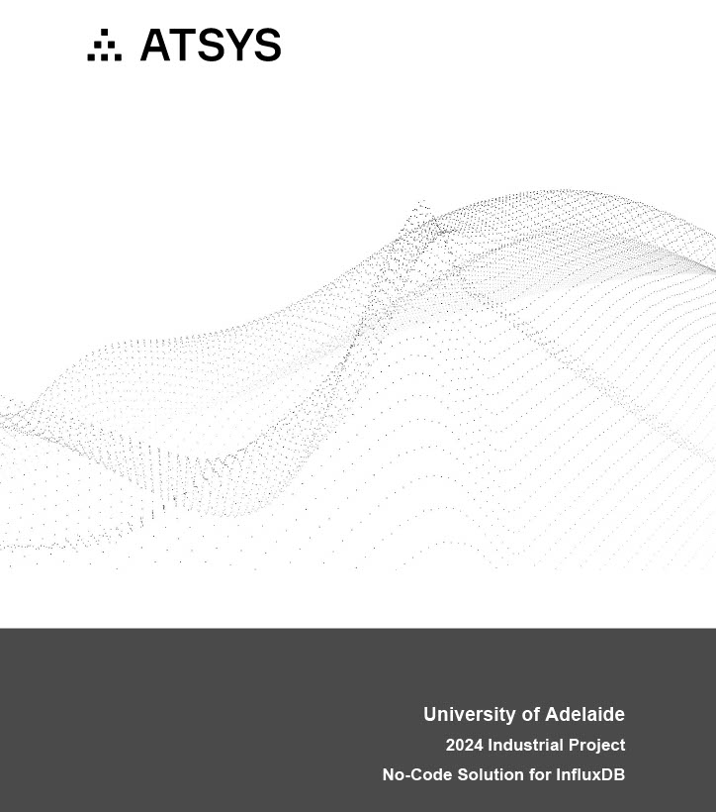
No-Code Solution for InfluxDB Project

Slide 2
User Story 1: Select Time Range and Measurement
As a user, I want to select a time range and measurement, so I can start querying data. Acceptance Criteria: - Users can easily pick a time range. - Users can select a measurement from a list. - The system should prepare to generate the query.

Slide 3
User Story 2: View Generated Query Code
As a user, I want to see the generated query code, so I can understand what is being executed. Acceptance Criteria: - The system shows the generated query code based on user selections. - Users can review the code before execution.

Slide 4
User Story 3: Visualize Data Results
As a user, I want to visualize the data results, so I can understand the output of my query. Acceptance Criteria: - The system displays the results in a simple graph. - Users can choose basic graph types (e.g., line, bar).

Slide 5
Thank You!
Let's get started on building the No-Code Solution for InfluxDB.

