Slide 1




3-D Scene Analysis via Sequenced Predictions over Points and Regions
Xuehan Xiong
Daniel Munoz
Drew Bagnell
Martial Hebert

Slide 2
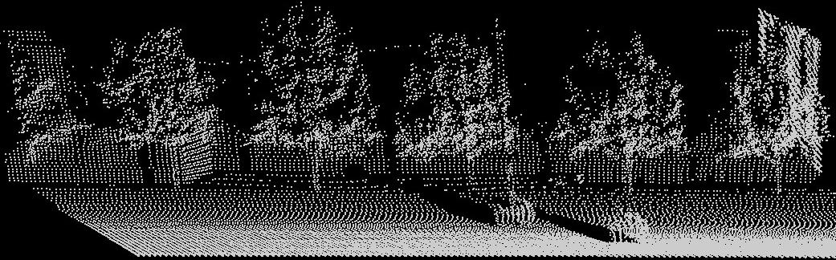
Problem: 3D Scene Understanding

Slide 3
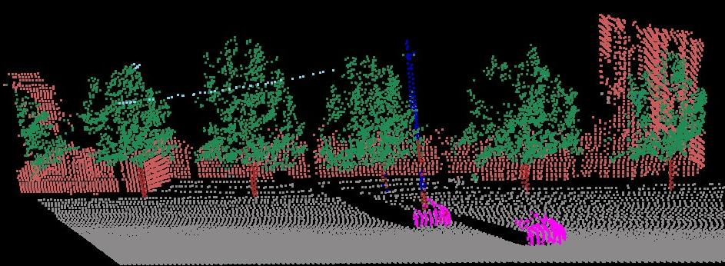
Solution: Contextual Classification
Building
Wire
Pole
Veg
Trunk
Car
Ground

Slide 4
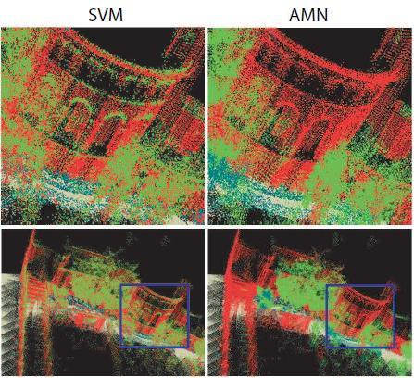
Classical Approach: Graphical Models
Graphical models
Intractable inference
Difficult to train
Limited success
Belief propagation
Mean field
MCMC
Kulesza NIPS 2007
Wainwright JMLR 2006
Finley & Joachims ICML 2008
Anguelov, et al. CVPR 2005
Triebel, et. al. IJCAI 2007
Munoz, et al. CVPR 2009
Fig. from Anguelov, et al. CVPR 2005

Slide 5
Classical Approach: Graphical Models
Graphical models
Intractable inference
Difficult to train
Limited success
Belief propagation
Mean field
MCMC
Kulesza NIPS 2007
Wainwright JMLR 2006
Finley & Joachims ICML 2008
Anguelov, et al. CVPR 2005
Triebel, et. al. IJCAI 2007
Munoz, et al. CVPR 2009
Fig. from Anguelov, et al. CVPR 2005

Slide 6
Classical Approach: Graphical Models
Graphical models
Intractable inference
Difficult to train
Limited success
Belief propagation
Mean field
MCMC
Kulesza
Wainwright
Finley & Joachims ICML 2008
Anguelov, et al. CVPR 2005
Triebel, et. al. IJCAI 2007
Munoz, et al. CVPR 2009
Fig. from Anguelov, et al. CVPR 2005

Slide 7
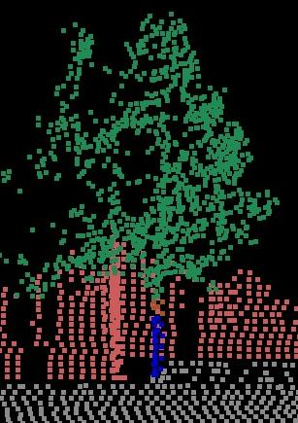
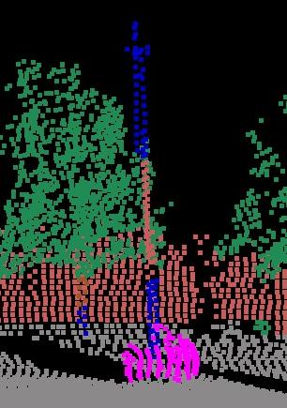

Slide 9
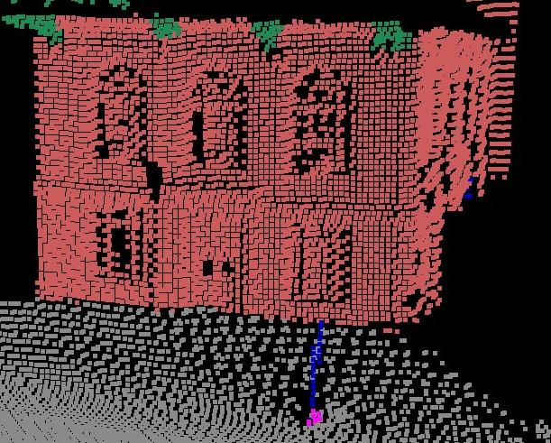

Slide 10




Slide 11
Our Approach: Inference Machines
Train an inference procedure, not a model.
To encode spatial layout and long range relations
Daume III 2006, Tu 2008, Bagnell 2010, Munoz 2010

Slide 12
Our Approach: Inference Machines
Train an inference procedure, not a model.
To encode spatial layout and long range relations
Daume III 2006, Tu 2008, Bagnell 2010, Munoz 2010
Inference via sequential prediction
T
T
C0
C1
C2
F
F
F
Reject
E.g. Viola-Jones 2001

Slide 13
Our Approach: Inference Machines
Train an inference procedure, not a model.
To encode spatial layout and long range relations
Daume III 2006, Tu 2008, Bagnell 2010, Munoz 2010
Inference via sequential prediction
context
context
C0
C1
C2
Ours

Slide 14

Example features
point features

Slide 15
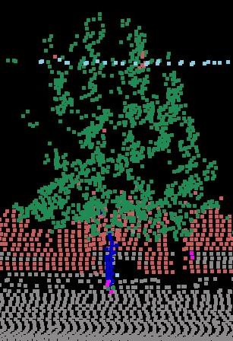
point features

Slide 16
top
mid
bottom
point features
Contextual features

Slide 17
top
mid
bottom
point features

Slide 18
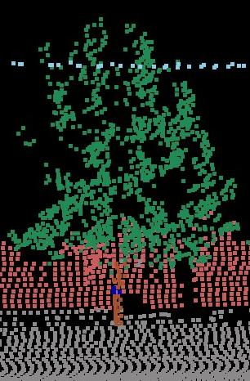
top
mid
bottom
point features

Slide 19
top
mid
bottom
point features

Slide 20
top
mid
bottom
point features

Slide 21
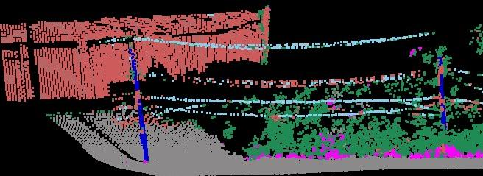
Local features only
Wire
Building
Pole
Veg
Ground
Car

Slide 22
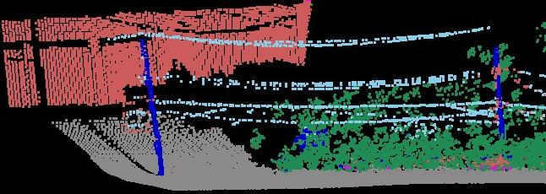
Round 1

Slide 23
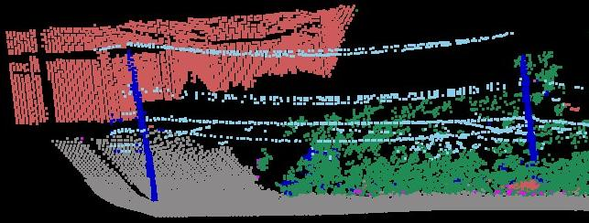
Round 2

Slide 24
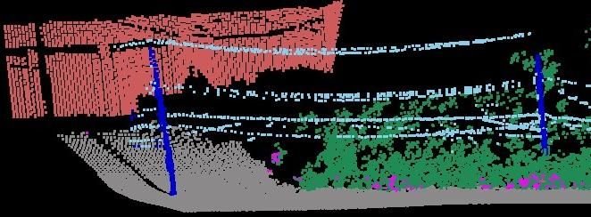
Round 3
Veg
Car

Slide 25

Create regions
Level 2
Level 1

Slide 27
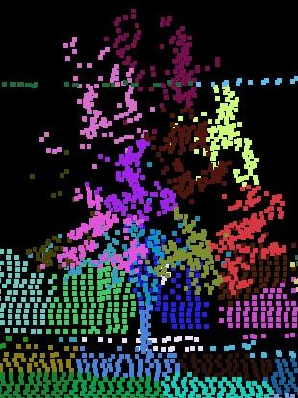
region features
Region level
Pt level

Slide 28
Level 2
Level 1

Slide 29
point features
Point level
Region level

Slide 30
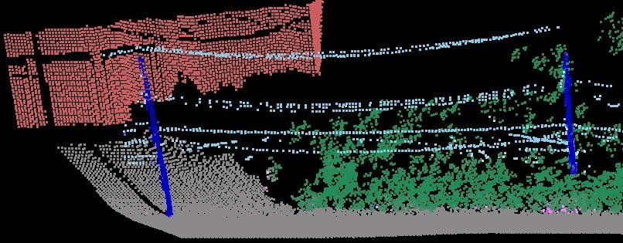
With Regions

Slide 31
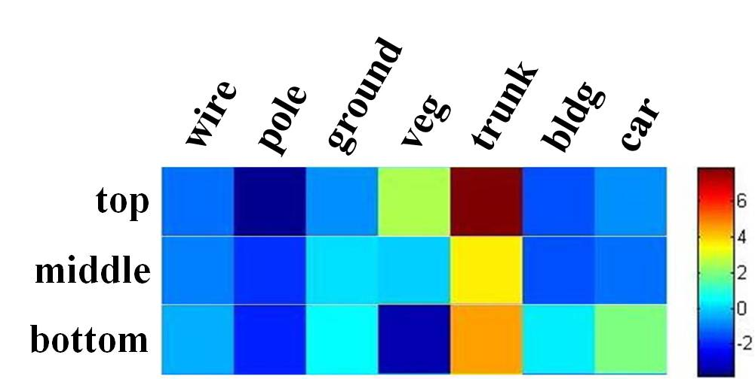
Learned Relationships
top
mid
bottom
point features
Neighbor contextual feature
Learned weights

Slide 32
Learned Relationships
top
mid
bottom
point features
Neighbor contextual feature
Learned weights

Slide 33
Experiments
3 large-scale datasets
CMU (26M), Moscow State (10M), Univ. Wash (10M)
Multiple classes (4 to 8)
car, building, veg, wire, fence, people, trunk, pole, ground, street sign
Different sensors
SICK (ground), ALTM 2050 (aerial), Velodyne (ground)
Comparisons
Graphical models, exemplar based

Slide 34
Quantitative Results
[1] Munoz CVPR 2009
[2] Shapovalov PCV 2010
[3] Lai RSS 2010 *
* Use additional semi-supervised data not leveraged by other methods.

Slide 35
CMU Dataset
[1] Munoz, et. al. CVPR 2009
Ours
Max Margin CRF [1]

Slide 36
CMU Dataset
[1] Munoz, et. al. CVPR 2009
Ours
Max Margin CRF [1]

Slide 37
CMU Dataset
[1] Munoz, et. al. CVPR 2009
Ours
Max Margin CRF [1]

Slide 38
Moscow State Dataset
Ours
Logistic regression

Slide 39
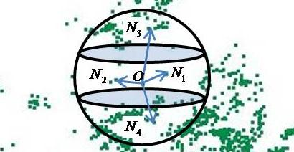
Conclusion
Simple and fast approach for scene labeling
No graphical model
Labeling via 5x logistic regression predictions
Support flexible contextual features
Learning rich relationships
context
context
C0
C1
C2

Slide 40
Thank you! And Questions?
Acknowledgements
US Army Research Laboratory, Collaborative Technology Alliance
QinetiQ North America Robotics Fellowship

