Slide 1
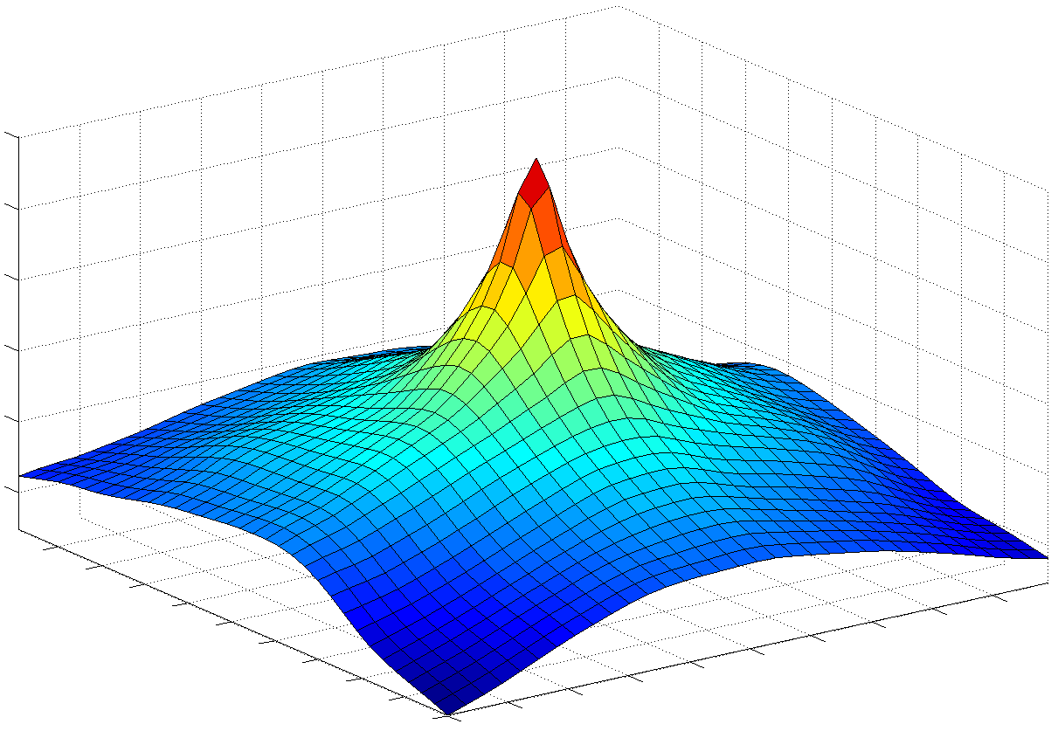
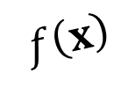

$$x_{∗}$$
$$f\left(x\right)$$

Slide 2



$$x_{∗}$$
$$f\left(x\right)$$
$$x_{0}^{3}$$
$$x_{0}^{1}$$
$$x_{0}^{2}$$

Slide 3

$$x_{∗}$$
$$f\left(x\right)$$
$$R_{0}$$

Slide 4
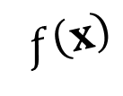
$$x_{∗}$$
$$f\left(x\right)$$
$$f\left(x\right)$$
$$R_{0}$$

Slide 5



$$x_{∗}$$
$$f\left(x\right)$$
$$f\left(x\right)$$
$$x_{1}^{3}$$
$$x_{1}^{1}$$
$$x_{1}^{2}$$

Slide 6

$$x_{∗}$$
$$f\left(x\right)$$
$$f\left(x\right)$$
$$R_{1}$$

Slide 7
$$x_{∗}$$
$$f\left(x\right)$$
$$f\left(x\right)$$
$$R_{1}$$

Slide 8



$$x_{∗}$$
$$f\left(x\right)$$
$$f\left(x\right)$$
$$x_{2}^{1}$$
$$x_{2}^{1}$$
$$x_{2}^{1}$$

Slide 9

$$x_{∗}$$
$$f\left(x\right)$$
$$f\left(x\right)$$
$$R_{2}$$

