Slide 1
CSTutor
Jon Inloes
Mark Gius
James Pearson
Evan Kleist
Russell Mezzetta
Matt Tytel

Slide 2
Why a CSTutor?
Reduce Freshmen Fail Rate
Encourage more independent Study
Provide a framework for progress gauging

Slide 3
System Personnel
The personnel involved in the CSTutor project are organized into the following groups and subgroups:
1. end users
1. registered students
2. anonymous students
3. instructors
4. master system administrators
2. customers
3. system developers

Slide 4
Target Environment
First year Programming class students
  Initial goal: Java/102
Hosted on CSC Infrastructure
  Vogon

Slide 5
Impacts
Postive
Immediate Feedback
Encourages Experimentation
24 hour access to lesson material.
Rapid distribution of new material
Provides help to students reluctant to seek in-person help
Negative
Potential decrease in interaction between Student and Teacher
Potential Abuse by instructors who use the system exclusively so as to avoid students
Lesson material may be incomplete/inaccurate
Computer Science Tutors won't be able to work as many hours

Slide 6
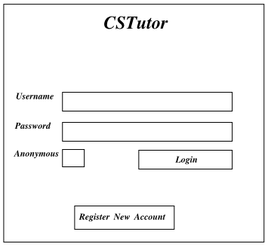
Logging In

Slide 7
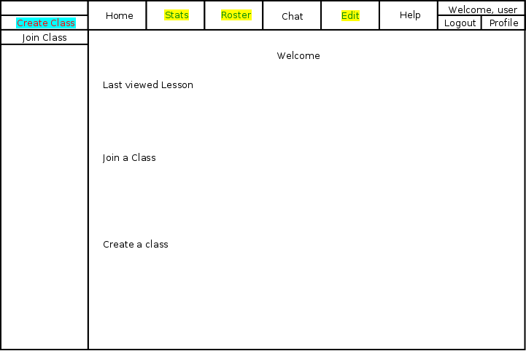
Basic UI

Slide 8
Classes
Only Instructors can create classes
Classes can be “public” or “private”

Slide 9
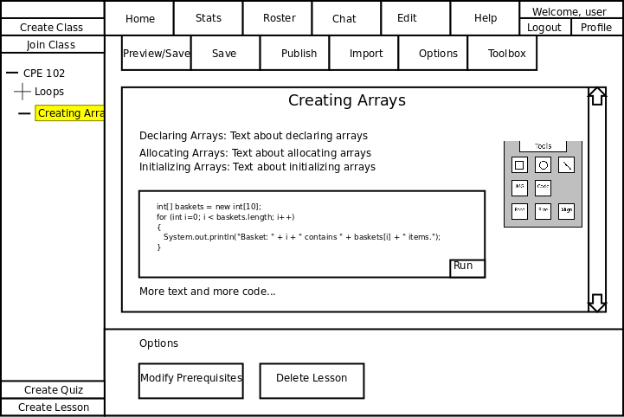
Creating/Editing Lessons

Slide 10
Other Lesson Operations
Delete
Import
  Upload an XML document representing the lesson
Rearrange

Slide 11
Quizzes
Basic Quizzes Can be added
  True/False
  Multiple Choice
  Code Snippet
Provides instant feedback
Import
  Create a quiz in XML and import it to the tool

Slide 12
Quiz Features
Prerequisites
  Require a quiz/lesson completion before being able to take the quiz
Visibility
  Make the quiz invisible to students until prerequisite has been satisfied
Paths
  Create as many different paths for students as desired. Each path will lead a student to a selected page if they score within a certain boundry.

Slide 13
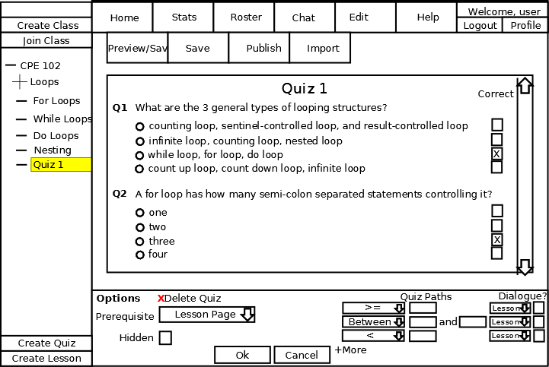
Creating a Quiz

Slide 14
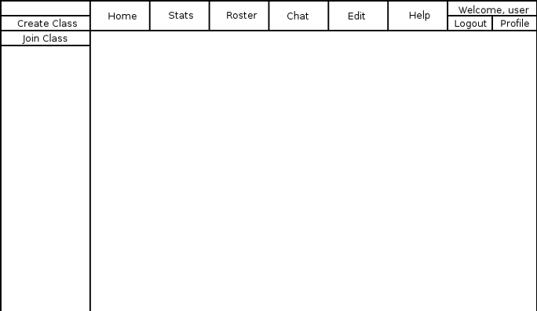
Statistics

Slide 15
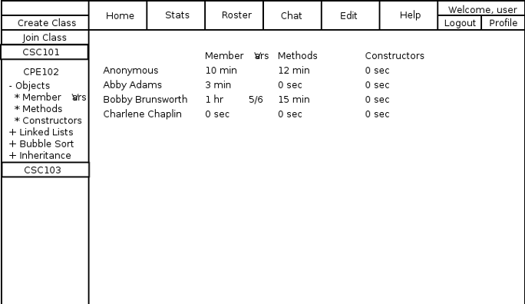
Statistics

Slide 16
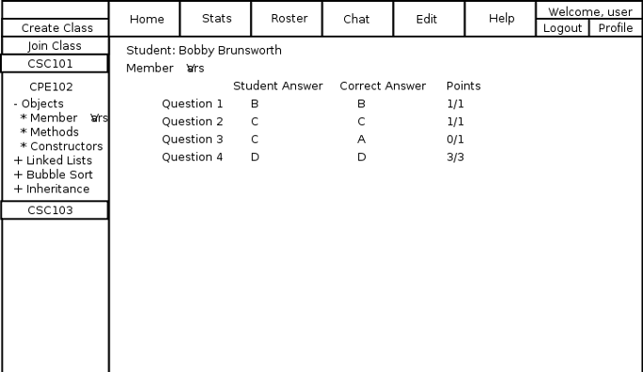
Statistics

Slide 17
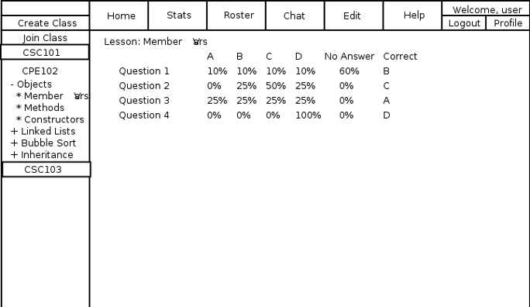
Statistics

Slide 18
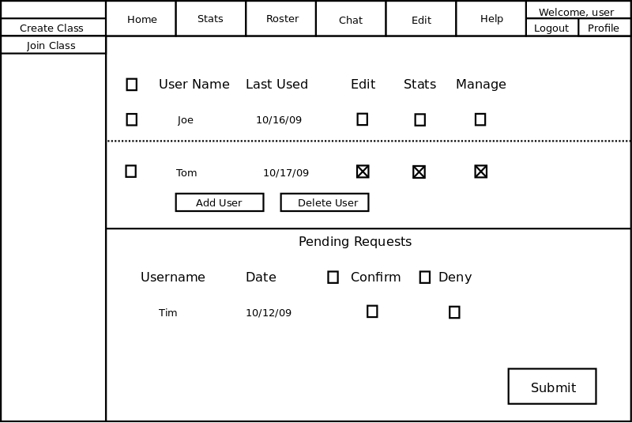
Roster Management
Add User
Edit User
Delete User
Accept Requests

Slide 19
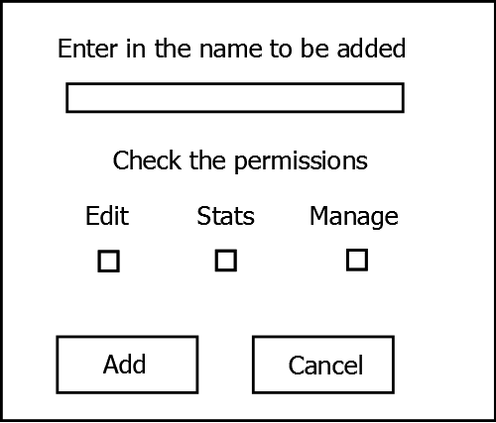
Add User

Slide 20
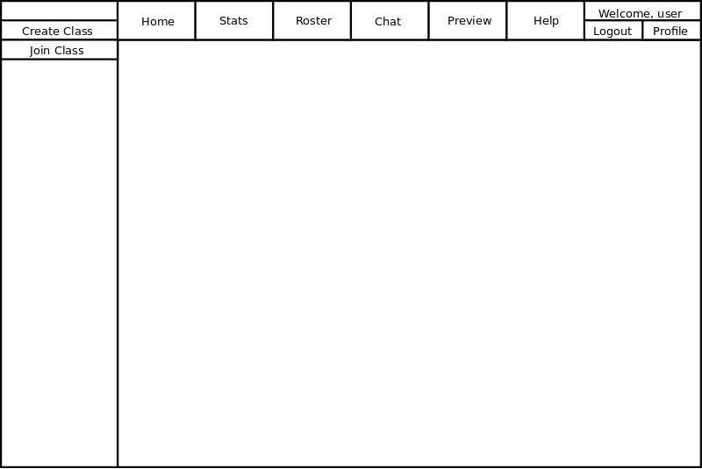
Preview a Page
Click Preview tab
Will be brought to a page which is what students will see

Slide 21
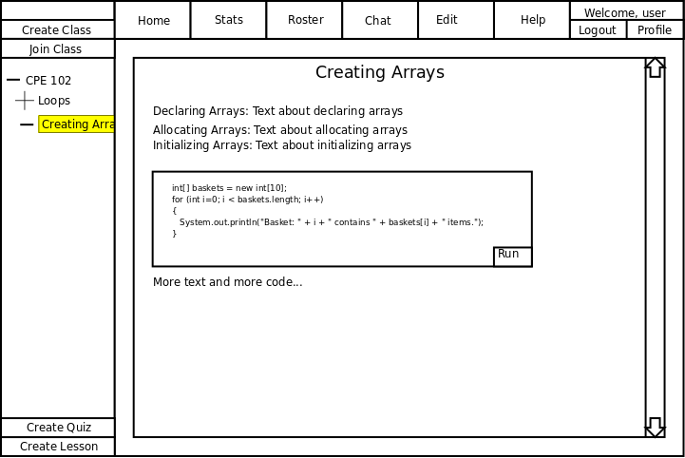
Taking a Lesson
Select a Lesson
Read Text
Interact with Code

Slide 22
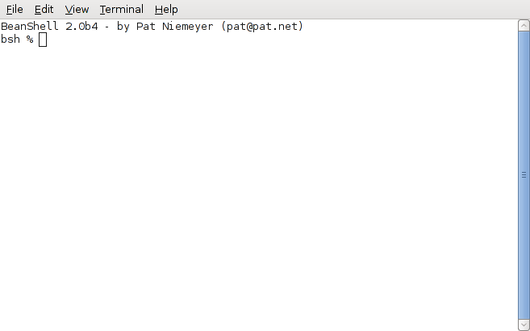
Interactive Code Shell

Slide 23
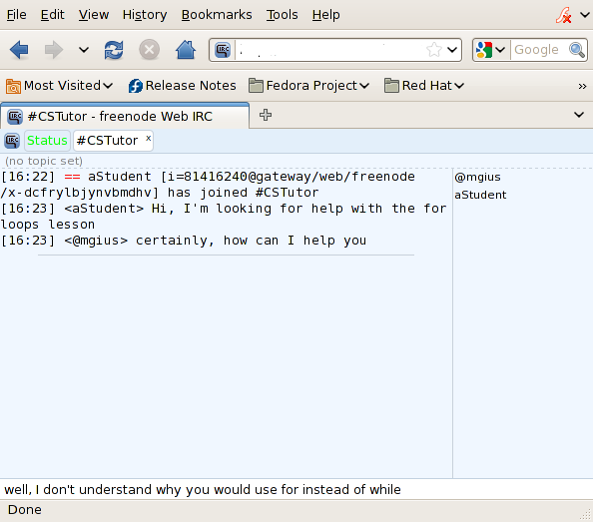
Collaboration Tools

