Slide 1


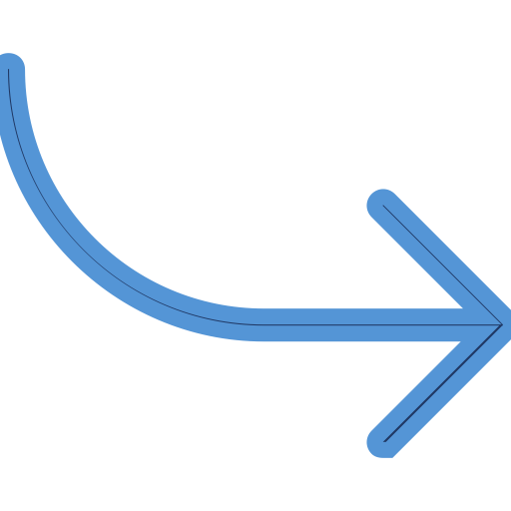

Reinforcement Learning Assistant

