Slide 1
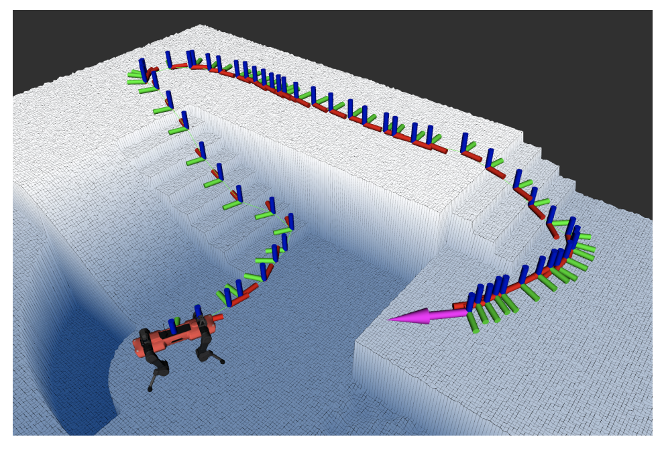
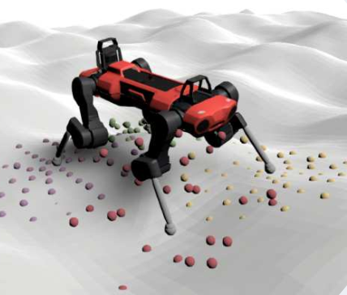
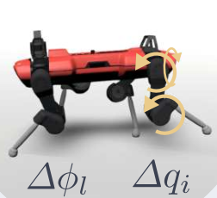
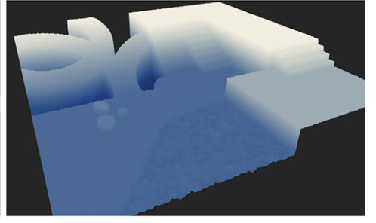
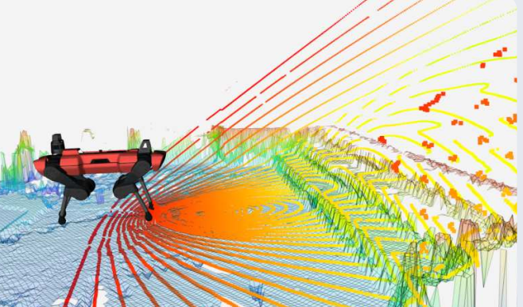

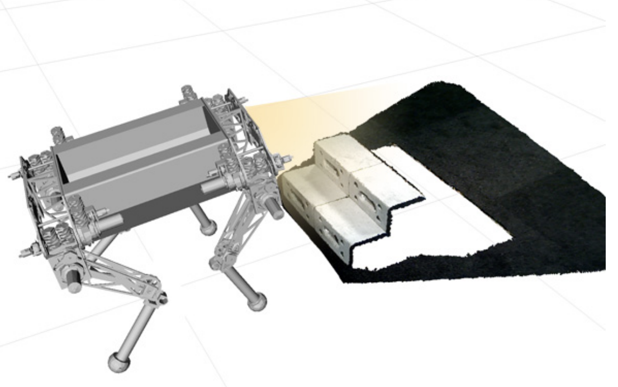
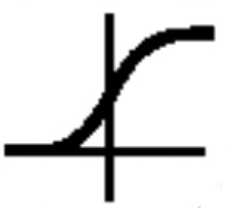
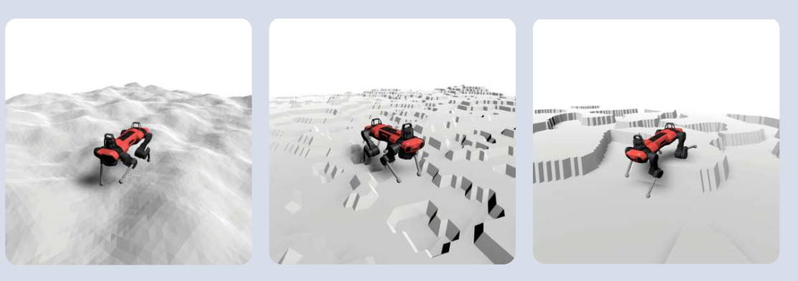
(2) Global navigation
(4) Robust joint Controller
navigation planning algorithms
﻿command sequence
pretrained joint controller
﻿proprioception
Noisy height scan
pretrained brief state encoder
(3) Safe-probing policy
action
looking-ahead perception model
static navigation map
Ensemble noisy future scan
intervention
for safe-probing
noisy forward scan
noisy camera image
belief encoder
obstacles identified by
probing module
temperature sensor
hidden
noisy state of model rollout
… …
MLP
add an obstacle “ ” to the map and replan to generate a new command ﻿﻿proprioception sequence
near zero?
yes
(1) Simulator
domain randomization for different terrains and treacherous situations
decoder
safety confidence
train for reconstruction
﻿privileged states
train via safe RL
rewards, constraints
are randomized danger obstacles

