Slide 1
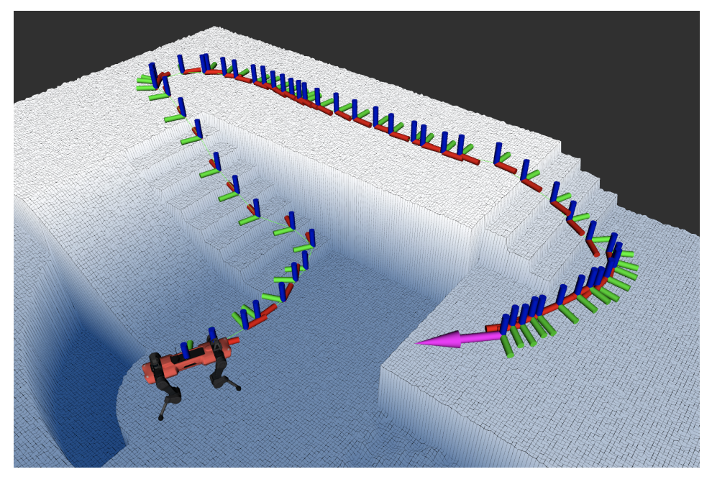
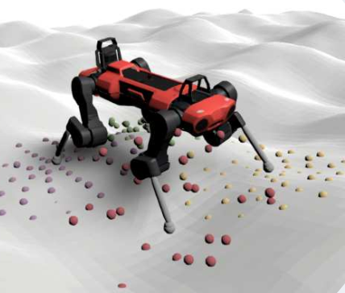
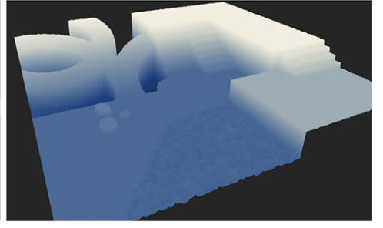
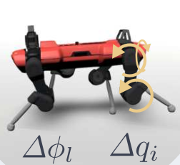
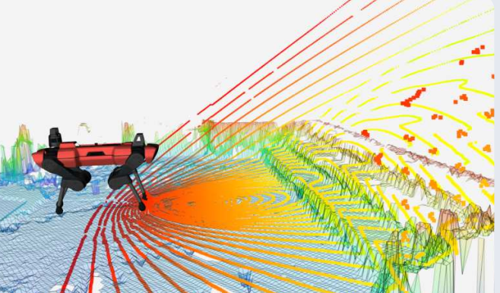
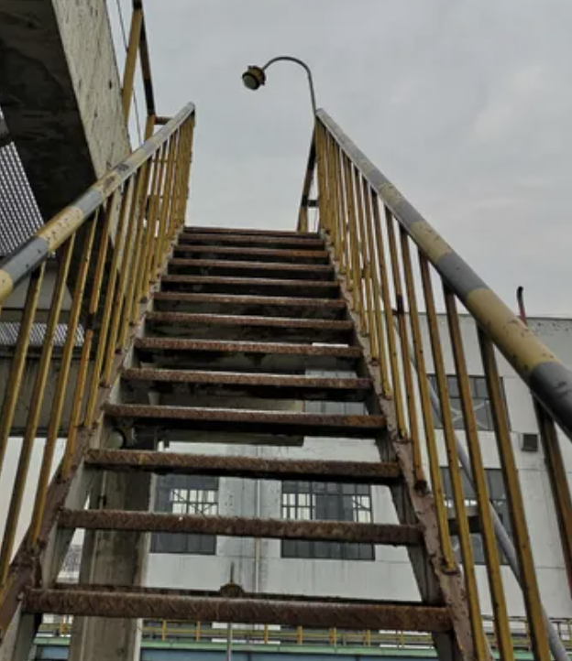
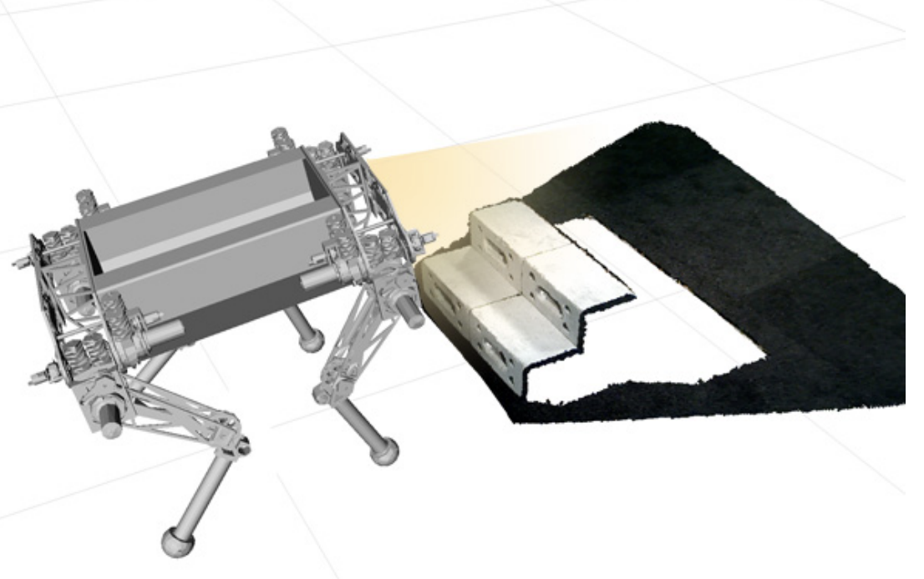
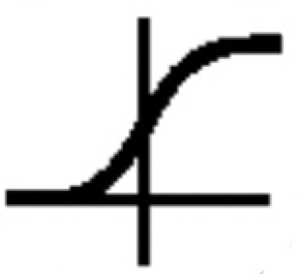
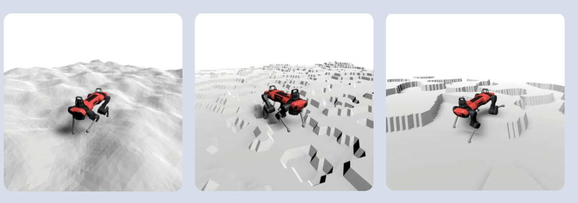
(2) Global navigation
(4) Robust skill controllers
navigation planning algorithms
﻿command sequence
pretrained gating network
predefined
motor skill
controllers
﻿proprioception
noisy height scan
(3) Safe-probing policy
Synthesis
DNN
static navigation map
looking-ahead perception model
action
multi-modal noisy future scan
correct
for safe probing
obstacles identified by
probing module
noisy forward scan
noisy camera image
belief encoder
temperature sensor
hidden
noisy state of model rollout
… …
MLP
add an obstacle “ ” to the map and generate a new command sequence
near zero?
yes
(1) Simulator
domain randomization for different terrains and treacherous situations
decoder
safety confidence
train for reconstruction
﻿privileged states
train via safe RL
rewards and constraints
are randomized danger obstacles

