Slide 1
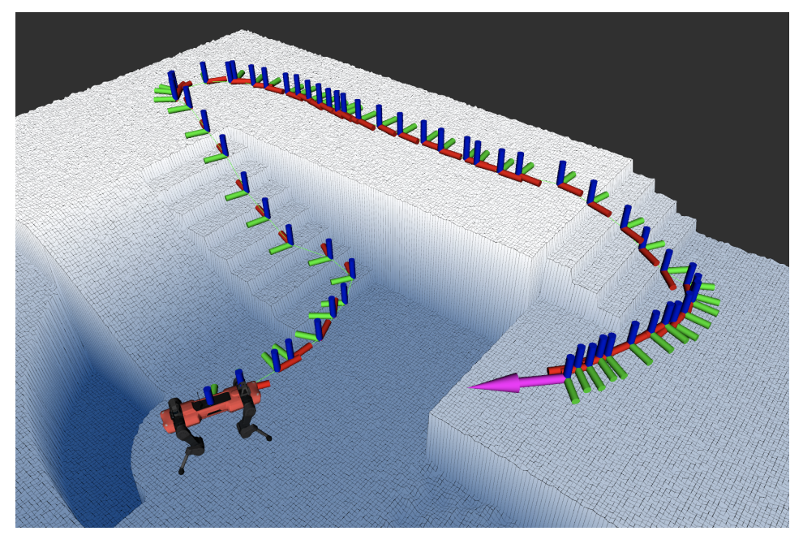
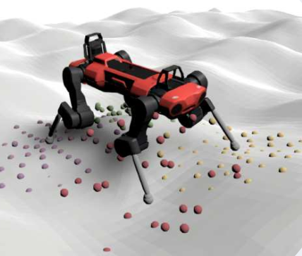
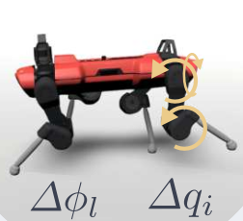
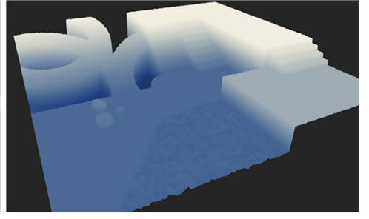
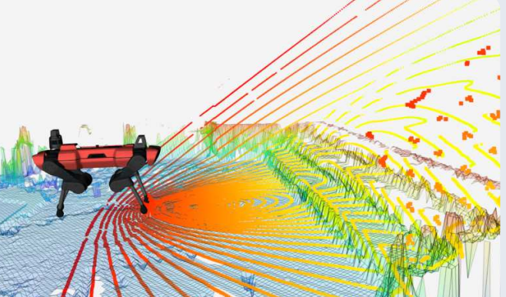
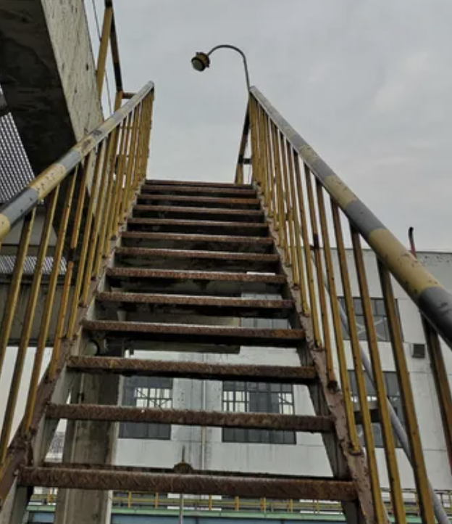
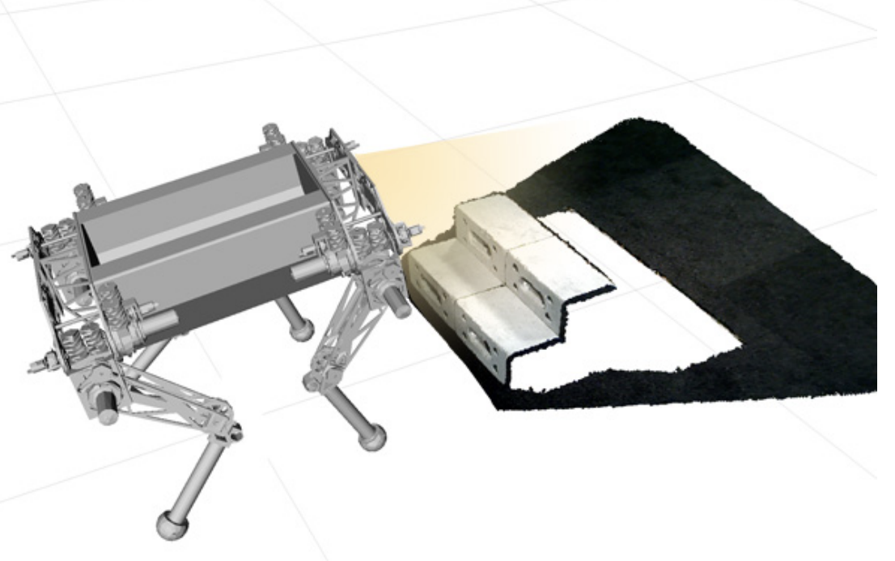
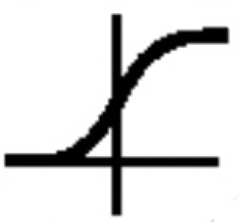
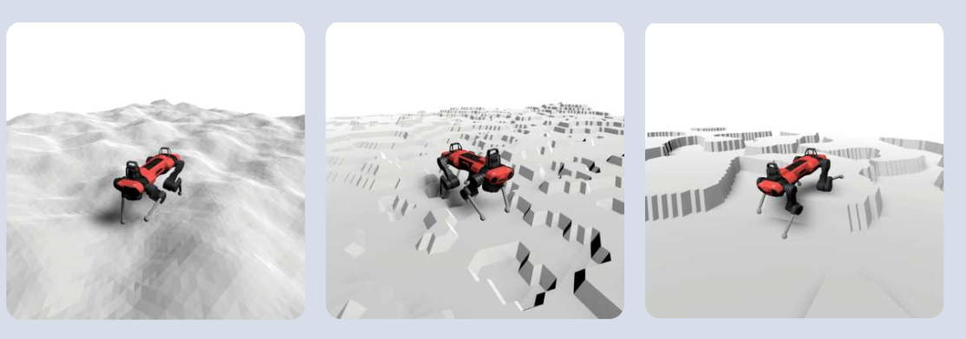
(2) Global navigation
(4) robust perceptive locomotion policy
Navigation Planning algorithms
﻿Command ﻿﻿Proprioception sequence
Pretrained robust controller
Noisy height scan
(3) Safe probing policy
action
looking-ahead perception model
Static navigation Map
Ensemble noisy future scan
rectification
for safe-probing
obstacles identified by
probing module
noisy forward scan
noisy camera image
Belief encoder
Safety critic
… …
noisy state of model rollout
hidden
MLP
Add an obstacle “ ” to the map and replan to generate a new command ﻿﻿proprioception sequence
near zero?
yes
(1) Simulator
decoder
confidence
Domain randomization for different terrains and dangerous obstacles
Train for reconstruction
﻿Privileged future states
Train with RL
Rewards
are randomized danger obstacles

Slide 2
(2) Global navigation
(4) Robust perceptive locomotion policy
navigation planning algorithms
﻿command ﻿﻿proprioception sequence
pretrained robust controller
Noisy height scan
pretrained brief state encoder
(3) Safe probing policy
action
Ensemble ﻿exteroceptive future encoder
static navigation map
Ensemble noisy future scan
intervention
for safe-probing
obstacles identified by
probing module
noisy forward scan
noisy camera image
(if existed)
near future encoder
temperature sensor
… …
hidden
noisy state of model rollout
MLP
add an obstacle “ ” to the map and replan to generate a new command ﻿﻿proprioception sequence
near zero?
yes
(1) Simulator
domain randomization for different terrains and dangerous obstacles
decoder
confidence
train for reconstruction
﻿privileged future states
train via Safe RL
rewards
are randomized danger obstacles

