Slide 1

ROBUST LOW-LIGHT OBJECT DETECTION
Combining Offline Illumination Compensation, Vision-Language Knowledge
Distillation, and Real-Time Detection Transformers
Law Zhi Xiong
Faculty of Computer Science & Information Technology | Universiti Malaya
MAI Research Project· 2026

Slide 2
Problem Statement and Research Objectives
Problem Statement: Why low light is hard
Research objectives
Low contrast and sensor noise degrade the features detectors rely on
Enhancement modules are welded to one backbone, so pipelines are brittle
Human annotation is the real bottleneck for any new domain
1
To empirically select a VLM annotation teacher from open-source models for low-light KD
2
To evaluate the individual and combined contributions of spatial enhancement and knowledge distillation using RF-DETR
3
To benchmark the resulting RF-DETR against published results on the evaluated ExDark dataset
Notes:
[40 s · by 0:55] Three beats: low light degrades features, existing enhancement fixes are coupled to a backbone, and annotation is the cost that actually blocks deployment.
The three objectives map onto the Preliminary phase, Stages 1-2, and Stage 3.
Land on the callout — every later slide answers it.

Slide 3
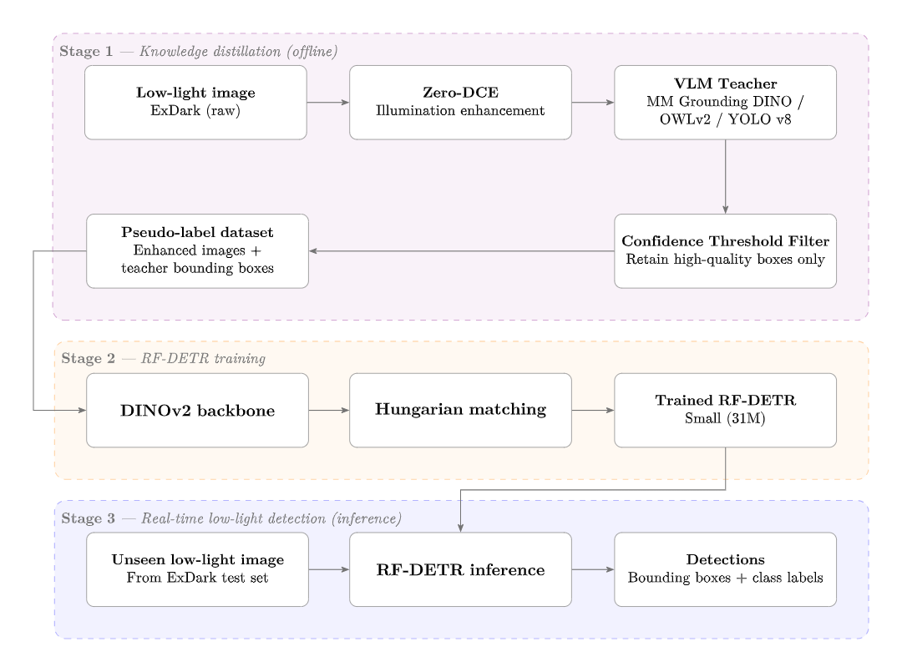
Methodology: Decoupled three-stage pipeline
Enhancement, annotation and training vary independently, to assess contribution of each component
Stage 1
Offline enhancement, then a VLM teacher annotates.
Boxes above a confidence threshold become pseudo-labels.
Stage 2
RF-DETR-Small trains on pseudo-label set.
One-to-one Hungarian matching suits one-to-one pseudo-labels.
Stage 3
Inference runs on the student alone.
Detection produces both bounding boxes and object labels.
Notes:
[45 s · by 1:40] Walk the figure left to right.
Stress the word decoupled: the VLM cost is paid once, offline. That separates this from enhance-then-detect pipelines where the enhancer is welded to the backbone.
The student is RF-DETR-Small, chosen for its DINOv2 backbone and NMS-free head.

Slide 4
Experimental design
ExDark: 7,363 images, 12 classes, 80/10/10 stratified → 5,886 train / 729 val / 748 test
Condition | Images | Labels | What it isolates
A | raw | human | Upper bound, no intervention baseline
B | enhanced | human | Enhancement alone
C@0.55 / C@0.60 | enhanced | pseudo | Knowledge distillation alone
H10 / H25 | enhanced | 10% / 25% human + pseudo | Performance improvement from human label additions
Zero-shot | raw & enhanced | none (COCO-pretrained) | Untrained baseline
Held constant
Same architecture, hyperparameters, seed and splits
Evaluation metrics
mAP@0.5: whether the object was found.
mAP@[.5:.95]: how precisely the box was drawn.
Notes:
[40 s · by 2:20] This table is the spine of the results chapter — every later number is one of these rows.
A and B differ only in the images; B and C differ only in the labels. That is the whole design.
Introduce the two metrics here so they need no explanation later: detection versus localisation.

Slide 5
Preliminary phase: VLM Teacher Selection
Three open-vocabulary candidates, run zero-shot on raw and enhanced images using a stratified sample of 600 images (~2,000 bounding boxes)
Teacher | Precision | Boxes kept | Zero-F1 classes | Mean per-class F1
OWLv2 | 0.864 | 265 | 5 of 12 | 0.326
MM Grounding DINO | 0.859 | 802 | 0 of 12 | 0.481
YOLO-World v8 | 0.849 | 1,255 | 0 of 12 | 0.641
Teacher performance at 0.60 confidence, enhanced condition
Precision alone cannot rank teachers
Constraints added: at least 1,000 boxes (50% of labels in stratified sample), and at least 10 in every class
Selected: YOLO-World v8, enhanced images, threshold 0.60
Notes:
[45 s · by 3:05] Figure first: YOLO-World's correct boxes pile up at high confidence, OWLv2's do not.
Then the table shows why that matters. OWLv2 wins on precision and is still unusable — 265 boxes against 1,996 ground-truth boxes, with five classes at zero F1.
Say it out loud: precision is not a selection criterion on its own. Coverage decides it.

Slide 6
Stage 1: VLM Pseudo Label Generation
The teacher is re-run across the full 5,886-image training split, not the 600-image sample
Threshold | Precision | Recall | F1 | Boxes kept | Smallest class
0.55 | 0.819 | 0.573 | 0.674 | 13,366 | 131
0.60 | 0.843 | 0.539 | 0.657 | 12,200 | 99
0.65 | 0.867 | 0.503 | 0.637 | 11,084 | 70
0.70 | 0.890 | 0.458 | 0.605 | 9,842 | 36
0.75 | 0.913 | 0.410 | 0.566 | 8,582 | 15
Precision–coverage trade-off, YOLO-World enhanced
Precision rises and coverage falls in every row
0.55 maximises F1 and keeps the most labels
At 0.75 the smallest class holds 15 boxes, making it unusable
Both 0.55 and 0.60 are carried into Stage 2
Notes:
[40 s · by 3:45] The point is that the operating point was re-derived, not assumed.
0.60 came from a 600-image sample; on the full split 0.55 maximises F1. Rather than choose, both were trained — that is what C@0.55 and C@0.60 are.
Honest number to mention: 13,366 pseudo-label boxes against 19,105 human boxes, so pseudo-labelling recovers only 70% of the supervision, and 12.8% of training images end up with no label at all.

Slide 7
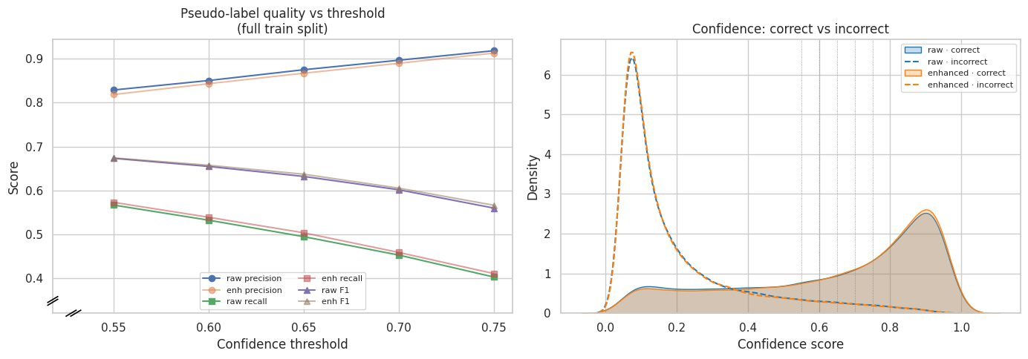
Stage 1: VLM Pseudo Label Generation
Enhancement produced nearly identical results as raw images
Notes:
[40 s · by 3:45] The point is that the operating point was re-derived, not assumed.
0.60 came from a 600-image sample; on the full split 0.55 maximises F1. Rather than choose, both were trained — that is what C@0.55 and C@0.60 are.
Honest number to mention: 13,366 pseudo-label boxes against 19,105 human boxes, so pseudo-labelling recovers only 70% of the supervision, and 12.8% of training images end up with no label at all.

Slide 8
Stage 2: Knowledge Distillation & Training
Condition A is strongest, Pseudo-labels produce reasonably good mAP@0.5 but struggle with stricter mAP
Condition | mAP@0.5 | mAP@[.5:.95] | Tightness
A · raw + human | 0.893 | 0.634 | 0.710
B · enhanced + human | 0.883 | 0.621 | 0.703
C@0.55 · pseudo | 0.758 | 0.420 | 0.554
C@0.60 · pseudo | 0.755 | 0.416 | 0.551
Condition B falls below A, enhancement does not help
Pseudo-labels performance gap ~0.14 mAP@0.5, and ~0.21 mAP@[.5:.95]. Lower confidence threshold gives slightly better results.
Tightness (Ratio of mAP@[.5:.95] to mAP@0.5)
  0.71 for human labels, 0.55 for pseudo-labels
  Suggests pseudo-labels struggle with localisation vs detection
Notes:
[55 s · by 4:40] The first substantive result — do not rush it.
Finding one: enhancement is neutral-to-negative. B sits 0.010 and 0.013 below A, and that holds for the rest of the study.
Finding two, the more interesting one: the pseudo-label penalty is not uniform. 0.14 at the loose metric, 0.21 at the strict one. That asymmetry is the localisation story, which slide 10 picks up with box geometry.
C@0.55 marginally beats C@0.60, so the larger, noisier label set won — coverage over purity.

Slide 9
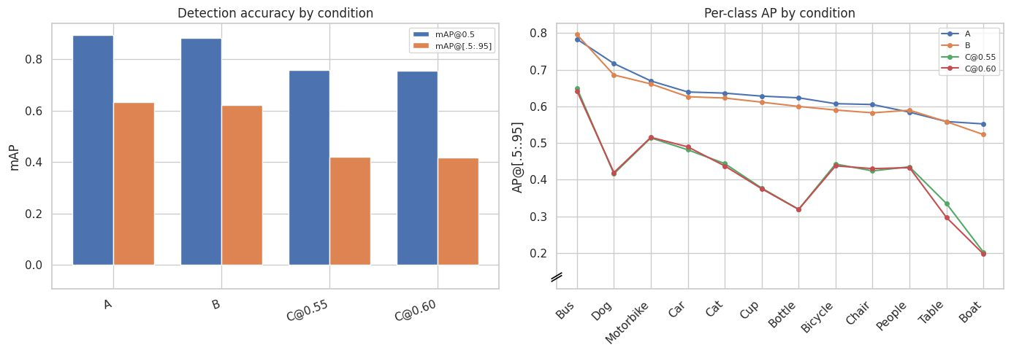
Stage 2: Knowledge Distillation & Training
Visualisation of test results after KD
Notes:
[55 s · by 4:40] The first substantive result — do not rush it.
Finding one: enhancement is neutral-to-negative. B sits 0.010 and 0.013 below A, and that holds for the rest of the study.
Finding two, the more interesting one: the pseudo-label penalty is not uniform. 0.14 at the loose metric, 0.21 at the strict one. That asymmetry is the localisation story, which slide 10 picks up with box geometry.
C@0.55 marginally beats C@0.60, so the larger, noisier label set won — coverage over purity.

Slide 10
Stage 2: Hybrid human-pseudo labels
A stratified fraction of human-labels is used to assess improvement vs pure pseudo-labels
Human labels | Condition | mAP@0.5 | mAP@[.5:.95] | Gap recovered @0.5 | Gap recovered @[.5:.95]
0% | C@0.55 | 0.758 | 0.420 | 0.0% | 0.0%
10% | H10 | 0.799 | 0.449 | 33.0% | 14.5%
25% | H25 | 0.827 | 0.479 | 55.0% | 29.5%
100% | B | 0.883 | 0.621 | 100% | 100%
Hybrid pseudo-label condition results
Human labels recover the performance gap at a non-linear improvement
Effect more pronounced for mAP@0.5, versus mAP@[.5:.95]
A quarter of the human-labelled images supplies 4,700 of 14,795 bounding boxes for H25, human-labelled images are more densely annotated
Notes:
[55 s · by 5:35] The practical result of the whole project.
Ten percent of the images recovers a third of the detection gap; twenty-five percent recovers over half. That is a favourable exchange rate for anyone paying annotators.
Explain why it beats the budget: human images are not label-equivalent to pseudo-labelled ones. They carry boxes the teacher missed entirely, so a quarter of the images supplies nearly a third of the boxes.
Figure 4.6: mAP@0.5 rises steeply then flattens, while mAP@[.5:.95] is close to linear — a little human data fixes detection fast, but localisation improves only in proportion to what is added.

Slide 11
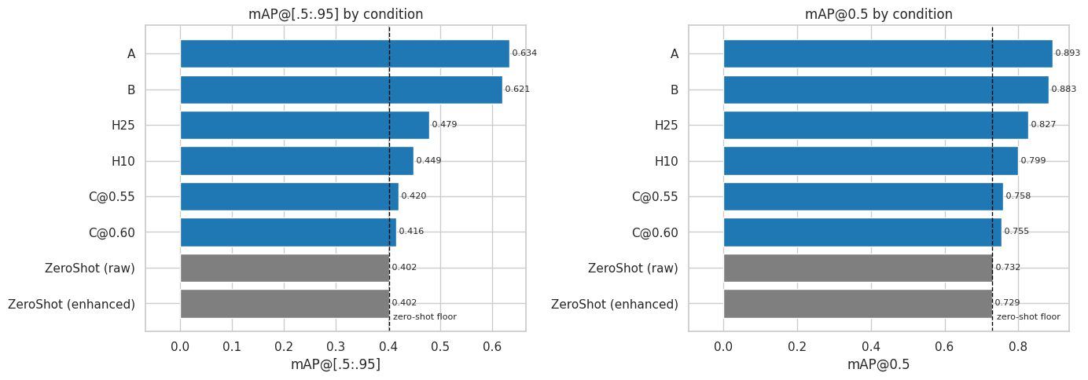
Stage 3: Performance Evaluation
Performance versus zero-shot COCO pre-trained RF-DETR.
Pseudo-label contribution is lesser than expected, and human labels improve mAP@[.5:.95] by up to 58%
Notes:
[50 s · by 6:25] The slide that keeps the rest honest.
RF-DETR is already strong out of the box — 0.732 mAP@0.5 having never seen an ExDark image. Any claim about pseudo-labelling has to be measured against that, not against zero.
Against that floor, pure pseudo-labelling buys very little. The hybrids are where the method earns its place.
This is the honest framing of the contribution: the adaptation gain is real but modest, because the backbone was already heavily pretrained.

Slide 12
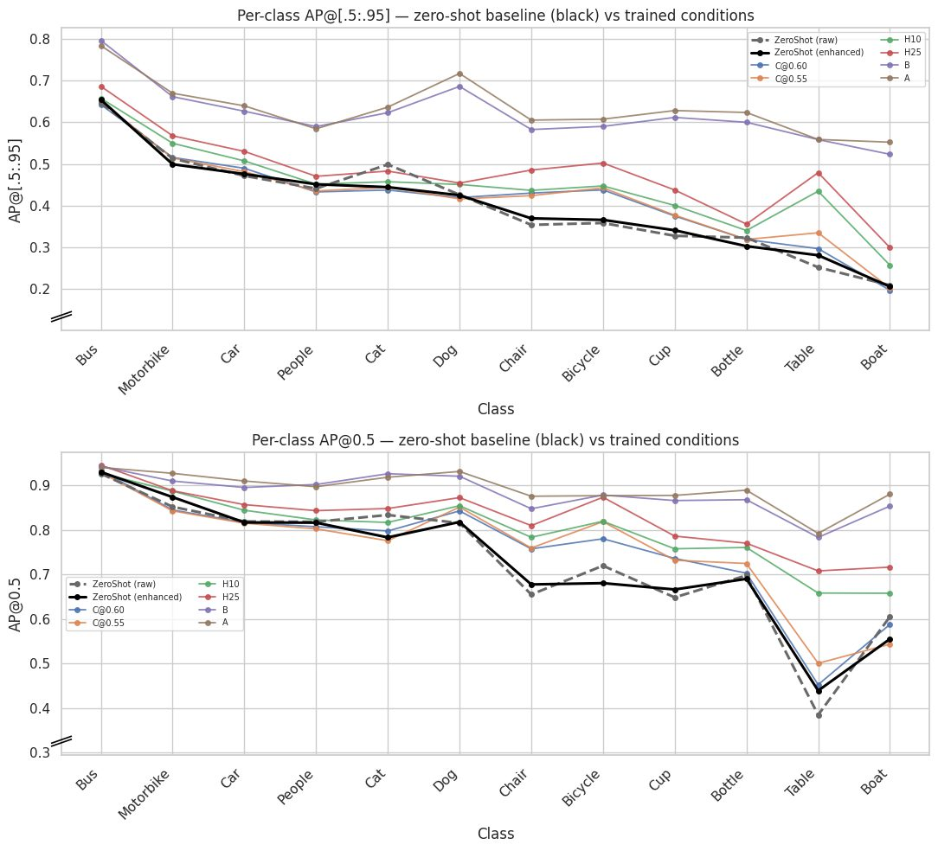
Stage 3: Performance Evaluation
Per-class AP comparison
Pseudo-label gains not distributed evenly across classes
Improvement from hybrid labels biggest for Table, which is YOLO-World teacher’s weakest class
Notes:
[50 s · by 6:25] The slide that keeps the rest honest.
RF-DETR is already strong out of the box — 0.732 mAP@0.5 having never seen an ExDark image. Any claim about pseudo-labelling has to be measured against that, not against zero.
Against that floor, pure pseudo-labelling buys very little. The hybrids are where the method earns its place.
This is the honest framing of the contribution: the adaptation gain is real but modest, because the backbone was already heavily pretrained.

Slide 13
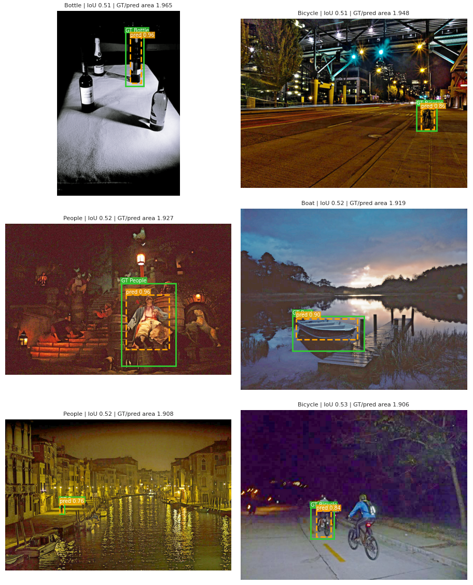
Stage 3: Box tightness evaluation
Box geometry for every matched detection, against the ExDark ground truth
Condition | % tighter than GT | Median GT / pred area
Zero-shot · raw | 38.4 | 1.192
C@0.55 · pseudo | 32.7 | 1.158
H25 · hybrid | 27.9 | 1.138
B · enhanced + human | 6.2 | 0.994
A · raw + human | 5.9 | 0.994
The untrained model draws the tighter box 38.4% of the time
That falls to 32.7% after pseudo-labels, and to 5.9% under human labels
Part of the strict-metric penalty is a difference in annotation convention, not a detection failure.
Notes:
[50 s · by 7:15] This closes the loop opened on slide 7 — why the strict metric suffers more.
Read the tighter column down: 38.4, then 32.7, then 5.9. The teacher loosens the student's boxes during distillation, and human labels finish the job. The median area ratio moves the same way, 1.192 to 1.158 to 0.994.
Be careful with the callout claim — it is a genuine confound, but it is not quantified. Note that the limitation on the final slide addresses exactly this.

Slide 14
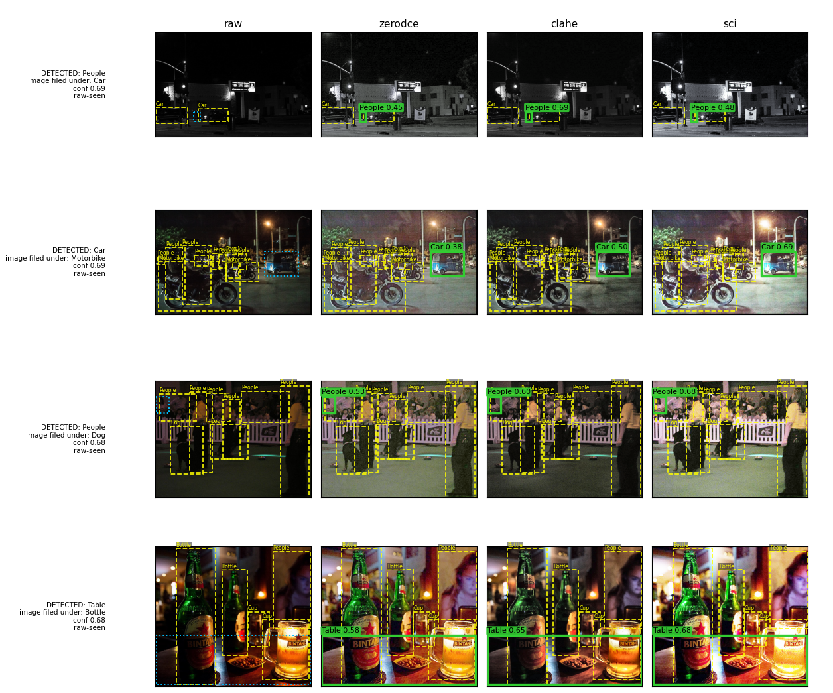
Stage 3: Additional enhancer probe
Stratified sample to confirm effect of enhancement, across 3 different methods
Condition | mAP@0.5 | mAP@[.5:.95]
raw | 0.8380 | 0.5722
CLAHE (Histogram equalisation) | 0.8346 | 0.5677
SCI (Retinex based illumination) | 0.8295 | 0.5644
Zero-DCE (Our enhancement) | 0.8252 | 0.5631
Every enhancement method performs below raw condition
In some scenarios, enhancements surface labels that are missed by raw and ground truth (133), however 118 are of confidence <0.50
Notes:
[45 s · by 8:00] Anticipate the obvious objection — maybe Zero-DCE was simply a bad choice.
The probe answers it. Three methods, three seeds each, and all twelve runs land below raw. The between-method spread, 0.5631 to 0.5677, is smaller than the 0.0050 seed spread within the raw condition alone. That is the strongest form of this claim.
Practical consequence: the enhancement stage can be dropped from deployment with no measured loss.

Slide 15
Stage 3: Comparison vs published ExDark results
The three papers from the review that report ExDark results, ordered by mAP@[.5:.95]
Method | mAP@0.5 | mAP@[.5:.95] | Params | GFLOPs | FPS
A (this study) | 0.893 | 0.634 | 31.8 M | 50.9 | 77.4
H25 (this study) | 0.827 | 0.479 | 31.8 M | 50.9 | 77.4
PFNN · Liu et al. (2025) | 0.717 | 0.451 | n/a | n/a | n/a
DarkYOLOv8 · Fu et al. (2025) | 0.698 | 0.430 | 2.9 M | 6.7 | n/a
DeC-YOLO · Li et al. (2026) | 0.831 | 0.421 | 10.7 M | 9.6 | 97.6
C@0.55 (this study) | 0.758 | 0.420 | 31.8 M | 50.9 | 77.4
DETR · Li et al. (2026) | 0.812 | 0.389 | 42.2 M | 52.6 | 21.4
A leads both metrics
H25 is second on the strict mAP, using only a quarter of human labels
C@0.55, with no human labels, is within 0.001 of DeC-YOLO
Efficiency Metrics
31.8 M parameters and 50.9 GFLOPs, roughly 3× DeC-YOLO and 11× DarkYOLOv8.
This pipeline sits between the lightweight YOLOs and the classical detectors.
Notes:
[50 s · by 8:50] Lead with accuracy, then give the cost yourself — more persuasive than letting the examiner find it.
The strongest single line: C@0.55 uses zero human annotation and still matches DeC-YOLO on the strict metric. A exceeds the best published entry by 0.062 at mAP@0.5 and 0.183 at mAP@[.5:.95].
On efficiency be direct. The transformer is three to eleven times heavier than the YOLO comparators. At 77.4 FPS it is real-time, but it is not an edge-deployment model — future work addresses that.

Slide 16
Discussion
Pseudo-labels excel at detection, but struggle with localisation vs ExDark Ground Truth
1
Pseudo-labels find objects almost as well as humans but draw them more loosely versus human-trained labels for ExDark.
The difference inherited from to COCO-pretraining convention from RF-DETR.
Injecting small amount of human labels gives non-linear improvement
2
25% of the images supplies 4,700 of 14,795 boxes, because human annotation includes objects the teacher missed.
10% recovers 14.5% of the 0.201 mAP@[.5:.95] gap; 25% recovers 29.5% of the gap.
Enhancement does not give significant benefit
3
Three enhancement methods do not give any significant improvement.
The pretrained backbone may already be illumination-robust.
Notes:
[40 s · by 9:30] Three claims, one per block, roughly thirteen seconds each.
One: the pseudo-label penalty is mostly a localisation penalty, and part of it is annotation convention rather than model error.
Two: the exchange rate on human annotation is favourable, and the reason is mechanical — human images carry boxes the teacher never produced.
Three: the enhancement null is robust, not an artefact of one enhancer, and it lets a whole preprocessing stage be deleted.

Slide 17
Conclusion and future work
Key findings
Future work
Human labels lead at 0.893 mAP@0.5 and 0.634 mAP@[.5:.95]
Pseudo-labels alone reach 0.758 mAP@0.5 and 0.420 mAP@[.5:.95]
10% and 25% Hybrid mixes recover 14.5% and 29.5% of the 0.201 mAP@[.5:.95], making it a strong alternative for training efficiency
Enhancement can be removed with no measured loss
77.4 fps inference makes model suitable for real-time detection
Implementing a smaller DETR student
The gain over zero-shot was limited because the backbone is already heavily pretrained.
A lighter student may benefit more from KD and improve deployment cost.
A benchmark audit
Limitation
Validating the Ground Truth labels would quantify over-penalised accuracy scores.
Testing with other low-light datasets would validate generalization ability
The tightness and surfaced-object findings are observed based on model predictions.
Validating them needs a manual audit of the ExDark ground truth.
Notes:
[30 s · by 10:00] Close on the three established results, then name the limitation first — it reads as confidence rather than a gap the examiner found.
Future work is framed as testing the study's own weakest assumption: the adaptation gain was small partly because the student was already strong. A smaller student tests that and fixes deployment cost at once.
Finish on the headline: a quarter of the annotation budget recovers roughly a third of the gap, and the enhancement stage can be deleted outright.

Slide 18
Appendix

Slide 19
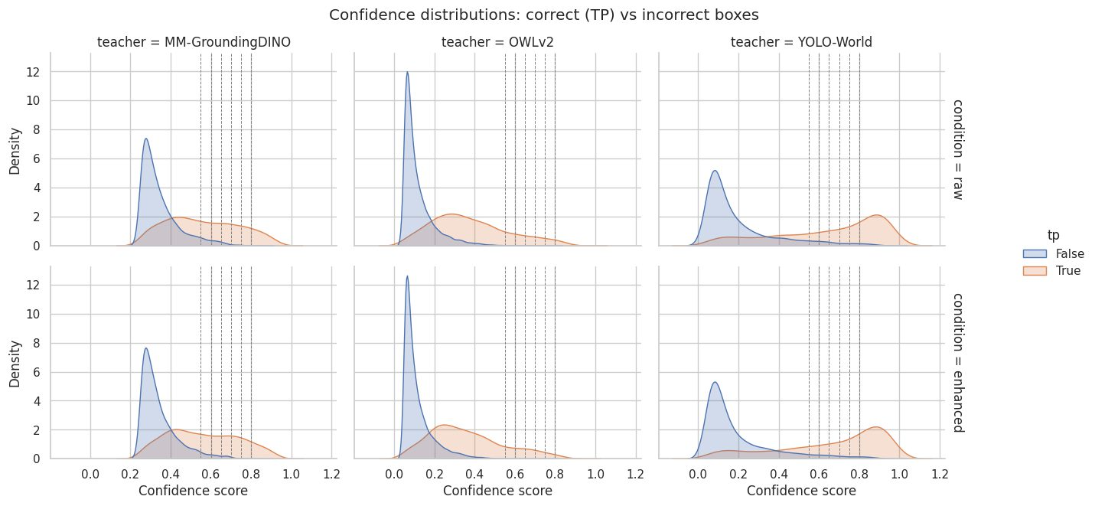
Preliminary phase: VLM prediction confidence separation
Clearer separation indicates better distinction between correct and incorrect predictions and hence pseudo-label quality. YOLO-World separation is best.
Notes:
[45 s · by 3:05] Figure first: YOLO-World's correct boxes pile up at high confidence, OWLv2's do not.
Then the table shows why that matters. OWLv2 wins on precision and is still unusable — 265 boxes against 1,996 ground-truth boxes, with five classes at zero F1.
Say it out loud: precision is not a selection criterion on its own. Coverage decides it.

