Slide 1
HP-WAN Use Case: Distributed Data Management (DDM) Supporting Big Science
July 23, 2024
IETF120-Sidemeeting-High-performance WAN

Slide 2
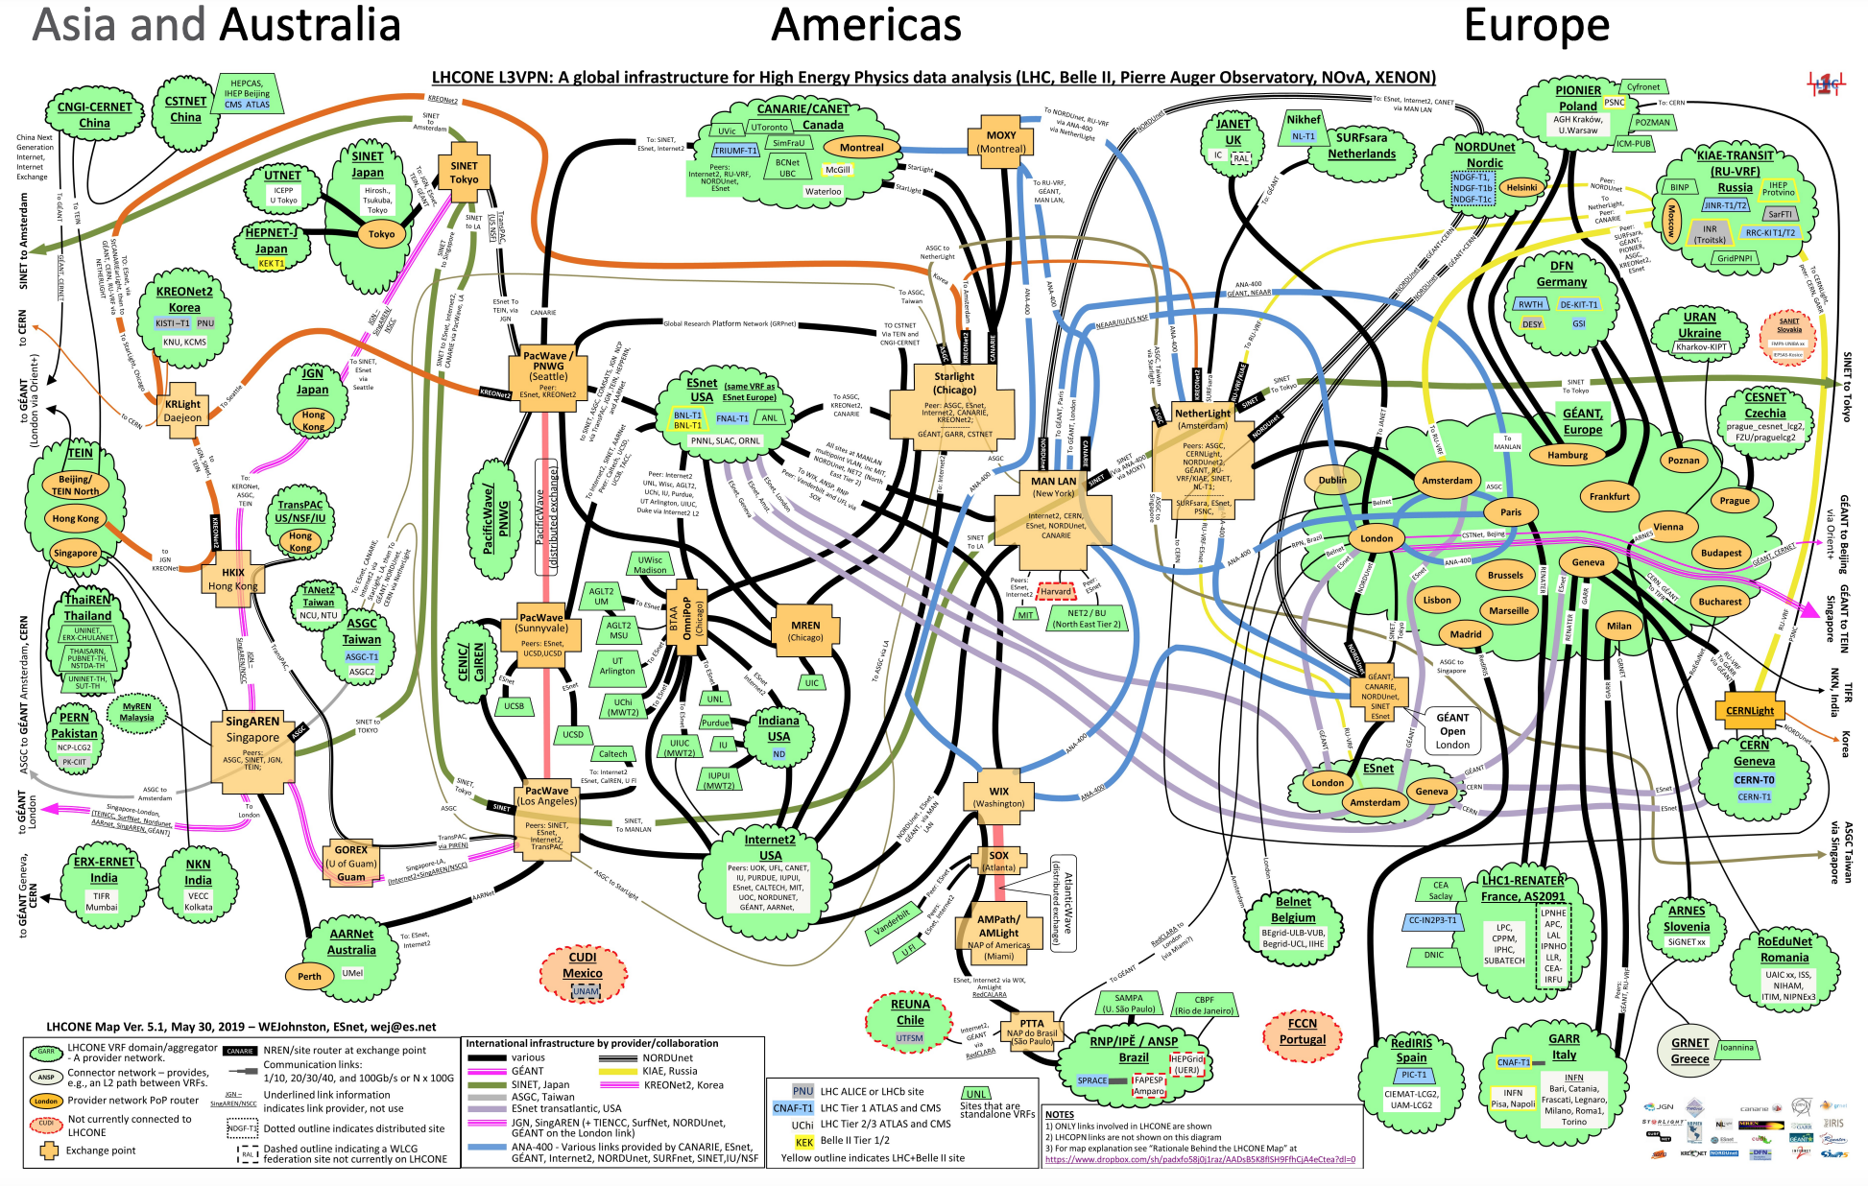
Use Case: Distributed Data Management (DDM) Supporting Big Science
Setting
A set of storage elements {SEi} distributed in a set of networks, connected by WAN, e.g., LHCONE [1] shown on the right
End users, control programs, or distributed computing systems issue data management commands, e.g.,
rucio download user.jdoe:user.jdoe.test.container.1234.1
rucio add-rule scope:first_dataset scope:second_dataset 2 'tier=2&country=uk\site=GLASGOW’
Control: Data moves between {SEi} controlled by a control plane
Orchestrator, e.g., Rucio [2]
Keeps data catalog
Determines source/destination of transfers
Monitors transfer outcomes and recovers if there are failures
Scheduler: e.g., FTS [3]
Finishes transfer requests from orchestrator
Schedules transfers to maximize efficiency, satisfy total transport capacity constraints, and share transfer capacities
Benefits of high-performance WAN
Reduce workflow latency, predictability
[1] https://twiki.cern.ch/twiki/bin/view/LHCONE/LhcOneMaps
[2] https://rucio.github.io
[3] https://fts.web.cern.ch/fts/

Slide 3

High-Level Network Related Components and Gaps
Source/destination selection
Need network cost/perf metrics
Path/route set up, if allowed
Need API for (dynamic) routing setup for given source/dest
Congestion control control (CCC)
Need ability to satisfy constraints, share transfer capacity
Control-plane/data plane interaction
WebDAV as main control, but lacking capabilities such as feedback [1]
g1
g2
g3
Circle: SE; rectangle: Control plane (e.g.,FTS)
[1] https://twiki.cern.ch/twiki/bin/view/LCG/HttpTpcTechnical

Slide 4
Potential Suggestion
Joint use case and gap analysis with other use cases
DDM use case (throughput focused, persistent traffic) vs distributed (WAN) training (latency important as well, on-off traffic)

