Slide 1
MSc Thesis Defense
A Hierarchical Time-Aware
Transformer for Flow-Level
Network Intrusion Detection
Xiaoyan Xiong | Supervisor: Le Viet Duc
25-minute defense
Notes:
Good morning, and thank you for coming to my thesis defense. My name is Xiaoyan Xiong. Today I will present my work, titled A Hierarchical Time-Aware Transformer for Flow-Level Network Intrusion Detection. The main idea is quite simple: network traffic has more than one level of structure. Packets form a flow, and related flows form a wider pattern of behaviour. My model follows this structure with two separate stages. Stage 1 learns what happens inside one flow. Stage 2 studies how earlier related flows can change the meaning of the current flow. I will first explain the basic networking concepts, then the model and evaluation, and finally the main results and limitations. To make the rest of the presentation easier to follow, I will start with the difference between a packet and a flow.
[Sources]
- Thesis: A Hierarchical Time-Aware Transformer for Flow-Level Network Intrusion Detection, Xiaoyan Xiong, 2026.

Slide 2
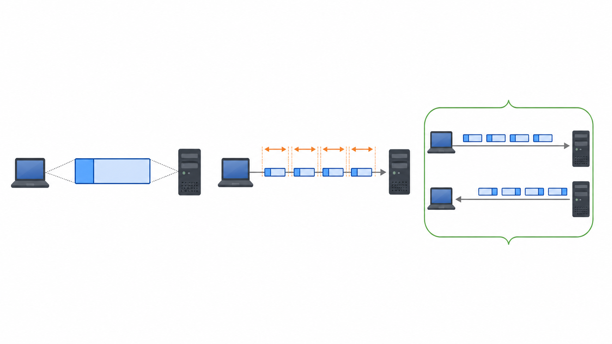
Packets are units; flows are network conversations
PACKET
PACKET SEQUENCE
FLOW
One transmitted unit with header metadata and a data length.
Ordered packets reveal direction, bursts, and unequal time gaps.
Related packets grouped by endpoints and protocol; statistics summarize the whole conversation.
This thesis keeps both views: packet dynamics inside each flow, and statistical/context information around the flow.
02
Notes:
Let me begin with two basic terms. A packet is one small unit transmitted through a network. We can think of it as one envelope. It has header information, such as a timestamp, source and destination, protocol, length, direction, and control flags. One packet gives only a small part of the communication. A flow is a group of related packets that belong to the same network conversation. In this thesis, the flow is bidirectional, so it can contain packets going from the client to the server and packets coming back. The order of the packets is useful. The time gaps are also useful. For example, the same packet order may happen in a very fast burst or over several seconds. Traditional flow statistics summarize the whole conversation with values such as duration, packet count, bytes, rates, and inter-arrival statistics. These summaries are efficient, but they cannot fully reconstruct how the flow developed. My thesis therefore keeps the packet sequence and the flow-level information. Now that these two terms are clear, I can explain the detection problem.
[Sources]
- Thesis: A Hierarchical Time-Aware Transformer for Flow-Level Network Intrusion Detection, Xiaoyan Xiong, 2026.

Slide 3
Network intrusion detection must balance detail and scalability
Raw packets
Aggregate flows
Independent decisions
Fine-grained order and timing
High volume and variable length
Compact and efficient
But packet dynamics disappear
Easy to deploy
But related behaviour is ignored
Research gap
Most systems model packet dynamics or cross-flow context — rarely both in one controlled hierarchy.
03
Notes:
A network intrusion detection system, or NIDS, monitors traffic and tries to identify suspicious activity. Rule-based systems such as Suricata are useful because their alerts are understandable and they work well for known patterns. Learning-based systems try to learn additional patterns from data. The difficulty is choosing the right representation. Raw packets preserve fine detail, but packet data are large and every flow has a different length. Aggregate flow records are compact and efficient, but packet order, direction changes, bursts, and unequal time gaps may disappear. There is also a second problem. Many detectors classify every flow independently. However, activities such as scanning, password guessing, repeated retries, or distributed attacks may only become clear when several related flows are viewed together. So there are two information losses: one inside a flow, and one between flows. This leads directly to the research gap and to the two research questions in my thesis.
[Sources]
- Thesis: A Hierarchical Time-Aware Transformer for Flow-Level Network Intrusion Detection, Xiaoyan Xiong, 2026.

Slide 4
The thesis asks two questions at two traffic levels
RQ1 — INTRA-FLOW
RQ2 — CROSS-FLOW
Does time-aware packet-sequence modelling produce more informative flow representations than flow-level aggregation alone?
Does incorporating cross-flow context improve flow-level intrusion detection compared with independent per-flow classification?
Research logic
Packets → Stage 1 flow representation → Stage 2 historical context → final flow-level prediction
Four contributions
•
Aligned extraction and leakage-controlled preprocessing
•
Position + cumulative-time packet encoding
•
Bounded statistical conditioning and target-query attention
•
Chronological internal and external evaluation
04
Notes:
The thesis uses two research questions. RQ1 asks: Does time-aware packet-sequence modelling produce more informative flow representations than flow-level aggregation alone? This question focuses on the intra-flow level, meaning the packets inside one flow. RQ2 asks: Does incorporating cross-flow context improve flow-level intrusion detection compared with independent per-flow classification? This question focuses on the inter-flow level, meaning the relation between the current flow and earlier flows. The research logic follows these two questions. First, Stage 1 turns an ordered packet sequence into one flow representation. Then Stage 2 adds historical context before the final flow-level prediction. The work contributes the aligned extraction pipeline, the time-aware packet encoder, bounded statistical conditioning, target-query context attention, and chronological internal and external evaluation. Before explaining the two stages, I will show how the data were constructed.
[Sources]
- Thesis: A Hierarchical Time-Aware Transformer for Flow-Level Network Intrusion Detection, Xiaoyan Xiong, 2026.

Slide 5
The dataset is large, chronological, and strongly imbalanced
8.62 GB
11.75 M
421,898
3.945%
enterprise PCAP
packet records
flow records
class-1 prevalence
PCAP
Suricata +
custom logger
aligned packet
& flow CSVs
70 / 10 / 20%
chronological split
model tensors
Weak labels: class 1 means at least one Suricata alert in the flow.
05
Notes:
The main source dataset is an enterprise packet capture of about 8.62 gigabytes. I used Suricata with a custom C output module. The module writes a packet CSV and a flow CSV during the same replay, so packet-to-flow alignment is retained through a common flow identifier. The raw output contains about 11.75 million packet rows and 421,898 flow rows. Only 16,644 flows belong to class 1, which gives a positive prevalence of 3.945 percent. This strong imbalance is important for the metric choices later. Flows are sorted by start time. The earliest 70 percent are used for training, the following 10 percent for validation, and the latest 20 percent for testing. Data-dependent preprocessing, such as clipping, robust scaling, and category vocabularies, is fitted only on training data. One limitation must be stated clearly: the target is alert-derived. Class 1 means that at least one packet triggered a configured Suricata alert. It is weak supervision, not independently verified attack ground truth. With this data interface in place, we can now look at the complete two-stage framework.
[Sources]
- Thesis: A Hierarchical Time-Aware Transformer for Flow-Level Network Intrusion Detection, Xiaoyan Xiong, 2026.

Slide 6
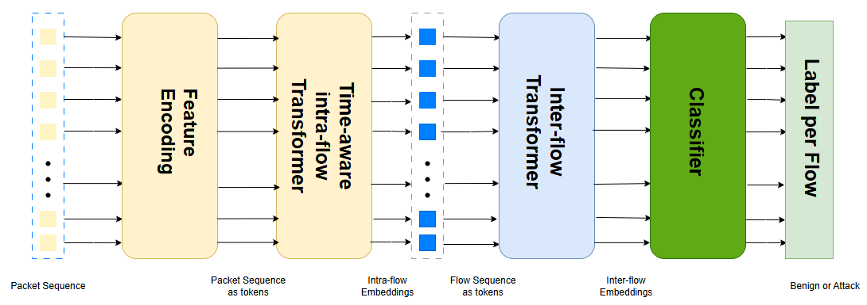
The model preserves two levels of traffic structure
Stage 1 learns how a flow develops. Stage 2 asks whether earlier related flows change its meaning.
06
Notes:
This figure summarizes the whole framework. On the left, a packet sequence enters Stage 1. Each packet becomes a token, and the intra-flow Transformer produces one fixed-length embedding for the complete flow. This embedding is a compact representation of how the flow developed. On the right, Stage 2 treats these flow embeddings as a new sequence. The target flow is combined with selected earlier flow embeddings, and the final classifier produces the probability for that target flow. The two stages have different jobs, and they are trained sequentially. Stage 1 focuses on representation inside one flow. Stage 2 focuses on context between flows. Keeping the stages separate also makes the experiments easier to understand, because I can first test the packet representation and then test the extra value of context. I will now explain Stage 1 in more detail, starting with time-aware encoding.
[Sources]
- Thesis Figure: overall framework, generated from the author's implementation.

Slide 7
Stage 1 encodes packet order and elapsed time separately
Packet position
Cumulative time
Where does the packet occur?
How much time has elapsed?
Time-aware
sinusoidal
encoding
1 2 3 4 5
0 μs 8 μs 13 μs 2.1 s
Why both?
Identical packet order can represent a burst or a slow interaction. Position and elapsed time provide complementary evidence.
07
Notes:
Stage 1 receives at most 128 selected packets from each flow. Standard positional encoding answers one question: where is this packet in the sequence? It tells the model whether the packet is first, second, or later. But position alone does not answer how much real time passed. Two adjacent packets may be separated by eight microseconds or by two seconds. I therefore use a second coordinate based on cumulative elapsed time. The packet inter-arrival time is stored with a logarithmic transform, reconstructed in the model, accumulated, and smoothed again. This time coordinate is combined with ordinal position in the sinusoidal encoding. The model therefore sees both order and elapsed time. I also test position only, time only, both coordinates, and no encoding. This is important because simply adding an interval as one feature is not the same as using time as the coordinate of the sequence. After encoding packet order and time, Stage 1 still needs to combine packet evidence with aggregate flow statistics.
[Sources]
- Thesis: A Hierarchical Time-Aware Transformer for Flow-Level Network Intrusion Detection, Xiaoyan Xiong, 2026.

Slide 8
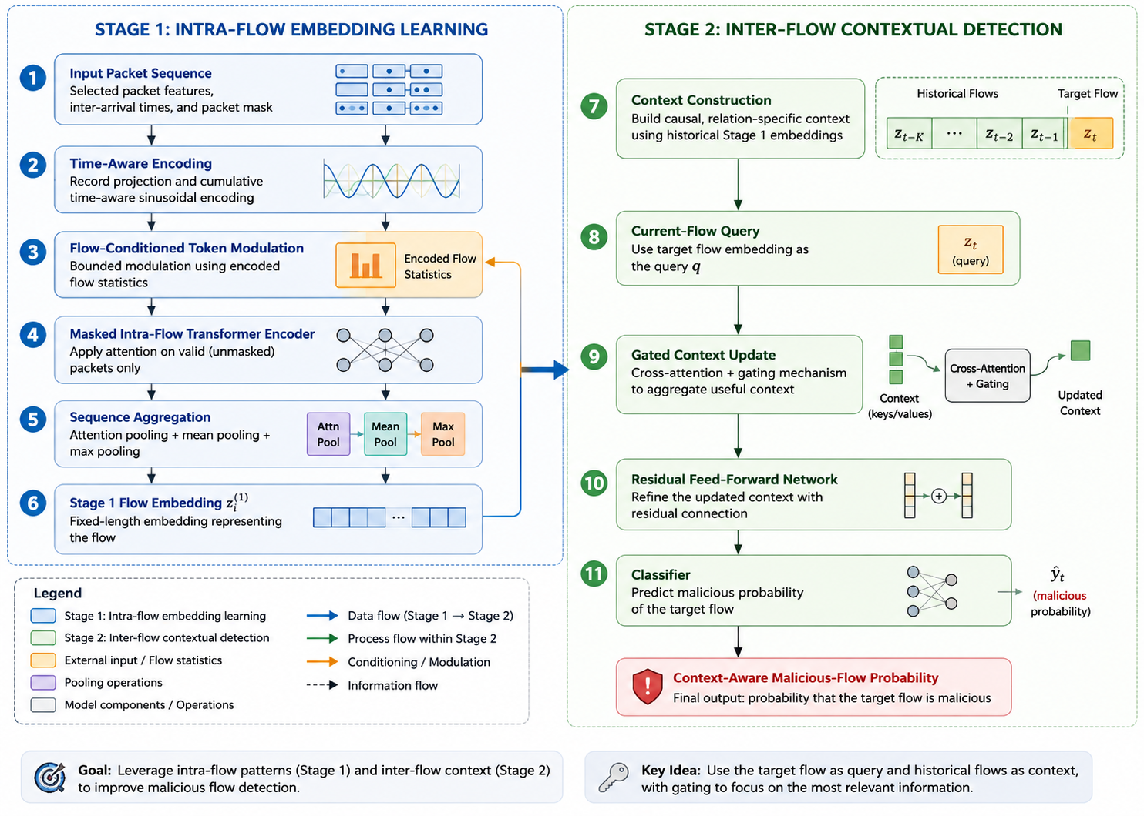
Stage 1 — Intra-flow embedding learning
Stage 1 output
One fixed 128-dimensional embedding per flow
Key design
Flow statistics condition packet tokens through a bounded residual.
08
Notes:
This slide shows the detailed Stage 1 pipeline. First, the selected packet features are projected into a 128-dimensional model space. Second, the time-aware encoding is added. Third, the flow-statistics vector is processed by a separate small network. Instead of copying the same statistics to every packet, the encoded statistics create a bounded correction for the packet tokens. I use a small initial scale and a maximum residual ratio, so training begins close to the packet-only pathway. The conditioned packet sequence enters a masked Transformer. Padding is excluded from attention. This stage is not causal inside the completed flow, because every retained packet may attend to every other retained packet. Finally, three pooling operations are combined: learned attention pooling, mean pooling, and maximum pooling. The output is one 128-dimensional embedding for each flow. This embedding is exported before the final Stage 1 classifier. That exported representation becomes the input to Stage 2, which has a different task: modelling historical context.
[Sources]
- Thesis Figure: detailed architectural overview, created for the thesis.

Slide 9
Stage 2 — Causal inter-flow context modelling
target z(t)
= query
final
logits
z(t-4)
z(t-3)
z(t-2)
z(t-1)
Relation policies
Eligibility and masking
Source host
Destination host
same initiator
same receiver
• earlier in stable start-time order
• no future embeddings or historical labels
• left padding excluded by the context mask
Endpoint
Time only
either endpoint
global recency
Scope: start-time ordered, but not yet strict flow-completion-time streaming.
09
Notes:
Stage 2 operates on flow embeddings, not on raw packets. For each target flow, I first collect eligible earlier flows. Four relation policies are tested. Source-host context uses flows initiated by the same source. Destination-host context uses flows sent to the same destination. Endpoint context allows either endpoint to match. Time-only context simply uses recent flows globally. The current flow is placed at the final valid position. It provides one query, while the historical embeddings provide keys and values. The attention result is a summary of the relevant history. A learned gate then decides how much this summary should update the current-flow representation. Future embeddings and historical labels are never used, and padding is masked. However, I use the term causal carefully. The implementation is causal in stable flow-start order. It does not require an earlier long flow to be completed before the target starts. Therefore, it is not yet a fully timed streaming system. This limitation will return near the end. Before viewing the results, I will briefly explain how models and thresholds were evaluated.
[Sources]
- Thesis: A Hierarchical Time-Aware Transformer for Flow-Level Network Intrusion Detection, Xiaoyan Xiong, 2026.

Slide 10
Evaluation focuses on class balance and operational errors
Macro-F1
PR-AUC
Equal weight to class 0 and class 1
Positive-class ranking across thresholds
Class-1 F1
FPR + FP / FN
Precision–recall balance at one threshold
False-alert rate and absolute errors
Model-selection protocol
1 Select checkpoint by validation PR-AUC
2 Select threshold by validation class-1 F1
3 Evaluate the untouched chronological test set
Accuracy is secondary: an always-negative rule would score about 96.1% on the raw data and detect no positive flow.
10
Notes:
Because class 1 is rare, accuracy can give a misleading impression. An always-negative model would score about 96.1 percent accuracy on the raw data, but it would detect no positive flow. I therefore give more weight to macro-F1, PR-AUC, class-1 F1, false-positive rate, and the absolute numbers of false positives and false negatives. Macro-F1 gives equal importance to the two classes. PR-AUC evaluates how well the model ranks the positive class across thresholds. Class-1 F1 describes the precision and recall balance at the selected operating point. The selection protocol has three steps. First, I choose the checkpoint using validation PR-AUC. Second, I choose the decision threshold using validation class-1 F1. Third, I apply the fixed checkpoint and threshold to the untouched chronological test data. All models inside one comparison block use the same manifest and preprocessing state. With this protocol defined, I will first answer RQ1 using the Stage 1 results.
[Sources]
- Thesis: A Hierarchical Time-Aware Transformer for Flow-Level Network Intrusion Detection, Xiaoyan Xiong, 2026.

Slide 11
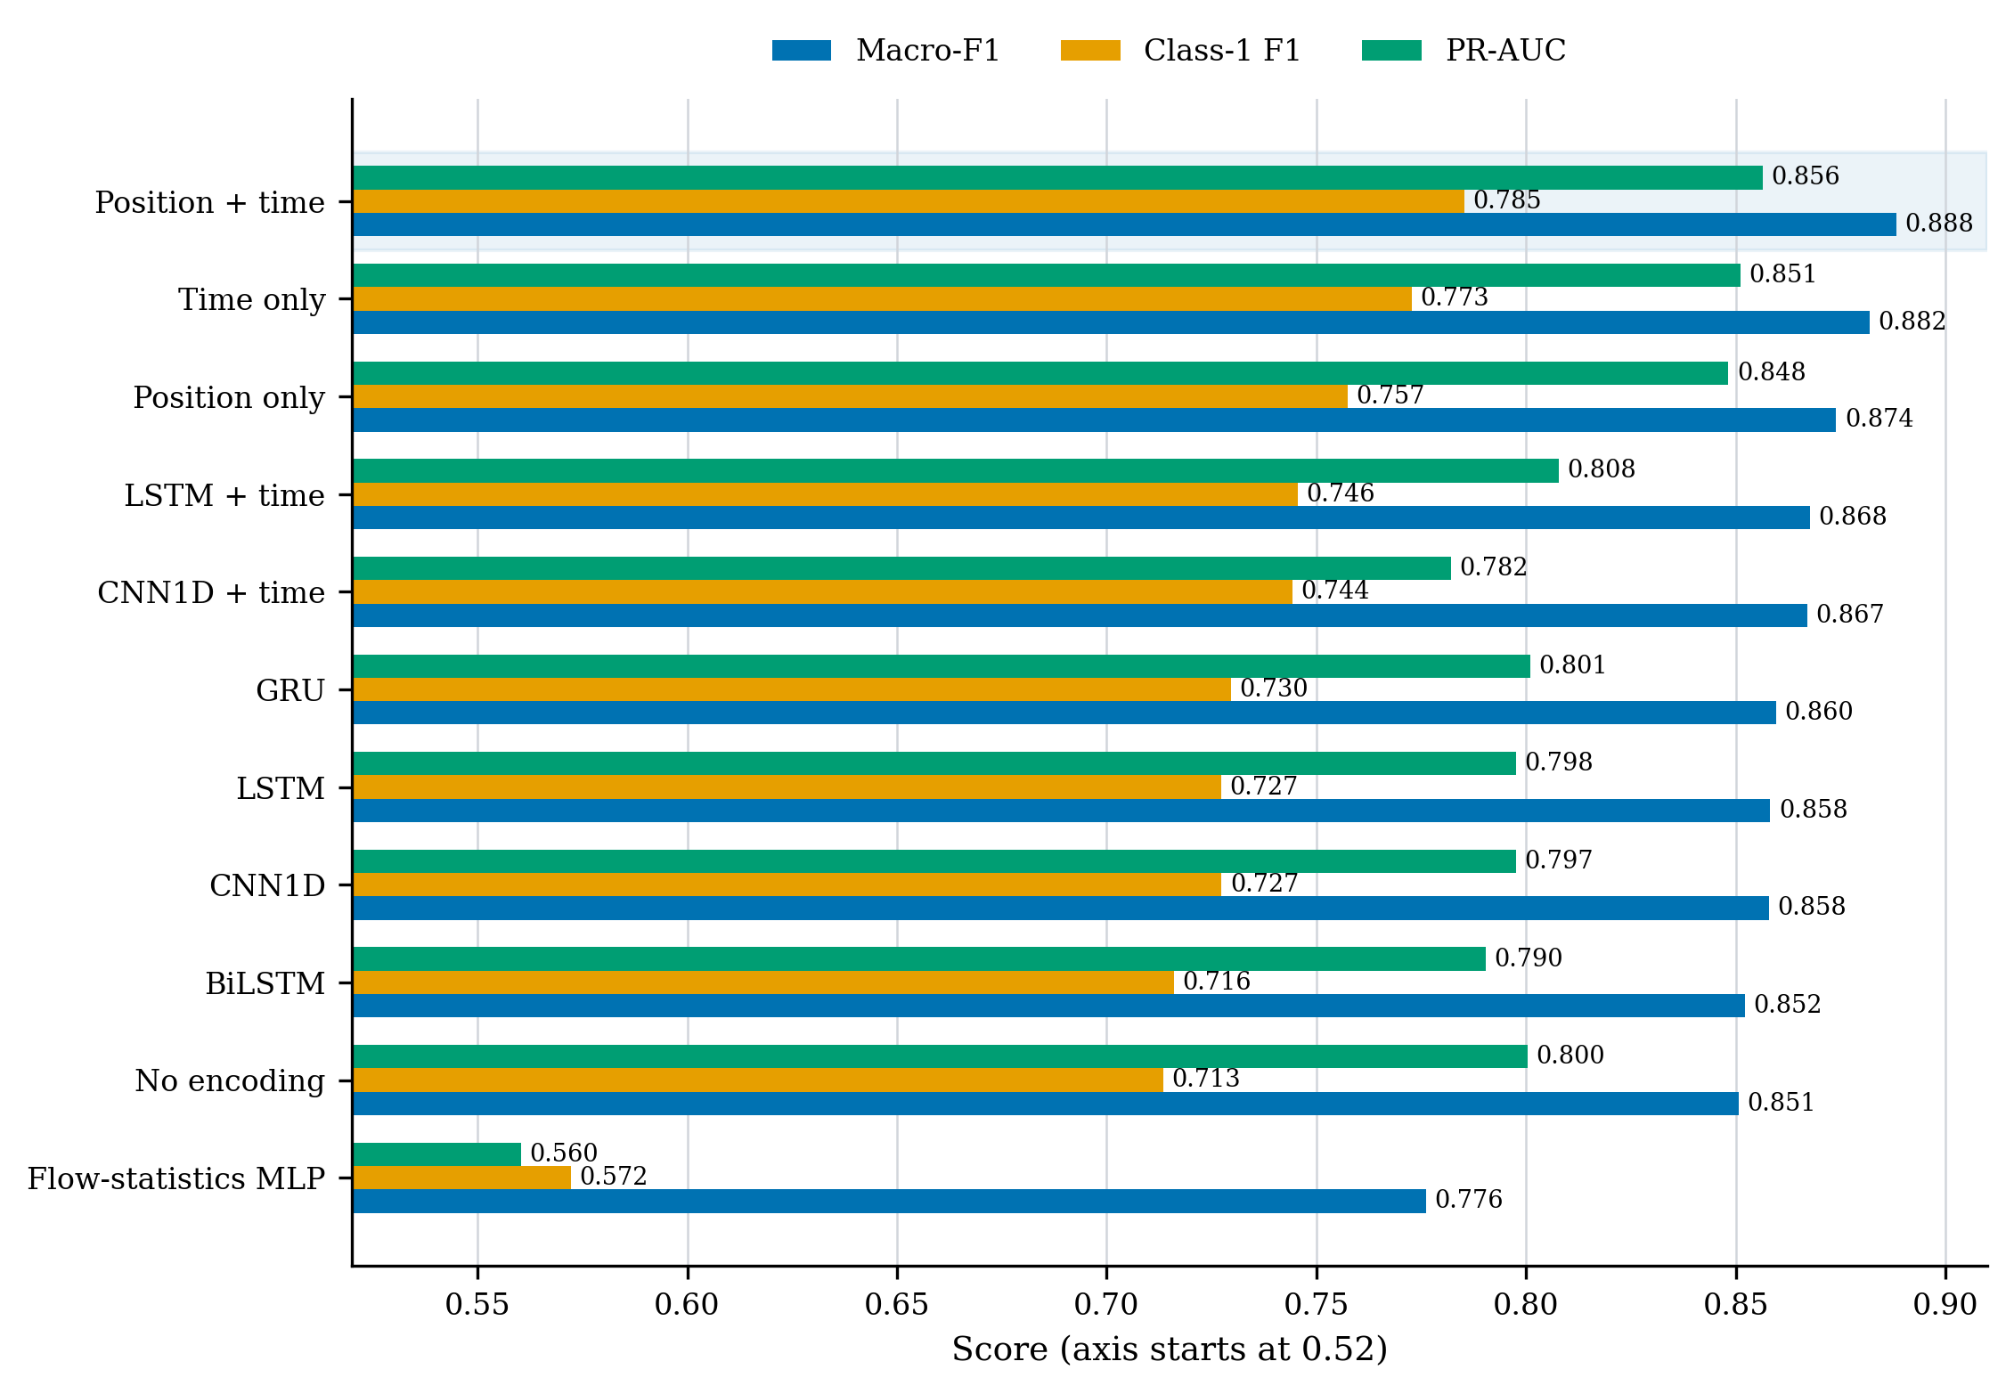
Stage 1 results — Position + time works best
Position + time
Macro-F1 0.8882 | PR-AUC 0.8564 | 296 FP | 306 FN
vs. flow MLP
+0.112 macro-F1
11
Notes:
This chart compares Stage 1 model families and encoding variants on the same controlled test manifest. The position-plus-time Transformer gives the strongest overall balance. It reaches a macro-F1 of 0.8882 and a PR-AUC of 0.8564. It performs better than the flow-statistics MLP, the LSTM, GRU, BiLSTM, CNN models, and the no-encoding Transformer. The comparison with the flow MLP is especially important because it directly tests whether the packet sequence adds information beyond aggregation. The macro-F1 difference is about 0.112. Looking at the encoding controls, time only is stronger than position only, and combining the two is stronger than either one alone. This supports the main answer to RQ1: the model benefits from knowing both where a packet occurs and how much time has passed. The next experiment asks how aggregate statistics should be added to this packet representation.
[Sources]
- Thesis results: Stage 1 model comparison on the common controlled test manifest.

Slide 12
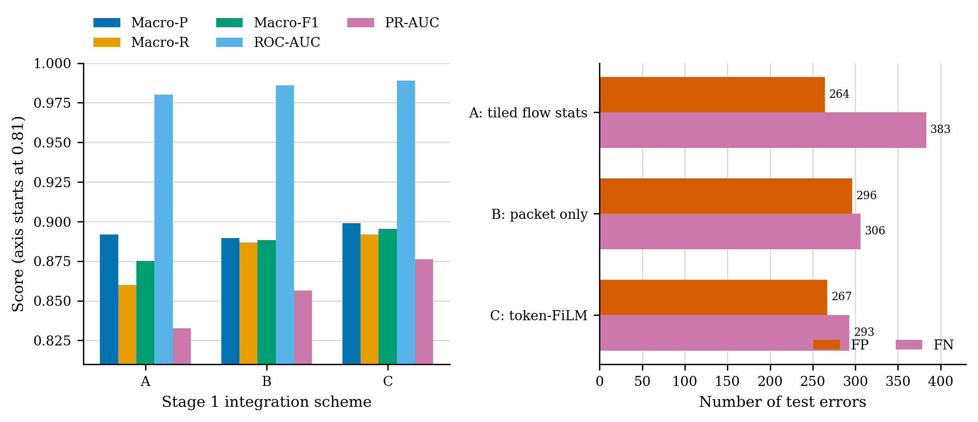
Stage 1 results — Separate statistical conditioning works best
Scheme A
repeat flow statistics
Scheme B
packet only
Scheme C
macro-F1 0.8954 | PR-AUC 0.8763 | 267 FP | 293 FN
12
Notes:
This ablation compares three integration schemes. Scheme A repeats, or tiles, the statistical flow vector at every packet position. Scheme B removes the statistical branch and uses packets only. Scheme C is the proposed design. It encodes the statistics once and uses bounded token modulation. Scheme B already improves over Scheme A, which suggests that repeating one aggregate vector may interfere with differences between packet tokens. Scheme C gives the strongest result. It reaches macro-F1 of 0.8954, PR-AUC of 0.8763, with 267 false positives and 293 false negatives. Both error counts are lower than in the packet-only scheme. The careful conclusion is that aggregate statistics still add useful global information when they condition the packet pathway. I do not claim that the entire gain comes only from the modulation operation, because Scheme C also changes capacity. Having established the Stage 1 representation, I now move to RQ2 and the Stage 2 context results.
[Sources]
- Thesis results: Stage 1 packet and flow-statistics integration ablation.

Slide 13
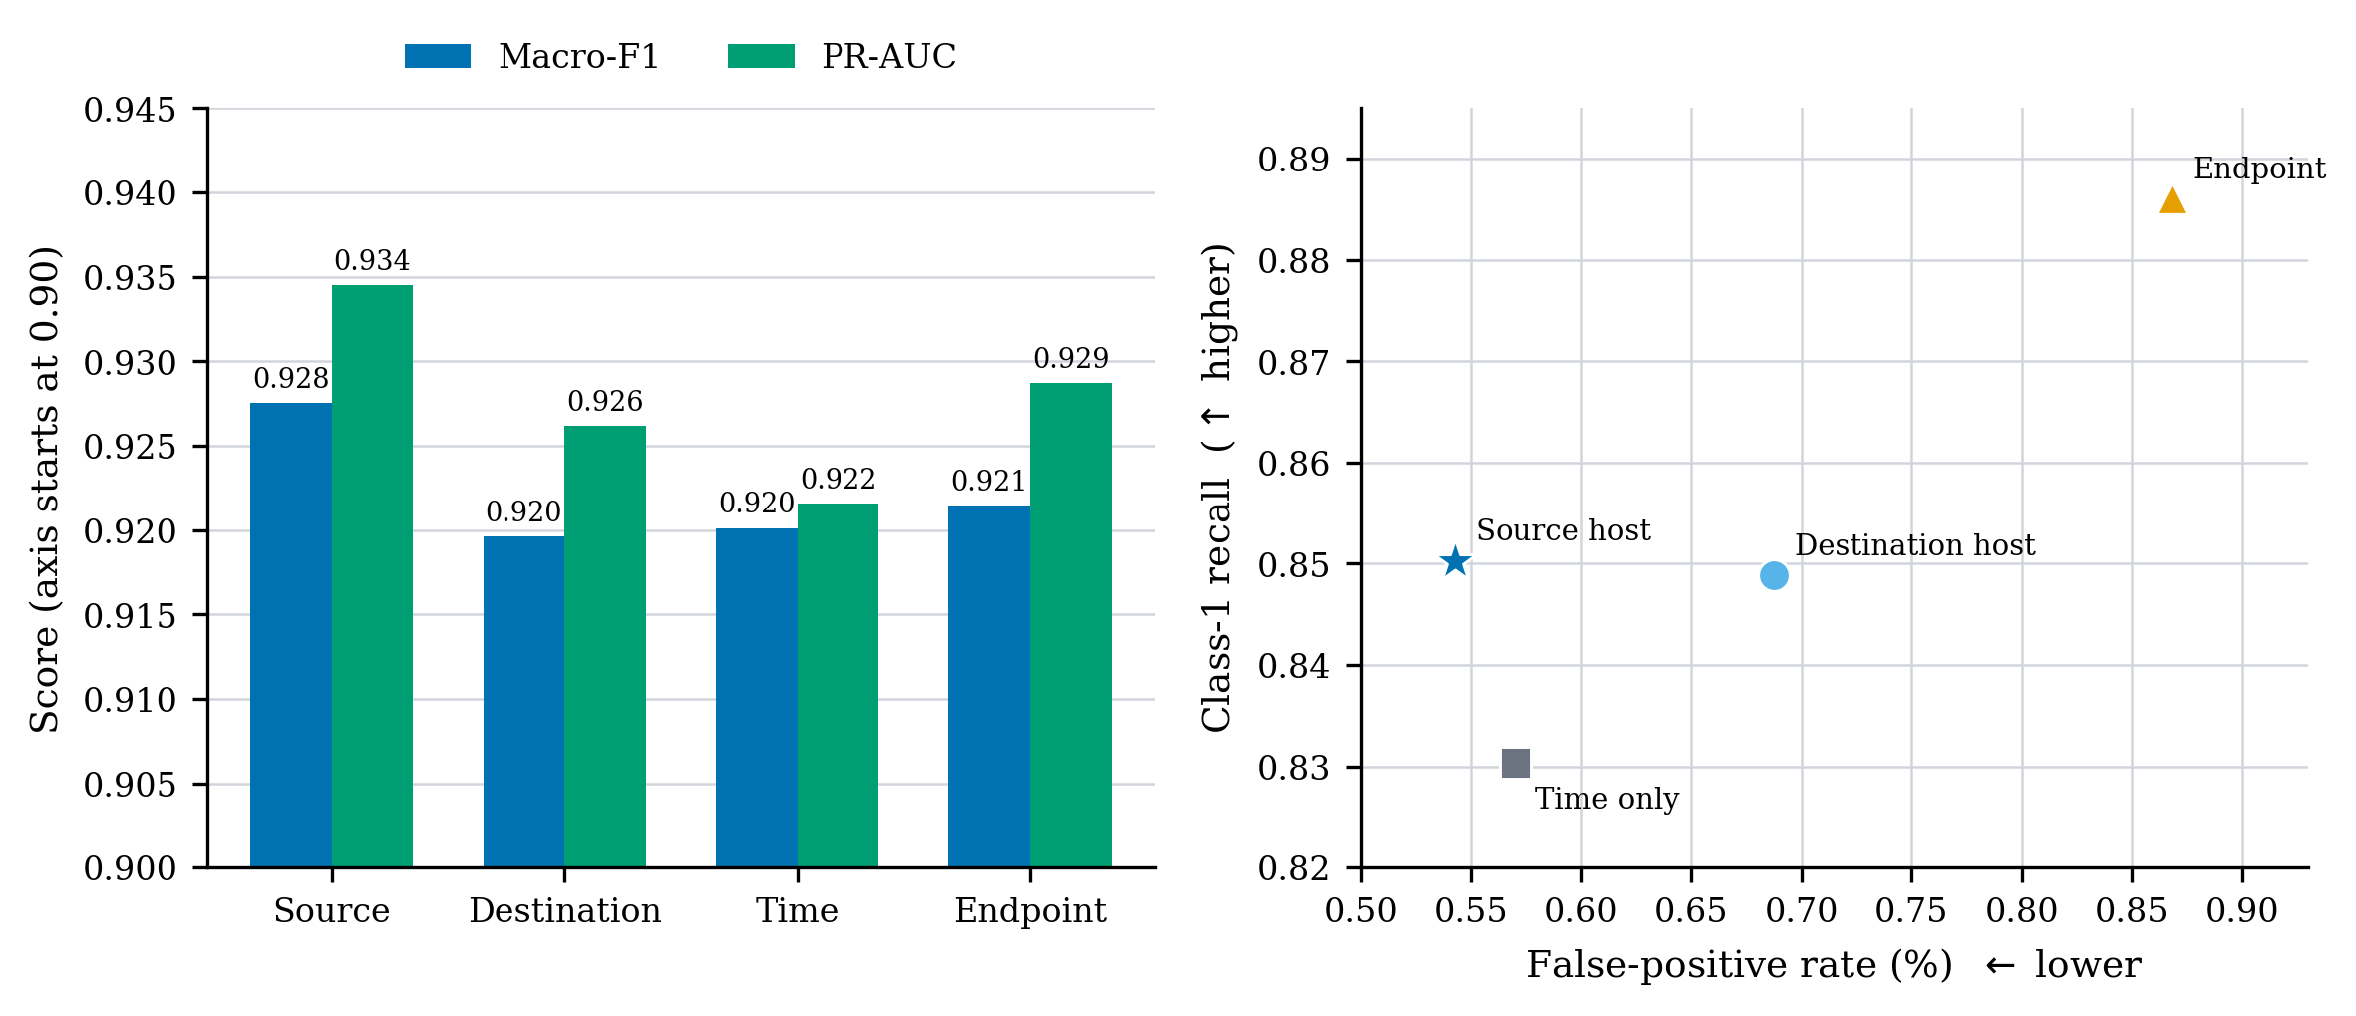
Stage 2 results — Source-host history gives the best balance
Source host
macro-F1 0.9275 | PR-AUC 0.9345 | class-1 recall 0.8503 | FPR 0.5429%
13
Notes:
This experiment keeps the Stage 2 model and context capacity fixed, while changing only the relation used to select historical flows. Source-host history gives the best overall balance. It reaches macro-F1 of 0.9275, PR-AUC of 0.9345, class-1 recall of about 0.8503, and the lowest false-positive rate among these relations, at 0.5429 percent. Endpoint context has higher class-1 recall, which means it misses fewer positives, but it also creates more false positives. Destination history and global time-only history are weaker overall. One possible explanation is that repeated outbound activity from the same source may preserve patterns such as scanning, retries, or coordinated connections. However, this is only a possible mechanism. The labels are binary, so they cannot show which attack families produced the gain. After selecting source-host context, I compare different Stage 2 architectures on the same histories.
[Sources]
- Thesis results: Stage 2 context-relation ablation at window size 128.

Slide 14
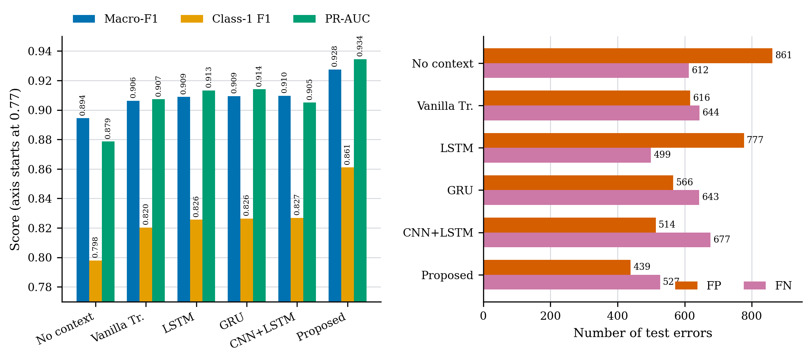
Stage 2 results — Target-query attention reduces errors
Proposed model
macro-F1 0.9275 | class-1 F1 0.8610 | PR-AUC 0.9345
vs. vanilla Transformer
−177 FP, −117 FN
14
Notes:
This chart compares the proposed target-query model with a no-context head, a vanilla Transformer, LSTM, GRU, and CNN-plus-LSTM. The Stage 1 embeddings, source-host histories, window size, training objective, checkpoint rule, and threshold protocol are fixed. The proposed model gives the strongest combined result: macro-F1 of 0.9275, class-1 F1 of 0.8610, and PR-AUC of 0.9345. Compared with the vanilla Transformer, it removes 177 false positives and 117 false negatives on the same flows. This means the macro-F1 improvement is not achieved by simply exchanging one type of error for the other. The design keeps the current flow as the query and treats history as a gated correction. Still, the no-context head is much smaller, and the other architectures are not perfectly parameter matched. Therefore, this experiment supports the integrated design, but it does not isolate every architectural component. The final performance question is whether the learned signal transfers outside the source capture.
[Sources]
- Thesis results: Stage 2 architecture comparison on the common full-data test manifest.

Slide 15
External evaluation — Transfer varies across windows
CICIDS2017 Wednesday: five non-overlapping 20,000-flow windows
Company cross-server
Window | Positive | Macro-F1 | PR-AUC
w01 | 18.195% | 0.9125 | 0.9088
w02 | 13.515% | 0.9226 | 0.9123
w06 | 16.480% | 0.8536 | 0.8906
w07 | 13.340% | 0.8640 | 0.8419
w08 | 15.235% | 0.9220 | 0.9397
Pooled | 15.353% | 0.8966 | —
38,513 flows
3.285%
positive prevalence
0.9026
macro-F1
0.8771
PR-AUC
Interpretation
Transfer is promising, but temporal and environmental shift changes the error balance.
15
Notes:
External evaluation uses the source-trained checkpoints, the source preprocessing state, and the source validation threshold. No external label is used for retraining or model selection. The first external source is the CICIDS2017 Wednesday capture. I report five non-overlapping windows of 20,000 flows. Their positive prevalence is shown in the table and ranges from 13.340 percent to 18.195 percent. Across the five windows, the pooled positive prevalence is 15.353 percent. Window-level macro-F1 ranges from 0.8536 to 0.9226, and the pooled macro-F1 is 0.8966. The variation is important: the model transfers, but not equally across time windows. The second external source is a company capture from a different server. It contains 38,513 flows, with only 3.285 percent positive. It reaches macro-F1 of 0.9026 and PR-AUC of 0.8771. These results show useful transfer under the implemented pipeline, but they do not prove universal generalisation. This brings me to the conclusions and the limits of the evidence.
[Sources]
- Thesis external-evaluation tables: five CICIDS2017 windows and one company cross-server capture.

Slide 16
The conclusions are strong within a deliberately limited scope
What the evidence supports
What it does not yet establish
•
Packet order and elapsed time are complementary
•
Independently verified attack ground truth
•
Aggregate statistics still add information
•
Strict streaming availability at target start
•
Selective source-host context improves the tested detector
•
Statistical significance across random seeds
•
External performance remains useful but variable
•
Universal transfer across networks and attack families
16
Notes:
The evidence supports four main conclusions. First, packet position and cumulative elapsed time provide complementary information inside a flow. Second, aggregate flow statistics are still useful when they condition, rather than replace, the packet representation. Third, selective source-host history improves the tested detector beyond independent flow classification. Fourth, useful discrimination remains on the public and cross-server external evaluations, although the performance and error balance vary. The scope is equally important. The labels are derived from Suricata alerts and are not independently verified attack truth. Stage 2 is start-time ordered but not strict completion-time streaming. The experiments use one fixed random seed, so small differences do not establish statistical significance. The external coverage is limited to two sources, so the results do not establish universal transfer. Future work should include repeated seeds, parameter-matched no-context controls, attack-family labels, strict embedding-availability timing, and broader external tests. I will finish with one short takeaway.
[Sources]
- Thesis: A Hierarchical Time-Aware Transformer for Flow-Level Network Intrusion Detection, Xiaoyan Xiong, 2026.

Slide 17
Takeaway
Network traffic is hierarchical.
The detector should be too.
Stage 1: how the flow develops
Stage 2: how earlier related flows change its meaning
Questions?
Notes:
The main takeaway is this: network traffic is hierarchical, so the detector should respect that hierarchy. Stage 1 explains how one flow develops through packet order, direction, and elapsed time. Stage 2 explains how earlier related flows can change the meaning of the current flow. These two stages address different losses of information, and the experiments show that they provide complementary value in the evaluated setting. The contribution is not simply the use of a Transformer. It is the controlled design and evaluation of a two-stage representation that connects packet-level timing with selective flow-level context. Thank you very much for listening. I am ready for your questions.
[Sources]
- Thesis: A Hierarchical Time-Aware Transformer for Flow-Level Network Intrusion Detection, Xiaoyan Xiong, 2026.

