Slide 1
MSc Thesis Defense
A Hierarchical Time-Aware
Transformer for Flow-Level
Network Intrusion Detection
Xiaoyan Xiong | Supervisor: Le Viet Duc
Notes:
Good morning, and thank you for being here. My name is Xiaoyan Xiong.
Today I will present my thesis, A Hierarchical Time-Aware Transformer for Flow-Level Network Intrusion Detection.
The aim of my research is to improve flow-level network intrusion detection.
I study two kinds of information. The first is the packet details inside each flow. The second is the history of earlier related flows. I want to see whether using both can help the detector make better decisions.
First, I will introduce the basic networking concepts used in this thesis. Then, I will explain the model and evaluation. Finally, I will present the main results and limitations.
Before discussing the research problem, I will define three basic terms: packet, packet sequence, and flow.

Slide 2
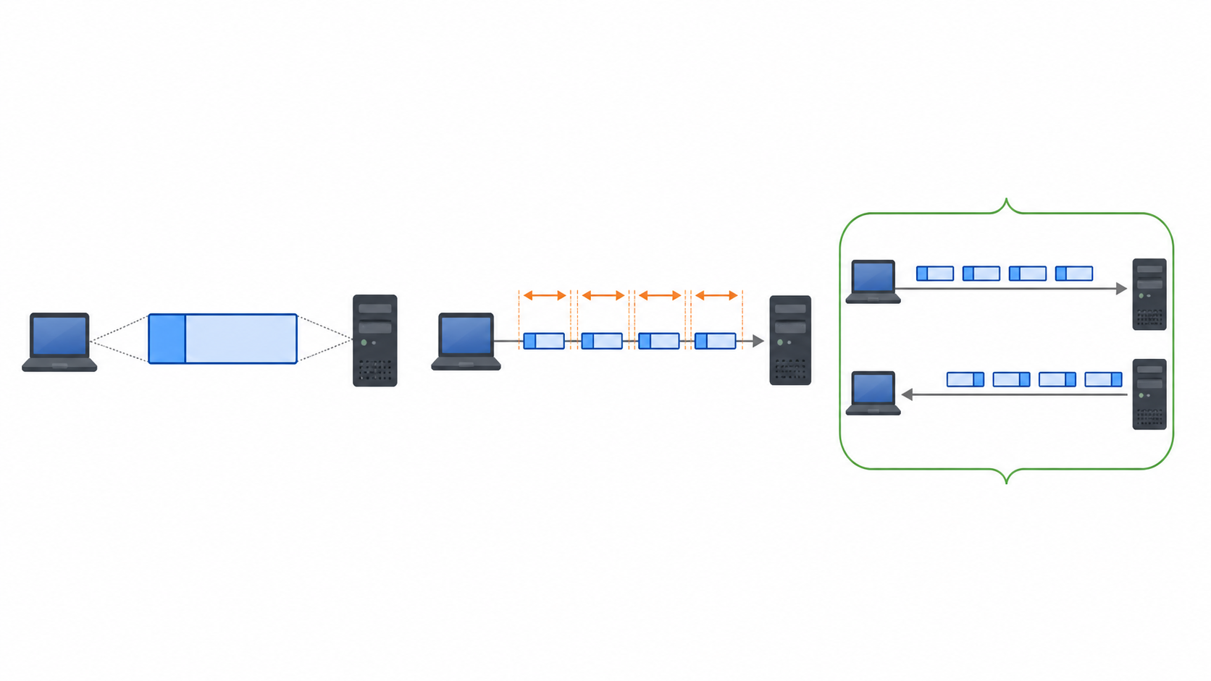
Packets are units; flows are network conversations
PACKET
PACKET SEQUENCE
FLOW
One transmitted unit with header metadata and a data length.
Ordered packets reveal direction, bursts, and unequal time gaps.
Related packets grouped by endpoints and protocol; statistics summarize the whole conversation.
This thesis keeps both views: packet dynamics inside each flow, plus flow statistics and cross-flow context.
02
Notes:
A packet is one small unit sent through a network. It contains information such as source, destination, protocol, length, direction, and control flags. One packet shows only a small part of a communication.
A packet sequence puts related packets in their original order. It shows how the communication develops, including direction changes, bursts, and different time gaps.
A flow is a group of related packets in one network conversation. In this thesis, a flow is bidirectional, so it can contain packets in both directions. Flow statistics summarise the whole conversation using values such as duration, packet counts, and byte rates.
My thesis keeps both the packet sequence and the flow-level information.
Now that these terms are clear, I can explain the detection problem.

Slide 3
Network intrusion detection must balance detail and scalability
Raw packets
Flow statistics
Independent decisions
Fine-grained order and timing
High volume and variable length
Compact and efficient
But packet dynamics disappear
Easy to deploy
But related behaviour is ignored
Research gap
Most systems model packet dynamics or cross-flow context — rarely both in one controlled hierarchy.
03
Notes:
A network intrusion detection system monitors traffic and looks for suspicious activity. Tools such as Suricata use signatures to detect known attacks. Learning-based systems try to learn more patterns from data.
The main challenge is how to represent the traffic.
Raw packet sequences keep detailed packet order and timing. They can show short bursts or unusual direction changes. However, they are large and have different lengths, so they are harder to process.
Flow statistics are more compact and have a fixed size. They are easier to store and model. However, they may lose packet order and detailed timing information.
There is another problem. Many detectors classify each flow by itself. This is simple, but it ignores relationships between flows. One flow may look normal, but several related flows together may show suspicious behaviour more clearly.
So, this thesis focuses on two types of information loss: information inside a flow and information between flows.
The next slide turns these two problems into two research questions.

Slide 4
The thesis asks two questions at two traffic levels
RQ1 — INTRA-FLOW
RQ2 — CROSS-FLOW
Does time-aware packet-sequence modelling produce more informative flow representations than flow statistics alone?
Does incorporating cross-flow context improve flow-level intrusion detection compared with independent per-flow classification?
Research logic
Packets → Stage 1 flow representation → Stage 2 start-time-ordered context → final prediction
04
Notes:
The thesis asks two research questions at two levels.
The first question is about one flow. Can time-aware packet-sequence modelling create a better flow representation?
The second question is about multiple flows. Can earlier related flows help improve detection?
These two questions define the two-stage model.
Stage 1 turns an ordered packet sequence into one flow representation.
Stage 2 adds earlier cross-flow context before making the final prediction.
Before I explain the model, I first need to show how the data were created.

Slide 5
The dataset is large, chronological, and strongly imbalanced
8.62 GB
11.75 M
421,898
3.945%
enterprise PCAP
packet records
flow records
class-1 prevalence
PCAP
Suricata +
custom logger
aligned packet
& flow CSVs
70 / 10 / 20%
chronological split
model tensors
Weak labels: class 1 means at least one Suricata alert in the flow.
05
Notes:
The data comes from an enterprise packet capture of 8.62 gigabytes.
I replayed the PCAP files through Suricata with a custom output module. This produced aligned packet records and flow records.
After preprocessing, the dataset contains 11.75 million packet rows and 421,898 flows. Only 3.945 percent of the flows are class 1, so the dataset is highly imbalanced.
I sort all flows by start time. The first 70 percent are used for training, the next 10 percent for validation, and the last 20 percent for testing.
All data preprocessing is fitted only on the training set. This helps reduce information leakage from future traffic.
One important limitation is the labels. They come from Suricata alerts. A flow is labelled as class 1 if at least one packet triggers an alert.
So, these are weak labels, not independently verified attack ground truth.
With the data ready, I can now introduce the full model.

Slide 6
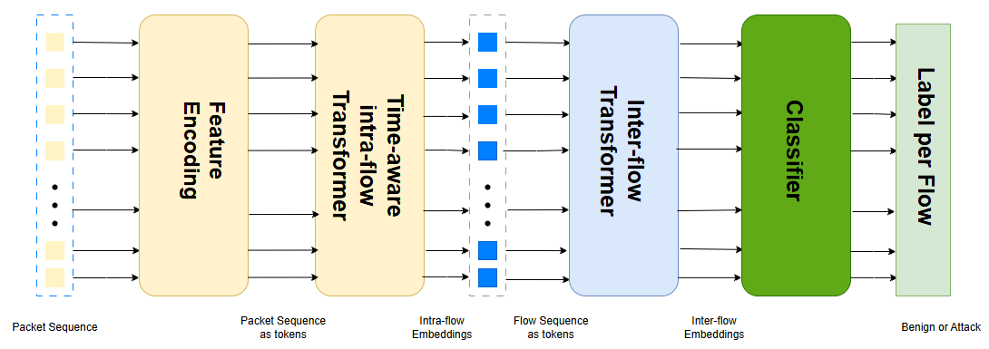
The model preserves two levels of traffic structure
Stage 1 learns how a flow develops. Stage 2 asks whether earlier related flows change its meaning.
06
Notes:
This figure shows the full two-stage model structure.
On the left is Stage 1. A packet sequence enters the model, and each packet becomes one token. The time-aware Transformer then produces one fixed-length embedding for the whole flow. This embedding describes how the flow develops.
On the right is Stage 2. Here, the flow embeddings form a new sequence. For each target flow, It combines the target flow with earlier related flows before the final prediction.
The two stages are trained separately. Stage 1 focuses on information inside one flow, while Stage 2 focuses on relationships between flows.
This is not an end-to-end design, but it makes the experiments easier to understand.
I can first test Stage 1 and then test whether cross-flow context brings extra improvement.
The two-stage structure is now clear. I will first look more closely at Stage 1. Let’s see how Stage 1 uses packet order and timing.

Slide 7
Stage 1 encodes packet order and elapsed time separately
Packet position
Cumulative time
Where does the packet occur?
How much time has elapsed?
Time-aware
sinusoidal
encoding
1 2 3 4 5
0 μs 8 μs 13 μs 2.1 s
Why both?
Identical packet order can represent a burst or a slow interaction. Position and elapsed time provide complementary evidence.
07
Notes:
Stage 1 uses two temporal signals.
The first signal is Packet position. It tells where a packet is in the sequence.
The second signal is Cumulative time. It tells how much real time has passed.
These signals describe different information. position describes the order, cumulative time describes the pace of the communication.
I combine these two signals in a time-aware sinusoidal encoding.
I also compare four settings: both position and time, position only, time only, and no encoding. This helps me to understand them more .
The next slide shows the complete Stage 1 pipeline.

Slide 8
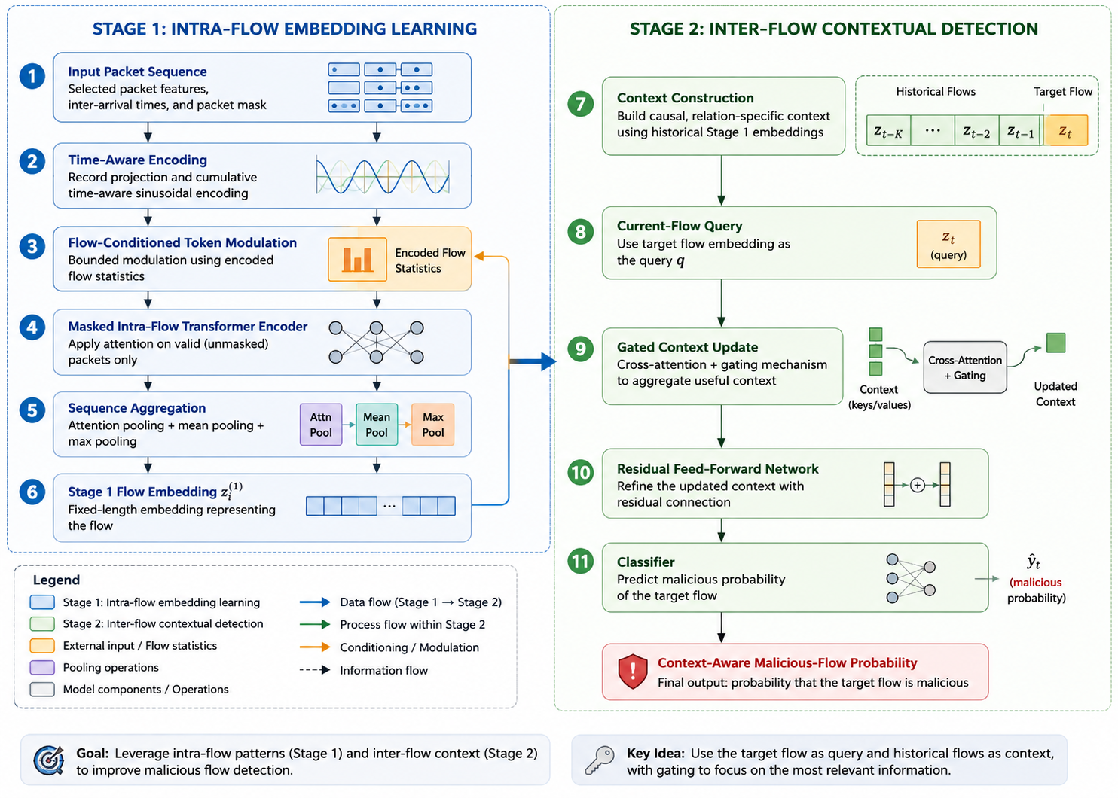
Stage 1: Intra-flow embedding learning
Stage 1 output
One fixed 128-dimensional embedding per flow
Key design
Flow statistics condition packet tokens through a bounded residual.
08
Notes:
Stage 1 has six main steps. I will follow the blue side of the figure from top to bottom.
First, the selected packet features are projected into 128 dimensions. Second, I add packet position and cumulative-time encoding.
Third, a separate network encodes the flow statistics. It uses them to make a small, bounded correction to the packet tokens.
Fourth, a Transformer processes the packet tokens. Padding is ignored, and each packet token can attend to the other packet token in the same flow.
Fifth, I combine attention pooling, mean pooling, and max pooling. These methods capture different information from the sequence.
Finally, Stage 1 produces one fixed-lenght embedding for each flow, no matter how many packets the flow contains.
Stage 2 uses these flow embeddings instead of going back to the raw packets.
I will now explain how Stage 2 pipeline.

Slide 9
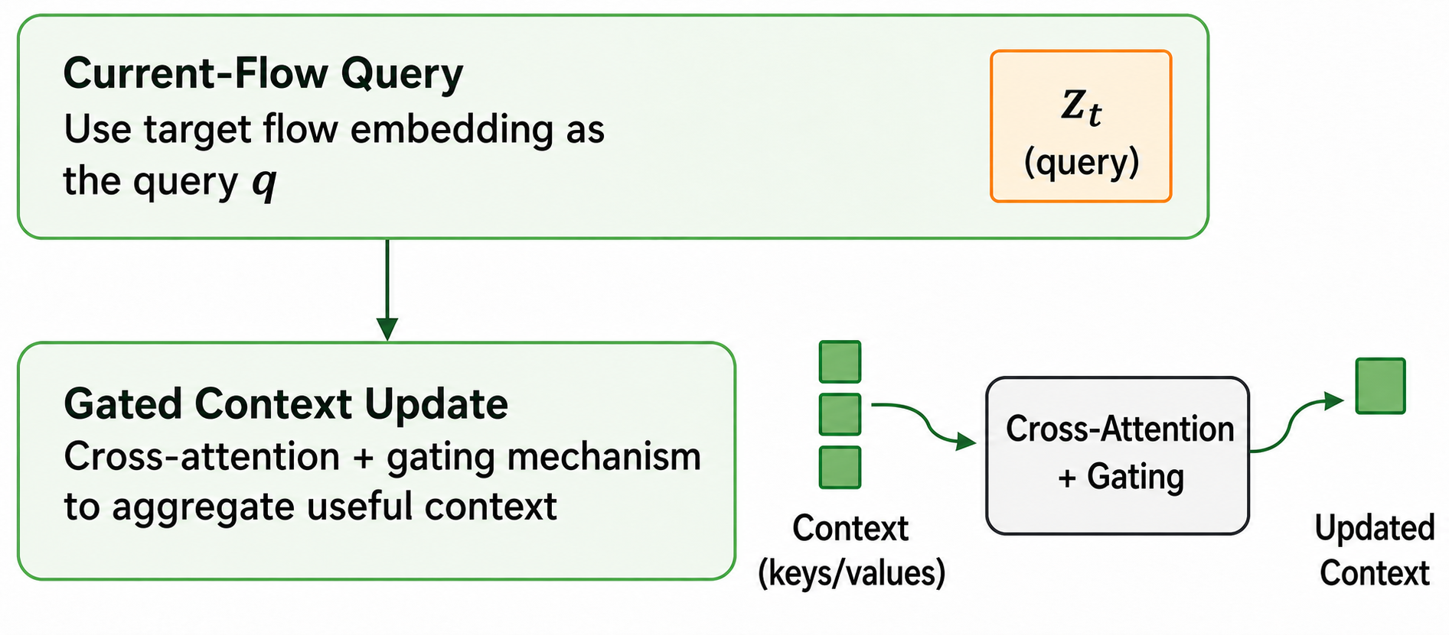
Stage 2: Start-time-ordered inter-flow modelling
target z(t)
= query
final
logits
z(t-4)
z(t-3)
z(t-2)
z(t-1)
Relation policies
Source host
Destination host
same source
same destination
Endpoint
Time only
either endpoint
global recency
Eligibility and masking
Scope: start-time ordered, but not yet strict flow-completion-time streaming.
• earlier in stable start-time order
• no future embeddings or historical labels
• left padding excluded by the context mask
09
Notes:
Stage 2 takes the flow embeddings from Stage 1.
For each target flow, it selects some earlier related flows as context, ordered by start time.
I test four types of context. Source-host uses earlier flows with the same source. Destination-host uses the same destination. Endpoint matches either endpoint. Time-only simply uses recent flows without an endpoint relation.
The current flow is the query, and the earlier flows provide the context. A learned gate controls how much this context changes the current flow representation.
The model does not use future flows or historical labels, and padding is ignored.
One limitation is that the order is based on flow start time. An earlier flow may still be running when the target flow starts. So, the setting is start-time ordered, but it is not strict completion-time streaming.
Now that both stages are clear, I will explain how I evaluate them.

Slide 10
Evaluation focuses on class balance and operational errors
Macro-F1
Average precision (AP)
Equal weight to class 0 and class 1
Reported as PR-AUC in this thesis
Class-1 F1
FPR, FP, and FN
Precision–recall balance at one threshold
False-positive rate and absolute errors
Accuracy is secondary: A model can predict every flow as negative and still get about 96% accuracy.
.
10
Notes:
Because the dataset is extremely imbalanced, accuracy can be misleading. For example, A model can predict every flow as negative and still get about 96 percent accuracy.
So, I focus on metrics that better reflect/consider both classes.
Macro-F1 gives equal importance to both classes. Class-1 F1 shows the balance between precision and recall for the positive class. False-positive rate shows how often normal flows are incorrectly flagged. FP and FN counts show the actual number of mistakes.
I also report average precision, or AP. In the thesis, I label this measure as PR-AUC. Strictly speaking they are ont extactly the same. However, both measure ranking performance across different thresholds.
With these metrics defined, I can now present the results.
I will start with packet position and timing in Stage 1.

Slide 11
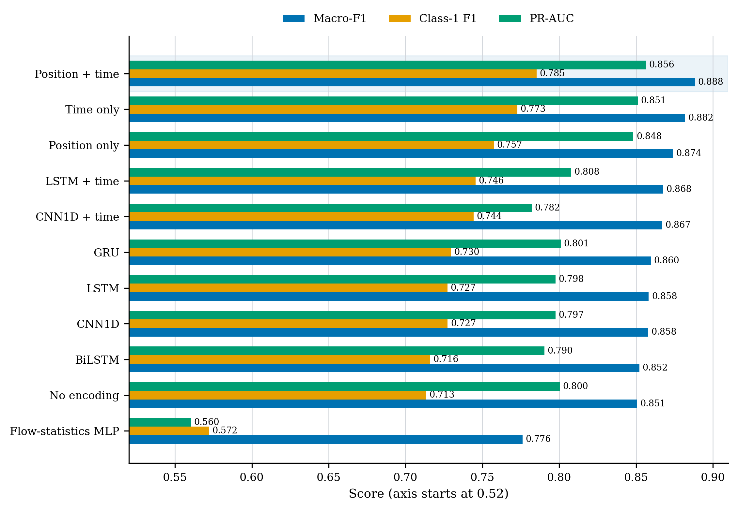
Stage 1 results: Position + time works best
Position + time
Macro-F1 0.888 | PR-AUC 0.856
vs. flow MLP
+0.112 macro-F1
11
Notes:
This chart compares different Stage 1 models and encoding varients on the same test set.
The main observation is that the Transformer with both position and time encoding gives the best result .Its macro-F1 is 0.888, and its PR-AUC is 0.856.
Time only performs better than position only, but using both og them together gives the best performance.
The flow-statistics MLP is clearly weaker.
This results shows that packet order and time provide complementary information.
Order tells the model what happened first, while time tells it how fast it happened.
Next, I will show how flow statistics are combined with the packet tokens.

Slide 12
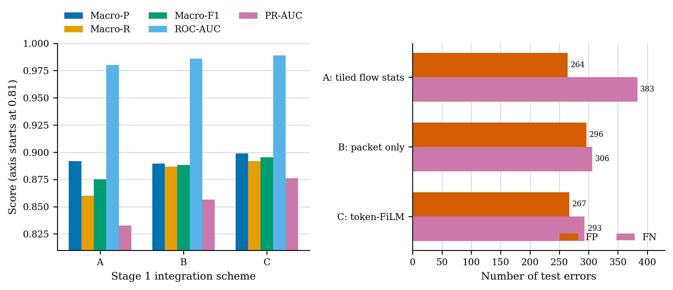
Stage 1: Flow-statistics conditioning works best
Scheme A
repeat flow statistics
Scheme B
packet only
Scheme C
macro-F1 0.895 | PR-AUC 0.876 | 267 FP | 293 FN
12
Notes:
This ablation compares three ways of useing flow statistics in Stage 1.
Scheme A repeats the flow-statistics vector at every packet token. Scheme B uses only packet information. Scheme C is my proposed design. It encodes the flow statistics once and uses it to make a small, bounded correction to the packet tokens.
Scheme C provides the strongest overall balance. Its macro-F1 is 0.895, and its PR-AUC is 0.876. It also reduces both FP and FN compared with Scheme B.
The results suggest that flow statistics are useful. In this experiment, bounded correction performs better than simple repetition.
The model sizes are not perfectly matched across the three schemes. I cannot tell which part of the design contributes most to the improvement.
Next, I will examine sequence length and packet selection.

Slide 13
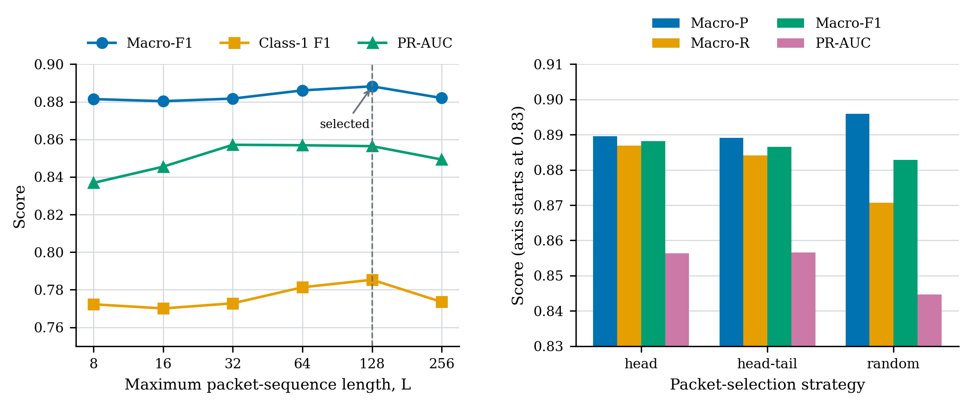
Stage 1: More packets do not always help
L = 128
best observed balance
Head
deterministic early prefix
At L = 256
+46 FP; lower macro-F1 and PR-AUC
13
Notes:
This slide studies two practical choices in Stage 1.
First, I compare sequence lengths from 8 to 256 packets. The best result appears at 128 packets. Using 256 packets adds more false positives and reduces both macro-F1 and PR-AUC. So, more packets do not always help.
Next, I compare three packet selection methods. Head and head-tail give similar results. Random selection has fewer false positives, but misses more positive flows.
Therefore, I use 128 packets with head selection. It is simple, deterministic, and performs best on this dataset without waiting for the final packets of a flow.
128 packets is not universally optimal. It is the best observed operating point for this capture, and simply adding more packets does not guarantee better detection.
Now, I will move to the Stage 2 results.

Slide 14
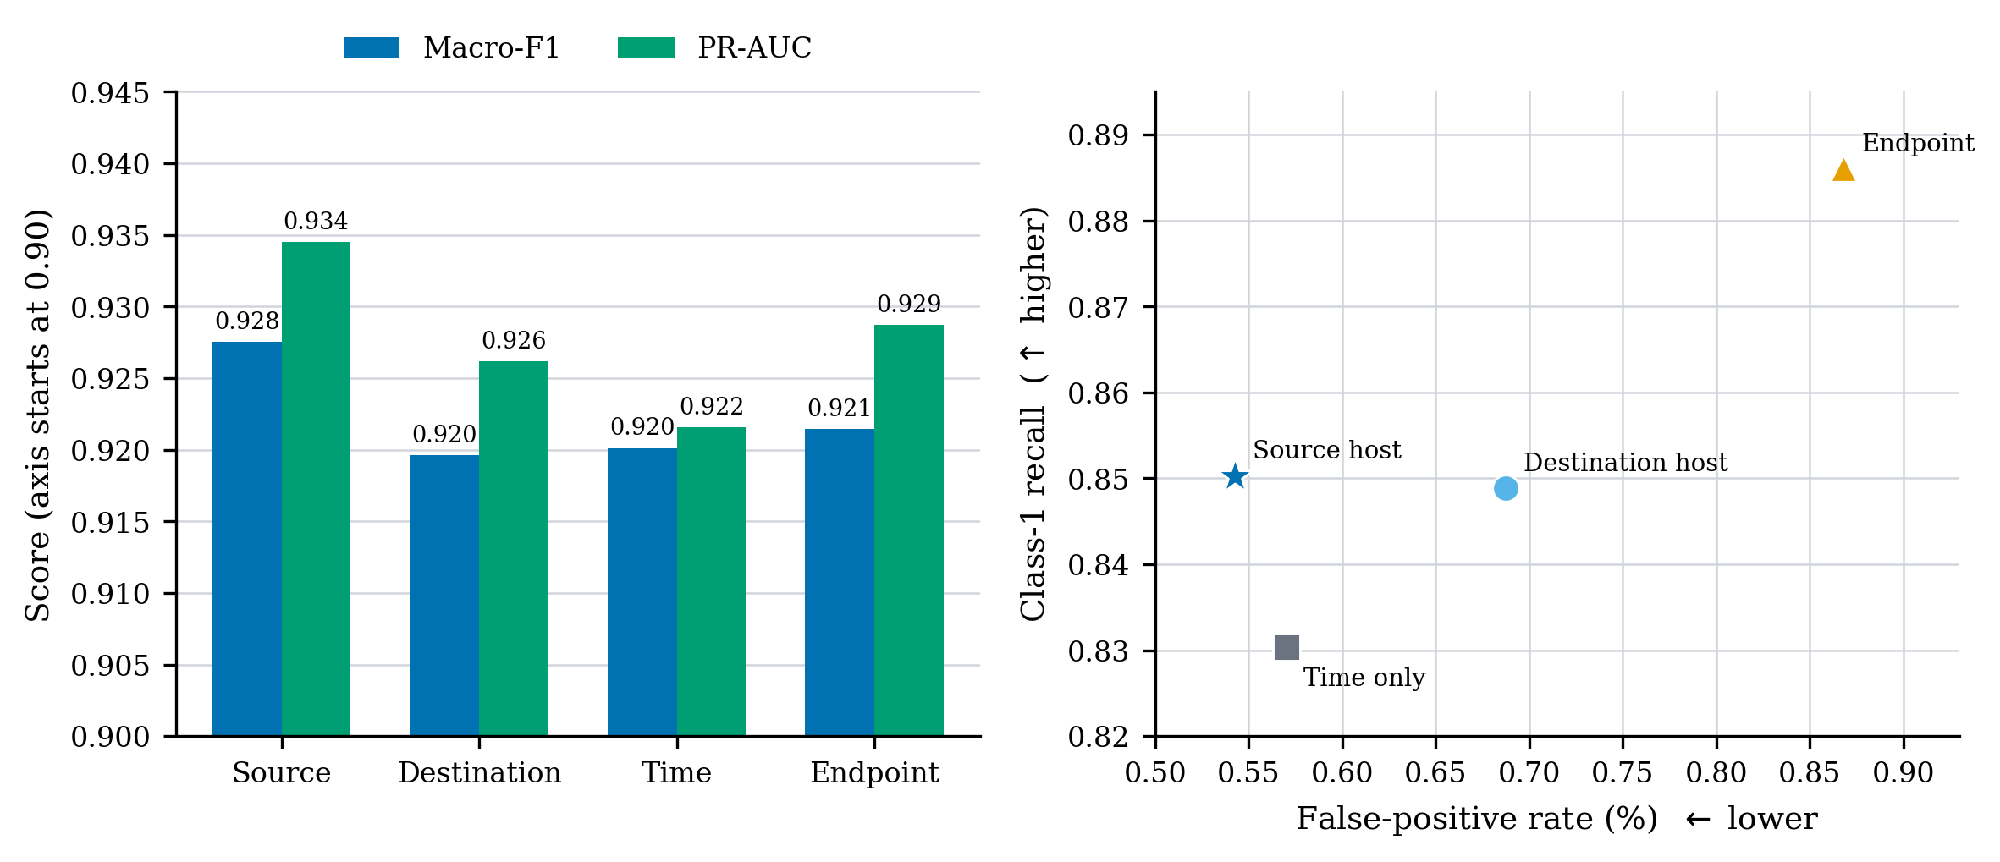
Stage 2: Source-host context gives the best balance
Source host
macro-F1 0.928 | PR-AUC 0.934 | class-1 recall 0.85 | FPR 0.543%
14
Notes:
This slide compares four ways to choose the Stage 2 context. Only the relation policy changes.
Among the four relation policies, source-host context provides the best overall balance. It combines the highest macro-F1 and PR-AUC with the lowest false-positive rate.
Endpoint context gives a higher class-1 recall, but it also creates more false positives. So, its overall balance is not as good.
One possible reason is that repeated flows from the same source can form a clearer pattern.
However, this is only a possible explanation. The binary labels cannot tell us the exact behaviour behind the improvement.
Based on this result, I use source-host context in the next experiment.
The next slide compares different Stage 2 model architectures.

Slide 15
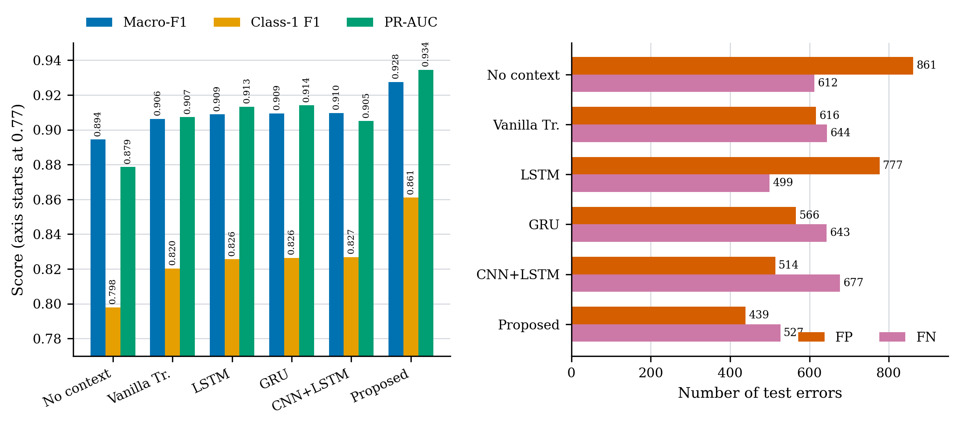
Stage 2: Target-query attention reduces FP and FN
Proposed model
macro-F1 0.928 | class-1 F1 0.861 | PR-AUC 0.934
vs. vanilla Transformer
−177 FP, −117 FN
15
Notes:
All models on this slide use the same Stage 1 embeddings and the same source-host context.
The main difference is how they use the history.
From the two charts, the proposed target-query model performs best in this comparison. Its macro-F1 is 0.928, class-1 F1 is 0.861 and PR-AUC is 0.934.
Look at the chart on the right side, the proposed model also gets the lowest false-positive and false-negative counts.
This means the improvement does not a trade-off between the two types of error.
One limitation is that the model sizes are not perfectly matched. so, I cannot tell how much of the improvement comes from target-query attention.
Next, I will test the model on external data.

Slide 16
External evaluation: Transfer varies across windows
CICIDS2017 Wednesday: five non-overlapping 20,000-flow windows
Company cross-server
Window | Positive | Macro-F1 | PR-AUC
w01 | 18.195% | 0.9125 | 0.9088
w02 | 13.515% | 0.9226 | 0.9123
w06 | 16.480% | 0.8536 | 0.8906
w07 | 13.340% | 0.8640 | 0.8419
w08 | 15.235% | 0.9220 | 0.9397
Pooled | 15.353% | 0.8966 | —
38,513 flows
3.285%
positive prevalence
0.9026
macro-F1
0.8771
PR-AUC
Interpretation
Useful transfer, but performance varies across time and environments.
16
Notes:
Internal results are not enough, so I also test the model on two external datasets.
The first is a public dataset CICIDS2017 Wednesday working-hours. I use five time windows. Each window contains 20,000 flows. The macro-F1 ranges from 0.85 to 0.92, and the pooled macro-F1 is 0.8966.
The second dataset comes from the same company but different server. It contains 38,513 flows（about thirty-eight）, with 3.3 percent positive samples. On this dataset, the model reaches a macro-F1 of 0.9026 and a PR-AUC of 0.8771.
These results show useful transfer to other dataset, but performance is not fully stable across different time windows.
So, the external results are promising, but they do not prove universal generalisation.
On the next slide, I will summarise the main conclusions and limitations.

Slide 17
The evidence supports gains within a limited scope
What the evidence supports
What it does not yet establish
•
Packet order and elapsed time are complementary
•
Independently verified attack ground truth
•
Flow statistics still add information
•
Statistical significance across random seeds
•
Selective source-host context improves the tested detector
•
Strict availability based on flow completion
•
External performance remains useful but variable
•
Universal transfer across networks and attack families
17
Notes:
The results support four main conclusions.
First, packet order and elapsed time provide different useful information. Second, flow statistics still help. Third, selective source-host context improves the tested detector. Finally, the model also works on external data, although performance changes across datasets and time windows.
There are also important limitations.
As noted earlier, the labels come from Suricata alerts, not independently verified attack ground truth. The experiments use only one random seed, so variation across seeds is not measured. The model sizes are not perfectly matched in every comparison.Stage 2 uses start-time order, not strict completion-time streaming. The external evaluation uses only two data sources, it cannot cover all network environments or attack types.
I will finish by returning to the main idea of the thesis.

Slide 18
Takeaway
Network traffic is hierarchical.
The detector should be too.
Stage 1: how the flow develops
Stage 2: how earlier related flows can change its meaning
Questions?
Notes:
The main message is simple. Network traffic is hierarchical, so the detector should respect that hierarchy.
Stage 1 asks how one flow develops.
Stage 2 asks whether earlier related flows can change the meaning of the target flow.
In my experiments, both levels provide useful information.
Stage 1 improves the flow representation. Stage 2 then improves the final detector.
The results are promising, but they are based only on the data tested in this study.
Thank you very much for listening.
I am happy to answer your questions.

