Slide 1
Packet-Sequence Modeling for NIDS
Xiaoyan Xiong
University of Twente
March 2026

Slide 2
Motivation
Increasing complexity of modern networks
Attacks: DDoS, APTs, ransomware
Signature-based → cannot detect unknown attacks
ML → relies on handcrafted features
RNN → limited scalability and long-range modeling

Slide 3
Research Gap
Existing Transformer/LLM methods operate at flow level
Flow aggregation loses:
Inter-packet timing
Packet size variation
Burst & direction patterns
Packet sequence modeling is more fine-grained

Slide 4
Research Questions
Can packet-level modeling improve detection?
Can packet embeddings support both packet & flow tasks?
Do LLMs outperform lightweight Transformers?

Slide 5
Problem Formulation
Flow = sequence of packets
Each packet has numerical + categorical features
Two tasks:
Packet-level classification
Flow-level classification

Slide 6
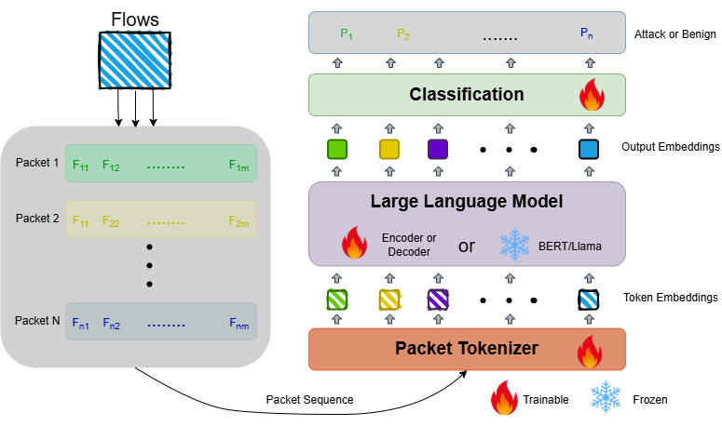
Framework Overview
1. Packet Tokenizer
2. Sequence Encoder (Transformer / LLM)
3. Classification Heads
Inspired by NLP sequence modeling

Slide 7
Data Pipeline
PCAP → Suricata → labeled packets
Build packet sequences per flow
Note: labels are pseudo-labels

Slide 8
Model Design
Tokenizer: encode numerical & categorical features
Encoder:
Lightweight Transformer
LLM (for comparison)
Dual-task outputs

Slide 9
Training & Evaluation
Metrics: Accuracy, Precision, Recall, F1, AUROC
Flow-level data split
Handle class imbalance
Evaluate efficiency (inference time)

Slide 10
Baselines
MLP (flow statistics)
Random Forest / XGBoost
LSTM
Small Transformer
Frozen LLM

Slide 11
Expected Contributions
Packet-level representation learning
Unified multi-task framework
Analysis of accuracy vs efficiency trade-off

Slide 12
Discussion & Open Questions
Is packet-level modeling worth the cost?
Are LLMs necessary?
Can it be deployed in real-time systems?

