Slide 1
Hierarchical Time-Aware and Graph-Enhanced NIDS
Packet
Sequence
From PCAP to packet sequences, flow embeddings, and behavior-semantic graphs
Encrypted traffic aware
Time-aware Transformer
BS-GAT graph reasoning
Flow
Embedding
Meeting objective: align on the problem framing, technical pipeline, and next-step experiments.
Flow
Graph

Slide 2
Research quesitons
A time-aware intra-flow Transformer will learn more discriminative flow representations than models based only on aggregated flow statistics or standard positional sequence encoding
A hierarchical model that combines intra-flow time-aware sequence encoding with inter-flow graph reasoning will outperform models that rely on only one level of modelling.

Slide 3
Motivation
Why a single flat model is not enough for realistic network intrusion detection
Flow-internal evidence
Cross-flow evidence
Practical constraint
Within one flow, packets carry strong local context: direction changes, TCP flag transitions, burst patterns, inter-arrival times, and request-response structure.
Many attacks leave weak signals in any single flow, but strong evidence across multiple flows, hosts, ports, or subnet regions.
Payload is often encrypted and expensive to process. A deployable NIDS should work well from headers, timing, direction, and statistics.
Key insight
Time adjacency is not the same as semantic relevance. If all flows in a window are fed to a Transformer as a flat sequence, the model may learn pseudo-order rather than true attack structure. This motivates a hierarchical design: model packet order inside a flow, and model relations between flows with a graph.

Slide 4
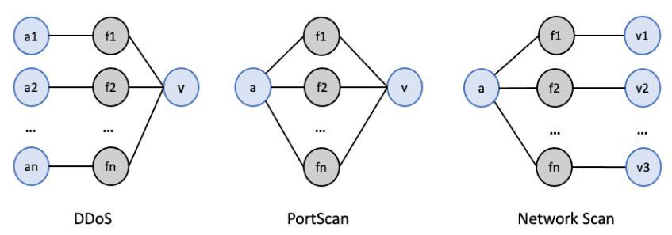
Graph-based representation of well-known attacks. a_{x} nodes refer to the attackers, v_{x} nodes represent the victims, and f_{x} nodes represent different flows.

Slide 5
Research Questions
The project is centered on three linked questions
RQ1. Time awareness
RQ2. Cross-flow reasoning
A time-aware intra-flow Transformer will learn more discriminative flow representations than models based only on aggregated flow statistics or standard positional sequence encoding?
Target output: a time-aware Transformer for packet sequences.
A hierarchical model that combines intra-flow time-aware sequence encoding with inter-flow graph reasoning will outperform models that rely on only one level of modelling?
Target output: a behavior-semantic graph with BS-GAT.
Overall hypothesis: local temporal context + global relational context will outperform flat sequence models and single-flow classifiers.

Slide 6
Overall Framework
A two-stage architecture aligned with the structure of network traffic
PCAP window
Stage 1: Flow encoder
Stage 2: Flow graph encoder
Prediction layer
Group packets by 5-tuple; sort packets by time; project structured packet records to token vectors; encode each flow with a time-aware Transformer.
Treat each flow embedding as a node; connect nodes by source-IP, subnet, and shared destination rules; aggregate with BS-GAT.
Node-level binary or multi-class intrusion detection, plus optional graph/window-level alarms.
Packets from a fixed time window, labeled by Suricata pseudo-labels for weak supervision.

Slide 7
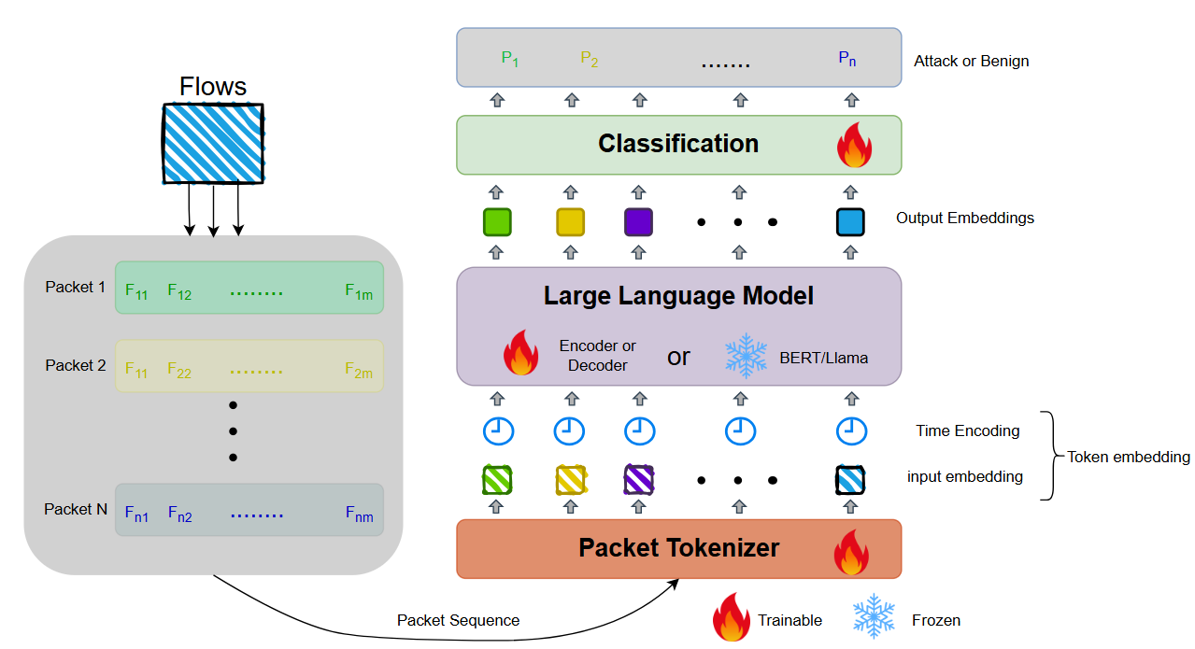
Overall framework
Notes:
In the first stage, we model each flow as a sequence of packets and use a time-aware Transformer to extract flow embeddings.
In the second stage, we construct a graph where each node is a flow, and use a graph neural network to model relationships between flows.
This allows us to jointly capture temporal and structural information.

Slide 8
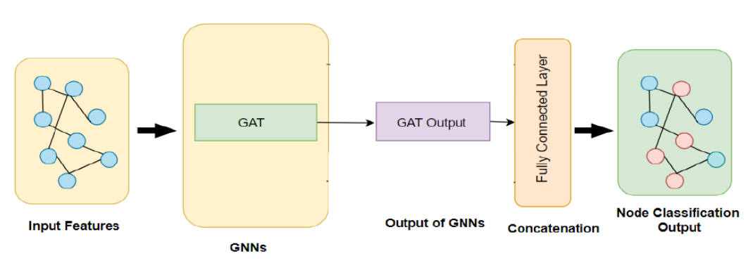
GNN model
Notes:
In the first stage, we model each flow as a sequence of packets and use a time-aware Transformer to extract flow embeddings.
In the second stage, we construct a graph where each node is a flow, and use a graph neural network to model relationships between flows.
This allows us to jointly capture temporal and structural information.

Slide 9
Data Pipeline
From raw traffic to packet tokens, flow embeddings, and graph edges
1
1. Capture / parse PCAP Packet header fields, timestamps, direction, and Suricata pseudo-labels.
2
2. Flow assembly Group packets by 5-tuple; maintain strict time order within each flow.
3
3. Feature schema Packet fields + metadata: protocol, ports, flags, packet length, TTL, direction, inter-arrival time, flow duration, bytes/packets per flow.
4
4. Sequence handling Variable-length packet sequence per flow; define max length and compare truncation strategies.
5
5. Graph construction For each time window, create flow nodes and weighted edges by source-IP, subnet, and shared destination rules.
Important modeling choice: packet tokens come from structured records, not payload bytes. This makes the pipeline realistic for encrypted traffic.

Slide 10
Stage 1: Time-Aware Flow Encoder
Encode packets within one flow as a structured sequence
Packet token design
Time-aware Transformer
Output and open design choices
Each packet is represented as a structured record rather than raw bytes.
Core fields:
• protocol, ports, TCP flags
• packet length, TTL, window size
• direction (inbound/outbound)
• delta time and relative time
• coarse/fine flow statistics
Replace or augment positional encoding with time encoding so attention can use actual packet timing.
Candidate signals:
• Δt to previous packet
• relative time from first packet
• log-scaled time gaps
• optional relative time bias in attention
Output: one flow embedding per flow.
Choices to test:
• pooling: CLS vs mean vs attention pooling
• max sequence length
• truncation vs head-tail vs uniform sampling
• where to inject flow-level statistics

Slide 11
Stage 2: Behavior-Semantic Flow Graph
Reason across flows with explicit network semantics
Es: same source IP
Weight = 1
Repeated behavior from the same host/device.
BS-GAT
Why this graph?
Behavior weights enter both attention and aggregation, combining learned neighbor importance with network priors.
Flow i
Em: same subnet region
It encodes source consistency, group-level coordination, and weaker cross-group target-sharing relations.
Weight = λ
Same group + same destination IP/port.
Eo: cross-region relation
Weight = μ
Other region with same destination IP/port
Not a generic similarity graph: edges are built from network behavior semantics.

