Slide 1
Packet-Sequence Modeling for NIDS
Xiaoyan Xiong
University of Twente
Notes:
Good morning, thank you for your time. Today I will present my research proposal on packet-sequence modeling for network intrusion detection using Transformer-based representation learning.
This work aims to explore whether modeling network traffic at the packet level can improve detection performance compared to traditional flow-level approaches.

Slide 2
Motivation
• Increasing complexity of modern networks
• Attacks: DDoS, APTs, ransomware
• Signature-based → cannot detect unknown attacks
• ML → relies on handcrafted features
• RNN → limited scalability and long-range modeling
Notes:
Modern network infrastructures are becoming increasingly complex, driven by cloud computing, IoT, and large-scale connectivity.
As a result, cyber attacks such as DDoS, ransomware, and advanced persistent threats are becoming more sophisticated.
Traditional intrusion detection systems have several limitations:
Signature-based systems can only detect known attacks and fail on zero-day threats.
Classical machine learning methods rely heavily on handcrafted features.
RNN-based models struggle with scalability and long-range dependencies.
Therefore, we need more powerful sequence modeling approaches for network traffic.

Slide 3
Research Gap
• Existing Transformer/LLM methods operate at flow level
• Flow aggregation loses:
- Inter-packet timing
- Packet size variation
- Burst & direction patterns
• Packet sequence modeling is more fine-grained
Notes:
Recently, Transformer-based and LLM-based methods have shown strong performance in intrusion detection.
However, most of these approaches operate at the flow level, where each flow is treated as a single unit.
This design overlooks important fine-grained information inside flows, such as:
inter-packet timing patterns
packet length variations
burst and direction changes
These signals can be critical for detecting stealthy or complex attacks.
Therefore, this work proposes modeling packet sequences directly, which is a more natural and detailed representation of network behavior.

Slide 4
Research Questions
• Can packet-level modeling improve detection?
• Can packet embeddings support both packet & flow tasks?
• Do LLMs outperform lightweight Transformers?
Notes:
Based on this motivation, this work focuses on three main research questions:
First, can packet-level sequence modeling improve detection performance compared to flow-level approaches?
Second, can learned packet embeddings support both packet-level and flow-level classification tasks?
Third, do large language models provide advantages over lightweight Transformer models for network traffic modeling?
These questions aim to evaluate both effectiveness and practicality.

Slide 5
Problem Formulation
• Flow = sequence of packets
• Each packet has numerical + categorical features
• Two tasks:
- Packet-level classification
- Flow-level classification
Notes:
In this work, we represent each network flow as an ordered sequence of packets.
Each packet contains both numerical and categorical features.
We consider two types of prediction tasks:
Packet-level classification, where each packet is labeled as benign or malicious
Flow-level classification, where the entire flow is assigned a label
The goal is to design a unified model that can handle both tasks simultaneously.

Slide 6
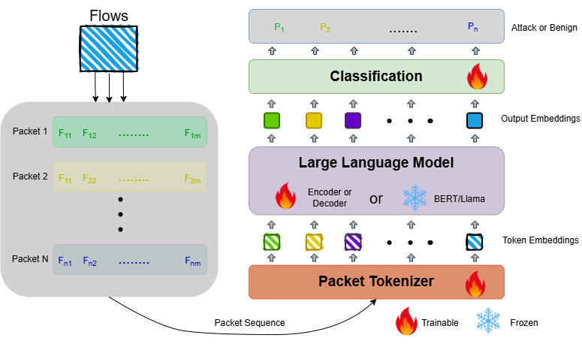
Framework Overview
1. Packet Tokenizer
2. Sequence Encoder (Transformer / LLM)
3. Classification Heads
• Inspired by NLP sequence modeling
Notes:
The proposed framework consists of three main components:
First, a packet tokenizer, which converts each packet into a dense embedding.
Second, a sequence encoder, such as a Transformer or an LLM, which captures contextual dependencies across packets.
Third, classification heads, which produce predictions at both packet and flow levels.
This design is inspired by natural language processing, where packets are treated similarly to tokens in a sentence.

Slide 7
Data Pipeline
• PCAP → Suricata → labeled packets
• Build packet sequences per flow
• Note: labels are pseudo-labels
Notes:
The dataset is constructed from raw network traffic in PCAP format.
We use Suricata to analyze the traffic and generate labels at the packet level.
It is important to note that these labels are rule-based and should be considered as pseudo-labels, rather than perfect ground truth.
After that, packets are grouped into flows and ordered by timestamp to form sequences.

Slide 8
Model Design
• Tokenizer: encode numerical & categorical features
• Encoder:
- Lightweight Transformer
- LLM (for comparison)
• Dual-task outputs
Notes:
For the model design, the packet tokenizer encodes both numerical and categorical features into fixed-dimensional embeddings.
The sequence encoder can be implemented in two ways:
A lightweight Transformer, which serves as an efficient baseline
A large language model, which provides stronger representation capacity
This allows us to study the trade-off between model complexity and performance.

Slide 9
Training & Evaluation
• Metrics: Accuracy, Precision, Recall, F1, AUROC
• Flow-level data split
• Handle class imbalance
• Evaluate efficiency (inference time)
Notes:
For training and evaluation, we split the dataset at the flow level to avoid data leakage.
We evaluate performance using metrics such as accuracy, precision, recall, F1-score, and AUROC.
In addition, we also measure inference time to assess computational efficiency.
To address class imbalance, techniques such as weighted loss or resampling may be applied.

Slide 10
Baselines
• MLP (flow statistics)
• Random Forest / XGBoost
• LSTM
• Small Transformer
• Frozen LLM
Notes:
To evaluate the effectiveness of the proposed approach, we compare it with several baselines:
Flow-level statistical models such as MLP
Traditional machine learning methods like Random Forest and XGBoost
Sequence models such as LSTM
Lightweight Transformer models
And LLM-based approaches
These baselines help us analyze the impact of modeling granularity and model complexity.

Slide 11
Expected Contributions
• Packet-level representation learning
• Unified multi-task framework
• Analysis of accuracy vs efficiency trade-off
Notes:
The expected contributions of this work are threefold:
First, we propose a packet-level representation learning framework for intrusion detection.
Second, we design a unified model that supports both packet-level and flow-level classification.
Third, we provide a systematic analysis of the trade-off between detection accuracy and computational efficiency.
This is particularly important for real-world deployment in high-throughput networks.

Slide 12
Discussion & Open Questions
• Is packet-level modeling worth the cost?
• Are LLMs necessary?
• Can it be deployed in real-time systems?
Notes:
Finally, I would like to highlight several open questions for discussion:
Is packet-level modeling worth the additional computational cost?
Are large language models necessary, or can lightweight models achieve similar performance?
Can this approach be deployed in real-time intrusion detection systems?
These questions are important for both research and practical deployment.

