Slide 1
Packet-Sequence Modeling for Network Intrusion Detection Using Transformer-based Representation Learning

Slide 2
Motivation
网络攻击越来越复杂（DDoS / APT / IoT）
传统方法问题：
signature → 只能检测已知攻击
ML → relies havily on handcrafted features
RNN → 难以建模长依赖 + 不可并行

Slide 3
Gap
现有Transformer/LLM方法都在flow-level
问题：
flow aggregation丢失信息：
inter-packet timing
packet size变化
burst & direction pattern
引出你的idea：
Packet-level sequence = 更自然的建模方式

Slide 4
Research Questions
Can packet-level sequence modeling improve detection performance compared to flow-level approaches?
Can packet embeddings effectively support both packet-level and flow-level classification tasks?
Do large language models provide advantages over lightweight Transformer models for network traffic modeling?

Slide 5
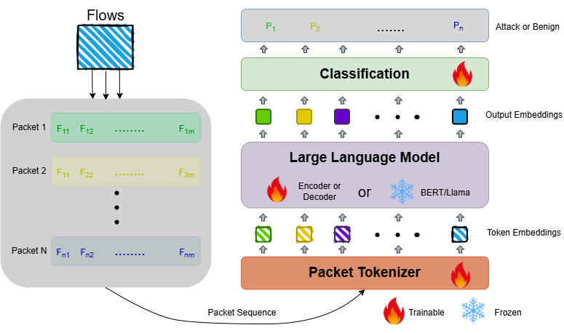
Overall Framework

Slide 6
Data pipeline
PCAP → Suricata → labeled packets
Flow reconstruction
Sequence building
Notes:
Suricata label = pseudo-label

Slide 7
Training & Evaluation
Metrics:
F1, precision, recall, AUC…
Split:
Flow-level split (avoid leakage)

Slide 8
Baseline
MLP (flow stats)
LSTM
Transformer
LLM

