Slide 1
Simulate Cavitation Bubble with Single Component Multi-Phase Lattice Boltzmann Method
Xin Xiong
Ph.D. student at Cranfield University
Supervisor: Dr Tom Robin-Teschner
20th April 2023

Slide 2
Background
Cavitation is a phenomenon that includes liquid-to-vapor transition because of the decrease of pressure.
LBM (Lattice Boltzmann Method) has its advantages in simulating the multiphase flow for its simplicity and locality.
Three models of multiphase LBM:
Shan-Chen Model
Color-Gradient Model
Free Energy Model

Slide 3
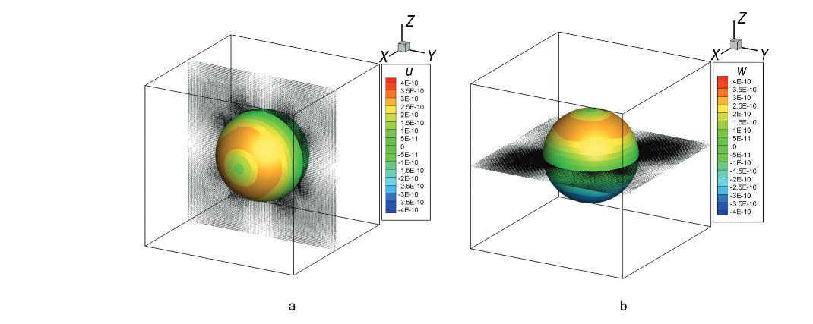
Research Gap and Motivation
Research Gap
Limitations of the models:
Spurious current
Limited density and viscosity ratio[1] [2] [3]
Few attempts have been made to study cavitation bubble clusters based on LBM with a distributed distance between bubble and size.
[1] Chien-Yi Chang, Ching-Wen Yang, Fang-Ting Lin, Tzu-Hsuan Chiu, and Chao-an Lin. Lattice boltzmann simulations of bubble interactions on gpu cluster. Journal of the Chinese Institute of Engineers, 44(5):491–500, 2021.
[2] Zhang S, Wu W, Zheng Q. An improved lattice Boltzmann model for high gas and liquid density ratio in composite grids[J]. Theoretical and Applied Mechanics Letters, 2018, 8(5): 326-333.
[3] Porter M L, Coon E T, Kang Q, et al. Multicomponent interparticle-potential lattice Boltzmann model for fluids with large viscosity ratios[J]. Physical Review E, 2012, 86(3): 036701.

Slide 4
Research Gap and Motivation
Motivation
Explore distributed size and distance bubble system of cavitation based on the Lattice Boltzmann method to investigate the dynamics of a single bubble in a multi-bubble system and the interaction between different bubbles.
Develop a new model for better stability and accuracy against cavitation bubble clusters with a high-density ratio.
Real-world cavitation usually happens with bubble clusters with random bubble sizes and distances

Slide 5
Case Setups
2D Shan-Chen single component multi-phase model for single bubble validation
Periodic boundary condition for validation of Laplace law
Flat interface case with different temperatures and different density ratios for Maxwell’s area construction
Different densities of liquid which triggered different pressure differences between bubble and liquid
Periodic boundary condition or
fixed pressure boundary condition
Periodic boundary condition or
fixed pressure boundary condition
Periodic boundary condition or
fixed pressure boundary condition
Flat interface case
liquid
liquid
gas
bubble
Periodic boundary condition or
fixed pressure boundary condition

Slide 6
Case Setups
Other important setups parameter:
Reduced temperature: 0.75
Equilibrium density of gas: 0.011
Equilibrium density of liquid: 0.33
Domain length: 100
Grid size: 101x101
Periodic boundary condition or
fixed pressure boundary condition
Periodic boundary condition or
fixed pressure boundary condition
Periodic boundary condition or
fixed pressure boundary condition
Flat interface case
liquid
liquid
gas
bubble
Periodic boundary condition or
fixed pressure boundary condition

Slide 7
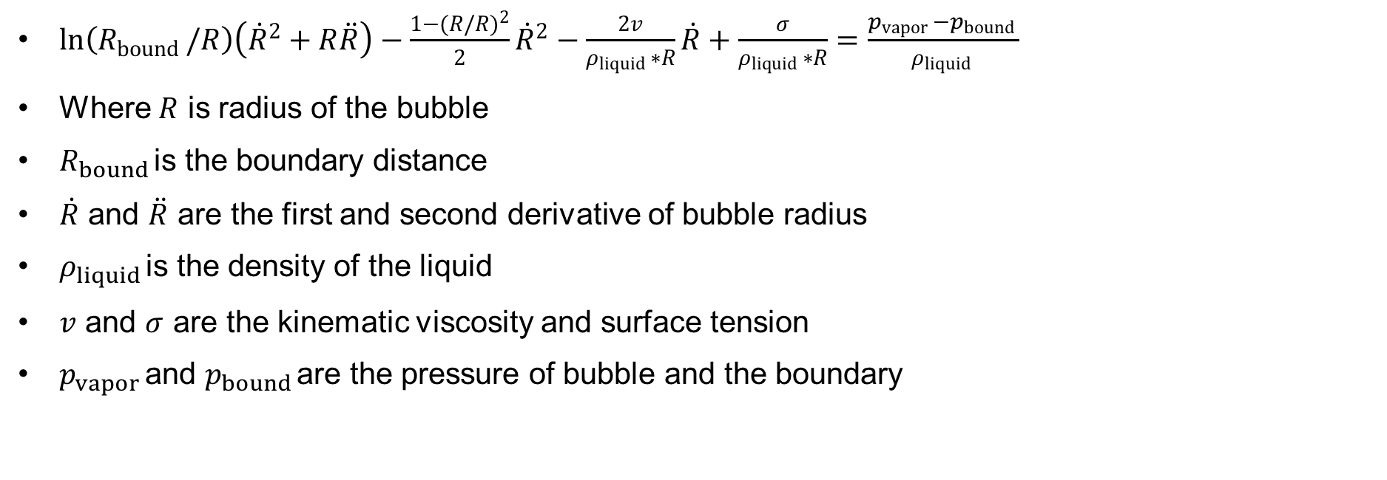
Case Setups
R-P equation
$ln\left(R_{bound }/R\right)\left({\dot{R}}^{2}+R\ddot{R}\right)−\frac{1−(R/R)^{2}}{2}{\dot{R}}^{2}−\frac{2v}{ρ_{liquid }∗R}\dot{R}+\frac{σ}{ρ_{liquid }∗R}=\frac{p_{vapor }−p_{bound }}{ρ_{liquid }}$
Where $R$ is radius of the bubble
$R_{bound }$is the boundary distance
$\dot{R}$ and $\ddot{R}$ are the first and second derivative of bubble radius
$ρ_{liquid }$is the density of the liquid
$v$ and $σ$ are the kinematic viscosity and surface tension
$p_{vapor }$and $p_{bound }$are the pressure of bubble and the boundary

Slide 8
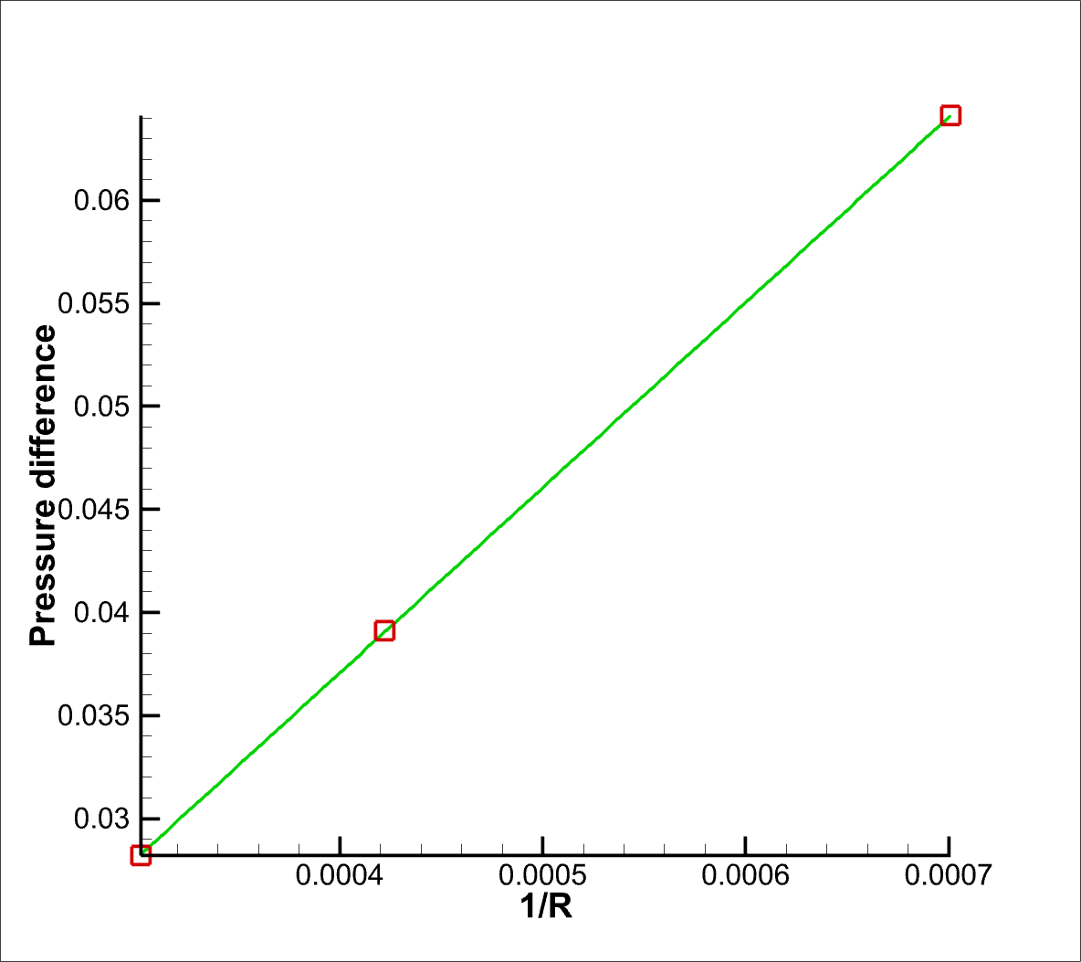
Results and Discussion
Laplace Law Validation
Here R is the bubble radius
Perform simulation with periodic boundary condition until it reaches the steady state.
The relation of 1/R and Pressure difference is almost linear which is in good agreement with Laplace Law.
The slope of the line is the surface tension

Slide 9
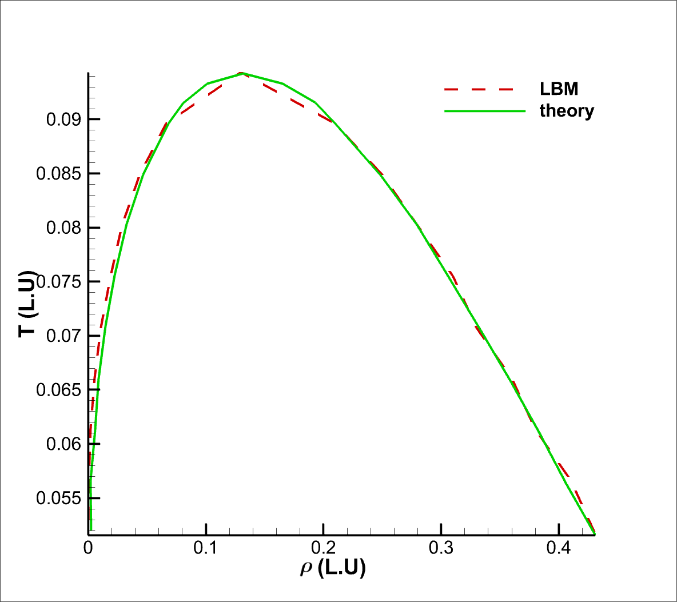
Results and Discussion
Maxwell’s Area Construction
With different temperatures different equilibrium densities of liquid and gas can be obtained based on flat interface simulation
The theory results are referred from Peng et al. [3].
Good Agreement has been achieved between LBM and the theory
[3] C Peng, S Tian, G Li, M C. Sukop. Simulation of multiple cavitation bubbles interaction with single-component multiphase Lattice Boltzmann method. International Journal of Heat and Mass Transfer, 2019, 137: 301-317.

Slide 10
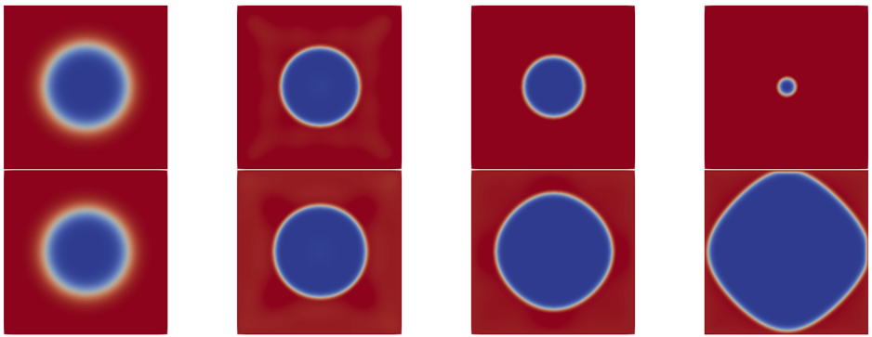
Results and Discussion
Contour of Bubble Density

Slide 11
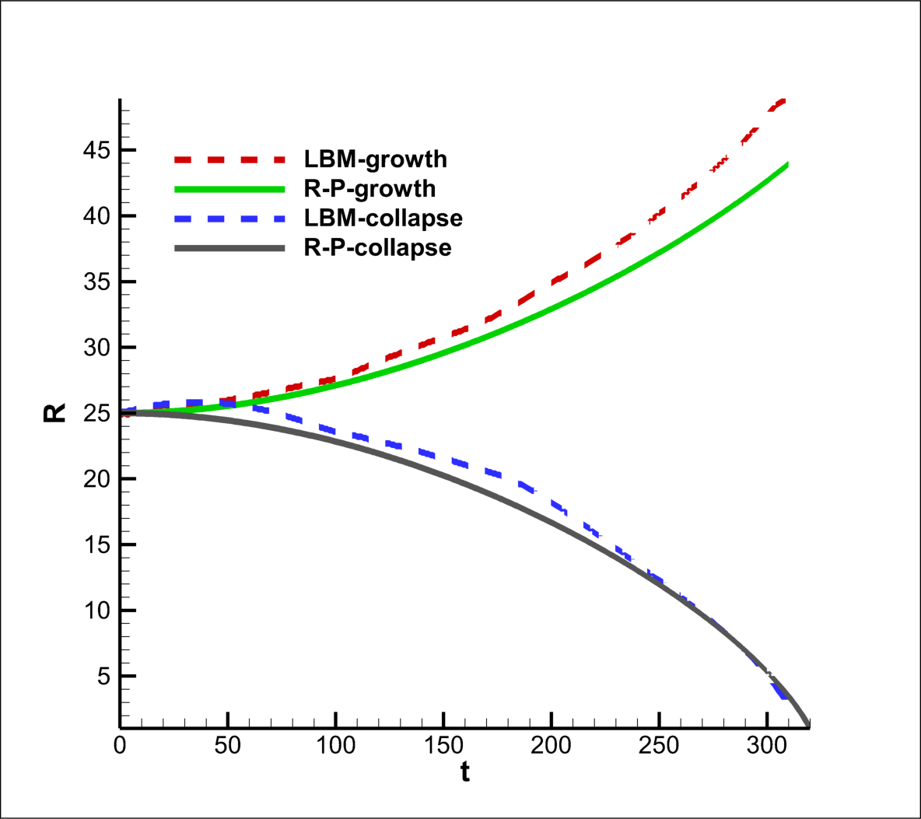
Results and Discussion
Validation of R-P (Rayleigh-Plesset) Equation
The results of bubble growth and collapse based on LBM simulation show good agreement with the R-P equation with a 100x100 mesh size.
The discrepancy may due to the fact that the LBM is based on cartesian coordinates while the R-P equation is derived with the cylindrical coordinate system.

Slide 12
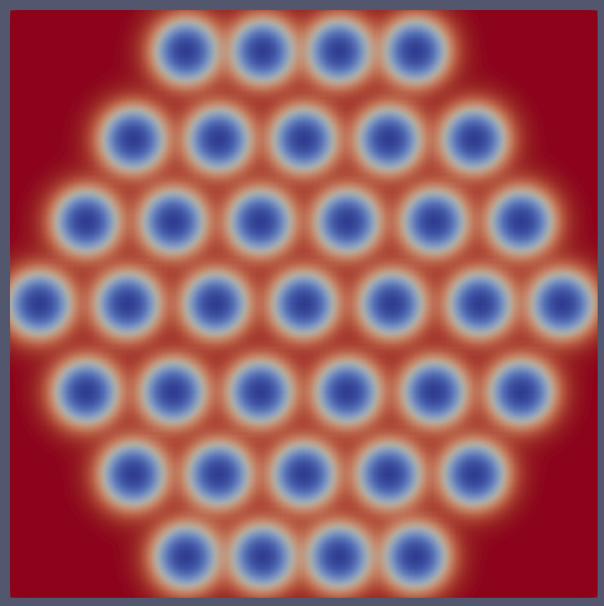
Future Work
Bubble Cluster Simulation
The case of the same distance between the bubbles has been set.
The case of the different distance between the bubbles will be set and a simulation based on that will be performed
The pattern of bubbles evolution will be check
Different bubble radius evolution with respect to distance and initial bubble size will be quantitively analysed.
Other variable such as pressure, velocity with respect to distance and initial bubble size will be analysed as well.

Slide 13
Thank you
Q&A

