Slide 1
Design Principles of Programming Languages Practices in Class
Chap 13-19
Zhenjiang Hu, Haiyan Zhao, Yingfei Xiong
Peking University, Spring Term

Slide 2
Code packages
“fullref”
“fullerror”
“rcdsub”
“fullsub”
“joinsub”
“joinexercise”

Slide 3
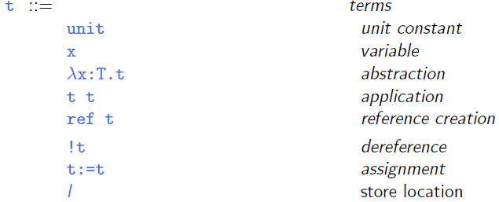
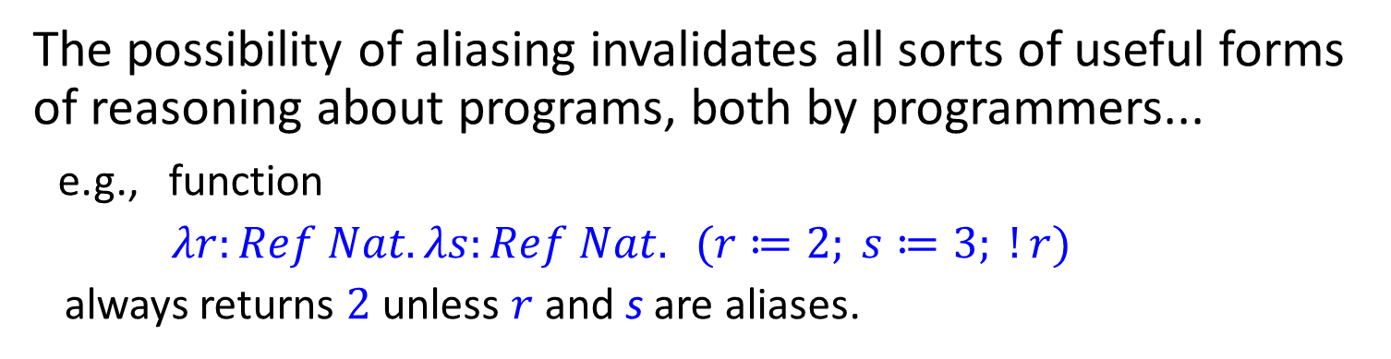
Syntax
We added to $λ_{→}$ (with $Unit$) syntactic forms for creating, dereferencing, and assigning reference cells, plus a new type constructor $Ref$.

Slide 4
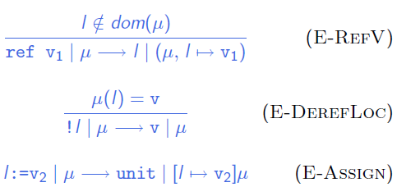
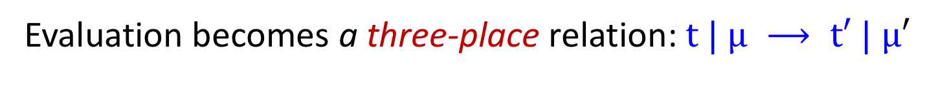
Evaluation
Evaluation becomes a three-place relation: $t | μ ⟶ t′ | μ′$

Slide 5
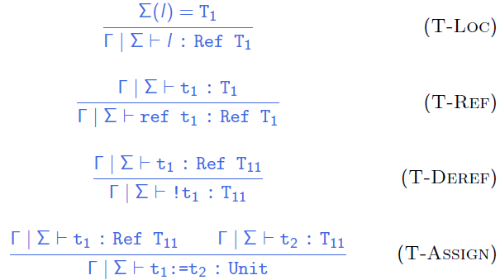
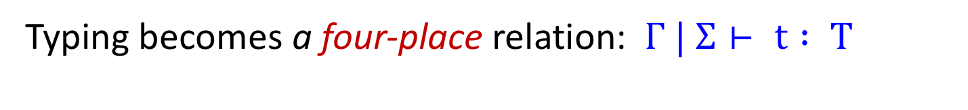
Typing
Typing becomes a four-place relation: $Γ | Σ⊢ t : T$

Slide 6
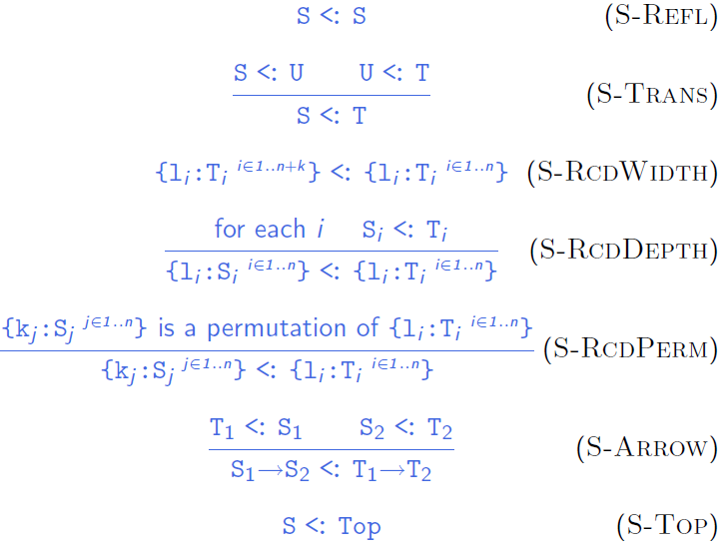
Subtype Relation

Slide 7
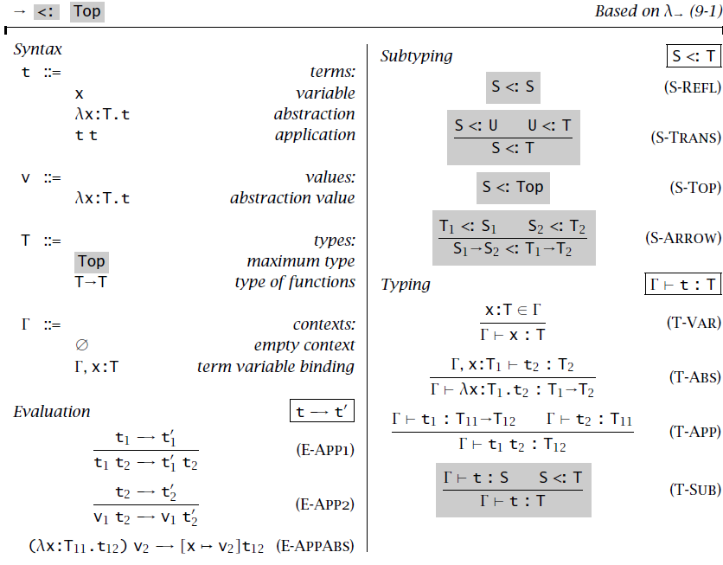

Slide 8
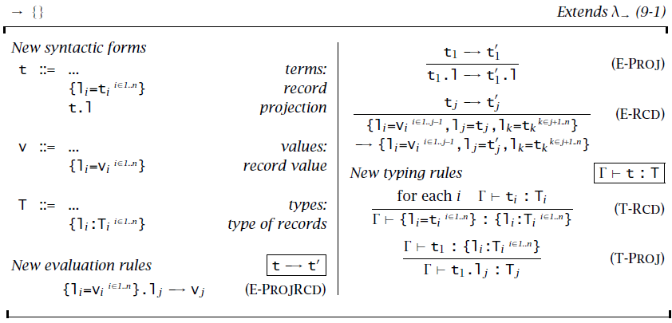
Records

Slide 9
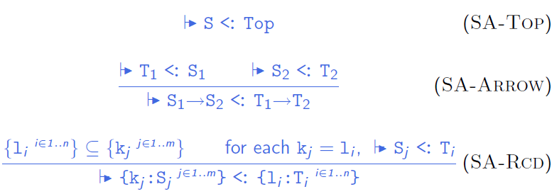
“Algorithmic” subtype relation

Slide 10
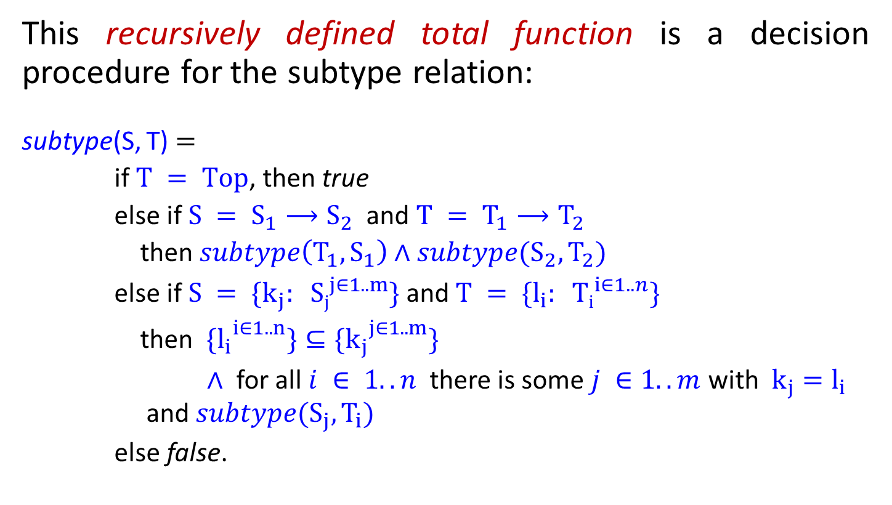
Subtyping Algorithm
This recursively defined total function is a decision procedure for the subtype relation:
subtype(S, T) $=$
if $T = Top$, then true
else if $S = S_{1}⟶S_{2}$ and $T = T_{1}⟶T_{2}$
then $subtype\left(T_{1},S_{1}\right)∧subtype(S_{2},T_{2})$
else if $S = \{k_{j}: {Sj}_{}^{j∈1..m}\}$and $T = \{l_{i}: {Ti}_{}^{i∈1..n}\}$
then $\{{l_{i}}^{i∈1..n}\}⊆\{{k_{j}}^{j∈1..m}\}$
$∧$ for all $i ∈ 1..n$there is some $j ∈1..m$ with $k_{j}=l_{i}$ and $subtype(S_{j},T_{i})$
else false.

Slide 11

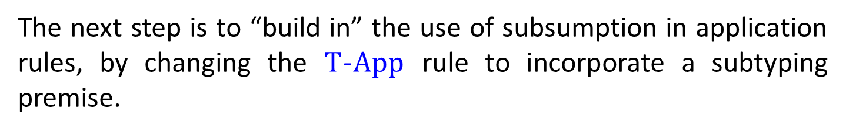
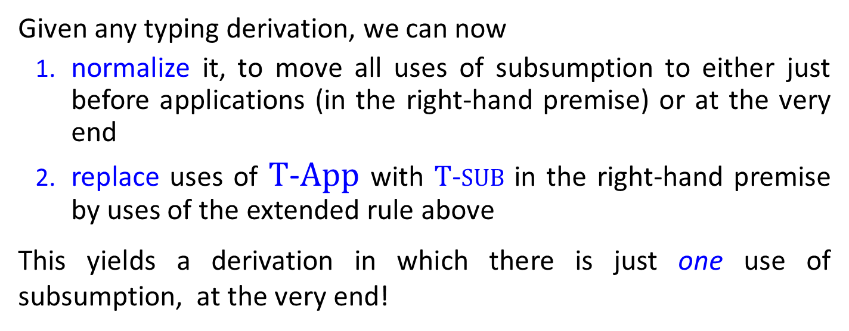
Algorithmic Typing
The next step is to “build in” the use of subsumption in application rules, by changing the $T$-$App$ rule to incorporate a subtyping premise.
Given any typing derivation, we can now
normalize it, to move all uses of subsumption to either just before applications (in the right-hand premise) or at the very end
replace uses of $T$-$App$ with $T$-$SUB$ in the right-hand premise by uses of the extended rule above
This yields a derivation in which there is just one use of subsumption, at the very end!

Slide 12
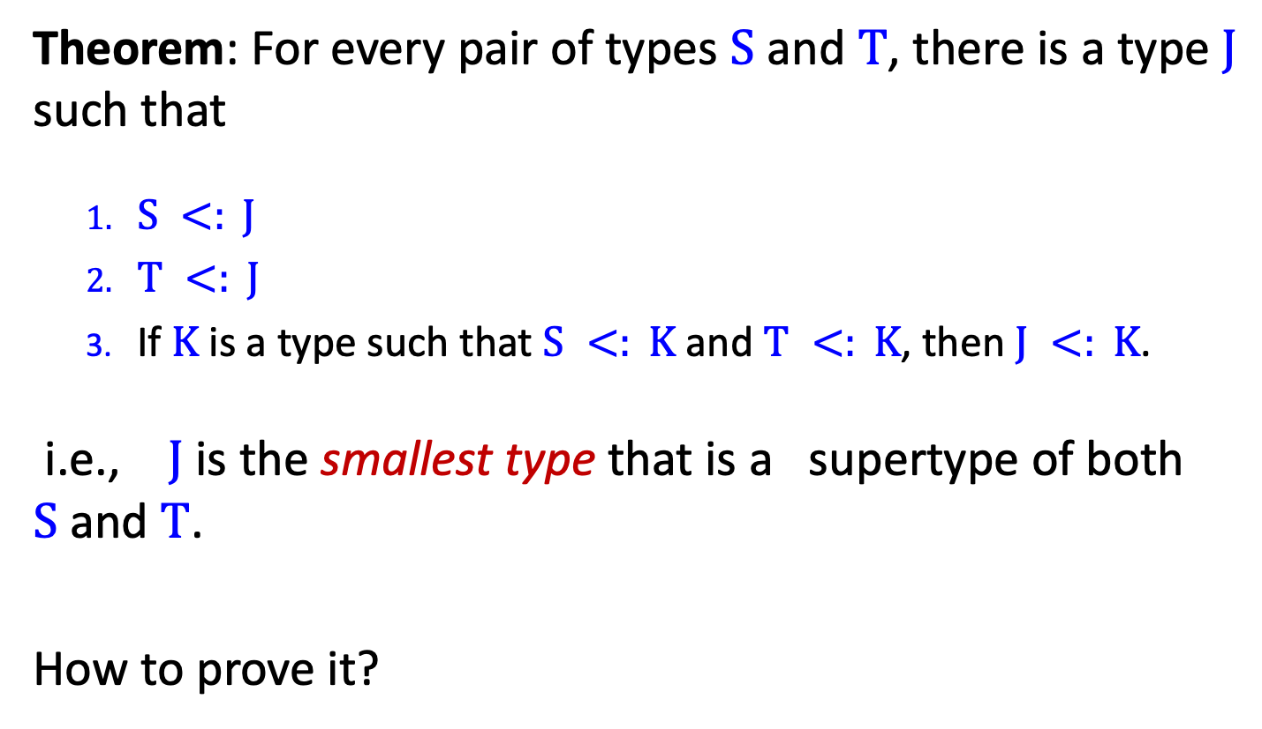
Existence of Joins
Theorem: For every pair of types $S$and $T$, there is a type $J$ such that
$S <: J$
$T <: J$
If $K$ is a type such that $S <: K$and $T <: K$, then $J <: K$.
i.e., $J$ is the smallest type that is a supertype of both $S$and $T$.
How to prove it?

Slide 13
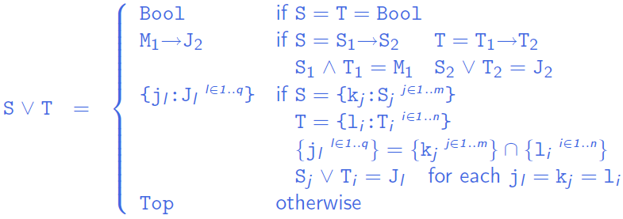
Calculating Joins

Slide 14
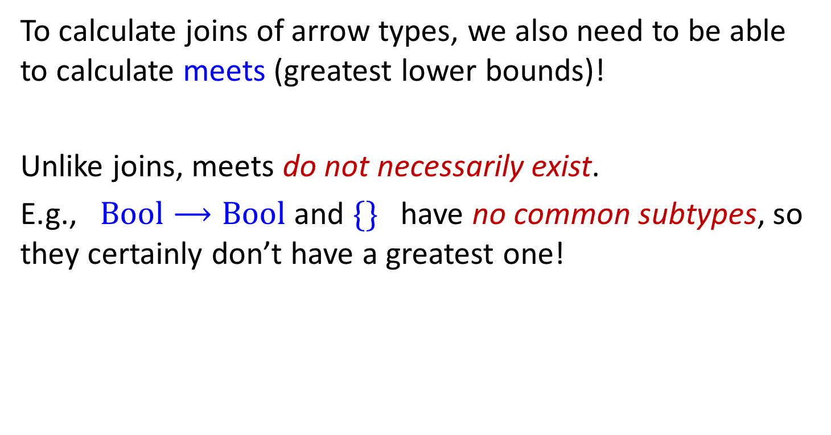
Meets
To calculate joins of arrow types, we also need to be able to calculate meets (greatest lower bounds)!
Unlike joins, meets do not necessarily exist.
E.g., $Bool⟶Bool$and $\{\}$ have no common subtypes, so they certainly don’t have a greatest one!

Slide 15
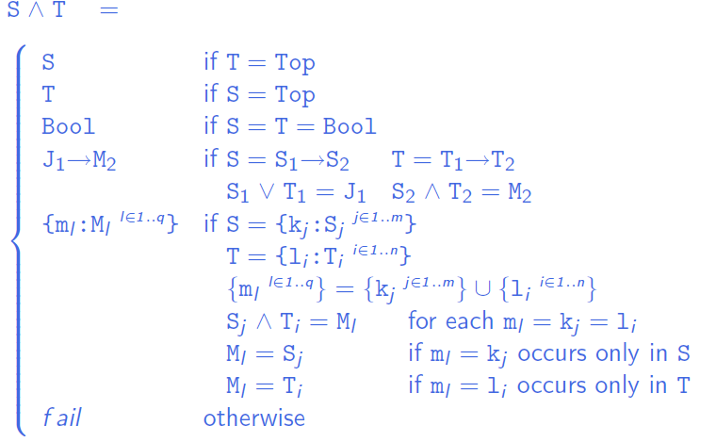
Calculating Meets

Slide 16
Practice #1
Do exercise 17.3.1
The joinexercise typechecker is an incomplete implementation of the simply typed lambda-calculus with subtyping, records, and conditionals: basic parsing and printing functions are provided, but the clause for TmIf is missing from the typeof function, as is the join function on which it depends. Add booleans and conditionals (and joins and meets) to this implementation.
Refer to: §16.3 showed how adding booleans and conditionals to a language with subtyping required extra support functions for calculating the least upper bounds of a given pair of types. The proof of Proposition 16.3.2 (see page 522) gave mathematical descriptions of the necessary algorithms

Slide 17
Practice #2
Do exercise 17.3.3
the subtype check in the application rule fails, the error message that our typechecker prints may not be very helpful to the user. And we can improve it by including the expected parameter type and the actual argument type in the error message
Error reporting can be greatly improved by changing the subtype function so that, instead of returning true or false, it either returns a trivial value (the unit value ()) or else raises an exception
Reimplement the typeof and subtype functions to make all of the error messages as informative as possible.

Slide 18
Design Principles of Programming Languages Practices
Chap 18-19
Please refer to the package of “fullref”
Zhenjiang Hu, Haiyan Zhao, Yingfei Xiong
Peking University, Spring Term, 2019

Slide 19
What learnt in Chap 18-19
Identify some characteristic “core features” of object-oriented programming
Develop two different analysis of these features:
2.1 A translation into a lower-level language (chap 18)
2.2 A direct, high-level formalization of a simple object-oriented language (“Featherweight Java”, chap19)

Slide 20
Object-oriented languages
In most OO languages, each object is regarded as
A data structure
encapsulating some internal state
offering access to this state via a collection of methods
basic features of object-oriented languages
encapsulation
Inheritance
…….

Slide 21

Modeling features of OO with $λ$ -calculus
How the basic features of object-oriented languages
encapsulation of state
Inheritance
……
can be understood as “derived forms” in a lower-level language with a rich collection of primitive features:
(higher-order) functions
records
references
recursion
subtyping

Slide 22
Encapsulation
An object is a record of functions, which maintain common internal state via a shared reference to a record of mutable instance variables.
This state is inaccessible outside of the object because there is no way to name it
lexical scoping ensures that instance variables can only be named from inside the methods.

Slide 23

Inheritance
Objects that share parts of their interfaces will typically (though not always) share parts of their behaviors.
To avoid duplication of code, the way is to write the implementations of these behaviors in just one place.
$⟹$ inheritance
Basic mechanism of inheritance: classes
A class is a data structure that can be
instantiated to create new objects (“instances”)
refined to create new classes (“subclasses”)

Slide 24

The essence of objects
Encapsulation of state with behavior
Behavior-based subtyping
Inheritance (incremental definition of behaviors)
Access of super class
Open recursion through $this$

Slide 25
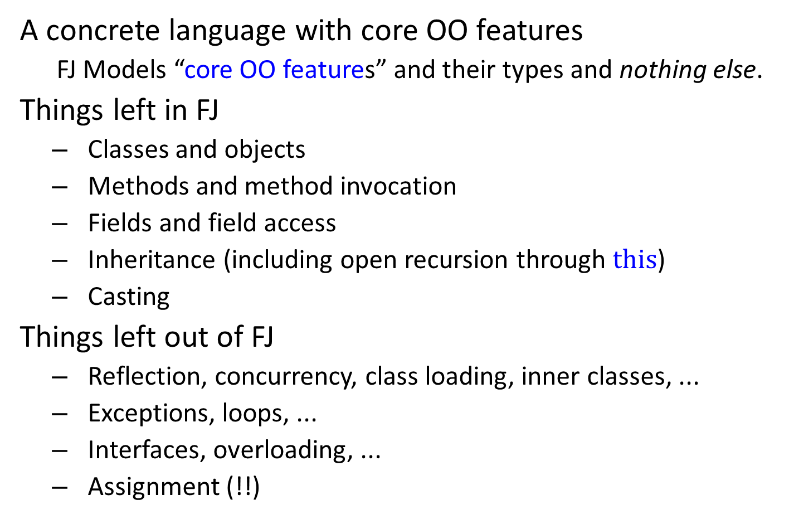
Featherweight Java
A concrete language with core OO features
FJ Models “core OO features” and their types and nothing else.
Things left in FJ
Classes and objects
Methods and method invocation
Fields and field access
Inheritance (including open recursion through $this$)
Casting
Things left out of FJ
Reflection, concurrency, class loading, inner classes, ...
Exceptions, loops, ...
Interfaces, overloading, ...
Assignment (!!)

Slide 26
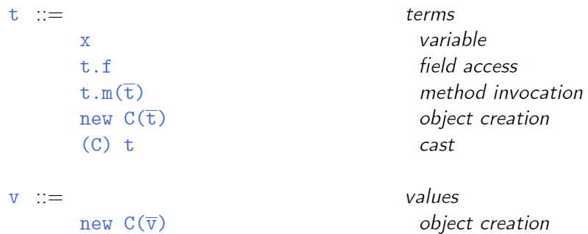
Syntax (terms and values)
Notes:
fly in the ointment: 美中不足；美中不足之处；败兴的人（或事物）；煞风景的人（或事物）
If you describe someone or something as a fly in the ointment, you think they spoil a situation and prevent it being as successful as you had hoped.

Slide 27
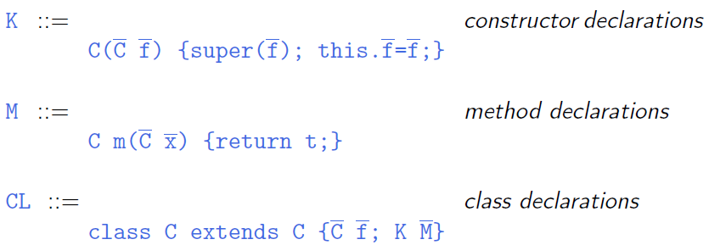
Syntax (methods and classes)

Slide 28
Practice #1
Do exercise 18.7.1
Define a subclass of backupCounterClass with two new methods, reset2 and backup2, controlling a second “backup register.” This register should be completely separate from the one added by backupCounterClass: calling reset should restore the counter to its value at the time of the last call to backup (as it does now) and calling reset2 should restore the counter to its value at the time of the last call to backup2.
Use the fullref checker to test your new class

Slide 29
Practice # 2
Do exercise 19.4.3
The operation of assigning a new value to the field of an object is omitted from FJ to simplify its presentation, but it can be added without changing the basic character of the calculus very much.
Using the treatment of references in Chapter 13 as a model.

Slide 30
Practice #3: Challenge
Do exercise 19.5.5
Starting from one of the lambda-calculus typecheckers, build a typechecker and interpreter for Featherweight Java.
Submit your typechecker and interpreter before June 10

