Slide 1
An Architecture Based Round-trip Approach towards Component Composition
--Plan, Progress and Problems
Notes:
I’m glad to have this opportunity to discuss our initial idea about combining … and … to achieve an architecture-based…
I will report our plan, current progress and also the problems we met during our initial attempts

Slide 2
Agenda
An Overview of ABC Method
Round-trip Component Composition
Plan and Progress
Discussion
Notes:
Brief overview about ABC Method. Derived from this short overview,
Then I will report our initial plan and current progress.

Slide 3
Terminologies
ABC method
  General: Architecture centric development, deployment and management of component based systems
  Special: Architecture based component composition
Software Architecture (SA)
  The structure of a software system
  A bridge between requirements and implementation
Component Composition
  Composing qualified, adapted or developed components into an application
Notes:
This general-meaning ABC method is big blue print, which needs the efforts of the whole institute
Big plan covers nearly every groups’ efforts
Intuitively
In an earlier literature, David Garlan defined SA as( “software architecture, a road map”)
Show the effect and status of software architecture

Slide 4
Motivation
From the perspective of Software Architecture research
  A proper way to bring SA into implementation
From the perspective of component composition
  A high-level guidance for composition
  A bridge between requirements and implementation
  An early inspection of the system
Notes:
Two aspects

Slide 5
Challenges for Component Composition
Technical challenges
  Components interoperability
  Resource management
  Security, transaction…
  Component standards and middleware (J2EE)
Methodological challenges
  How to get a right composition
Notes:
We know that component based approach is current mainstream towards software reuse.
And the key issue is how to compose the existing, reusable components, and make them work together.
There are a lot of technical challenges, for example,
Many Industrial approaches have tried to meet these challenges

Slide 6
Right Composition
High-level constraints
  Requirements
  Design decision
Low-level constraints
  Component standard
  Middleware constraints
  Assets limitation
Notes:
Our goal is to provide a method and a corresponding tool support to help developers composing reusable components into a right application, which satisfies the above constraints

Slide 7
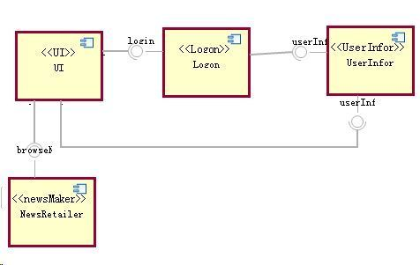
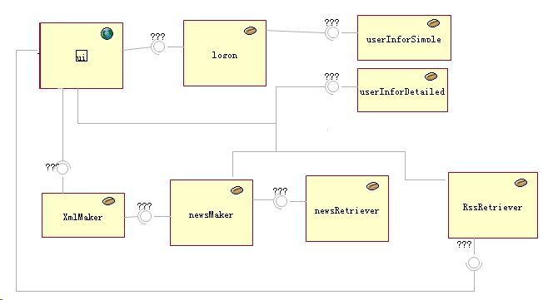
Approach
Transformation
  Manual, with Automated support
Requirements
Design Decision
SA
Component Standard
transformation
Middleware Constraint
Assets Limitation
J2EE
Notes:
Discover the potential problems in an early stage

Slide 8
Discussion (1)
Ideally: a top-down approach
  Designers concentrate on meeting requirements
  “Composers” concentrate on meeting the design and in the mean time satisfying the low level constraints
Practically: some problems
  Sometimes the design may be hard to well implement
  Not well reuse component standard and middleware
    “A language affects the way you think about programming”. So component standard and middleware also affect the design
  Not considering the reusable implementation
Notes:
Utilize the current implement condition to satisfy the original design.
The root of the problem is that
There was an early and famous saying about programming language that that “A lang..” (Alan Perlis)

Slide 9
Discussion (2)
Previous solutions
  Component adaptation and SA refactoring
    By designers or composers?
  Abstracting middleware elements into SA
    Hard to construct the design model
Industrial approach
  Designing directly on component standard
  Using patterns to guide the designing
  A difficult task for a large system, but well for not-too-large cases
Notes:
We have made some effort to
Industrial practitioner
Now you can see that ABC method is still a research proposal. To make it more useful, we may also have to learn from the current in use industrial approaches for component composition.
At least, for some not-too-large systems, this approach works well.
Maybe we have paid too much attentions on the high-level design model, but ignored the importance of implementation level model

Slide 10
Agenda
An Overview of ABC Method
Round-trip Component Composition
Plan and Progress
Discussion

Slide 11
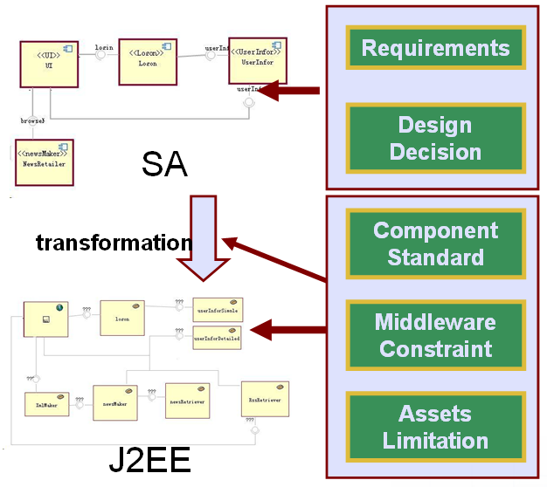
Basic proposal
Refinement of implementation model
  Naturally support component standard and middleware
  Directly considering assets limitation
Problems
  Architects do not trust composers to refine the implementation model freely
  Composers are not confident to refine it freely
  Requirements are always the most important
Notes:
Unlike the previous attempts, we do not expect to get a final implementation through a one-time transformation
Treat the transformed implementation model as a draft
Developers can keep on refining this model according to the implementation constraints
Similar to the industrial approach

Slide 12
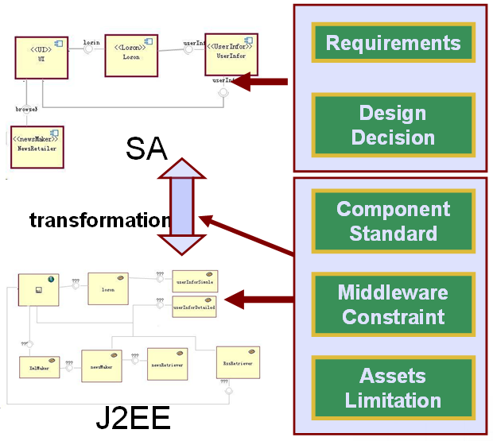
Improvement
Introducing bidirectional transformation
  Reflect low level refinement in the high level model
Round-trip refinement
  Design -> generate a draft -> refine the draft -> design based on the refinement -> generate…
  Designers and composers refine the application upon their own artifacts, in their familiar way
  They are aware of what others do through the effect on their own artifact, in their familiar way

Slide 13
A Round-Trip Refinement Process
From the architect’s perspective
  There may be some detailed decisions he need not to or can not consider, and he can leave them to composers
  Review and reevaluate the reflected results from composer’s refinement and make further decision based on them
From the composer’s perspective
  Refine the generated, draft implementation model according to implementation-level knowledge
  Ask the architect to review or reevaluate his refinement
Notes:
Transform the partial design into a draft

Slide 14
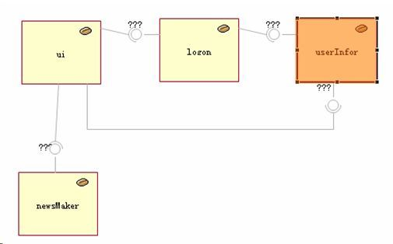
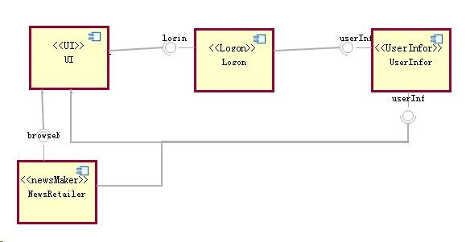
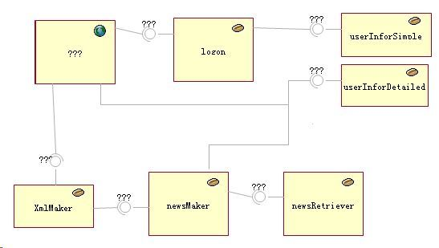
A Made-up Case
Notes:
News release application

Slide 15
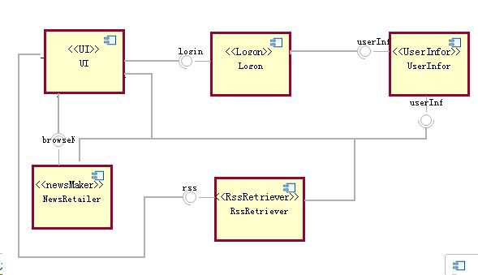
A Made-up Case

Slide 16
Technology (1)
Bi-transformation between SA and J2EE
  Language, tool, and rules
Why bi-transformation
  Write forward and backward behavior at once
  Guarantee that the user-defined rule be correct and stable
    The two basic properties (GETPUT, PUTGET)
Notes:
Convenient and reliable
Worry about

Slide 17
Technology (2)
Cooperation between architects and composers
  Based on a collaborative ABCTool
    One user changes the model and commits it into CVS
    Tool records relevant information with changes, like rationale
    For other users, the tool checkout and encapsulate the changes into a special kind of elements, and the users can use these elements to understand the change
  Using bi-transformation to support cooperation based on different artifacts
    Reflect changes on one model into the other
Notes:
Another key issue towards the round-trip refinement is how to support the cooperation between
Our initial plan for this collaborative ABCTool was to support cooperation between different architects
To help other users understand

Slide 18
Agenda
An Overview of ABC Method
Round-trip Component Composition
Plan and Progress
  Short-term plan
  Current progress
  Long-term plan
Discussion

Slide 19
A Short-term Plan
A nontrivial case from architecture design to component composition (without round-trip)
  Object application (Java PetStore)
    The application may not affect the transformation very much
  Software architecture model
    ABC/ADL
  Implementation model
    J2EE component model
  Transformation
    ATL
Notes:
Did not have a Consensus

Slide 20
Current Progress
SA model
  The current ABC/ADL carries little information
  Need to extend it
    Domain specific information (?)
J2EE Model
  From Eclipse Standard J2EE Tool
    A component of Eclipse Web Technology Project
  Directly mapped to J2EE deployment descriptor
  Still need to investigate the ability of the tool
A prototype transformation
Notes:
I have spent several days to survey the existing j2ee tools

Slide 21
Long-term Plan
A Round-trip refinement process between design model and implementation model
  A bi-transformation language
  A proper method
  Experience
Investigate a similar way towards Bi-transformation between requirement model and design model

Slide 22
Agenda
An Overview of ABC Method
Round-trip Component Composition
Plan and Progress
Discussion
  Technical problems we meet so far
  Discussion about ongoing and further work

Slide 23
Technical Problems Overview
Technical Problems
  Arise during our initial attempts
  Mainly caused by the strange format of J2EE model
    Directly mapped to J2EE description xml files
  May be useful for designing synchronization mechanism between models
Overview
  File split, Name reference, Many to one, One to Many, Hierarchical source model…
Notes:
Although we just started our initial attempts, we have already met some problems.
We think these problems may be valuable for the designing of a bi-tr language

Slide 24
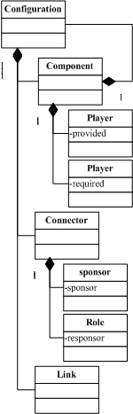
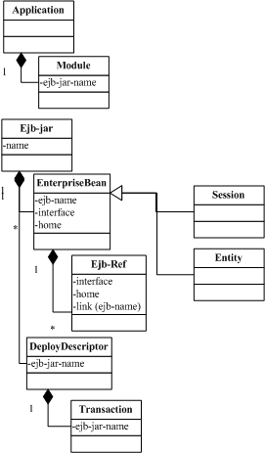

Slide 25
Common Refinements
The obtained target model is just a draft
Composers may need such refinements
  Complement attributes
  Change attributes (adapt to the actual implementation)
  Replace one draft ejb with more actual ones (each for a partial of the original function)
  Introduce extra ejbs
    For dependency of the selected ejb
    For adaptation of the selected ejbs
  Change the type of elements
    Entity bean to session bean
  Add extra links

Slide 26
File Split
Cause
  For J2EE model, each ejb-jar is described by an independent file
  Transforming one file for SA model into many files for J2EE
Potential solution
  Introducing an intermediate file

Slide 27

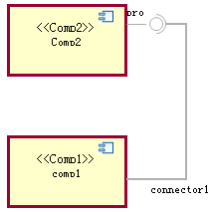
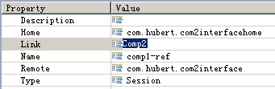
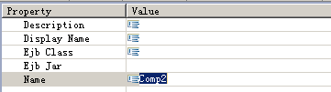
Name Reference
Properties for comp1-ref
Properties for comp2
Notes:
The second problem is the J2EE model use “Name attributes” to maintain associations.
Here is an illustration, for example, in SA
Now the developer may have to change the name of “comp2”, what will happen?

Slide 28
Name Reference
The Problem
  Use attribute (not “id”) to express associations
  Common in XML files
Implementation model
  No mechanism to maintain the dependency between “link” and “name”
    These two attributes have no dependency in J2EE model
    Their dependency is defined by SA and the transformation
  Use bi-transformation to maintain the dependency?
    Change “name”?
    Change “link”?
Notes:
The problem is that J2EE model use common attribute, but not identity attribute, to express associations. The difference is that id attributes usually do not changes during the lifecycle, but common attributes, like the name of EJB may be changed.
Common J2EE tools do not pay attention to the name reference. If one want to change the ejb’s name, he must change the link value manually.
Inspired by an earlier work of Prof. Hu,

Slide 29
Many to One and One to Many
Different types of source element may map to the same type of target elements
  Components map to EnterpriseBeans
  Complex Connectors map to EnterpriseBeans
The same type of source elements may map to different types of target elements
  Components can map to Session or Entity
  Connectors can map to Session or just Link attribute
How about the backward transformation?
Notes:
Similarly,
In ATL, we can use Boolean OCL to partition the source elements, and so how about the target elements when we have to transform them back

Slide 30
Hierarchical Source Model
Forward transformation: “flatten the SA”
  Ignore combined components
    Just transform the primitive components into ejbs
    Maintain the correct connection
  Transform combined components into proxy ejbs
    The “inner” ejbs communicate with “outer” ones through this proxy
Backward transformation
  Depends on the intention of composers
Notes:
The most intractable and interesting problems we met so far were caused by the hierarchical structure of source model.
To support a stepwise refinement, design models like SA usually support hierarchical structures, but implementation models don’t always support that. In J2EE, an enterprise bean cannot contain other beans.
Tow tactics to flatten the SA
Now the question is when a developer change the implementation model, what is the proper behavior of backward transformation?

Slide 31
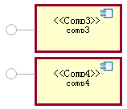


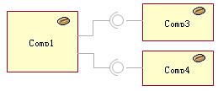
Examples
Replace one draft ejb with several ones:
  Each successor provides a part of the original function
  Form the inner structure of the original component
transform
transform
refine
Notes:
These two components together implement the original comp2, and the right backward transformation is that we create two concept components for Comp3 and Comp4, and these two concept components form the inner structure of Comp2
Now if the design does not care about the inner structure, he can consider that the composer did not violate his original design decisions.

Slide 32

Examples
Introduce extra ejbs for dependency
  One selected ejb depends on another ejb
  The two ejbs provides one function
  Form the inner structure of the original component
Introduce extra ejbs for adaptation
  Some ejb does not match the required reference
  Add new ejb, just for communication
  Form the inner structure of the original connector

Slide 33
Discussion on the Further Work
Primary task
  Complete the current transformation
Further Work
  Try to achieve a usable round-trip refinement process between SA and J2EE
    SA is still not so practical (to add much information)
    J2EE is hard to use (consider other implementation platform?)
    The whole process is hard to formalize and generalize
  An architecture guided J2EE development tool?
    Base on an existing J2EE development environment
Notes:
Here is the problems we met so far, and during the further research, we may meet more problems.
Our primary task now is to complete the current transformation from SA to J2EE, and base on the transformation to consider the direction of our further work.
Our original idea was to achieve a round-trip refinement process between SA and J2EE. The best result is that we can provide a usable, practical and widely accepted development method for J2EE. But we are afraid that we can just get a prototype. It’s difficult for practitioners to accept this method now,
It may be hard for us to achieve a useful, practical, and widely accepted development approach.

Slide 34
Discussion on the Further Work
Further work (continue...)
  Turn to common round-trip engineering between PIM and PSM
    Extract some general problems for common round-trip engineering in MDA
    Support cooperation based on heterogeneous artifacts
  Focus on some of the technical problems
    Name reference or hierarchy relevant problems
    Try to find formal description and novel solution
Need further discussions
Notes:
Another potential direction
Generalize our attempts into a common round-trip approach between PIM and PSM
Based on this bi-transformation, or synchronization, we can support cooperation…
We do not attempt to achieve a unified, complete round-trip approach between PIM and PSM, but focus on some particular problems during this round-trip approach.
We can take this opportunity to have further discussions

Slide 35
Thank you!

