Slide 1
ABC：
Architecture Based Component Composition
Software Institute
Peking University
Dec. 7, 2007

Slide 2
ABC Technical Framework
Feature Oriented Requirements Analysis
Design of Software
Architecture
Architecture Based Component Composition
Architecture Based Application Deployment
Architecture Based Maintenance and Evolution
FMTool (Feature Modeling Tool)
ABCTool (Architecture Modeling Tool)
PKUAS (J2EE-compliant Middleware)
Proposed in 1998
  Introduces software architectures into each phase of software life cycle
  Aims for automated component based reuse
  Evolves to ……

Slide 3
ABC Technical framework
Object Oriented Analysis & Design
Componentized SA
ABCTool
Feature Oriented Requirements Analysis
Design View
Implementation View
Deployment View
Runtime View
Meta Model of ADL
Architecture Recovery of Legacy Systems
Online maintenance & evolution
Deployment
Reusable Component
Standard Middleware
Reflective Middleware
Component Library
(JBCL)
Web Services
PKUAS
CORBA
J2EE
JOnAS
Fractal

Slide 4
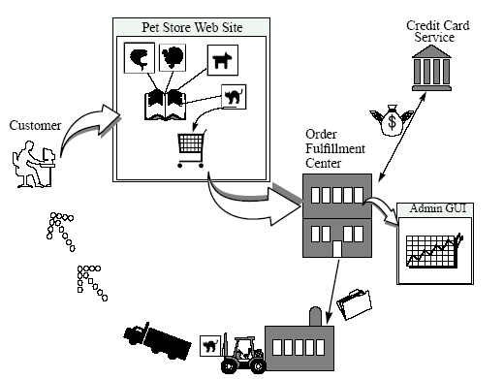
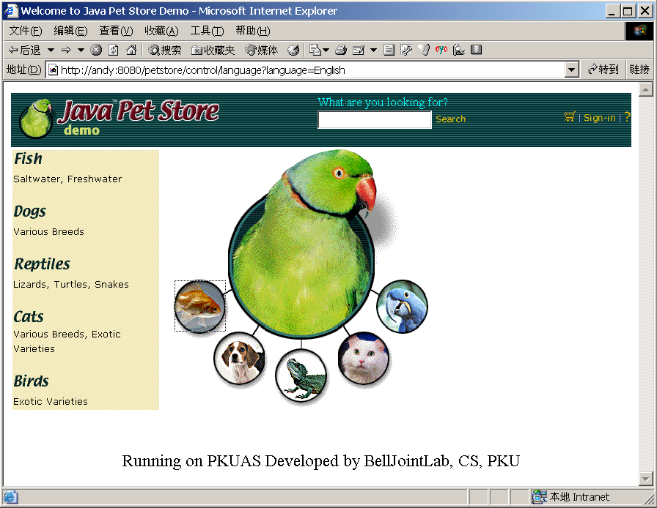
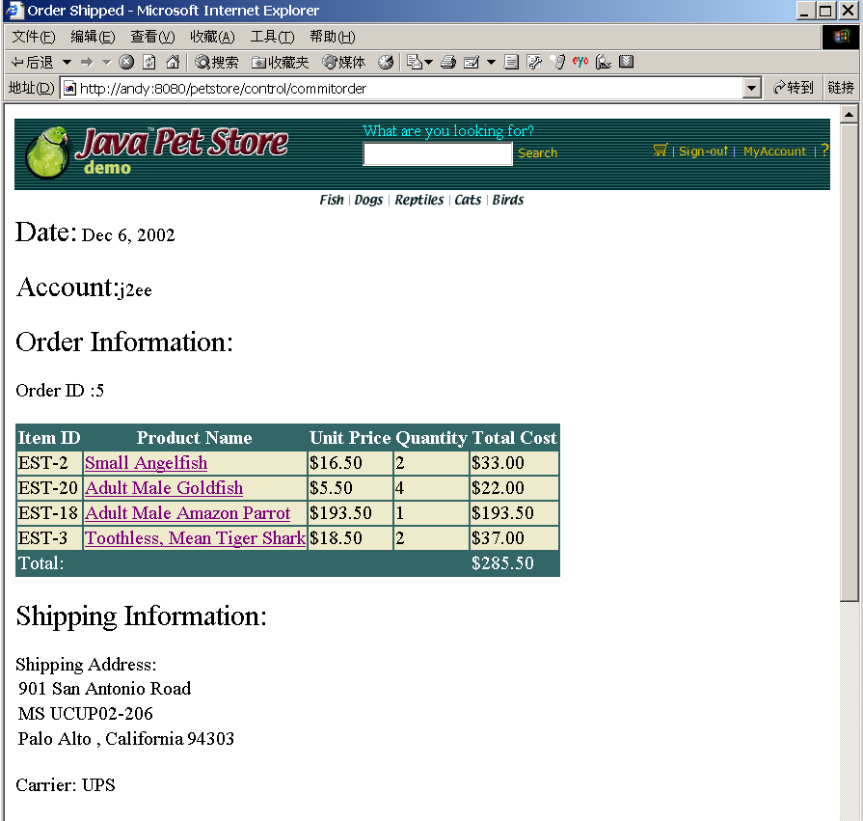
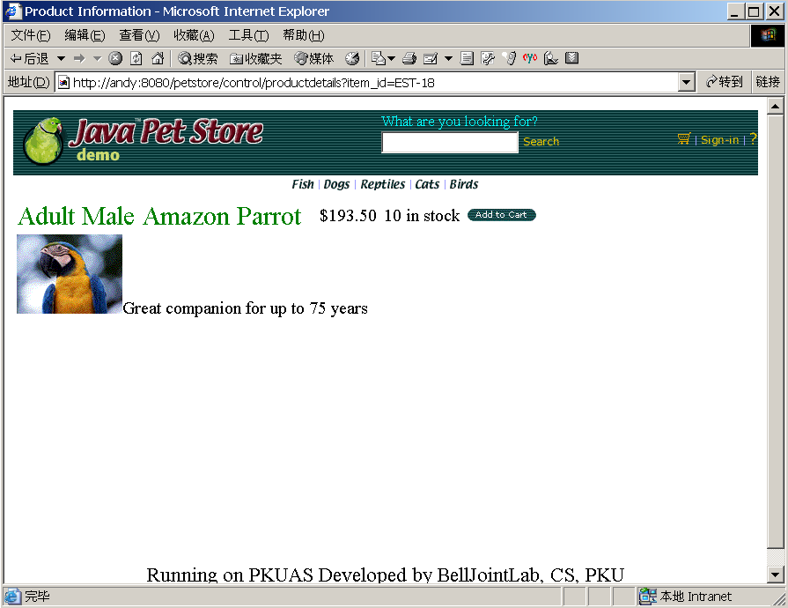
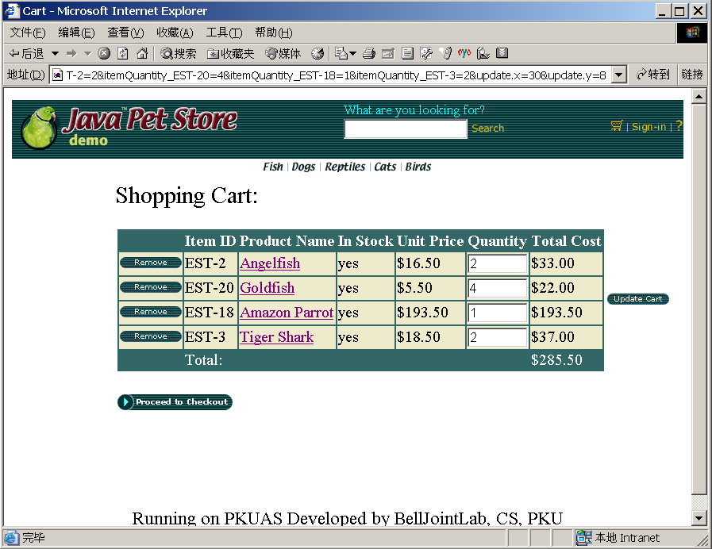
Illustrative Sample
Java Pet Store (JPS)
  A sample application by Java Blueprints program at Sun Microsystems
  An online pet store enterprise that sells products – animals – to customers
Order
Process
Center

Slide 5
Feature Oriented Modeling
Treats features as the basic entities in the problem space.
  A feature describes a software characteristic from user or customer views, which essentially consists of a cohesive set of individual requirements.
Uses features and relations between features (feature model) to specify the problem space.
Problem space
Feature
Relation between features
Feature-oriented view of the problem space
Notes:
1 The feature-oriented approach to requirements modeling treat features as the basic entities in the problem space,
and use features and relations between features (namely, feature model) to specify the problem space.
2 A feature describes a software characteristic from user or customer views, which essentially consists of a cohesive set
of individual requirements.

Slide 6
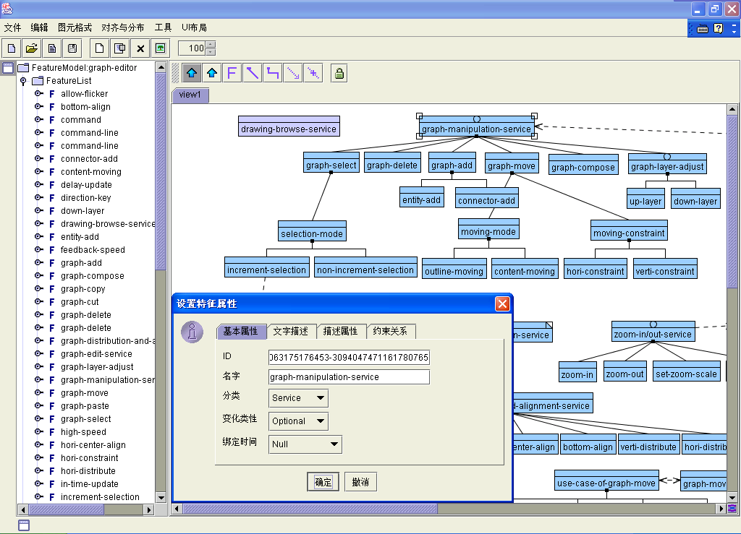
GUI of FMTool
Domain Feature Model
Application Feature Model
Draft Software Architecture

Slide 7
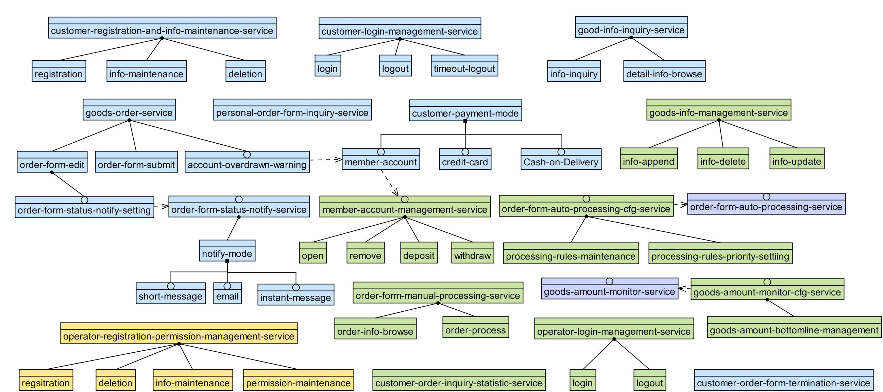
Domain Feature Model of E-shops
Domain Feature Model
Application Feature Model
Draft Software Architecture

Slide 8
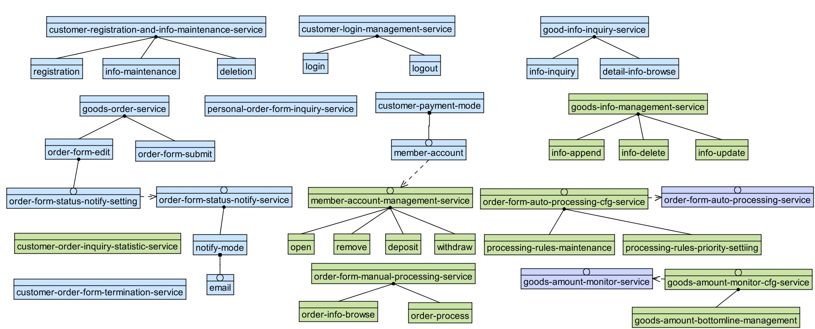
Customized Feature Model of JPS
Domain Feature Model
Application Feature Model
Draft Software Architecture

Slide 9
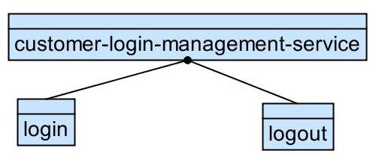
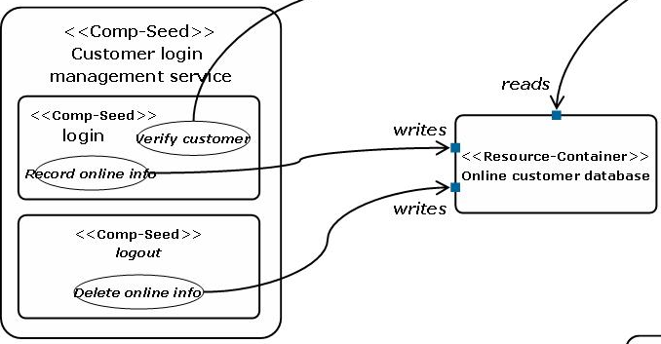
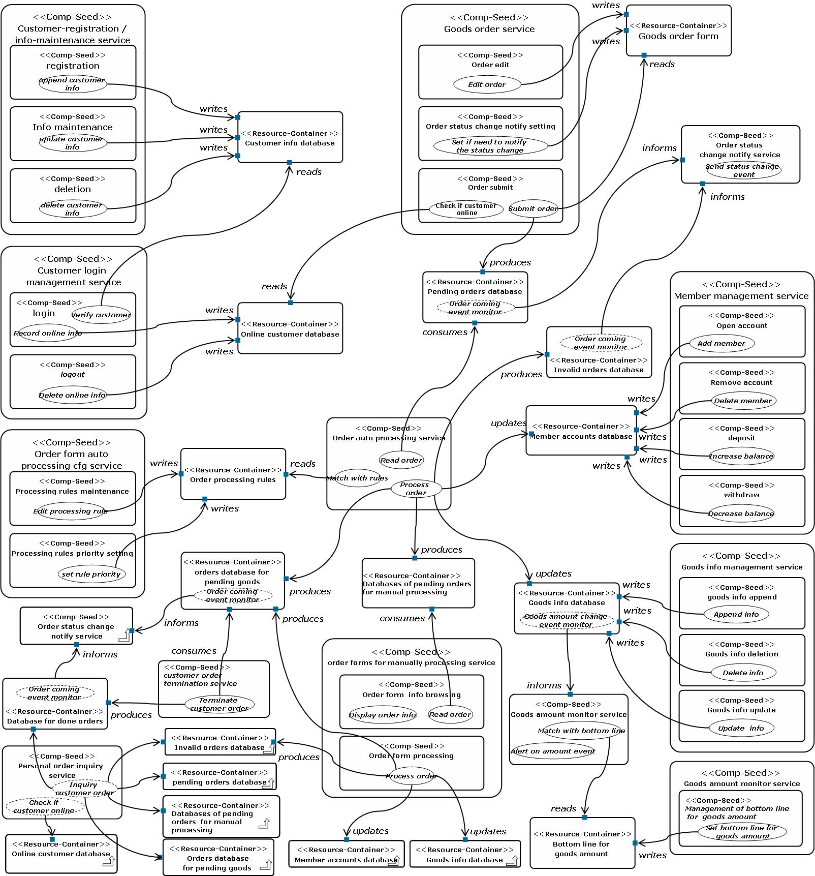
Draft Software Architecture of JPS
Feature model
The way similar to functional decomposition works well in this case
Draft software architecture
Domain Feature Model
Application Feature Model
Draft Software Architecture

Slide 10
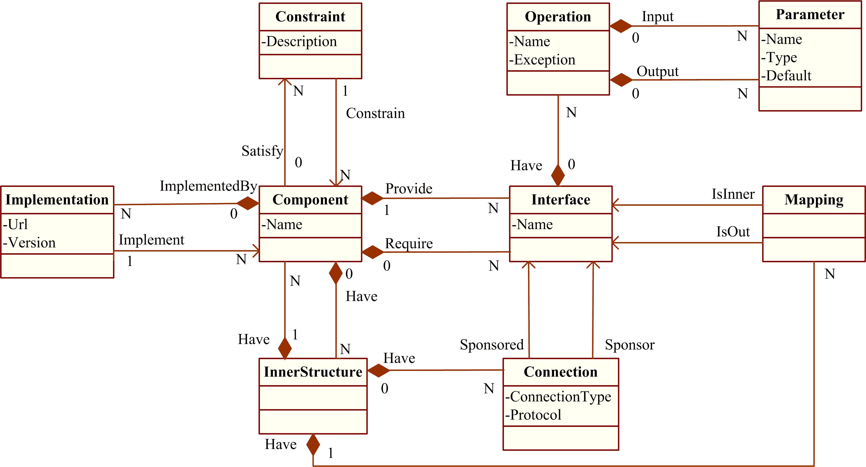
Software Architecture Modeling
generality
Platform independent
Platform specific
Product specific
Design View
Implementation View
Deployment View
Runtime View
Meta Model of ADL
The meta model of ADL only defines the elements common to all views and necessary for traceability
  This meta model will become the Chinese Industry Standard soon

Slide 11
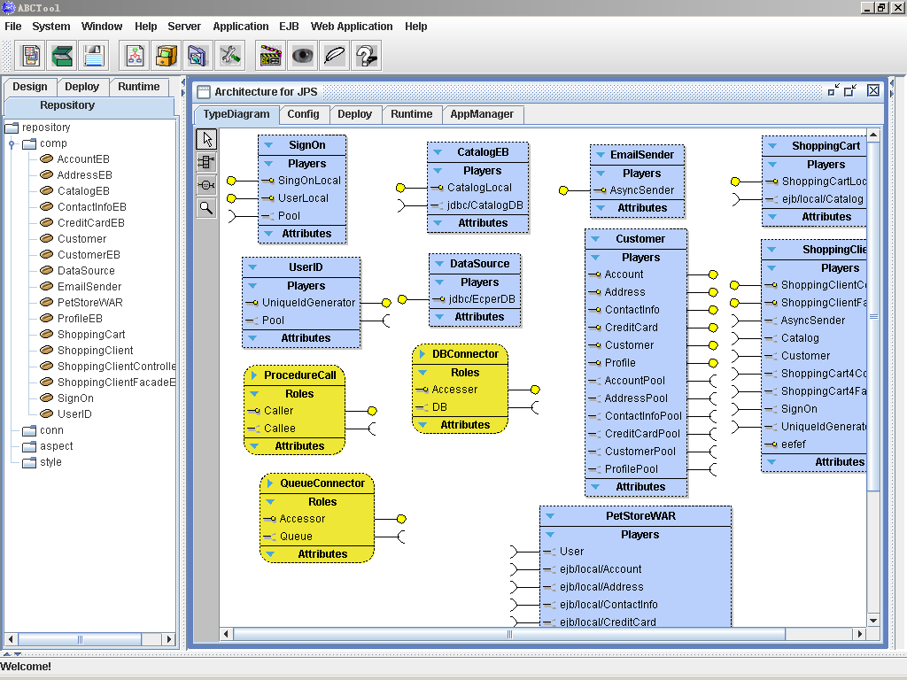
ABC Perspectives, each of which provides a set of diagrams for Design, Implementation, Deployment, Runtime M&E
Design Perspective:
Type Diagram
Reusable Elements in Repository for Implementation.
Component Type
Connector Type

Slide 12
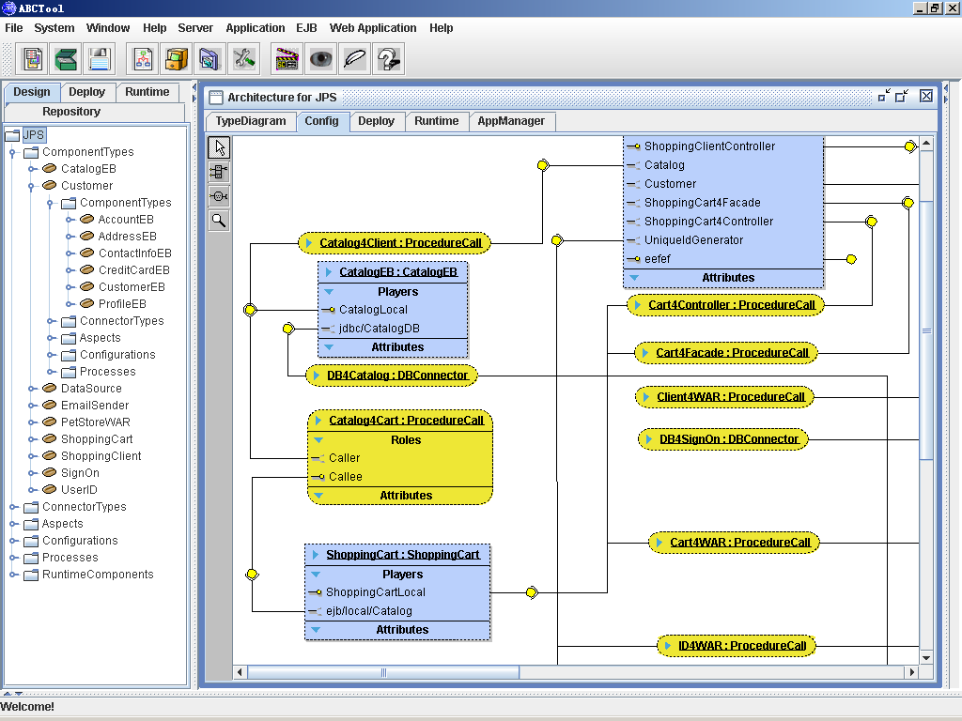
Design Perspective:
Configuration Diagram
Connection between component and connector
Tree of SA elements
Notes:
王建：如何设计一个软件体系结构，如何把握一个构件的粒度？

Slide 13
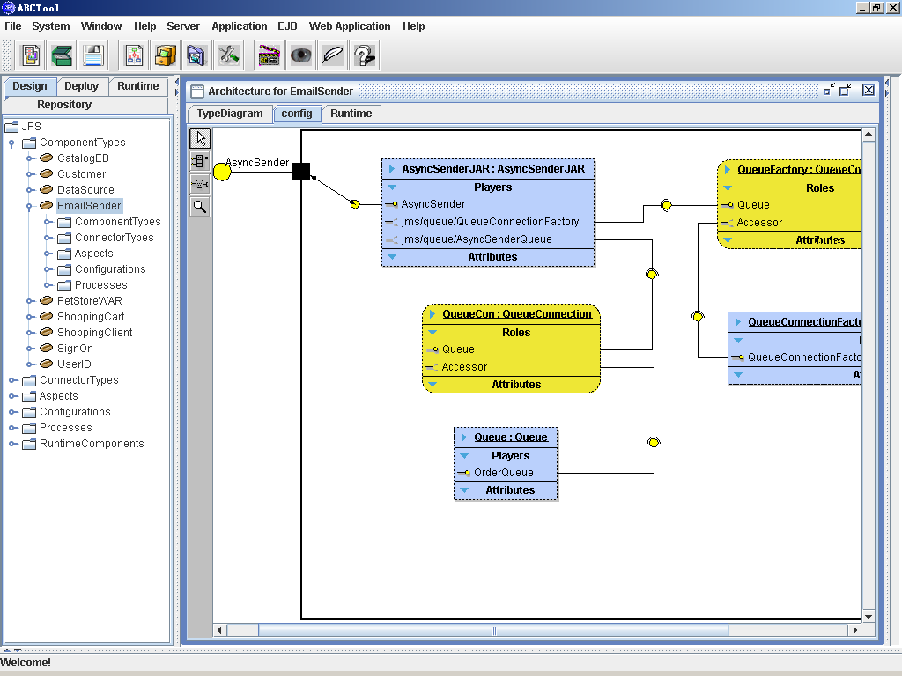
Design Perspective:
Inner architecture diagram
→modeling architecture inside a component
→Zoom in & Zoom out
→Hierarchical Modeling
Notes:
复合构件EmailSender的内部结构。实心黑框表示复合构件对外提供的接口。
ABCTool会为每一个复合构件新开一个窗口，这些窗口里没有Deploy和AppManger标签页

Slide 14
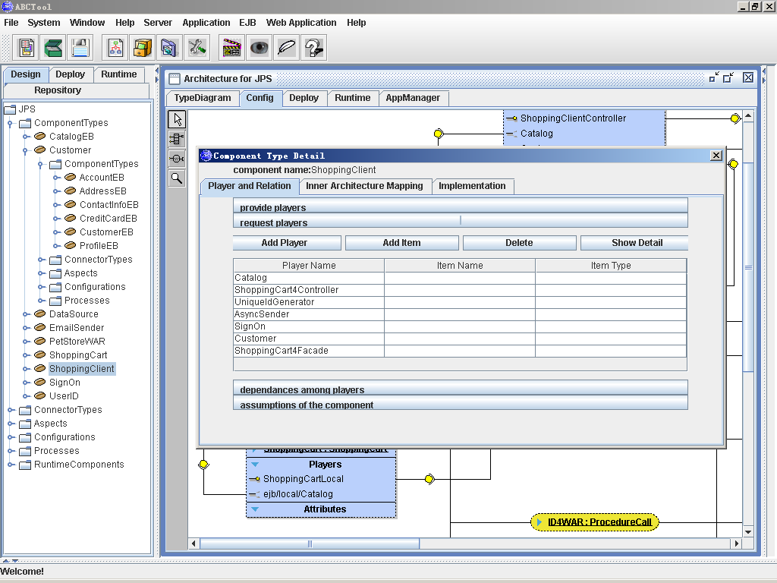
Implementation Perspective:
→Similar with Design Perspective
→Only add implementation specific info
e.g., ShoppingClient is implemented as a Java Servlet
Design Perspective: Detail Dialog
→Show detailed information of component “ShoppingClient”
Notes:
显示构件详细的静态信息。这些信息实际上都是和config diagram相关的，所以总觉得这张图好像说明不了什么。
在这几张图里一共出现了三次“构件详细信息”，这次是设计时的信息，主要是和其他构件的关系；后面在deploy view里有一张通过as观察构件的部署信息的图；最后还有一个runtime的，reflected information。这三种里有一些重复项，但侧重点不同，不过主要还是获得信息的方式不同。这幅图是从ADL中得到的信息，部署那张是从as里读出的信息，最后那张是通过反射。

Slide 15
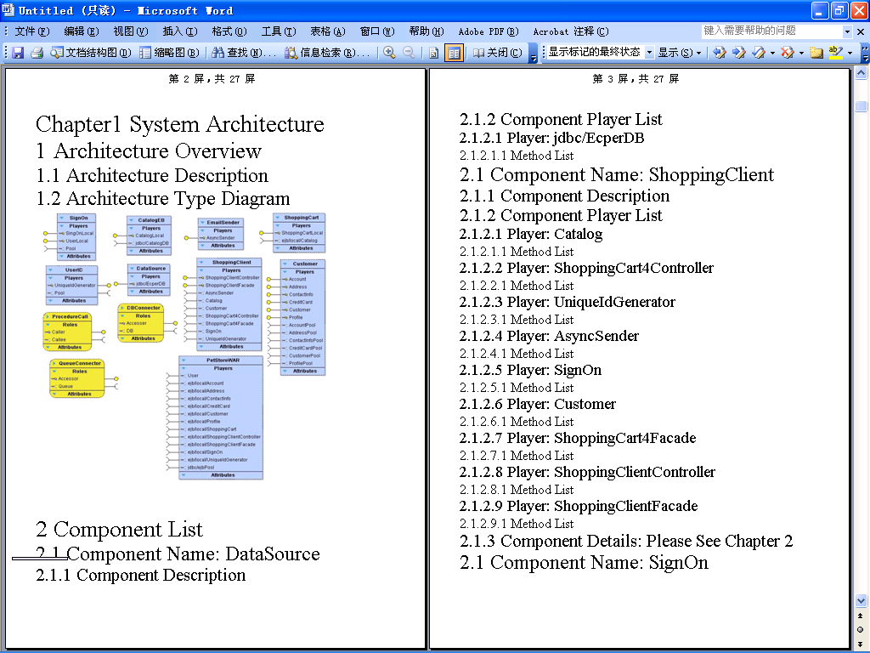
Automatic Generation of Design Document

Slide 16
Architecture based Deployment
generality
Platform independent
Platform specific
Product specific
Design View
Implementation View
Deployment View
Runtime View
Meta Model of ADL
Challenges to Deployment (specific to J2EE)
  Understanding applications to be deployed
    But the application becomes more and more complex
  Configuring the whole systems
    But current tools require so many manual efforts
  Deploying to multiple nodes easily
    But current tools only support node by node

Slide 17
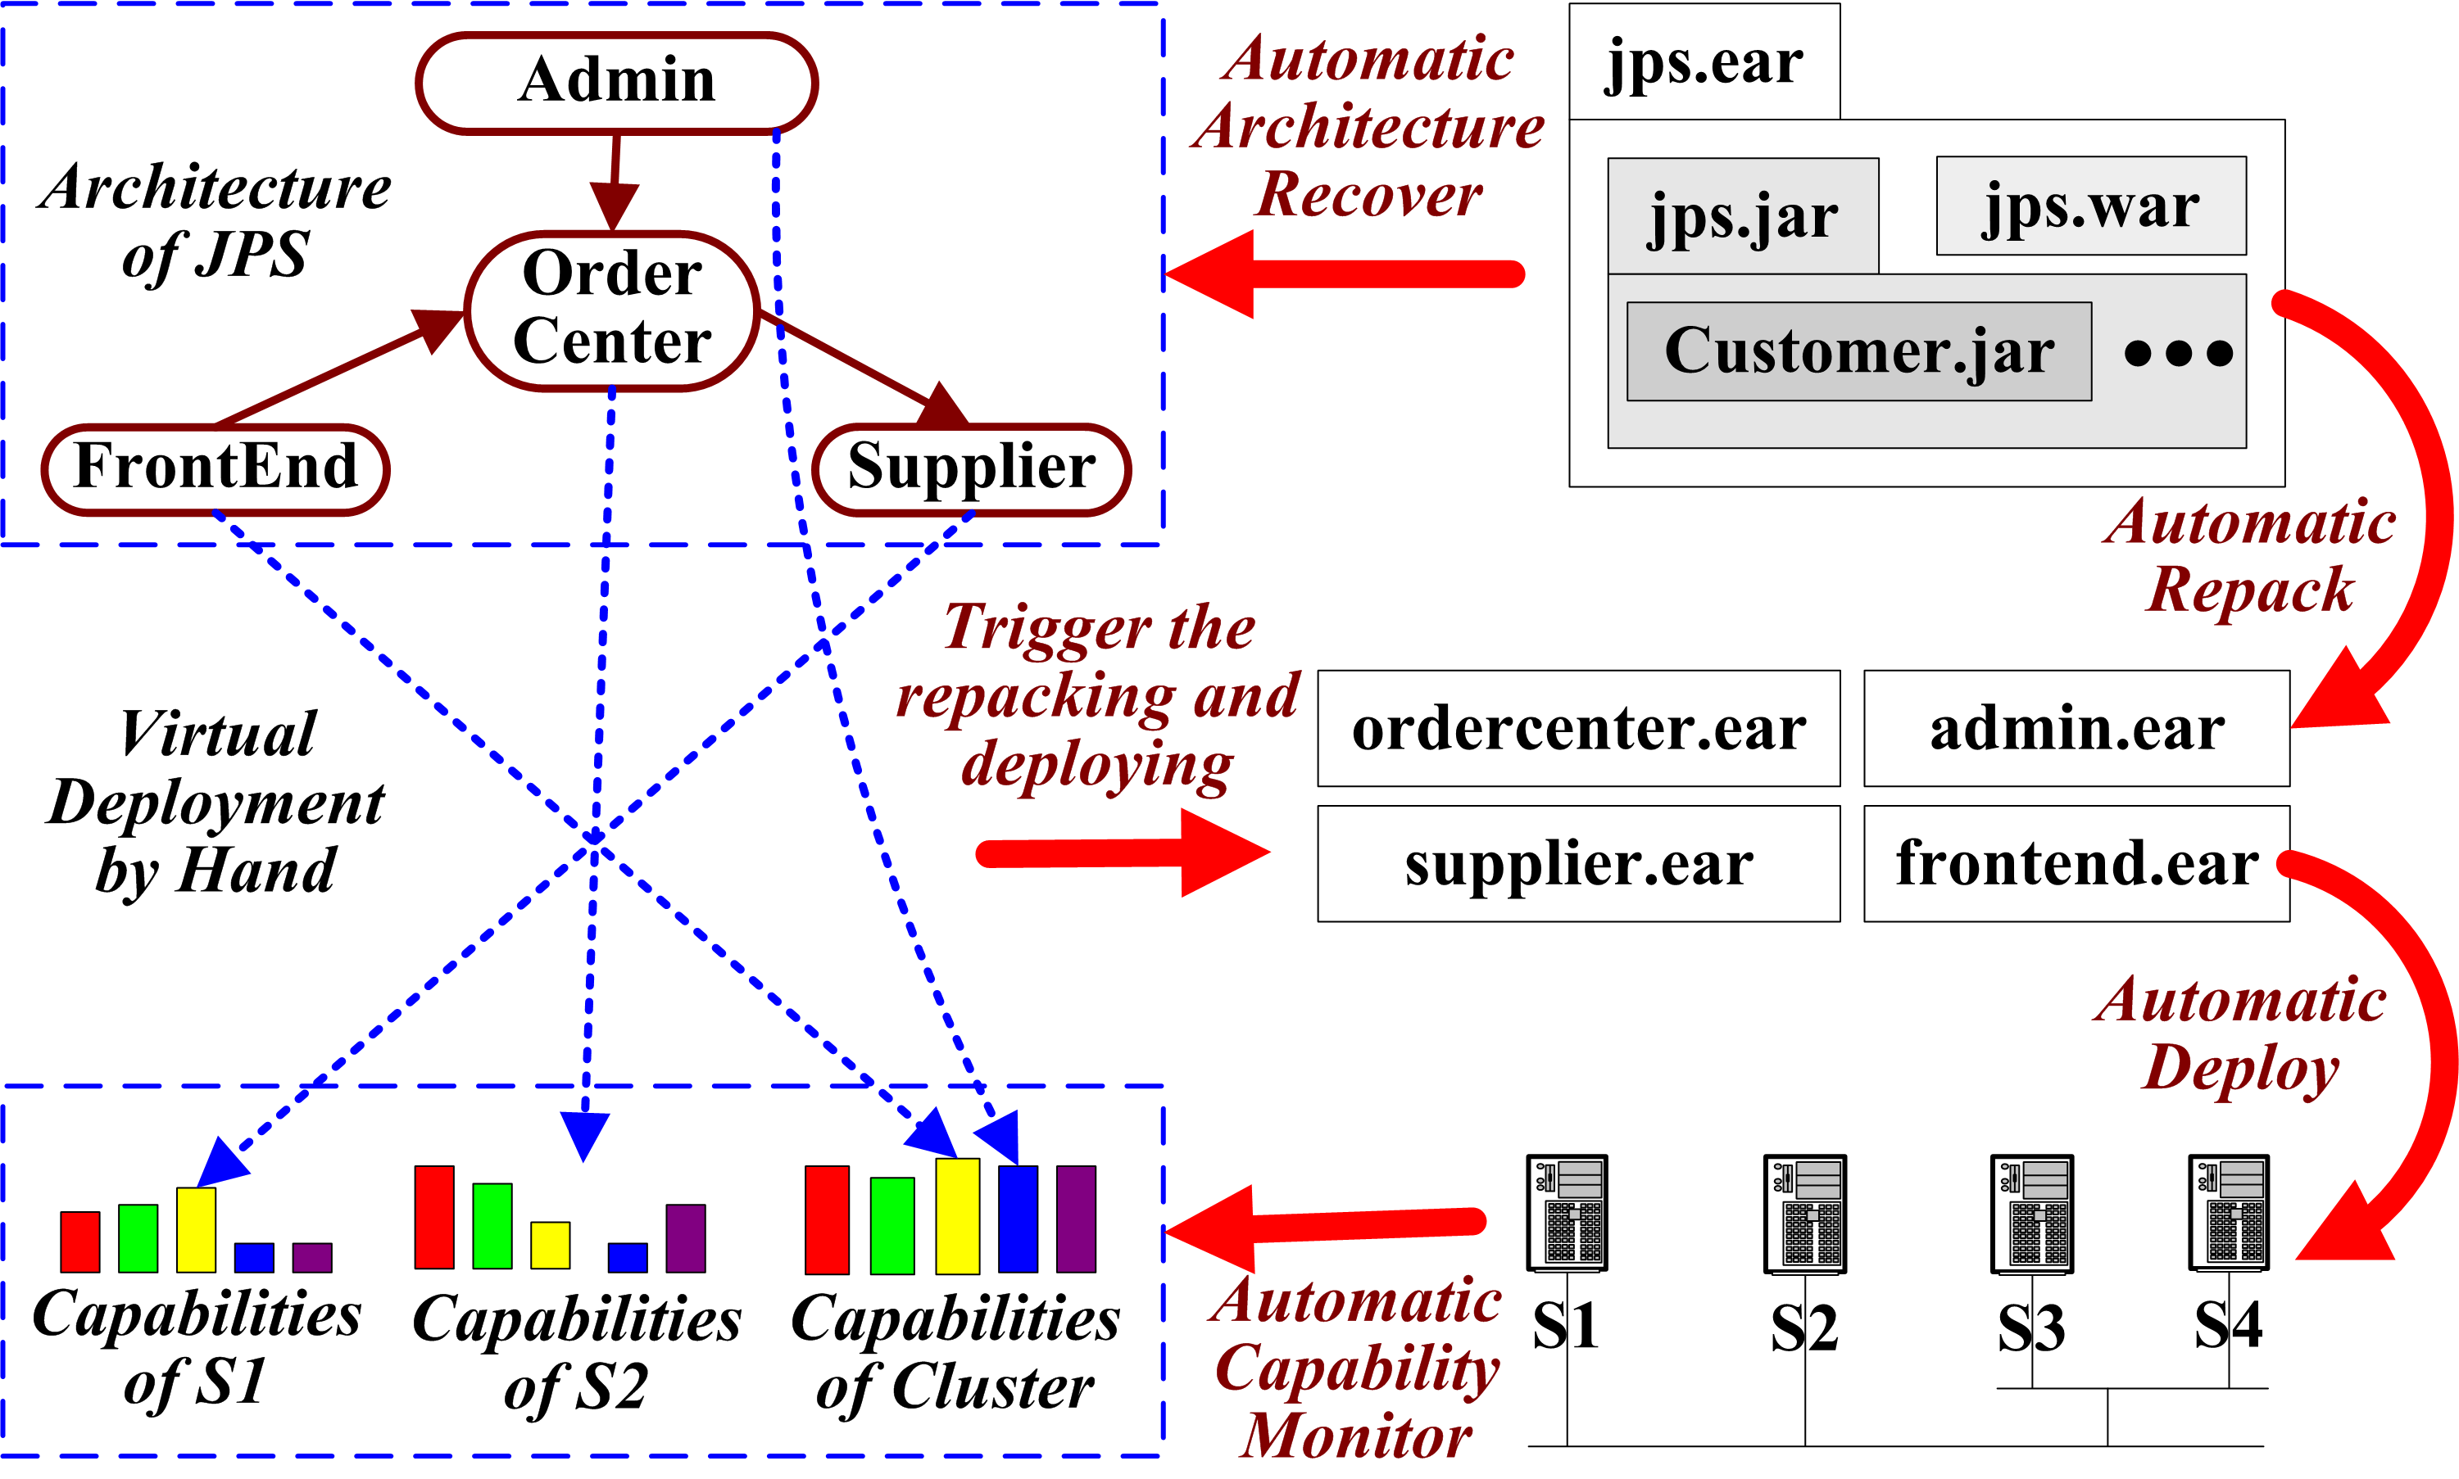
Architecture based Deployment Process

Slide 18
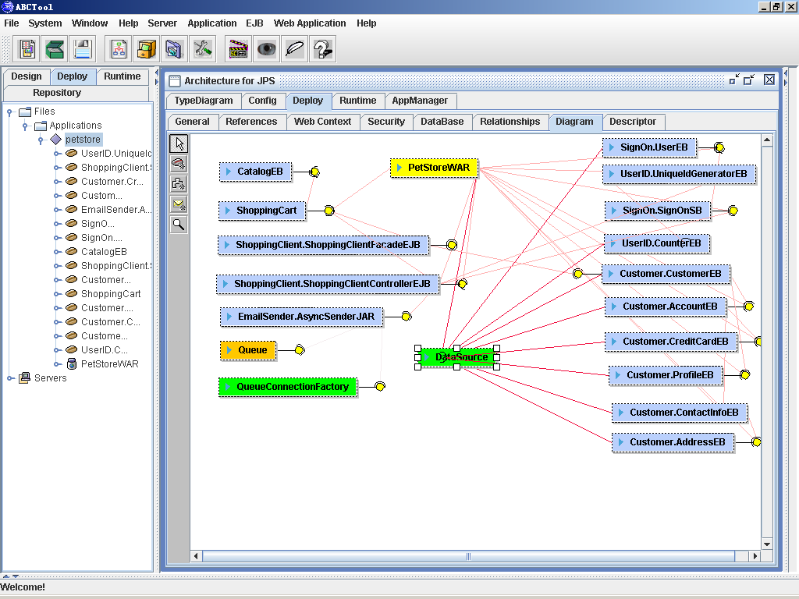
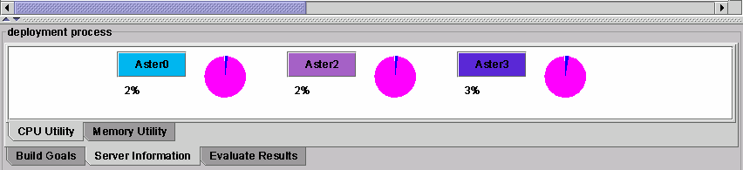
Deployment Perspective: Configuration Diagram
→Show relationship between deployed elements
Highlight associated components of this DataSource
visualizing server resource utilization
Notes:
苏辉：如果能够将部署输入项从1000减少到20，意义非常重要。是否在一些实际系统中应用过？

Slide 19
Architecture based
Maintenance and Evolution
generality
Platform independent
Platform specific
Product specific
Design View
Implementation View
Deployment View
Runtime View
Meta Model of ADL
Online Maintenance and Evolution
  very valuable for large-scale distributed systems and 7x24 (7 days 24 hours) high availability
  But very challenging to why, when, what & how
ABC’s Runtime Software Architecture Leverages
  Software architecture knowledge for why, when & what
  Middleware adaptability for how

Slide 20
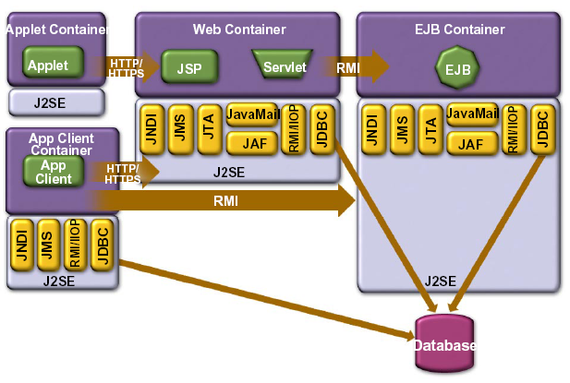
Runtime Software Architecture
Runtime Software Architecture
  A model representing a runtime system as a set of architectural elements which are causally connected with the internal states and behaviors of the runtime system
    Causal connection means changes at one side will immediately lead to the corresponding changes at the other side, and vice versa
Self
Representation
by Meta Objects
Notes:
刘英: 如何能够知道一个运行构件与其他构件之间的关系？如何保证正确性？性能开销？

Slide 21
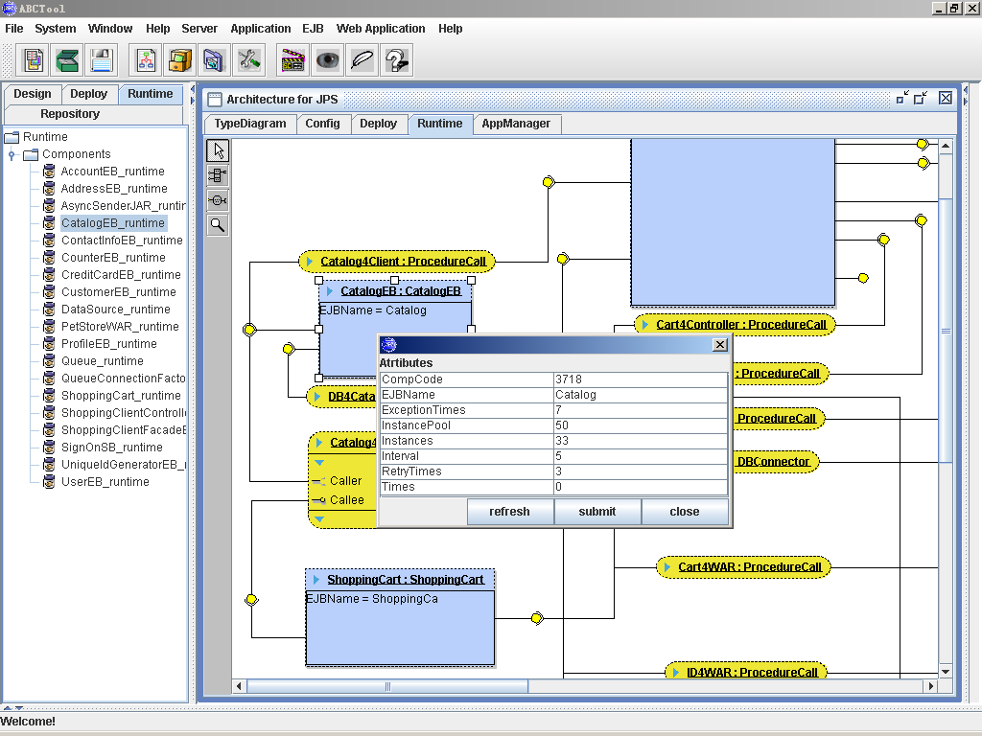
Runtime Perspective:
→ Plentiful runtime info is added
Runtime Perspective: Controller Dialog
→monitor and control runtime states and behaviors through controllers
→controller is a meta object in RSA
→application developers can insert user-defined controllers into RSA for implementing application specific reflection
Four steps using Runtime Perspective:
Open SA artifacts in development (SA can be recovered from runtime system but which lacks of design info)
Associate SA elements with runtime entities (instantiate SA to RSA)
Customize whether a component is reflective and what reflection is activated when necessary (for controlling performance penalty)
Reflecting SA elements
Notes:
某个controller的详细信息。可读可写

Slide 22
ABC Applications & Collaboration
Applications
  Information modeling of Beijing 2008 Olympic Games
  Commercialized by four software companies
  Commercial use in finance, telecom, transportation, government, education, etc.
Collaboration
  One of OW2 founders (open source middleware community)
    merged by Objectweb & Orientware
    J2EE AS, Component Model, Autonomic Management
  Integrated with
    AVAYA eXvantage (testing platform)
    Platform EGO (grid management)
  Tokyo Univ. (model transformation), Arizona State Univ. (service oriented architecture), IBM (solution engineering), Lucent (feature interaction), ……

Slide 23
Thanks
Feature Oriented Requirements Analysis
Design of Software
Architecture
Architecture Based Component Composition
Architecture Based Application Deployment
Architecture Based Maintenance and Evolution
FMTool (Feature Modeling Tool)
ABCTool (Architecture Modeling Tool)
PKUAS (J2EE-compliant Middleware)
ABC:
Architecture Centric Engineering
for net based Software
Transformation

