Slide 1
Responsibility-based Transformation from Feature Model to Software Architecture
Haiyan Zhao
(Joint work with Wei Zhang, Hong Mei)
1st workshop on bi-trans on ABC
Dec. 7, 2007, PKU, Beijing

Slide 2
Why Transformation?
Feature Oriented Requirements Analysis
Design of Software
Architecture
Architecture Based Component Composition
Architecture Based Application Deployment
FMTool (Feature Modeling Tool)
FDDItool (Feature driven domain Implementation Tool)
Requirement Analysis model → design model
Feature Model → software architecture

Slide 3
Source ：Feature Model
Relationship
Classifier
Relationship
Classifier
Invoke
+requirer
Entity
DirectExplicitInteraction
Require
*
1
Meta
-
LevelConfigure
1..2
*
1
DirectExplicitInteraction
Constraint
name
0..1
+requiree
requirements
2..
*
1..
*
Constraint
Exclude
specification
+trigger
*
2
1
*
Interaction
ResourceConfigure
1..2
optionality
1
*
Interaction
binding
-
time
+triggee
IndirectExplicitInteraction
ComplexConstraint
*
binding
-
state
IndirectExplicitInteraction
Influence
ComplexConstraint
2..
*
Decomposition
Decomposition
Feature
ResourceContainer
DirectImplicitInteraction
Notify
ResourceContainer
Detailization
DirectImplicitInteraction
Detailization
+parent
Refinement
Specialization
Flow
1
*
IndirectImplicitInteraction
1
0..1
Refinement
Specialization
+child
0..1
IndirectImplicitInteraction
Mutex
Notes:
Here is the meta-model of our feature models.
It is a more formal description of what we have said about feature models.

Slide 4
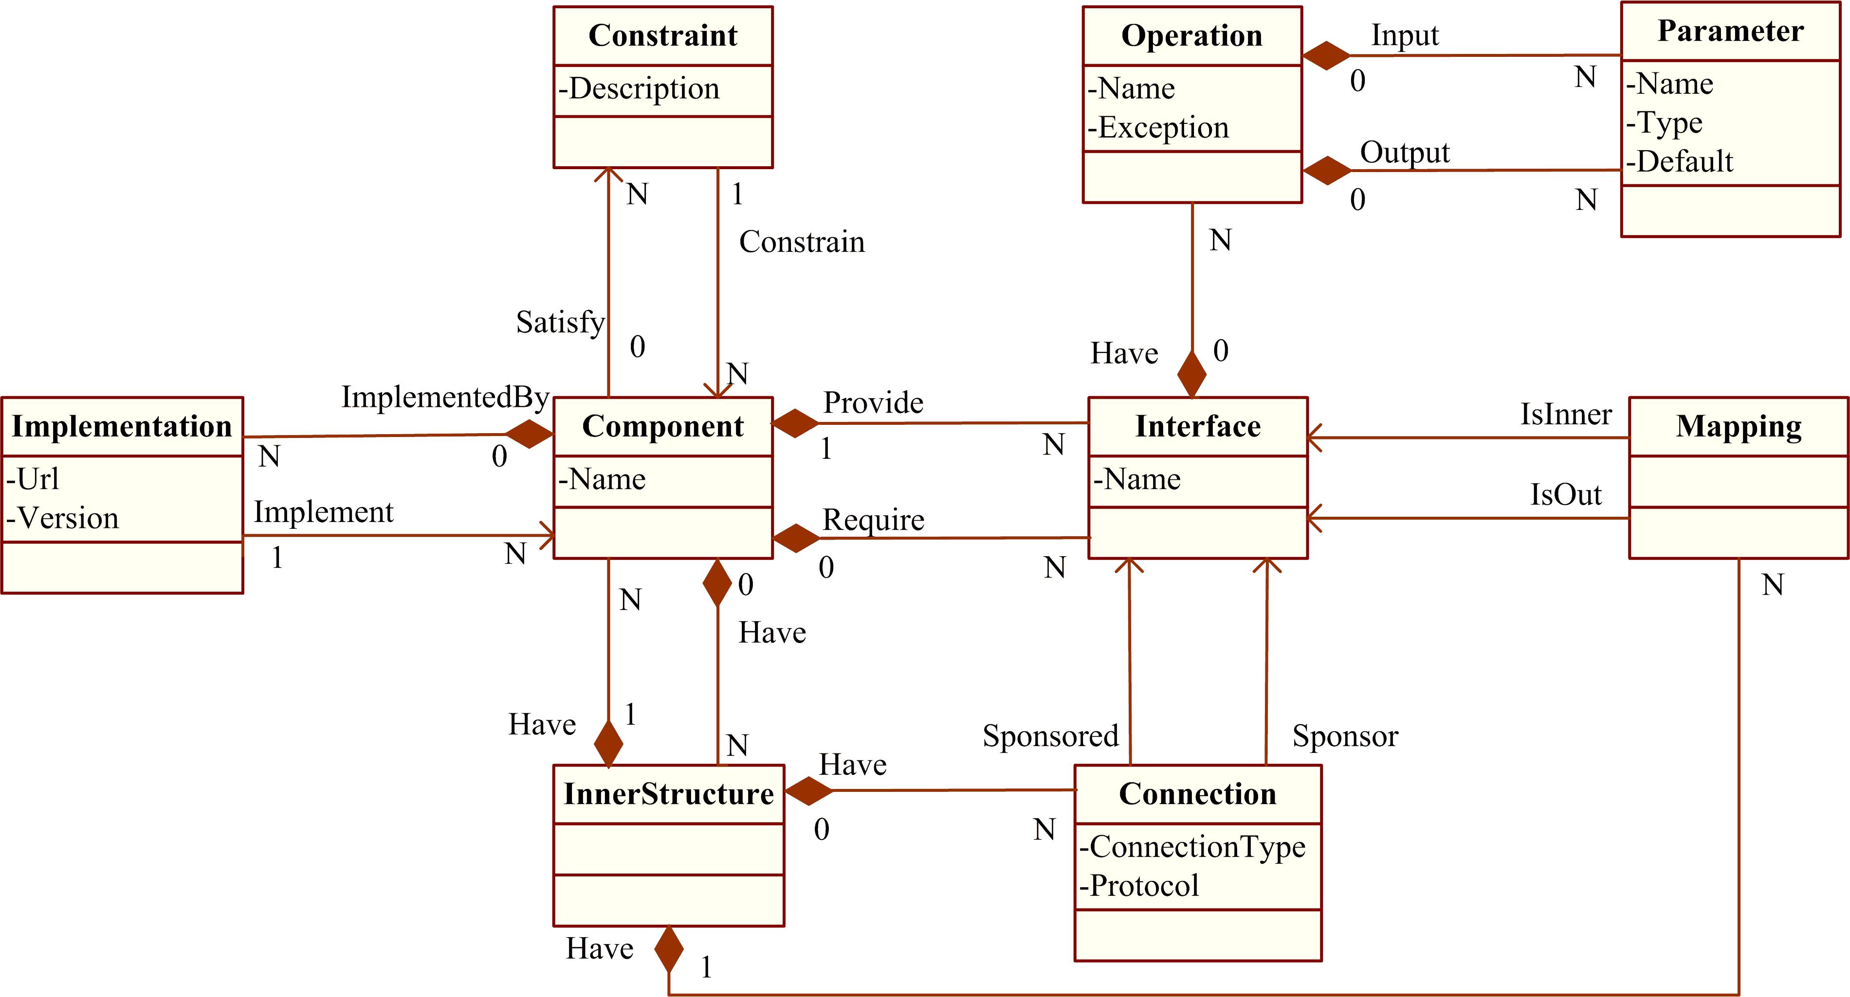
Target : component model
Notes:
Here is more formal description of our approach.
In the requirement level, there is features and interactions between features.
Then, a feature is operationalized into a set of responsibilities.
And indirect interactions are used to help find resource containers.
Then, we can see that interactions between features are transformed into direct-interactions
between responsibilities and between responsibilities and resource containers.
Then, every feature relate a feature component in the specification level.
Then, responsibilities are assigned to feature components.
There are two kinds of responsibilities: core-responsibilities and added-responsibilities.
Here we use a example to show the distinction between the two kinds of responsibilities.
Then, resource containers and feature components are clustered into conceptual components.
Then, Conceptual components are implemented by infrastructure components.

Slide 5
How transformation?
Depends heavily on designers’ personal creativity and experience
  Two fundamental problems to address：
    How to address the m-n relationship between features and components;
    How to construct the software architecture based on the feature model
Responsibility-based approach
  Just a disciplined way
  Not fully automated

Slide 6
Responsibility-based Transformation
Take advantage of the information in feature models in the design stage
A cluster of specifications
Responsibility
Operationalized into
Assigned to
Features
Interactions between Features
Components
Interactions between Components
GAP
(THE PROBLEM SPACE)
(THE SOLUTION SPACE)
Notes:
We think, DRM-Based DSSA Design is about how the information in feature models can be used in the design stage.
Here is our approach to this problem.
In the problem space, there are features and interactions between features.
In the solution space, there are components and interactions between components.
And we use Responsibilities as the connector between the two spaces. Here A responsibility means a cluster of specifications.
In our approach,
a feature is firstly operationalized into a set of responsibilities,
and then responsibilities are assigned into components.

Slide 7
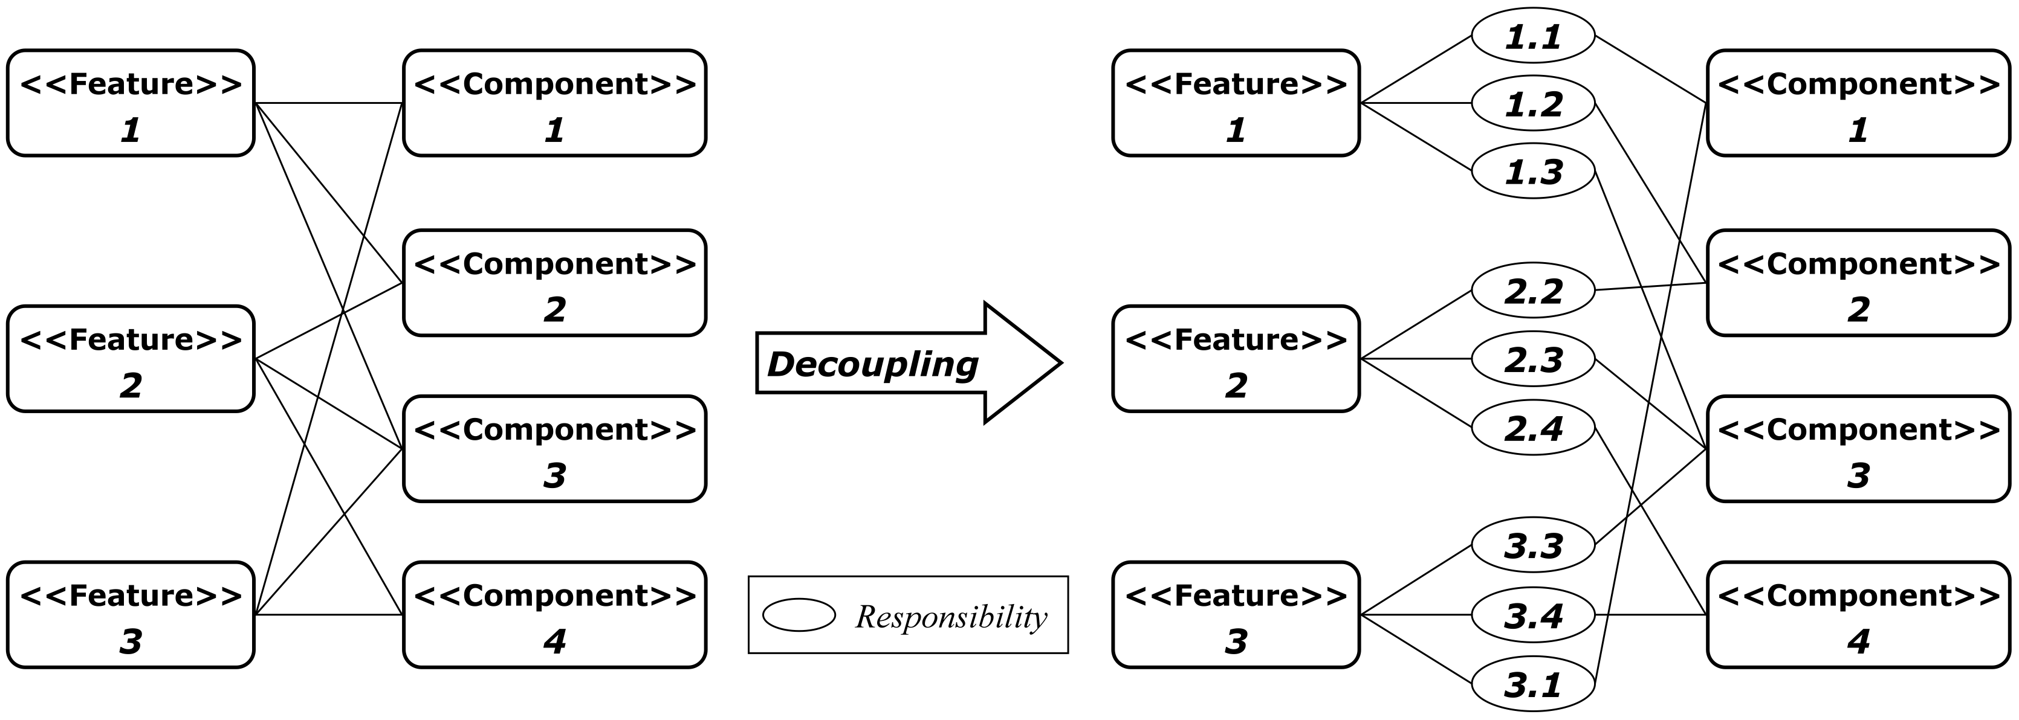
What is Responsibility？
In intension, a responsibility is a cohesive set of program specifications.
In extension, a responsibility is a basic unit for work assignment to software developers.
N-to-N
1-to-N
N-to-1
<number>/45

Slide 8
Decouple the relationship between Features and Components
A feature is decomposed into a set of responsibilities
R1
<<Feature>>
A
decomposed
R2
R3
<<Feature>>
B
R6
<<Feature>>
C
R4
R7
R5

Slide 9
Decouple the relationship between Features and Components
A component can implemented a set of responsibilities
<<Comp>>
D
R1
R3
R1
R2
R3
Clustered
R2
<<Comp>>
E
R6
R4
R6
R4
R7
R5
<<Comp>>
F
R7
R5

Slide 10
Relations between components
Identified from
  Interaction between responsibilities
    Responsibilities from same feature assigned to different component
  Constraints on features
<<Comp>>
D
R1
<<Comp>>
E
R1
R2
R2

Slide 11
Special responsibility
Resource container is
  to structure resources related to features
  to be assigned responsibilities of passively accepting requests from environment for resource storing, querying and retrieving
  To be identified by
    analyzing the description of features
    analyzing constraints on features

Slide 12
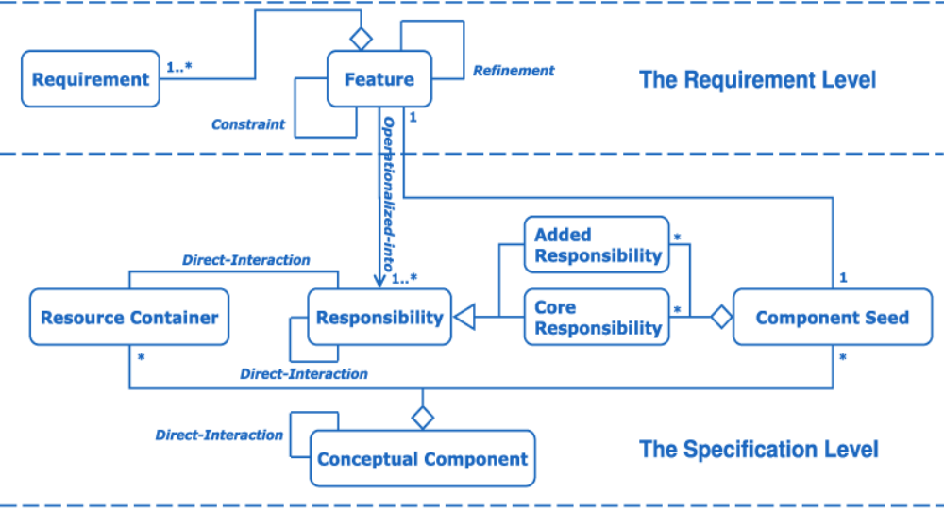
From Feature Model to Software Architecture: responsibility centric

Slide 13
Example: document editor
Feature1: Save
  Save a document into a disk.
Feature2: Copy
  Copy the selected text to the clipboard.
Feature3: Cut
  Cut the selected text to the clipboard.
Feature4: Paste
  Paste text from the clipboard to the current position in the document.
Feature5: Un/Re-do
  Redo or undo unsaved edit operations (i.e. copy, cut, paste) according to users’ requests.
<<Feature>>
Edit
<<Feature>>
<<Feature>>
<<Feature>>
Copy
Cut
Paste
<<Feature>>
<<Feature>>
Save
Un/re
-
do
<<Feature>>
<<Feature>>
Undo
Redo

Slide 14
Example: document editor
<<Feature Component>>
Save
<<Feature Component>>
Copy
1
2
<<Feature Component>>
Cut
<<Feature Component>>
Un/Re-do
3
<<Feature Component>>
Paste
5
4
Notes:
Here are five feature components of these 5 features.

Slide 15
Example: document editor
<<Resource Container>>
Clipboard
6
<<Feature Component>>
Save
<<Feature Component>>
Copy
Save
1
Copy
2
<<Feature Component>>
Cut
<<Feature Component>>
Un/Re-do
Cut
3
<<Feature Component>>
Paste
5
Paste
4
: Core Responsibility
: Added Responsibility
Notes:
The Save is a core-responsibility of Feature Save.
And the same is for copy, cut, and paste.
Clipboard is a resource container we have identified from requirements of feature Copy, Cut, and Delete.

Slide 16
Example: document editor
<<Resource Container>>
Clipboard
<<Feature Component>>
Save
6
<<Feature Component>>
Copy
Save
1
write
Copy
2
<<Feature Component>>
Un/Re-do
<<Feature Component>>
Cut
write
Cut
3
<<Feature Component>>
Paste
5
read
Paste
4
: Core Responsibility
: Added Responsibility
Notes:
Here are interactions between responsibilities (i.e. copy, cut, and paste) and the resource container Clipboard.
Then we begin to operationalize the feature Un/Re-do.

Slide 17
Example: document editor
<<Resource Container>>
Clipboard
6
<<Feature Component>>
Save
<<Feature Component>>
Copy
Save
Inform Saved
write
1
Copy
Record URI
2
<<Feature Component>>
Un/Re-do
<<Feature Component>>
Cut
<<Resource
Container>>
Un/Re-do Info
(URI)
Undo
Redo
write
Cut
Record URI
3
7
Clear URI
<<Feature Component>>
Paste
5
read
Paste
Record URI
: Core Responsibility
: Added Responsibility
4
Notes:
We can see that the Feature Component have three core-responsibilities.
The feature Un/Re-do also imposes responsibilities to other four features.
The Resource Container Un/Re-do Info is identified from the influence interactions between un/re-do and copy, cut, paste.

Slide 18
Example: document editor
<<Resource Container>>
Clipboard
6
<<Feature Component>>
Save
<<Feature Component>>
Copy
Save
Inform Saved
write
1
Copy
Record URI
write
2
inform
<<Feature Component>>
Un/Re-do
<<Feature Component>>
Cut
<<Resource
Container>>
Un/Re-do Info
(URI)
consume
write
consume
Undo
Redo
Cut
Record URI
write
3
7
<<Feature Component>>
Paste
clear
Clear URI
5
read
Paste
Record URI
write
: Core Responsibility
: Added Responsibility
4
Notes:
Here are interactions between responsibilities and between responsibilities and resource containers.

Slide 19
Example: document editor
<<Feature Component>>
Save
<<Resource Container>>
Clipboard
6
Save
Inform Saved
<<Feature Component>>
Copy
1
write
inform
Copy
Record URI
write
2
<<Feature Component>>
Un/Re-do
<<Feature Component>>
Cut
consume
consume
Undo
Redo
write
Cut
Record URI
write
<<Resource
Container>>
Un/Re-do Info
(URI)
3
7
clear
Clear URI
<<Feature Component>>
Paste
5
read
Paste
Record URI
4
write
: Core Responsibility
: Added Responsibility
Notes:
If we cluster feature components copy, paste, and delete into a conceptual component,
And treat clipboard as a conceptual component, the same for Feature Component save , un/re-do
and resource component URI,
Then we get such a software architecture.

Slide 20
Example: document editor
<<Conceptual Component>>
Clipboard
<<Conceptual Component>>
Save
<<Resource Container>>
Clipboard
<< Feature Component >>
Save
<<Conceptual Component>>
URI
<<Conceptual Component>>
Edit
<<Resource Container>>
URI
<<Feature Component>>
Copy
<<Feature Component>>
Cut
<<Conceptual Component>>
Un/Re-do
<<Feature Component>>
Paste
<<Feature Component>>
Un/Re-do

Slide 21
Example: document editor
<<Resource Container>>
Clipboard
6
<<Feature Component>>
Save
Save
Inform Saved
<<Feature Component>>
Copy
1
write
Copy
Record URI
write
2
inform
<<Feature Component>>
Cut
<<Feature Component>>
Un/Re-do
<<Resource
Container>>
Un/Re-do Info
(URI)
consume
write
Cut
Record URI
write
consume
Undo
Redo
3
7
<<Feature Component>>
Paste
clear
Clear URI
read
Paste
Record URI
5
4
write
: Core Responsibility
: Added Responsibility
Notes:
If we think there tight relation between URI and Un/Re-do, then we get such a software architecture.

Slide 22
Example: document editor
<<Conceptual Component>>
Clipboard
<<Conceptual Component>>
Save
<<Resource Container>>
Clipboard
<< Feature Component >>
Save
<<Conceptual Component>>
Edit
<<Feature Component>>
Clipboard
<<Conceptual Component>>
Un/Re-do
<<Feature Component>>
Clipboard
<<Feature Component>>
Un/Re-do
<<Feature Component>>
Clipboard
<<Resource Container>>
URI
Notes:
In future, we will further research on
how feature components and resource containers can be clustered into conceptual components.

Slide 23
Example: document editor
<<Conceptual Component>>
Clipboard
<<Conceptual Component>>
URI
<<Conceptual Component>>
Save
<<Resource Container>>
Clipboard
<<Resource Container>>
URI
<< Feature Component >>
Save
Depend-on
Depend-on
<<Infrastructure Component>>
Stack Component
(Provided by API)
Depend-on
<<Infrastructure Component>>
Clipboard Component
(Provided by OS)
<<Infrastructure Component>>
I/O Component
(Provided by OS)
Notes:
Here are some relations between conceptual components and infrastructure component.

Slide 24
Supporting tool
Provide
  Import the feature model
  Operationalize feature into responsibilities
  Construct the component model
  Cluster responsibilities into component
  Identify the interaction between components

Slide 25
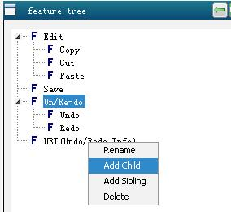
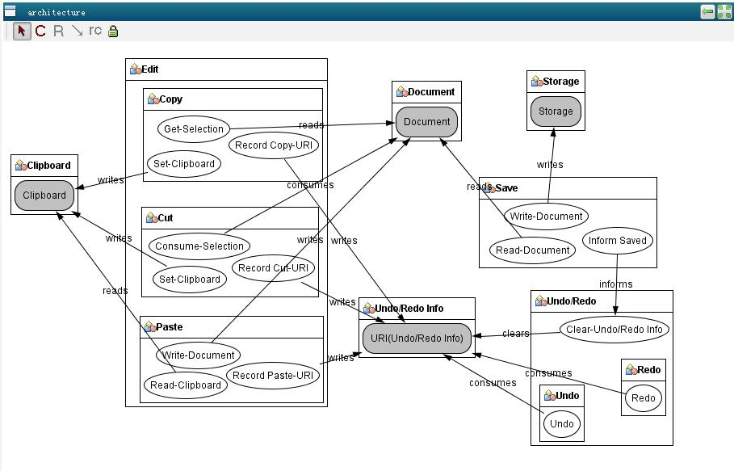
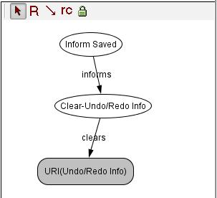

Slide 26
Traceability between FM and SA
Responsibility centric
  Xml files to trace relation
    between feature and responsibilities
    between responsibilities and components

Slide 27
To investigate
How to take advantage of the bi-Trans results
  Rule to decompose feature into responsibilities is case by case
  Rule to cluster responsibilities into component is case by case
Bi-Trans for documents ?

