Slide 1
Architecture-Based
Development and Management for Application Server
ZHOU Minghui
School of Electronics Engineering and Computer Science
Peking University, Beijing, 100871, China
Dec.7, 2007

Slide 2

Agenda
Challenges for ABC
Architecture-based application server composition
Architecture-based application server management
Summary

Slide 3
Review of ABC
SA - Software Architecture
  A critical aspect of design for any large software system
  A top-down approach to realize component-based reuse
CBSD - Component-Based Software Development
  Supported by middleware technologies
  A bottom-up approach to realize component-based reuse
ABC
  Architecture-Based component Composition
  Introduces software architectures into each phase of software life cycle
  Takes SA as the blueprint of system development
  Shortens the distance between high-level design and implementation by supporting tools and mapping mechanisms
  Realizes the automated system composition and deployment on runtime component operating platforms
  Makes architecture available at runtime for software maintenance and evolution
Notes:
ABC: Supporting Software Architectures in the Whole Lifecycle
ABC introduces software architectures into each phase of software life cycle, takes SA as the blueprint of system development, shortens the distance between high-level design and implementation by supporting tools and mapping mechanisms, realizes the automated system composition and deployment on runtime component operating platforms, and makes architecture available at runtime for software maintenance and evolution

Slide 4
Runtime infrastructure for ABC:
J2EE Application server
It not only acts as a test bed for architecture-based component composition, but also enforces software architecture in the whole lifecycle of software systems, that is, software systems can be maintained and evolved based on software architecture.
PKUAS
Feature Oriented Requirements Analysis
Architecting
Architecture Based Component Composition
Architecture Based Application Deployment
Architecture Based Maintenance and Evolution
Feature Model
and Modeling Tool
Software Architecture and Modeling Tool
Component Operating Platform:
J2EE Application Server
Notes:
We develop a deployment and runtime infrastructure for ABC. It not only acts as a test bed for architecture-based component composition, but also enforces software architecture in the whole lifecycle of software systems, that is, software systems can be maintained and evolved based on software architecture.

Slide 5
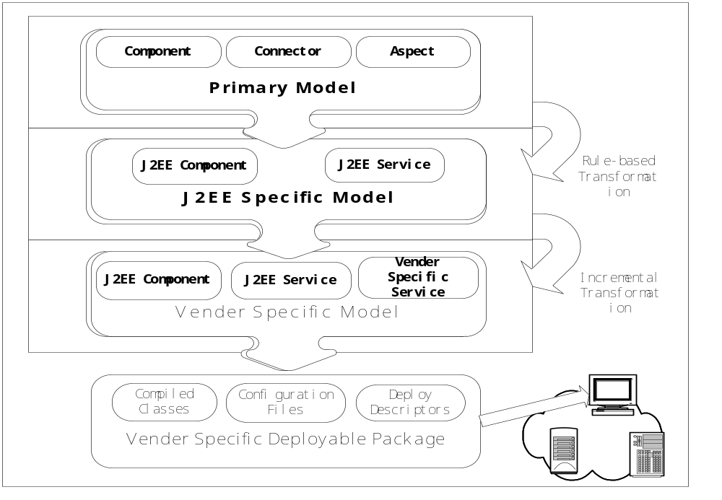
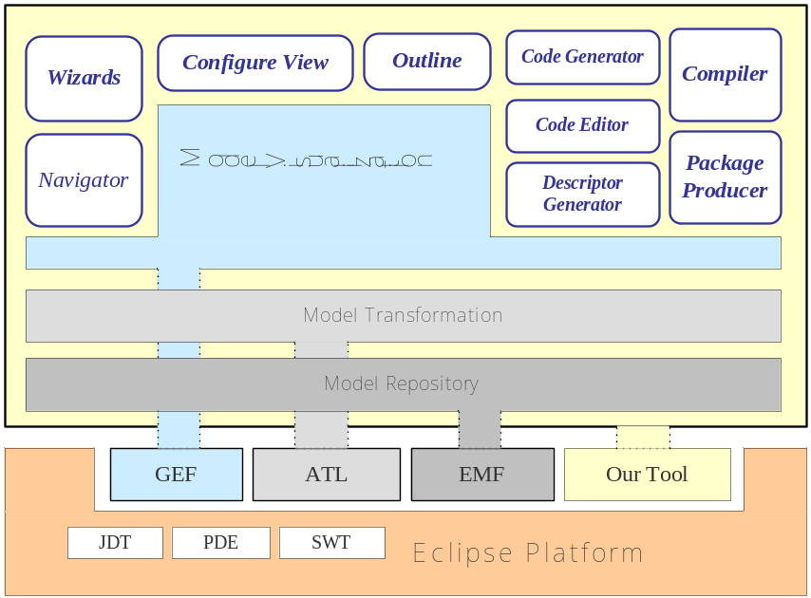
Model Transformation
WareBridge is built: Provide a reasonable way for J2EE component composition by leveraging
  Model transformation
  Automated code generation
  Powerful capabilities of Eclipse platform
    GEF for visual model presentation, EMF for maintaining underlying model, JFace@SWT for faster and more convenient user interfaces
Problem faced
  What’s the advantages brought by this comparing with existing development tool such as Eclipse?
  Commonality Abstraction of complexity is difficult
Reason
  No reuse, no advantage (large- scale application)
  Commonality Abstraction is complex, resolvable?

Slide 6
Challenges
If we have domain, we would know how to customize the existing architecture according to the requirement, maybe. But we don’t.
If we have perfect model transformation, we’ll get a system just with drawing an architecture. But the truth is it’s too general always.
  Coarse granularity is useless always. (What are the important parts which should be kept in the architecture?)
If we build architectures for applications case by case, the point is
  Tradeoff between simplicity and usability
    Too complex, out of control
    Too simple, useless
  Is the architecture complete enough to describe the real system?
  How to map between the architecture and the real system, which components should be visible on the SA

Slide 7
Philosophy
Introspection
  Maybe general architecture description/transformation isn’t a good idea in practical use
  Find the way starting from the specific application domains, applying architecture to guide the development and management of application systems with bottom-up approach
  Case: application server!
Principles
  Bottom-up approach first
  Practical requirements driven
  Experiments prove

Slide 8
Architecture-based Application Server Composition

Slide 9
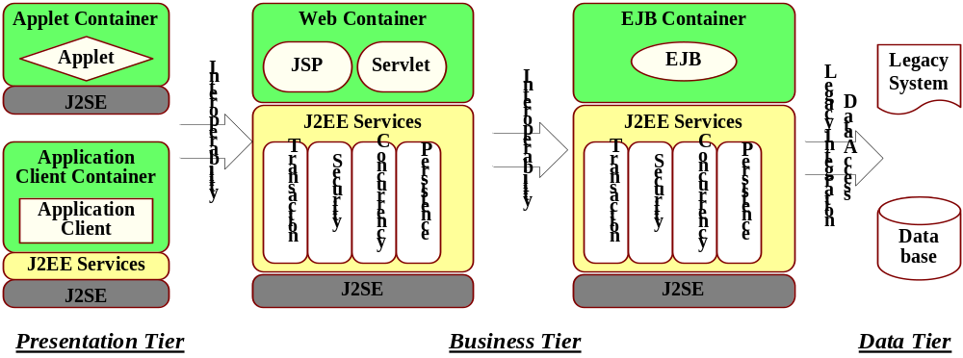
Motivation
With the ever increasing complexity and scale of application server, it is rather difficult to construct a total application server for communities besides big companies like IBM.
  There have been 23 specifications in Java Enterprise Edition 5 (Java EE 5) until now
  There are many components, and every component maybe has a family
It’s popular to construct application server using third-party components
  Open source communities provides reliable middleware services, such as ObjectWeb JOTM for transaction service
Can we just use an architecture to construct and maintain the application server according to the requirements?
  Whenever the component evolves or changes to another vendor product
  Change the architecture elements, things done

Slide 10
Challenges
What are the necessary elements for the application server composition?
What are the necessary components?
  Container, services
What are the necessary relations between components?
  Service API
What are the mechanisms enabling this architecture at runtime?
Notes:
Architecture provides a means to develop, maintain and evolve the application server.
Once the architecture is built, that means, the dependencies among components are defined clearly, it's possible to switch between different component implementations according to requirements even at runtime, and thus obtains flexibility and customizability for the application server.

Slide 11
Documentation transformation TO Software transformation
Source
  Software
View
  Architecture view
View generator
  Source code to architecture

Slide 12
Architecture of application server
Container
ejbcontainer
metadata
Container-API
(relations)
webcontainer
SecurityService
Other Services…
Service-API
(relations)
TransactionService
NamingService
DataSourceService
MessageService

Slide 13
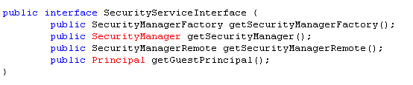
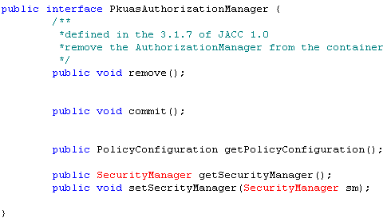
Relationships between components
--Service-API
Security

Slide 14
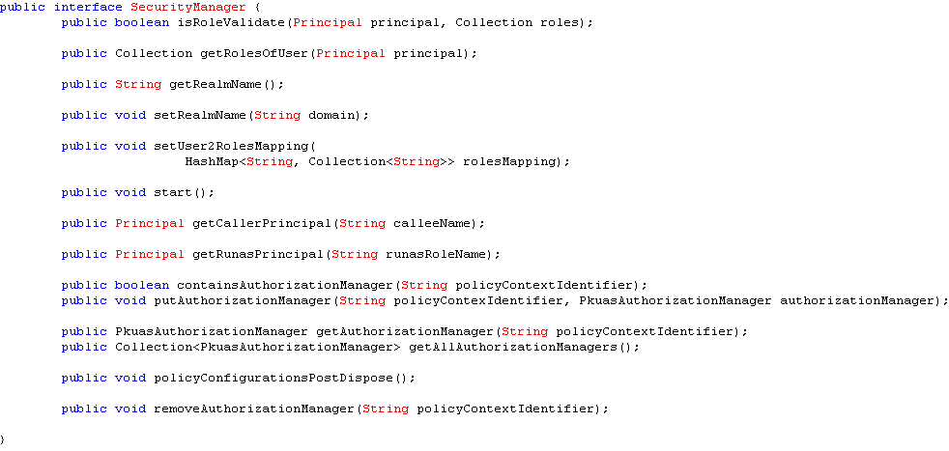
Service-API
Security

Slide 15
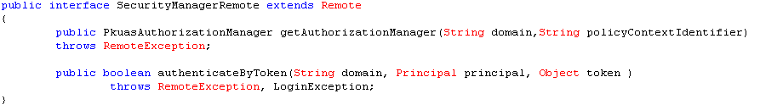

Service-API
Security

Slide 16

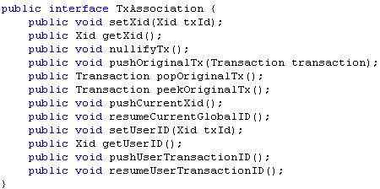
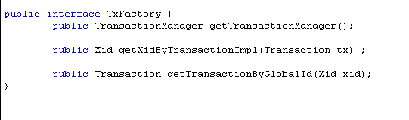
Service-API
Transaction

Slide 17
Mechanisms
XML file <-> parser <-> runtime architecture
OSGi enables the separation of components
JMX monitors the changes and reflects to the architecture at runtime
Other
Module
Service
Module
Service
Module
Container
Module
…
Kernel
OSGi
ManagedObject Model
ManagedObjectMBean
……
ManagedObjectMBean
MBeanServer
ServiceMBean
MBean
ServiceMBean
MBean
……
ContainerMBean
MBean
ManagedResource
JTA
ManagedResource
JMS
ManagedResource
EJB

Slide 18
Document To Code
- <project xmlns="http://maven.apache.org/POM/4.0.0" xmlns:xsi="http://www.w3.org/2001/XMLSchema-instance" xsi:schemaLocation="http://maven.apache.org/POM/4.0.0 ">
<modelVersion>4.0.0</modelVersion>
- <properties>
<pkuas.groupId>pku.as</pkuas.groupId> …
<description>PKUAS : Peking University Application Server</description>
<name>PKUAS</name> <!-- url></url -->
<packaging>pom</packaging>
- <modules>
<module>core</module>
<module>modules</module>
</modules> <!-- Prefered dependencies version -->
- <dependencyManagement>
- <dependencies>
- <dependency>
<groupId>asm</groupId>
<artifactId>asm</artifactId>
<version>3.0</version>
</dependency>
- <dependency>
<groupId>castor</groupId>
<artifactId>castor</artifactId>
<version>1.0</version>
</dependency>
- <dependency>
<groupId>cglib</groupId>
<artifactId>cglib</artifactId>
<version>2.1</version>
</dependency>
- <dependency>
<groupId>jaxen</groupId>
<artifactId>jaxen</artifactId>
<version>1.1</version>
</dependency>
- <dependency>
<groupId>jdom</groupId>
<artifactId>jdom</artifactId>
<version>1.0</version>
</dependency>
- <dependency>
<groupId>jms</groupId>
<artifactId>jms</artifactId>
<version>1.1</version>
</dependency>
- <dependency>
<groupId>saxpath</groupId>
<artifactId>saxpath</artifactId>
<version>1.0-FCS</version>
</dependency>
- <dependency>
<groupId>xerces</groupId>
<artifactId>xerces</artifactId>
<version>2.4.0</version>
</dependency>
- <dependency>
<groupId>commons-logging</groupId>
<artifactId>commons-logging-api</artifactId>
<version>1.1</version>
</dependency> <!-- javaee -->
- <dependency>
<groupId>javax.activation</groupId>
<artifactId>activation</artifactId>
<version>1.1</version>
</dependency>
- <dependency>
<groupId>javax.annotation</groupId>
<artifactId>jsr250-api</artifactId>
<version>1.0</version>
</dependency>
- <dependency>
<groupId>javax.ejb</groupId>
<artifactId>ejb</artifactId>
<version>2.1</version>
</dependency>
- <dependency>
<groupId>javax.faces</groupId>
<artifactId>jsf-api</artifactId>
<version>1.2</version>
</dependency>
- <dependency>
<groupId>javax.jms</groupId>
<artifactId>jms</artifactId>
<version>1.1</version>
</dependency>
- <dependency>
<groupId>javax.jws</groupId>
<artifactId>jsr181</artifactId>
<version>1.0</version>
</dependency>
- <dependency>
<groupId>javax.mail</groupId>
<artifactId>mail</artifactId>
<version>1.4</version>
</dependency>
- <dependency>
<groupId>javax.mx4j</groupId>
<artifactId>mx4j</artifactId>
<version>3.0.2</version>
</dependency>
- <dependency>
<groupId>javax.persistence</groupId>
<artifactId>persistence-api</artifactId>
<version>1.0</version>
</dependency>
- <dependency>
<groupId>javax.resource</groupId>
<artifactId>connector</artifactId>
<version>1.0</version>
</dependency> <!-- javaee.servlet -->
- <dependency>
<groupId>javax.servlet</groupId>
<artifactId>jsp.jsp-api</artifactId>
<version>2.1</version>
</dependency>
- - <dependency>
<groupId>javax.xml</groupId>
<artifactId>bind.jaxb-api</artifactId>
<version>2.1</version>
</dependency>
- <dependency>
<groupId>javax.xml.soap</groupId>
<artifactId>saaj</artifactId>
<version>1.2</version>
</dependency>
- <dependency>
<groupId>javax.xml</groupId>
<artifactId>stream.stax-api</artifactId>
<version>1.0-2</version>
</dependency>
- <dependency>
<groupId>javax.xml</groupId>
<artifactId>ws.jaxws-api</artifactId>
<version>2.1</version>
</dependency> <!-- end of javaee --> <!-- Jakarta Commons -->
- <dependency> <!-- more class in this than in the pkuas -->
<groupId>commons-beanutils</groupId>
<artifactId>commons-beanutils</artifactId>
<version>1.7.0</version>
</dependency>
- <dependency> <!-- more class in this than in the pkuas -->
<groupId>commons-collections</groupId>
<artifactId>commons-collections</artifactId>
<version>3.2</version>
</dependency>
- <dependency>
<groupId>commons-digester</groupId>
<artifactId>commons-digester</artifactId>
<version>1.7</version>
</dependency>
- <dependency>
<groupId>commons-logging</groupId>
<artifactId>commons-logging</artifactId>
<version>1.1</version>
……
</project>

Slide 19
Effect
Architecture guides the choice of component
  Only the components which satisfy the quality restrictions are matched
Architecture guides the composition of components
  Only the components which satisfy the connection restrictions are composed
GUI assisted
Notes:
Restrictions include connections (interfaces) and qualities

Slide 20
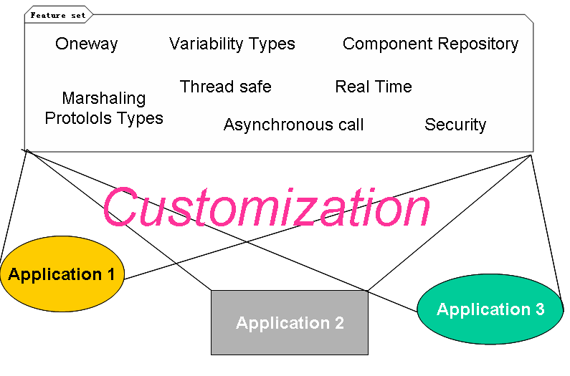
Future?

Slide 21
Architecture-Based Management

Slide 22

Motivation
Build a configuration is quite difficult
  Heterogeneous files (properties, XML, …)
  Numerous files and parameters
    JOnAS = 46 files, Apache configuration file =160 lines
SOA platform => several products, cluster mode => multiple nodes, large scale deployment
Same problem for the monitoring task
  Huge number of events to monitor
      Distributed architecture
      Multiple levels
Conf
Prop.
XML
!!! Not manageable by human beings !!!
<number>/25

Slide 23





Solution: JASMINe
JASMINe: New OW2 project
  Bull, SERLI, INRIA, PKU
Tool for administration of SOA platforms
  For the designer
    Configuration (clusters)
    Deployment
  For the administrator
    monitoring, error detection, performance tracking
    Autonomic administration configuration
Configuration and Deployment
  Based on logical configuration through ADL and JADE
Monitoring and autonomous management
  Probes, filters, rules engine
<number>/25

Slide 24
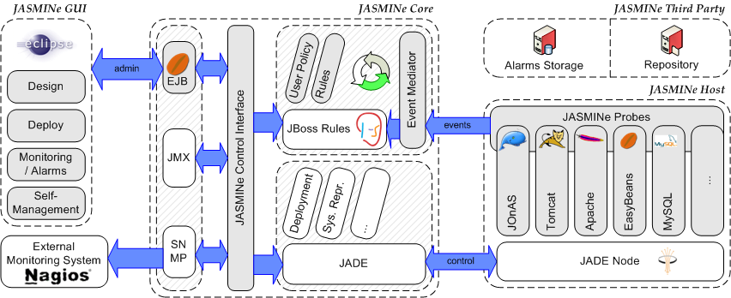
JASMINe architecuture

Slide 25
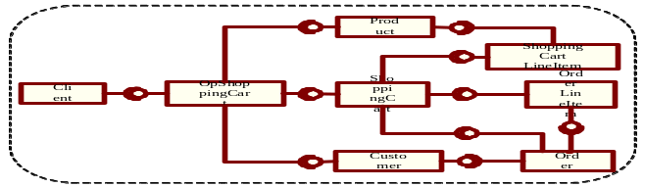
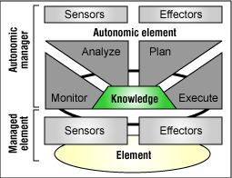
Management Process
Monitoring
  Measuring parameters of the controlled system that are relevant for the function under control
Decision
  Deciding the corrective action to be taken.
  Analyzing and planning
Execution
  Actually performing the actions on the controlled system.
Knowledge base
  Represents information on the controlled system.
Application SA

Slide 26
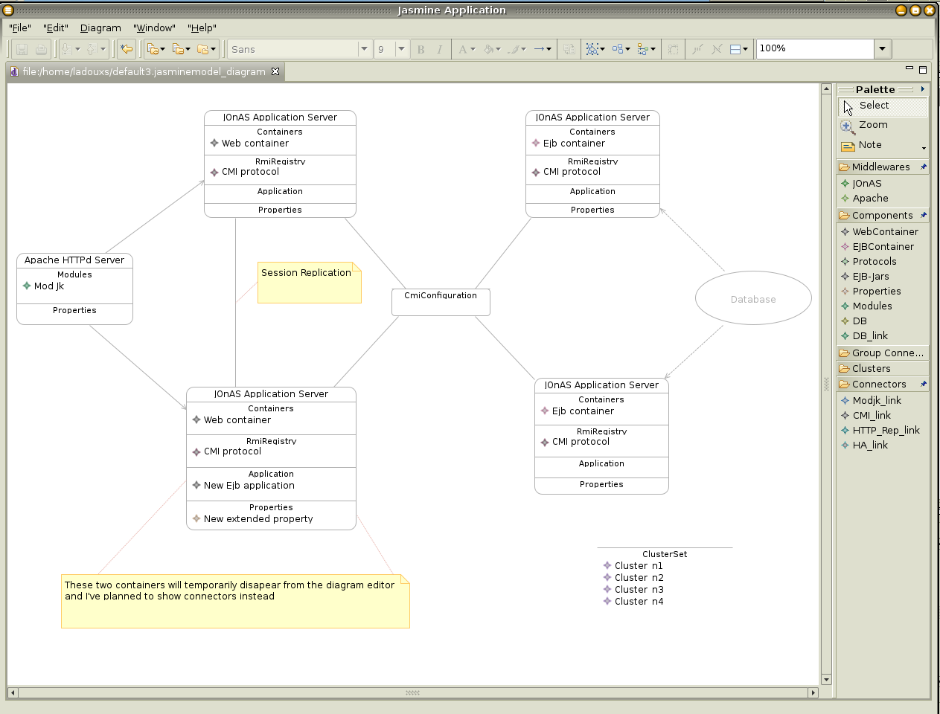
JASMINe: Design GUI
Eclipse EMF/GMF for architecture description
<number>/25

Slide 27

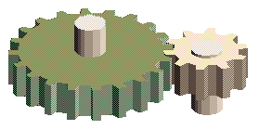
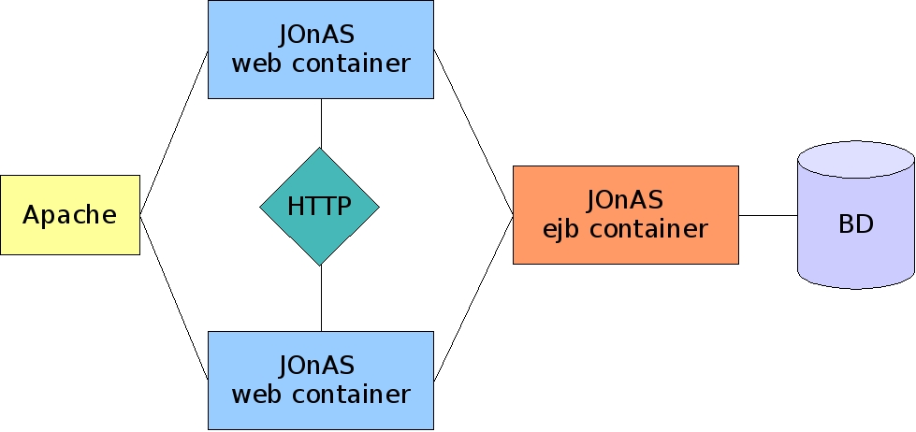
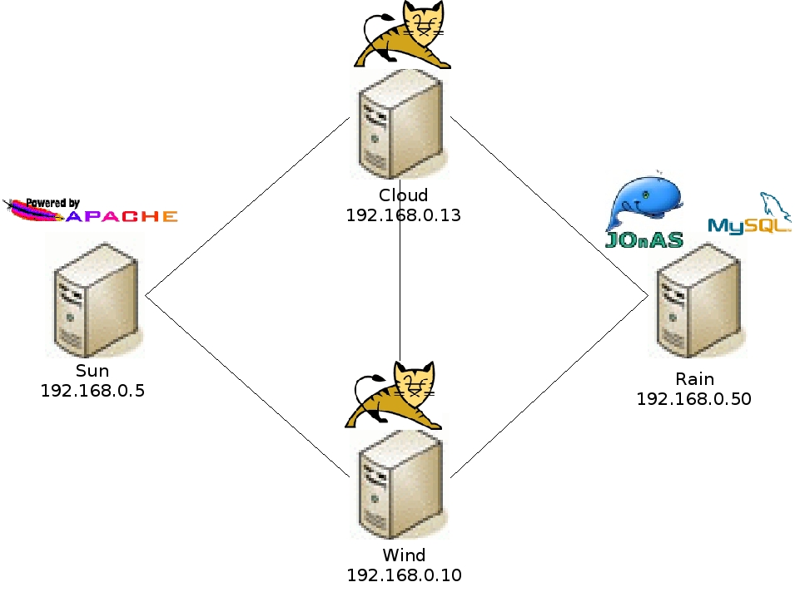
Configuration and Deployment
Logical configuration TO physical configuration
JASMINe
ADL
JADE
ajp-port=8009
http-port=80
driver=mysqlDriver
ajp-port=8009
<number>/25

Slide 28
Monitoring and Autonomous Management
sonde
sonde
Data
probe
JASMINe
sonde
Data
sonde
sonde
sonde
probe
probe
Data
Rules
Log
Mail
SMS
…
sonde
sonde
probe
Data
<number>/25

Slide 29
Summary
Architecture makes development and management efficient for large scale applications
  Automation and virtualization make things easy
Runtime architecture is useful, depending on it deserves or not
  What are the necessary important parts in the architecture?
  How to tradeoff between simplicity and usability?
  Synchronization burden is heavy
When is model transformation useful?
  Can machines make decisions and control complex situations without inflexible dependence on predetermined programs?

Slide 30
Thanks

