Slide 1
Towards Automatic Model Synchronization from Model Transformation
Yingfei Xiong, 2007

Slide 2
ASE Work

Slide 3
The Problem of Data Interchange
Suppose we have a software modeling system
We want to write a code generating system that generates code from the models in the modeling system
Modeling System
------------
------------
------------
------------
Code Generator
Models
Code

Slide 4
Difficulties
The format how the models are stored is unknown
Even if the format is known, there are many trivial details to deal with
  Byte encoding: high bit first? Low bit first?
  Char encoding: GB2312? UTF-8?
  …

Slide 5
Solution
Standards
  W3C XML
  OMG MOF
Standards for data interchange that
  Provide a generic data structure to describe data
    XML: tree
    MOF: graph
  Provide means to define the format of data
    XML: DTD, Schema
    MOF: meta model
  Define how the data are stored into and loaded from files
    XML: part of the basic XML standard
    MOF: XMI
  Provide a set of general APIs to operate data

Slide 6
The resulting system
The modeling system produces data in MOF models for data interchange.
------------
------------
------------
------------
Modeling System
MOF
Models
Code Generator
Code

Slide 7
A More General Situation
The code generating system wants to support more modeling system
The system proposes a meta model and supports input of models in the meta model
Modeling
System A
Models in
Metamodel A
Models in
Metamodel C
Code Generator
Modeling
System B
Models in
Metamodel B

Slide 8
Solution
Provide specific languages for converting model formats between meta models
Modeling
System A
Models in
Metamodel A
Models in
Metamodel C
Transform A2C
Transform B2C
Modeling
System B
Models in
Metamodel B
Code Generator

Slide 9
Walk a little further
Software development yields artifacts in different formats
  Requirement documents
  Design models
  Code
  …
If we can provide transformations between these artifacts, we can automate software development

Slide 10
Model-Driven Development
MDD
  An model-based approach to software development
  Developing software by transforming models
MDA
  The set of standards by OMG for realizing MDD
Model Transformation Languages
  ATL [F. Jouault and I. Kurtev. 2005]
  QVT [OMG, 2006]
Notes:
This paper is about model synchronization from model transformation.

Slide 11
A UML2Java Transformation in ATL
module UML2Java ;
create OUT : Java from IN : UML ;
rule Class2Class {
from u : UML ! Class
to j : Java ! Class (
name <- u.name ,
fields <- u.attrs
)
}
rule Attribute2Field {
from a : UML ! Attribute
to f : Java ! Field (
name <- ’_’ + a.name ,
type <- a. type
)
}

Slide 12
An Example of Executing UML2Java
UML!Class
name = “Book”
description = “a demo class”
UML!Attribute
name = “title”
type = “String”
UML!Attribute
name = “price”
type = “Double”

Slide 13
The Transformation Result
UML!Class
Java!Class
name = “Book”
description = “a demo class”
name = “Book”
comment = “”
UML!Attribute
Java!Field
name = “title”
type = “String”
name = “_title”
type = “String”
UML!Attribute
Java!Field
name = “price”
type = “Double”
name = “_price”
type = “Double”

Slide 14
Modifications
Java!Class
UML!Class
name = “Book”
comment =
“_bookTitle cannot be null”
name = “Book”
description = “a demo class”
UML!Attribute
Java!Field
_bookTitle
name = “title”
type = “String”
name = “_title”
type = “String”
UML!Attribute
name = “authors”
type = “String”
UML!Attribute
Java!Field
name = “price”
type = “Double”
name = “_price”
type = “Double”

Slide 15
Model Synchronization
Model synchronization is a process that propagates modifications across different models, making the models consistent with each other.

Slide 16
Model Synchronization
Src0
Transform
Tar0
Modify
Modify
Src1
Tar1
Synchronize
Src2
Tar2

Slide 17
Existing Approaches
General Frameworks
  Multi-view synchronization [J. Grundy et al. 1998]
  Rely on users to write code to handle each type of modifications in each side
  It is users who should ensure the consistency of the code
Specific Languages
  FSML [M. Antkiewicz and et al. 2006]
  Feature model to code synchronization

Slide 18
Our Contributions
A clear semantics of model synchronization
  Four properties
An automatic model synchronization approach
  Using the existing unidirectional ATL byte code program
  Requiring no extra code
  Satisfying the four properties
A prototype tool for synchronizing EMF models

Slide 19
Our Contributions
A clear semantics of model synchronization
  Four properties
An automatic model synchronization approach
  Using the existing unidirectional ATL byte code program
  Requiring no extra code
  Satisfying the four properties
A prototype tool for synchronizing EMF models

Slide 20
Our Contributions
A clear semantics of model synchronization
  Four properties
An automatic model synchronization approach
  Using the existing unidirectional ATL byte code program
  Requiring no extra code
  Satisfying the four properties
A prototype tool for synchronizing EMF models

Slide 21
The ATL Transformation System
ATL Program
QVT Program
Compile
ATL Byte-code

Slide 22
Our Contributions
A clear semantics of model synchronization
  Four properties
An automatic model synchronization approach
  Using the existing unidirectional ATL byte code program
  Requiring no extra code
  Satisfying the four properties
A prototype tool for synchronizing EMF models

Slide 23
The ATL Transformation System
ATL Virtual
Machine
Original
Source Models
Original
Target Models
Modified
Source Models
Modified
Target Models
ATL Byte-code
MetaModels

Slide 24
Our System
Original
Source Models
Modified
Source Models
Modified
Target Models
Our System
ATL Byte-code
MetaModels
Synchronized
Source Models
Synchronized
Target Models

Slide 25
Our Contributions
A clear semantics of model synchronization
  Four properties
An automatic model synchronization approach
  Using the existing unidirectional ATL byte code program
  Requiring no extra code
  Satisfying the four properties
A prototype tool for synchronizing EMF models

Slide 26
Review the example
Java!Class
UML!Class
name = “Book”
comment =
“_bookTitle cannot be null”
name = “Book”
description = “a demo class”
UML!Attribute
Java!Field
_bookTitle
name = “title”
type = “String”
name = “_title”
type = “String”
UML!Attribute
name = “authors”
type = “String”
UML!Attribute
Java!Field
name = “price”
type = “Double”
name = “_price”
type = “Double”

Slide 27
The Synchronized Result
Java!Class
UML!Class
name = “Book”
comment =
“_bookTitle cannot be null”
name = “Book”
description = “a demo class”
UML!Attribute
bookTitle
Java!Field
_bookTitle
name = “title”
type = “String”
name = “_title”
type = “String”
UML!Attribute
name = “authors”
type = “String”
UML!Attribute
Java!Field
name = “price”
type = “Double”
name = “_price”
type = “Double”
Java!Field
name = “_authors”
type = “String”

Slide 28
Our Contributions
A clear semantics of model synchronization
  Four properties
An automatic model synchronization approach
  Using the existing unidirectional ATL byte code program
  Requiring no extra code
  Satisfying the four properties
A prototype tool for synchronizing EMF models

Slide 29
Content
Background and Motivation
Outline of our work
Details of our work
  A clear semantics
  An automated approach
  A prototype tool

Slide 30
Properties of Synchronization
To ensure the synchronization process exhibits reasonable behavior, we need to define clear semantics to model synchronization
Our semantics includes four important properties:
  Stability
  Preservation
  Propagation
  Composibility

Slide 31
Stability
If no model is modified, the synchronized models are not modified.
UML!Class
Java!Class
Transform
name = “book”
name = “book”
description = “demo”
comment = “”
UML!Class
Java!Class
name = “book”
name = “book”
description = “demo”
comment = “”
Synchronize
UML!Class
Java!Class
name = “book”
name = “book”
description = “demo”
comment = “”

Slide 32
Preservation
Modifications on both sides should be kept.
UML!Class
Java!Class
Transform
name = “book”
name = “book”
description = “demo”
comment = “”
UML!Class
Java!Class
name = “book”
name = “book”
description = “demo”
comment = “persistent”
Synchronize
UML!Class
Java!Class
name = “book”
name = “book”
description = “demo”
comment = “persistent”

Slide 33
Propagation
The modifications should be propagated to the other side if necessary.
UML!Class
Java!Class
Transform
name = “book”
name = “book”
description = “demo”
comment = “”
UML!Class
Java!Class
publication
name = “book”
name = “book”
description = “demo”
comment = “”
Synchronize
UML!Class
Java!Class
publication
publication
name = “book”
name = “book”
description = “demo”
comment = “”

Slide 34
Composibility – Step 1
A series of modifications have the same effect regardless of whether is applied once or is applied incrementally
UML!Class
Java!Class
Transform
name = “book”
name = “book”
description = “demo”
comment = “”
UML!Class
Java!Class
publication
name = “book”
name = “book”
description = “demo”
comment = “”
Synchronize
UML!Class
Java!Class
publication
publication
name = “book”
name = “book”
description = “demo”
comment = “”

Slide 35
Composibility – Step 2
A series of modifications have the same effect regardless of whether is applied once or is applied incrementally
UML!Class
Java!Class
publication
publication
name = “book”
name = “book”
description = “demo”
comment = “”
UML!Class
Java!Class
publication
name = “book”
name = “book”
description = “demo”
comment = “persistent”
Synchronize
UML!Class
Java!Class
publication
publication
name = “book”
name = “book”
description = “demo”
comment = “persistent”

Slide 36
Composibility - Composed
A series of modifications have the same effect regardless of whether is applied once or is applied incrementally
UML!Class
Java!Class
Transform
name = “book”
name = “book”
description = “demo”
comment = “”
UML!Class
Java!Class
publication
name = “book”
name = “book”
description = “demo”
comment = “persistent”
Synchronize
UML!Class
Java!Class
publication
publication
name = “book”
name = “book”
description = “demo”
comment = “persistent”

Slide 37
Content
Background and Motivation
Outline of our work
Details of our work
  A clear semantics
  An automated approach
  A prototype tool
Conclusion

Slide 38
Backward Modification Propagation
To put back modifications from target to source, we need to know which source items are related to a target item
Bidirectional ATL Virtual Machine
  Record trace information when performing the transformation
    Trace the sources of items
    Trace how items are transformed

Slide 39
Examples of Tracing
to f : Java ! Field (
name <- ’_’ + a.name ,
type <- a. type
)
The f.name is created from a.name by prefixing an underscore
When f.name is modified, we modify a.name by removing the prefixed underscore

Slide 40
Propagate Modifications
UML!Class
I am from here!
Java!Class
name = “Book”
description = “a demo class”
When I am deleted,
delete the source class
and all its attributes
name = “Book”
comment = “”
I am from here!
UML!Attribute
When I am changed,
find corresponding attribute
and set that attribute back
Java!Field
name = “title”
type = “String”
name = “_title”
type = “String”
UML!Attribute
Java!Field
name = “price”
type = “Double”
I am from here!
When I am changed,
remove the leading ‘-’ and
copy me back!
name = “_price”
type = “Double”

Slide 41
Synchronization Algorithm
Src. Modifications
Src0
Transform
Tar0
Tar. Modifications
Shared
Modifications
Difference
Src1
Tar1
Difference
Tagged Src
Tagged Tar
Backward
Propagate
Inter. Src
Inter. Tar
Source
Merging
Supplementray
Merging
Transform
Src2
Tar2
Notes:
Color

Slide 42
Content
Background and Motivation
Outline of our work
Details of our work
  A clear semantics
  An automated approach
  A prototype tool
Conclusion

Slide 43
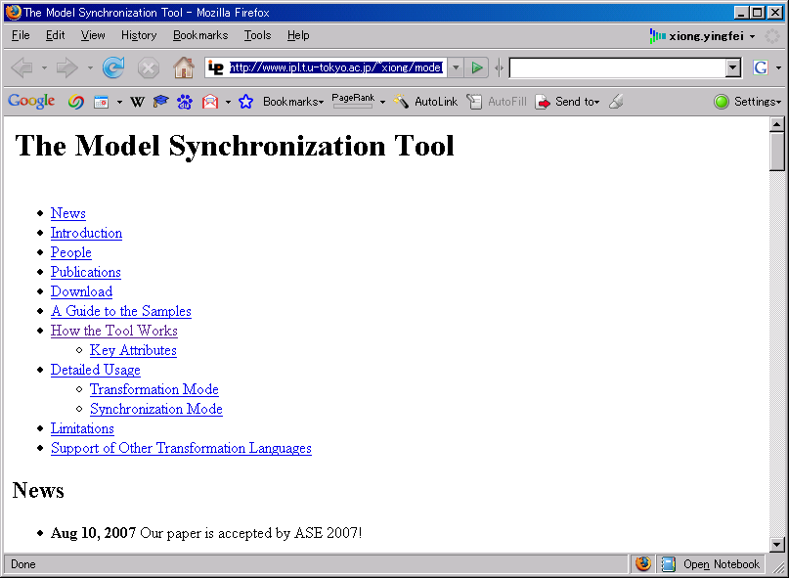
Implementation
A prototype tool
  Synchronizing EMF models
  Using an ATL byte-code program
  Requiring no extra code
Available at:
  http://www.ipl.t.u-tokyo.ac.jp/~xiong/modelSynchronization.html
Notes:
Examples
LOC

Slide 44
Content
Background and Motivation
Outline of our work
Details of our work
  A clear semantics
  An automated approach
  A prototype tool

Slide 45
Ongoing Work

Slide 46
Problem in the ASE work
Cannot deal with insertions
Lack of well-defined semantics for references
  My recent study shows that in our ASE work, properties may be violated when there are complex reference operations
Synchronization is slow
  Some applications require instant updating of models
    EclipseUML
    Synchronization of document and view in MVC applications
Cannot apply to data that is not XMI files
  Other data includes: XML files, in-memory structures

Slide 47
My Current Work: Objectives
Provide a general framework for implementing synchronization applications
  To support all kinds of modifications
  To support incremental synchronization
    Finding out what modification operations should be taken to make models consistent from some initial modification operations
  To allow users to define new data structures
  Can easily correspond to a unidirectional imperative program

Slide 48
My Current Work: Approach
Provide a framework to allow users to construct execution graphs
Execution graphs can be analyzed from imperative programs
Execution graphs can be invoked when there are modifications on values

Slide 49
An Execution Graph
source int a, b;
target int x, y;
x = a + 1;
y = a + b;
a
b
+1
a+b
x
y

Slide 50
Forward Transformation
a = 1
b = 2
Mod
a = 1
Mod
b = 2
+1
a+b
x
y

Slide 51
Forward Transformation
a = 1
b = 2
Mod
a = 1
Mod
b = 2
+1
a+b
Mod
x = 2
Mod
y = 2

Slide 52
Incremental Synchronization
a => 5
y => 10
Mod
a = 5
b = 2
+1
a+b
x = 2
Mod
y = 10

Slide 53
Incremental Synchronization
a => 5
y => 10
Mod
a = 5
Mod
b = 5
+1
a+b
Mod
x = 6
Mod
y = 10

Slide 54
The Next Step in My Plan
Automatically derive execution graphs from ATL programs

