Slide 1
Synchronizing Software Engineering Artifacts
XIONG Yingfei
Ph.D. Student
IPL, University of Tokyo
Advisor: HU Zhenjiang
2008

Slide 2
Information Processing Laboratory
One of the earliest software laboratories in Japan
Members:
  3 Professors
  3 Post doctors
  5 Ph.D. Students
  5 Master Students
Research Groups
  Program Transformation and Optimization in Calculational Form
  High Level Program Programming and Parallelization
  Bidirectional/Inverse Computation

Slide 3
Transformation and Synchronization
In software development, it is common that a set of artifacts share a certain amount of information, but are stored in different formats.
  Feature models
  UML models
  Code
  Test cases

Slide 4
Transformation
A transformation transform information in one format into another format
------------
------------
------------
------------
Transformation
Models
Code

Slide 5
Two Transformations
Two transformations between two artifacts are expected to work coherently.
------------
------------
------------
------------
Forward
Model
Code
------------
------------
------------
------------
Backward
Model
Code

Slide 6
Reversible / Bijective Transformation
Use a single transformation program to describe both transformations
  g = f ⁻¹
Our work
  Inv[MPC04]
------------
------------
------------
------------
f
Model
Transformation
Program
Code
------------
------------
------------
------------
g
Model
Code

Slide 7
Bidirectional Transformation
Use a single program to describe two functions
  f : A -> B
  g : A ×B -> A
------------
------------
------------
------------
f
Model
Transformation
Program
Code
------------
------------
------------
------------
g
Model’
f(Model’) = Code’
Code’

Slide 8
Our Work on Bidirectional Transformation
BiX [JSSST07]
Bidirectional XQuery [PEPM07]
Bidirectionalizing a general function language [ICFP07]

Slide 9
Synchronization
What if the model and the code are modified at the same time?
------------
------------
------------
------------
f
Model
Code
------------
------------
------------
------------
Model’
Code’

Slide 10
Synchronization
consistent
a0
b0
Modify
Modify
a1
b1
Synchronize
a2
b2
consistent

Slide 11
Properties of Synchronization
Synchronization should satisfy some properties to ensure predictable behavior
We propose three properties
  Stability
  Preservation
  Propagation

Slide 12
Stability
If no artifact is modified, the synchronization will modify no artifact.
UML!Class
Java!Class
name = “book”
name = “book”
description = “demo”
comment = “”
UML!Class
Java!Class
name = “book”
name = “book”
description = “demo”
comment = “”
Synchronize
UML!Class
Java!Class
name = “book”
name = “book”
description = “demo”
comment = “”

Slide 13
Preservation
Modifications on both sides should be kept.
UML!Class
Java!Class
name = “book”
name = “book”
description = “demo”
comment = “”
UML!Class
Java!Class
name = “book”
name = “book”
description = “demo”
comment = “persistent”
Synchronize
UML!Class
Java!Class
name = “book”
name = “book”
description = “demo”
comment = “persistent”

Slide 14
Propagation
The modified artifacts should be consistent.
UML!Class
Java!Class
name = “book”
name = “book”
description = “demo”
comment = “”
UML!Class
Java!Class
publication
name = “book”
name = “book”
description = “demo”
comment = “”
Synchronize
UML!Class
Java!Class
publication
publication
name = “book”
name = “book”
description = “demo”
comment = “”

Slide 15
Synchronization and Transformation
null
null
Modify
a
null
Synchronize
a
b

Slide 16
Synchronization and
Reversible Transformation
null
null
Modify
null
b
Synchronize
a
b

Slide 17
Synchronization and
Bidirectional Transformation
f(a0) = b0
a0
b0
Modify
a0
b1
Synchronize
a2
b2
f(a2)=b2

Slide 18
Our Work
Deriving synchronization from a forward transformation [ASE07]
A compositional framework to synchronization (on going work)

Slide 19
ASE Work

Slide 20
Model-Driven Development
MDD
  An model-based approach to software development
  Developing software by transforming models
Model Transformation
  Converting models in different formats (meta-models)
Model Transformation Languages
  ATL [F. Jouault and I. Kurtev. 2005]
  QVT [OMG, 2006]
Notes:
This paper is about model synchronization from model transformation.

Slide 21
A UML2Java Transformation in ATL
module UML2Java ;
create OUT : Java from IN : UML ;
rule Class2Class {
from u : UML ! Class
to j : Java ! Class (
name <- u.name ,
fields <- u.attrs
)
}
rule Attribute2Field {
from a : UML ! Attribute
to f : Java ! Field (
name <- ’_’ + a.name ,
type <- a. type
)
}

Slide 22
An Example of Executing UML2Java
UML!Class
name = “Book”
description = “a demo class”
UML!Attribute
name = “title”
type = “String”
UML!Attribute
name = “price”
type = “Double”

Slide 23
The Transformation Result
UML!Class
Java!Class
name = “Book”
description = “a demo class”
name = “Book”
comment = “”
UML!Attribute
Java!Field
name = “title”
type = “String”
name = “_title”
type = “String”
UML!Attribute
Java!Field
name = “price”
type = “Double”
name = “_price”
type = “Double”

Slide 24
Modifications
Java!Class
UML!Class
name = “Book”
comment =
“_bookTitle cannot be null”
name = “Book”
description = “a demo class”
UML!Attribute
Java!Field
_bookTitle
name = “title”
type = “String”
name = “_title”
type = “String”
UML!Attribute
name = “authors”
type = “String”
UML!Attribute
Java!Field
name = “price”
type = “Double”
name = “_price”
type = “Double”

Slide 25
Our Work
consistent
src0
tgt0
Modify
ATL
Program
Modify
src1
tgt1
Synchronize
src2
consistent
tgt2

Slide 26
Two Questions
What is the consistency relations between two artifacts?
How to synchronize the two artifacts?

Slide 27
Example of Consistency
UML!Class
Java!Class
name = “Book”
description = “a demo class”
name = “Book”
comment = “”
UML!Attribute
Java!Field
name = “title”
type = “String”
name = “_title”
type = “String”
UML!Attribute
Java!Field
name = “price”
type = “Double”
name = “_price”
type = “Double”
If we transform the source using the original transformation program and we get the target, the source and the target are consistent.
Do all other cases inconsistent?

Slide 28
Example of Inconsistency
UML!Class
Java!Class
name = “Book”
description = “a demo class”
name = “Book”
comment = “”
UML!Attribute
Java!Field
_bookTitle
name = “title”
type = “String”
name = “_title”
type = “String”
UML!Attribute
Java!Field
name = “price”
type = “Double”
name = “_price”
type = “Double”

Slide 29
Example of Consistency
Java!Class
UML!Class
name = “Book”
comment =
“_bookTitle cannot be null”
name = “Book”
description = “a demo class”
UML!Attribute
Java!Field
name = “title”
type = “String”
name = “_title”
type = “String”
UML!Attribute
Java!Field
name = “price”
type = “Double”
name = “_price”
type = “Double”

Slide 30
Reflectable and unreflectable modifications
If the modified target is always in the range of the transformation, the modification is reflectable.
If the modified target sometimes is outside the range of the transformation, the modification is irreflectable

Slide 31
Consistency
If we transform the source, and the result model differs with the target model only in irreflectable modifications, the source model and the target model are consistent.

Slide 32
Two Questions
What is the consistency relations between two artifacts?
How to synchronize the two artifacts?

Slide 33
Backward Modification Propagation
To put back modifications from target to source, we need to know which source items are related to a target item
Bidirectional ATL Virtual Machine
  Record trace information when performing the transformation
    Trace the sources of items
    Trace how items are transformed

Slide 34
Examples of Tracing
to f : Java ! Field (
name <- ’_’ + a.name ,
type <- a. type
)
The f.name is created from a.name by prefixing an underscore
When f.name is modified, we modify a.name by removing the prefixed underscore

Slide 35
Propagate Modifications
UML!Class
I am from here!
Java!Class
name = “Book”
description = “a demo class”
When I am deleted,
delete the source class
and all its attributes
name = “Book”
comment = “”
I am from here!
UML!Attribute
When I am changed,
find corresponding attribute
and set that attribute back
Java!Field
name = “title”
type = “String”
name = “_title”
type = “String”
UML!Attribute
Java!Field
name = “price”
type = “Double”
I am from here!
When I am changed,
remove the leading ‘-’ and
copy me back!
name = “_price”
type = “Double”

Slide 36
Synchronization Algorithm
Src. Modifications
Src0
Transform
Tar0
Tar. Modifications
Shared
Modifications
Difference
Src1
Tar1
Difference
Tagged Src
Tagged Tar
Backward
Propagate
Inter. Src
Inter. Tar
Source
Merging
Supplementray
Merging
Transform
Src2
Tar2
Notes:
Color

Slide 37
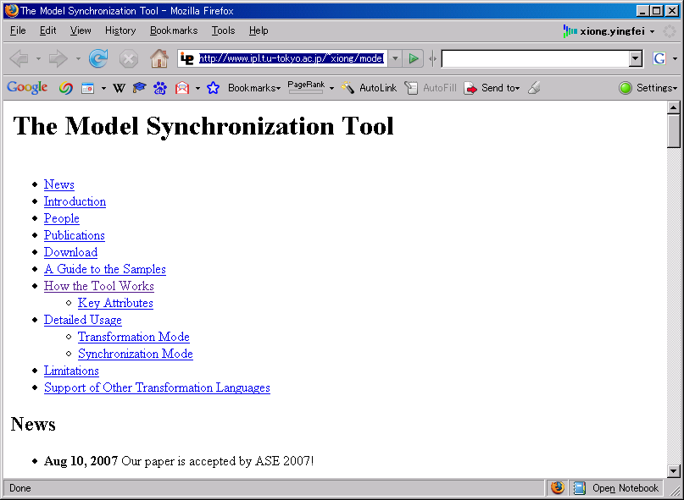
Implementation
A prototype tool
  Synchronizing EMF models
  Using an ATL byte-code program
  Requiring no extra code
Available at:
  http://www.ipl.t.u-tokyo.ac.jp/~xiong/modelSynchronization.html
Notes:
Examples
LOC

Slide 38
Ongoing Work

Slide 39
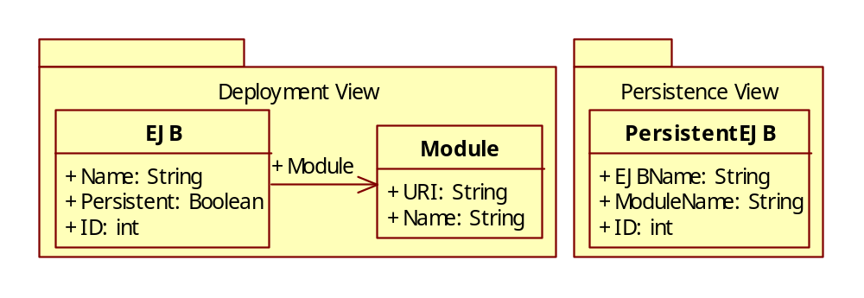
The Running Example

Slide 40
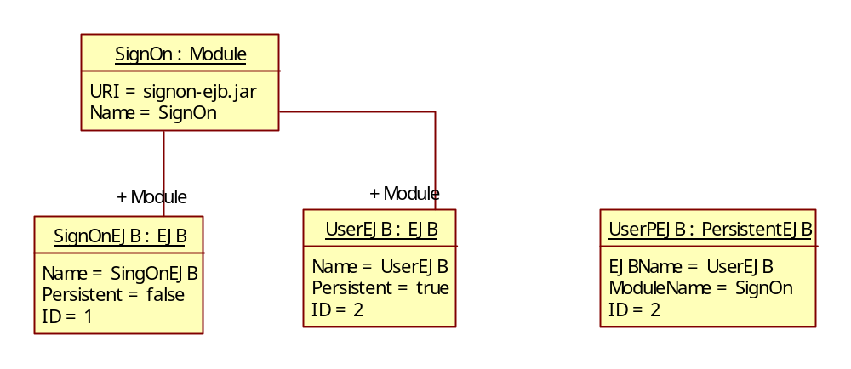
An Example

Slide 41
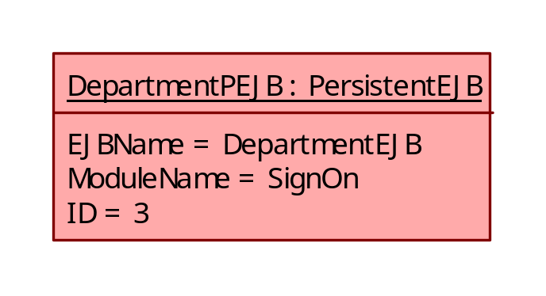
Problems in ASE work
Cannot support reflectable insertion on the target side

Slide 42
Problems in ASE work
Synchronization is slow
  Retransform the whole model even when there is only small modification
  Artifacts in other format have to be transformed into XMI MOF models

Slide 43
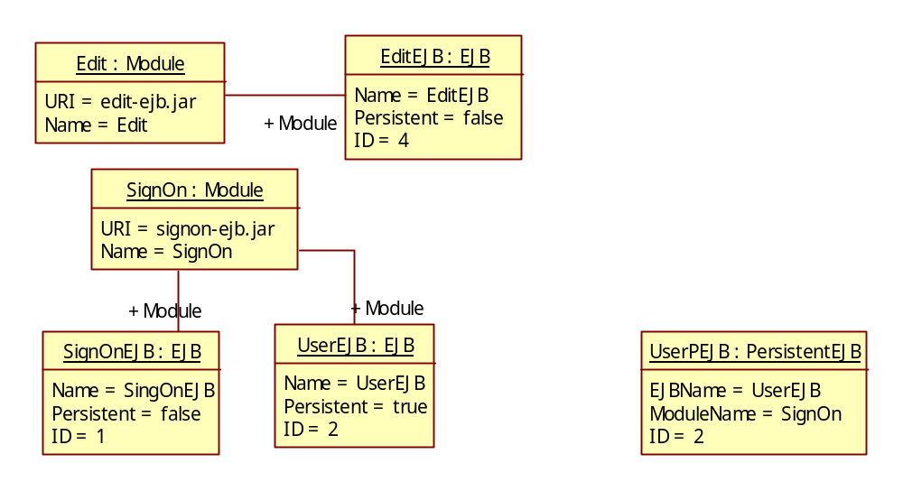
Problems in ASE work
Difficult to precisely define the semantics of synchronization just in a forward transformation
Edit
Edit

Slide 44
Our Approach
Propose general synchronizers whose semantics is precisely defined
Synchronizers rely on modification operations to perform synchronization
  Only compute the modified part
  Do not have to convert the whole artifacts to an intermediate format
Synchronizers work compositely
  Primitive synchronizers perform primitive synchronization
  Combinators combine smaller synchronizers into bigger ones

Slide 45
Represent Pointers
Pointers interconnect objects, making it difficult to decompose data
Solution
  Assume every object has a key attribute uniquely identify the object
  A set of objects are represented by dictionaries mapping the key attribute to the object
  Objects are also represented by dictionaries mapping from the attribute name to attribute values
  A pointer are represented by the key attribute’s value of the target object
We do not need to physically convert objects into this form because we only use modification operations

Slide 46
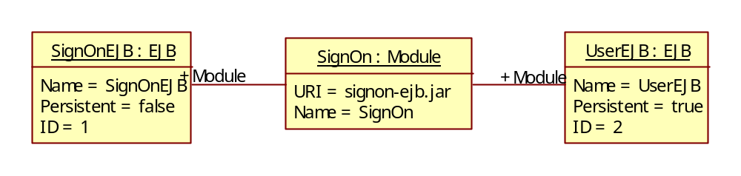
Represent Pointers
{1= {Name=“SignOnEJB” Persistent=“false” Module=“signon-ejb.jar”},
2={Name=“UserEJB” Persistent=“true” Module=“signon-ejb.jar”}}
{“signon-ejb.jar”={Name=“SignOn”}}

Slide 47
Modification Operations
Formally, a dictionary is a partial function mapping from keys to values
  If the function is not defined in key k, k is not in the dictionary
Replace a value
  replace[v](a)=v
Delete a value by setting it to null
  delete(a) = null
Make modifications to a value identified by a specific key inside a dictionary
  dictmod[k, mod](d) = d[k <- mod(d[k])]

Slide 48
To do
add pictures to the previous slide

Slide 49
Synchronizers
A synchronizer consists of
  A consistent relation
  An inner state set
  A start state
  A function for perform incremental synchronization
  A function for perform non-incremental synchronization

Slide 50
A Get Synchronizer
Consistent relation: ejb.Name = name
state1
state= start state
replace[“UserEJB”]
1
Get[Name]
2
ejb = null
name = null
dictmod[Name, replace[“UserEJB”]]
Incremental Synchronization

Slide 51
A Get Synchronizer
Consistent relation: ejb.Name = name
state2
dictmod[Name, replace[“PersonEJB”]]
state= state1
replace[“PersonEJB”]
1
Get[Name]
2
ejb = {
Name = “UserEJB”
ID = 1
Persistent = true
}
name = “UserEJB”
Incremental Synchronization

Slide 52
Properties
Stability
  If no artifacts is modified, no modification operation is produced
Preservation
  The produced modification operations will not conflict with the existing ones
Propagation
  After applied the produced modification operations, the artifacts are consistent

Slide 53
A Get Synchronizer
Consistent relation: ejb.Name = name
state2
state= stateX
replace[“PersonEJB”]
1
Get[Name]
left2right=true
2
ejb = EJB{
Name = “PersonEJB”
}
name = “UserEJB”
Non-Incremental Synchronization

Slide 54
Combinators
Primitive synchronizers can be combined by combinators to become larger synchronizers
1
Get[Name]
2
2
Get[EJBName]
1
ejb
name
persistentEJB
Two synchronizers combined by a graph combinator

Slide 55
Synchronzing the Running Example
A dictionary map combinator with a inner synchronizer syncA
Modules
EJBs
a EJB
syncA
a PersistentEJB
PersistentEJBs

Slide 56
SyncA
A Switch combinator combining syncB0 and syncB1
Modules
a EJB
a PersistentEJB
syncB0
syncB1

Slide 57
syncB0
Modules
a EJB
persistent
Get[Persistent]
Equal[false]
Equal[null]
a PersistentEJB

Slide 58
syncB1
Modules
module
module name
Get
Get[Name]
Get[Module]
Get[ModuleName]
module reference
persistent
a EJB
Get[Persistent]
Equal[true]
ejb name
Get[Name]
Get[EJBName]]
a PersistentEJB

Slide 59
If ModuleName Changes
Modules
EJBs
a EJB
syncA
a PersistentEJB
dictmod[ModuleName, replace[“PersonEJB”]]
PersistentEJBs
dictmod[2, dictmod[ModuleName, replace[“PersonEJB”]]]

Slide 60
SyncA
dictmod[ModuleName, replace[“PersonEJB”]]
Modules
a EJB
a PersistentEJB
dictmod[ModuleName, replace[“PersonEJB”]]
syncB0
syncB1
Fail

Slide 61
Customize the behavior
Dictmod[‘Name”, replace[“edit”]]
replace[“edit”]
Modules
module
module name
Get
modify_key
Get[Name]
Change the name of corresponding Module object
dctmod[“signon-ejb.jar”, dictmod[“Name”, replace[“edit”]]]
Get[Module]
Get[ModuleName]
module reference
Find a module object equal to the changed one
persistent
a EJB
Get[Persistent]
Equal[true]
dictmod[‘ModuleName”, replace[“edit”]]
ejb name
Get[Name]
Get[EJBName]]
a PersistentEJB

Slide 62
SyncA
dictmod[ModuleName, replace[“PersonEJB”]]
Modules
a EJB
a PersistentEJB
dictmod[ModuleName, replace[“PersonEJB”]]
dctmod[“signon-ejb.jar”, dictmod[“Name”, replace[“edit”]]]
syncB0
syncB1
dctmod[“signon-ejb.jar”, dictmod[“Name”, replace[“edit”]]]
Fail

Slide 63
If ModuleName Changes
dctmod[“signon-ejb.jar”, dictmod[“Name”, replace[“edit”]]]
Modules
EJBs
a EJB
syncA
a PersistentEJB
dictmod[ModuleName, replace[“PersonEJB”]]
PersistentEJBs
dictmod[2, dictmod[ModuleName, replace[“PersonEJB”]]]
call syncA for all pairs to propagate the modification on Modules

Slide 64
Summary of Synchronizers
A compositional approach to synchronization
Precisely defined semantics leads to predictable behavior
Options enable customization of behavior
Incremental synchronization ensures short execution time
Support pointers

Slide 65

Thank you for listening!

Slide 66
msn:gaochushu@hotmail.com
email:gaochushu@otcaix.iscas.ac.cn
msn:wangwei_email@hotmail.com
email:wangwei@otcaix.iscas.ac.cn

