Slide 1
A Linguistic Approach to Model Synchronization
Yingfei Xiong
Ph.D., University of Tokyo
Advisors: Zhenjiang Hu and Masato Takeichi
Notes:
Planned Time:
introduction 15 mins
foundation 8 mins
off-site synchronization 7 mins
on-site synchronization 13 mins
application 3 mins
future work 4 mins
time for last presentation:
introduction 20 mins
foundation 10 mins
offsite 10 mins
onsite 16 mins
application 3 mins
future work 9 mins

Slide 2
Bio
2000~2004, UESTC, B.Eng
2004~2006, Peking University
2006~2009, University of Tokyo, Ph.D.
2009~2011?, University of Waterloo, Postdoc

Slide 3
Model Driven Engineering
An emerging paradigm for software development
Capturing software artifacts as models
Developing software by transforming and refining models
Feature model
UML model
Database model
Deployment model

Slide 4
Model Synchronization
Consistency need to be established over all models
When one model is updated, the update need to be propagated across all models
Feature model
UML model
Database model
Deployment model
update
Consistent

Slide 5
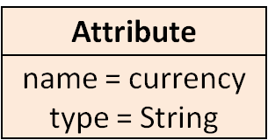
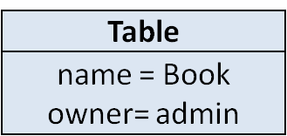
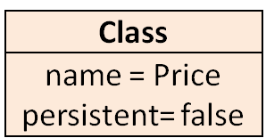
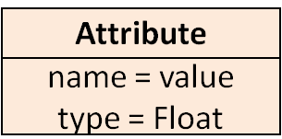
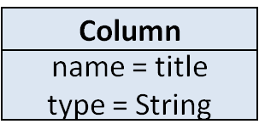
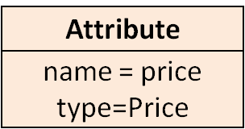
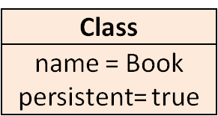
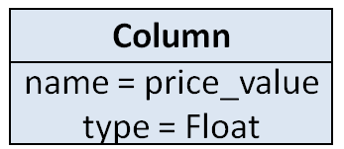
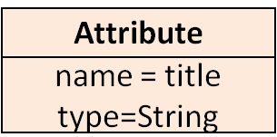
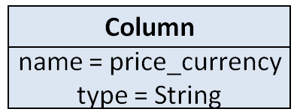
Running Example
UML Modeling Tool
Database Design Tool
Equal

Slide 6
Running Example
UML Modeling Tool
Database Design Tool
Publication
Publication

Slide 7
Synchronizer
Synchronizing models is not easy
  Identify affected locations
  Propagate updates to these locations
  Trade off between different propagation strategies
Synchronizers are needed
  A synchronizer propagates updates automatically to make all models consistent when user modify models

Slide 8
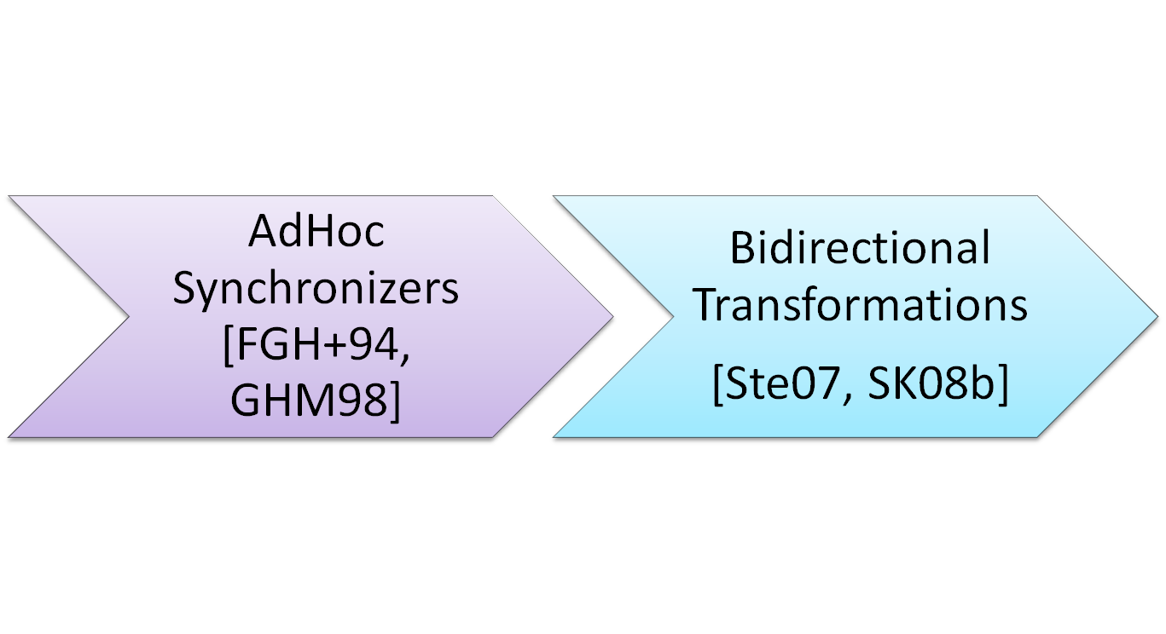
Existing Approaches

Slide 9
Adhoc synchronizers [FGH+94, GHM98]
For adhoc cases
Implemented in languages like Java or C++
Example:
  If (t is a table&& t.name changes to x) {
  find the corresponding class c;
  c.name = x;
  }
Problems:
  Difficult to develop
  Difficult to maintain

Slide 10
Bidirectional Transformation [Ste07, SK08b]
Consistency Relation in Bidirectional Languages
generate
Updated UML model
Forward Transformation
Database model
Updated database model
UML model
Updated UML model
Backward Transformation
Updated database model

Slide 11
Problems of Bidirectional Transformation
Problem 1: Developers have to learn a new language
Problem 2: Not allow parallel updates on the two models
Problem 3: Support limited types of consistency relation
  Not support on-site synchronization

Slide 12
Off-Site Synchronization
Synchronize between two applications
Application A
Synchronizer
Application B
Models of
Application A
Models of
Application B

Slide 13
On-Site Synchronization
Synchronization within One Application
UML Modeling Tool
Synchronizer
Application
Equal

Slide 14
On-Site Synchronization
Synchronization within One Application
UML Modeling Tool
BookPrice
Synchronizer
Application
BookPrice

Slide 15
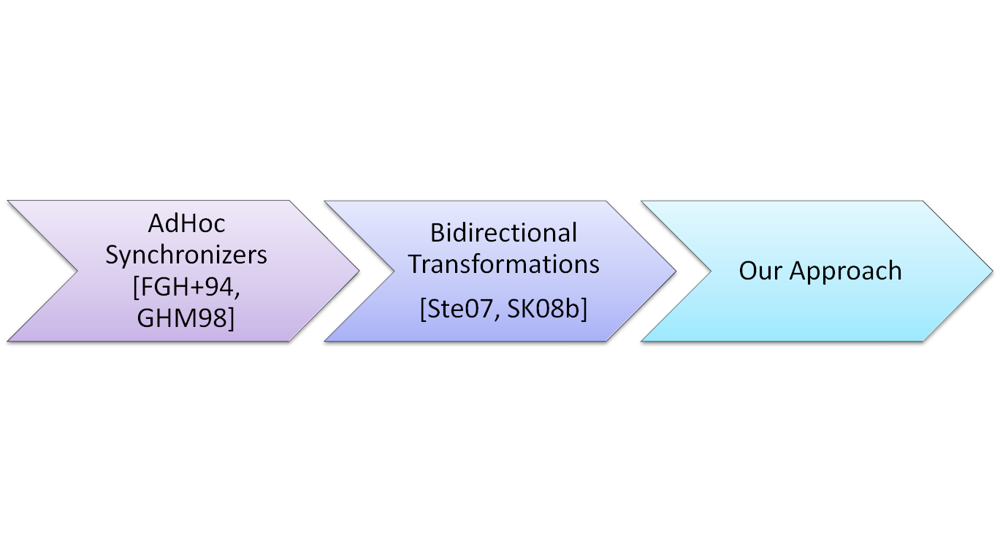
Our Approach

Slide 16
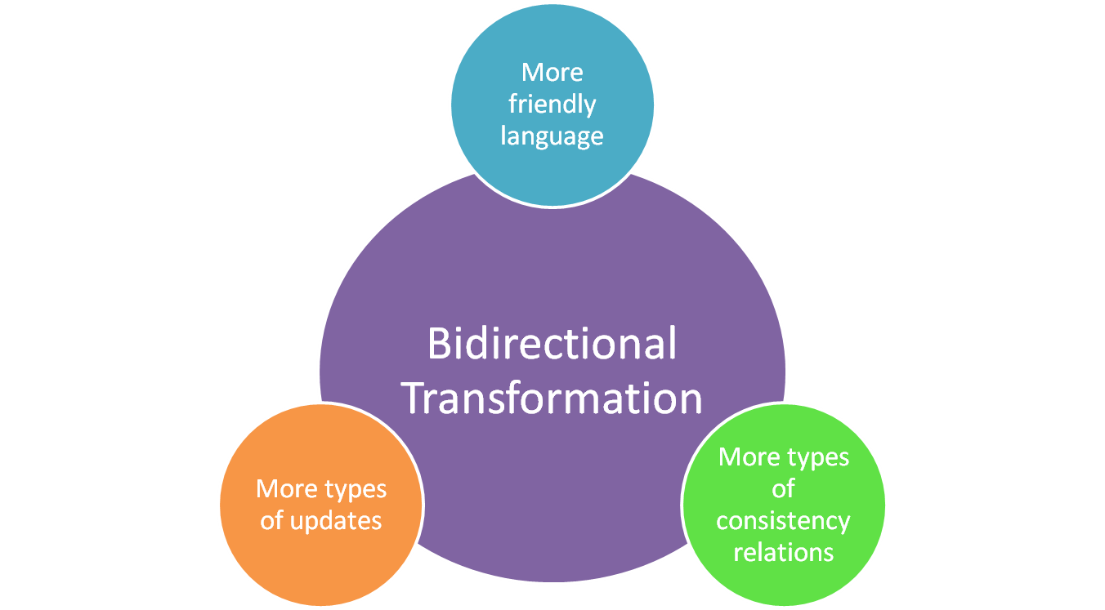
Our Approach

Slide 17
Our Approach
Consistency Relation in Existing Languages
generate
Synchronizer

Slide 18
Our Approach
Consistency Relation in Existing Languages
Consistency Relation is specified in existing relation-specifying languages
Benefit
    Reusing existing programs
    Reusing developer knowledge
  Different languages for different situations
generate
Synchronizer

Slide 19
Our Approach
Consistency Relation in Existing Languages
Allowing parallel updates over different models
generate
Synchronizer

Slide 20
Our Approach
Consistency Relation in Existing Languages
Supporting more consistency relation description, particularly, on-site synchronization
Supporting more consistency relation description, particularly, on-site synchronization
generate
Synchronizer

Slide 21
Contributions
Requirement of Model Synchronization (Chapter 2)
Unidirectional Transformation
Bidirectional Transformation
Logic Expression
Chapter 4
ASE07
Chapter 5
ICMT09
Chapter 6,7
FSE09
Application: Runtime Management Framework (Section 5.5)
(Models@Runtime 09)
Off-Site Synchronizer
Off-Site Synchronizer
On-Site Synchronizer
Dictionary-based Representation of Models and Updates (Chapter 3)

Slide 22
Contributions
Requirement of Model Synchronization (Chapter 2)
Unidirectional Transformation
Bidirectional Transformation
Logic Expression
Chapter 4
ASE07
Chapter 5
ICMT09
Chapter 6,7
FSE09
Application: Runtime Management Framework (Section 5.5)
(Models@Runtime 09)
Off-Site Synchronizer
Off-Site Synchronizer
On-Site Synchronizer
Dictionary-based Representation of Models and Updates (Chapter 3)

Slide 23
Requirement of Model Synchronization
Three properties
  Consistency
  Preservation
  Stability
A synchronizer is correct only if it satisfies the three properties

Slide 24
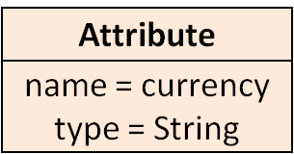
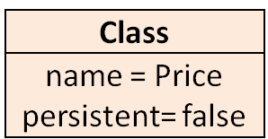
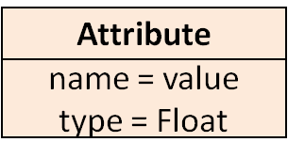
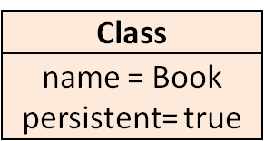
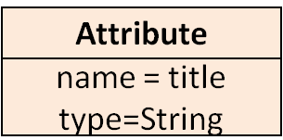
Consistency
After synchronization, the data should be consistent
Publication
Equal
Publication

Slide 25
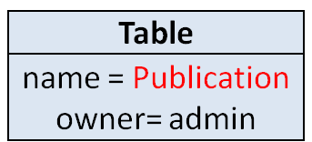
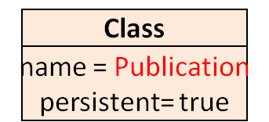
Consistency
After synchronization, the data should be consistent
Equal

Slide 26
Preservation
Synchronizer cannot overwrite user updates
Book
Publication

Slide 27
Stability
If users change nothing, the synchronizer changes nothing

Slide 28
Contributions
Requirement of Model Synchronization (Chapter 2)
Unidirectional Transformation
Bidirectional Transformation
Logic Expression
Chapter 4
ASE07
Chapter 5
ICMT09
Chapter 6,7
FSE09
Application: Runtime Management Framework (Section 5.5)
(Models@Runtime 09)
Off-Site Synchronizer
Off-Site Synchronizer
On-Site Synchronizer
Dictionary-based Representation of Models and Updates (Chapter 3)

Slide 29
Why Dictionaries?
Models are defined by MOF Standard
  contains a lot of concepts
  easy for end users
  difficult for researchers
Our contribution
  Defining a small dictionary structure
  Defining updates on dictionaries
  Representing most frequently used concepts in models

Slide 30
Dictionaries
A dictionary maps keys to values
  {“name”->”Book”, “persistent”->true}
  {1->{5->”a”, 4->”b”}, 2->{3->”x”, 4->”y”}}
An update on dictionary is also a dictionary mapping from keys to updates
  ,4->”y”
  “x”
  {1->”a”, 2->”b”, 3->”c”}
{1->!”x”, 2->!null, 4->!”y”}

Slide 31
Representing Models
A model maps id to objects
Assign an ID to each object
{1->{name->Price,
persistent->false,
__type->Class},
2->{name->currency,
type->String,
parent->1,
__type->Attribute},
}
type information is stored in “__type”
2
1
An object maps attribute names to attribute values
Reference values are IDs of the referred object

Slide 32
Representing Models
{1->{name->Price,
persistent->false,
__type->Class},
2->{name->currency,
type->String,
parent->1,
__type->Attribute},
}
2
1

Slide 33
Representing Models
{1->{name->Price,
persistent->false,
__type->Class},
2->{name->currency,
type->String,
parent->1,
__type->Attribute},
}
2
1

Slide 34
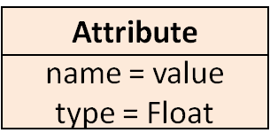
Representing Updates
Updates on models are converted to updates on dictionaries
2
1
3
BookPrice
{1->{Name->!BookPrice}}

Slide 35
Contributions
Requirement of Model Synchronization (Chapter 2)
Unidirectional Transformation
Bidirectional Transformation
Logic Expression
Chapter 4
ASE07
Chapter 5
ICMT09
Chapter 6,7
FSE09
Application: Runtime Management Framework (Section 5.5)
(Models@Runtime 09)
Off-Site Synchronizer
Off-Site Synchronizer
On-Site Synchronizer
Dictionary-based Representation of Models and Updates (Chapter 3)

Slide 36
Off-Site Synchronization
In practice, what we have is
UML model
Unidirectional Transformation
Database model

Slide 37
Off-Site Synchronization
What we need is
UML model
Database model
Updated UML model
Updated database model
Off-Site Synchronizer
Synchronized UML model
Synchronized database model

Slide 38
Our Approach
Unidirectional Transformation Program
ATL Transformation Program
UML model
Database model
Updated UML model
Updated database model
Off-Site Synchronizer
Synchronized UML model
Synchronized database model

Slide 39
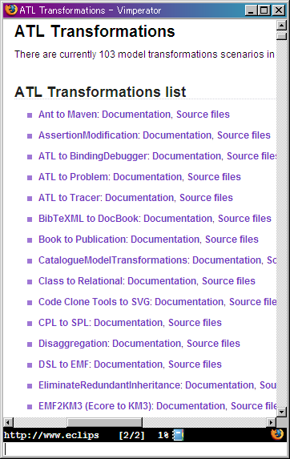
Evaluation
Applied to five real world ATL transformations
  UML to Database
  UML to Java
  BibTex to DocBook
  Make to Ant
  Book to Publication
Working well in all programs
A page on ATL web site listing real world ATL programs

Slide 40
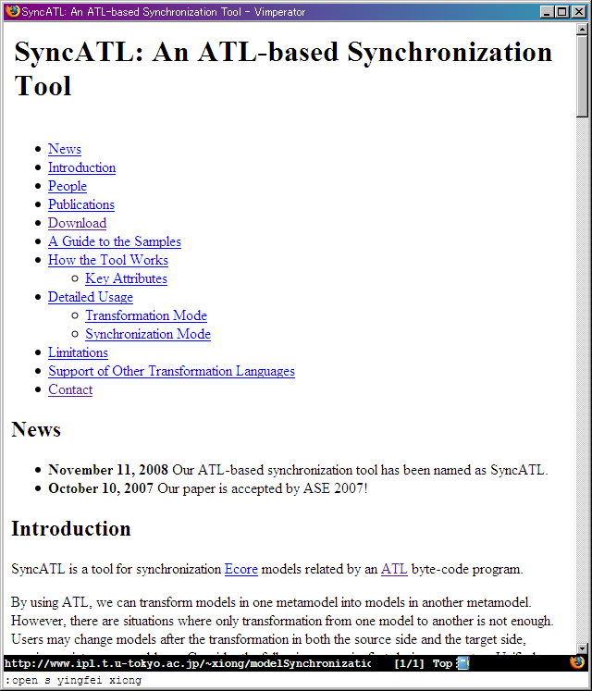
Implementation and Impact
Our approach has been implemented and has been used by other researchers [YKW+08]
In addition, our ASE paper has been cited 40 times (2009-11-05, Google Scholar), and is one of the most cited paper in ASE 2007
SyncATL Website

Slide 41
Contributions
Requirement of Model Synchronization (Chapter 2)
Unidirectional Transformation
Bidirectional Transformation
Logic Expression
Chapter 4
ASE07
Chapter 5
ICMT09
Chapter 6,7
FSE09
Application: Runtime Management Framework (Section 5.5)
(Models@Runtime 09)
Off-Site Synchronizer
Off-Site Synchronizer
On-Site Synchronizer
Dictionary-based Representation of Models and Updates (Chapter 3)

Slide 42
Motivation
In some cases, we already have a a bidirectional transformation
but the two models may be updated at the same time
Updated UML model
Database model
Forward Transformation
Updated database model
UML model
Updated database model
Backward Transformation
Updated UML model

Slide 43
Our Approach
Derive a synchronizer from a pair of change-propagating transformations
Forward Transformation
Backward Transformation
Off-Site Synchronizer

Slide 44
Properties of Bidirectional Transformation [Ste07]
Do the two transformations fit together?
  Correctness
  Hippocraticness

Slide 45
Relation between Properties
Bidirectional transformation properties lead to synchronization properties
Synchronizer
Forward Transformation
Forward Transformation
Backward Transformation
Backward Transformation
Correctness
Consistency
Hippocraticness
Stability
Preservation

Slide 46
Contributions
Requirement of Model Synchronization (Chapter 2)
Unidirectional Transformation
Bidirectional Transformation
Logic Expression
Chapter 4
ASE07
Chapter 5
ICMT09
Chapter 6,7
FSE09
Application: Runtime Management Framework (Section 5.5)
(Models@Runtime 09)
Off-Site Synchronizer
Off-Site Synchronizer
On-Site Synchronizer
Dictionary-based Representation of Models and Updates (Chapter 3)

Slide 47
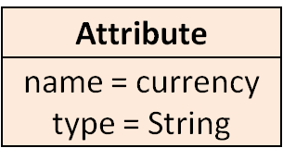
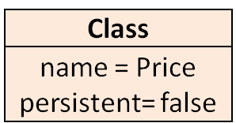
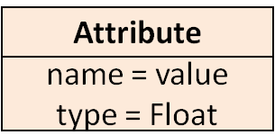
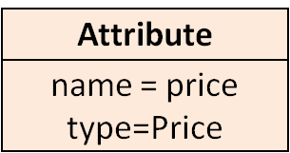
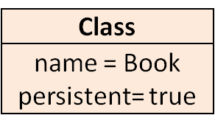
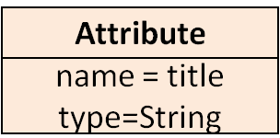
Object Constraint Language (OCL)
OCL is a first-order logic language used to define and check relations over models
  attribute.type=“String”
  or
  attribute.type=“Float”
  or
  allClasses->exists(class |
  class.name = attribute.type)
OCL is also used by adhoc synchronizer developers for dynamically assert the correctness of synchronizers
UML Modeling Tool
Equal

Slide 48
Idea: Derive a Synchronizer from an OCL Expression
OCL Expression
Synchronizer

Slide 49
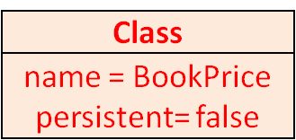
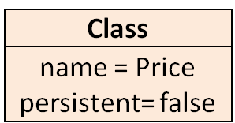
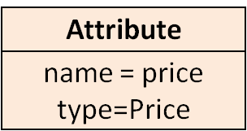
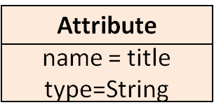
Problem: Synchronization Behavior Ambiguity
UML Modeling Tool
UML Modeling Tool
BookPrice
BookPrice
BookPrice

Slide 50
Our Approach
Beanbag
  similar to OCL syntactically
  has enriched constructs for confining synchronization behavior
Every Beanbag Program has two types of semantics
  Checking semantics for checking whether the relation is satisfied
  Synchronization semantics for synchronize updates

Slide 51
Beanbag Overview
Beanbag Program
On-Site Synchronizer
Updates
Updates

Slide 52
DEMO

Slide 53
Overview: Constructs in Beanbag
expr ::= variable
| constant
| expr.expr
| not expr
| expr=expr
| expr and expr
| expr or expr
| expr->forall(v|expr)
| expr->exists(v|expr)
| expr->exists!(v|expr)

Slide 54
Overview: Enriched Constructs for Specifying Synchronization Behavior
OCL Constructs | Enriched Constructs
expr1=expr2 | expr1=expr2 expr2=expr1
expr1 and expr2 | expr1 and expr2 expr2 and expr1
expr1 or expr2 | expr1 or expr2 expr2 or expr1
expr->exists(v | expr) | expr->exists(v | expr) expr->exists!(v | expr)

Slide 55
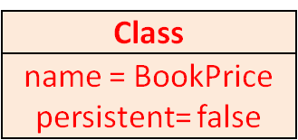
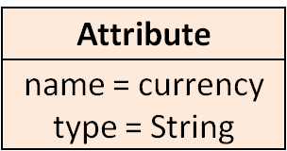
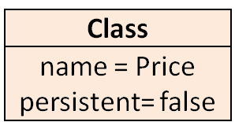
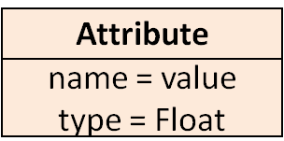
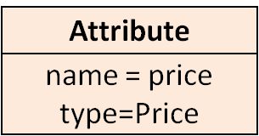

Specifying Synchronization Behavior
UML Modeling Tool
def rel(attribute, allClasses) =
attribute.type=“String”
or
attribute.type=“Float”
or
allClasses->exists(class |
class.name = attribute.type)
BookPrice

Slide 56
Specifying Synchronization Behavior
def rel(attribute, allClasses) =
attribute.type=“String”
or
attribute. type=“Float”
or
allClasses->exists!(class |
class.name = attribute. type)
UML Modeling Tool
BookPrice
BookPrice

Slide 57
How we compile a Beanbag program
Basic relations (like a=b) | Primitive synchronizers
Connectives (like and, or, forall) | gluing their inner synchronizers into a bigger synchronizer
Consider an example:
  Relation: a=b and b=c
and
a=b
b=c

Slide 58
Primitive Synchronizer: a=b
a=b
3
3
3
3
a=2
a=2
a=2
a=2
3
3
3
4
b=2
b=2
b=2
b=2
report conflict

Slide 59
Combinator
and
a=b
b=c
a=3
b=3
c=3
1
1
1

Slide 60
Evaluation
Steps
  collected 84 consistency relations from MOF standard, UML standard, and industry [Egyed07]
  identified requirements for 24 synchronizer
  implementing these programs in Beanbag
Result
  implemented 17 programs, 71% of all programs
  The rest 7 programs can be implemented with minor extensions to Beanbag

Slide 61
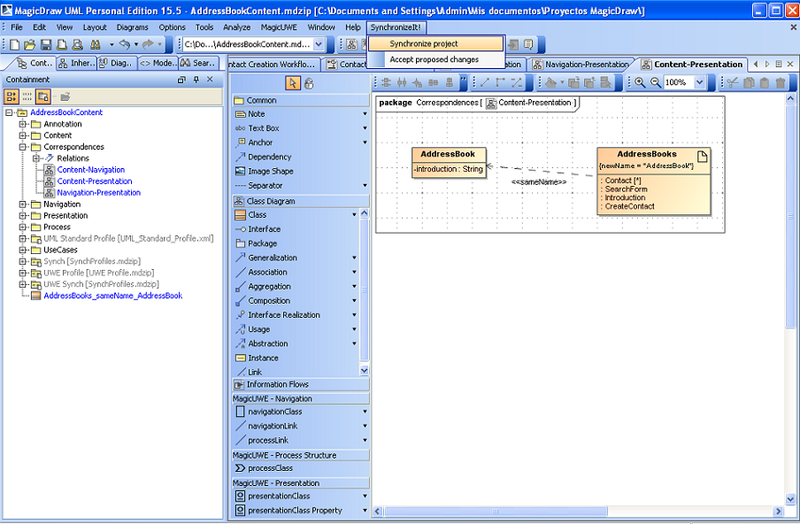
Implementation
Beanbag has been implemented and published on the web
An old version has been used by several researchers [RKK+09]
A graphic UML synchronization tool
that is developed by University of
Malaga using Beanbag

Slide 62
Contributions
Requirement of Model Synchronization (Chapter 2)
Unidirectional Transformation
Bidirectional Transformation
Logic Expression
Chapter 4
ASE07
Chapter 5
ICMT09
Chapter 6,7
FSE09
Application: Runtime Management Framework (Section 5.5)
(Models@Runtime 09)
Off-Site Synchronizer
Off-Site Synchronizer
On-Site Synchronizer
Dictionary-based Representation of Models and Updates (Chapter 3)

Slide 63





Application: Runtime Management Framework
read
Client
calcu
1
Client
phone1
2
Client
tablet
5
Bluetooth
Wi-Fi
Ethernet
Server
10
synchronize
write
A management interface
a running system

Slide 64
Architecture of the Runtime Management Framework
Runtime Management UI
QVT program
Synchronizer
generate
Running System
Notes:
Talk about the evaluation and submission orally

Slide 65
Summary
Formalization of model synchronization
  Requirement of model synchronization
  Dictionary-based representation of models and updates
Support for off-site synchronization
  from unidirectional transformation (ASE07)
  from bidirectional transformation (ICMT09)
Support for on-site synchronization
  A first-order logic language (FSE09a, submitted)
Application (FSE09b, submitted)

Slide 66
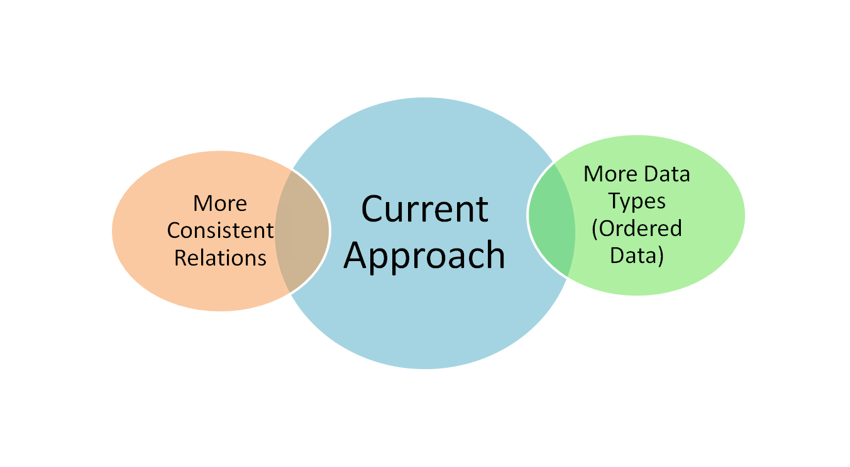
Future Work - Horizontal

Slide 67
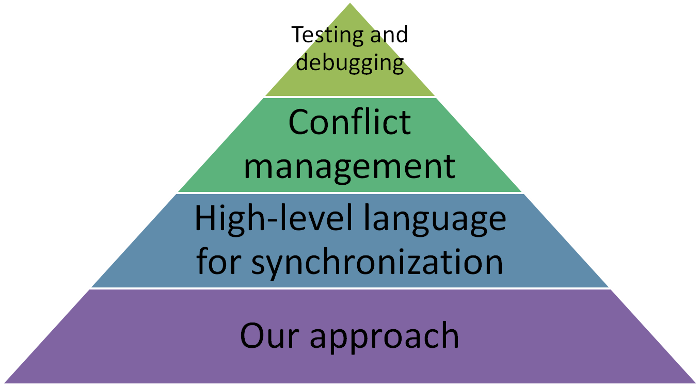
Future Work - Vertical

Slide 68


Slide 69
Reference
[ELF08] Alexander Egyed, Emmanuel Letier, and Anthony Finkelstein. Generating and evaluating choices for fixing inconsistencies in UML design models. ASE08.
[NEF03] Christian Nentwich, Wolfgang Emmerich, and Anthony Finkelstein. Consistency management with repair actions. ICSE03.
[FGH+94] A. C. W. Finkelstein, D. Gabbay, A. Hunter, J. Kramer, and B. Nuseibeh. Inconsistency handling in multiperspective specifications. TSE94.
[GHM98] John Grundy, John Hosking, and Warwick B. Mugridge. Inconsistency management for multiple-view software development environments. TSE98.

Slide 70
Reference
[Ste07] Perdita Stevens. Bidirectional model transformations in QVT: Semantic issues and open questions. MoDELS07.
[SK08b] Andy Schurr and Felix Klar. 15 years of triple graph grammars. ICGT08.
[RKK+09] Daniel Ruiz-Gonzalez, Nora Koch, Christian Kroiss, Jose-Raul Romero, Antonio Vallecillo. Viewpoint Synchronization of UWE Models. (submitted for publication).
[YKW+08] Yijun Yu, Haruhiko Kaiya, Hironori Washizaki, Yingfei Xiong, Zhenjiang Hu and Nobukazu Yoshioka. Enforcing a security pattern in stakeholder goal models. QoP08.

