Slide 1
Towards Automatic Model Synchronization from Model Transformation
Yingfei Xiong University of Tokyo
Dongxi Liu University of Tokyo
Zhenjiang Hu University of Tokyo
Haiyan Zhao Peking University
Masato Takeichi University of Tokyo
Hong Mei Peking University

Slide 2
Model-Driven Development
MDD
  An model-based approach to software development
  Developing software by transforming models
Model Transformation
  Converting models in different formats (meta-models)
Model Transformation Languages
  ATL [F. Jouault and I. Kurtev. 2005]
  QVT [OMG, 2006]
Notes:
This paper is about model synchronization from model transformation.

Slide 3
A UML2Java Transformation in ATL
module UML2Java ;
create OUT : Java from IN : UML ;
rule Class2Class {
from u : UML ! Class
to j : Java ! Class (
name <- u.name ,
fields <- u.attrs
)
}
rule Attribute2Field {
from a : UML ! Attribute
to f : Java ! Field (
name <- ’_’ + a.name ,
type <- a. type
)
}

Slide 4
An Example of Executing UML2Java
UML!Class
name = “Book”
description = “a demo class”
UML!Attribute
name = “title”
type = “String”
UML!Attribute
name = “price”
type = “Double”

Slide 5
Transformation
Create Java!Class for each UML!Class
UML!Class
Java!Class
name = “Book”
description = “a demo class”
name = “”
comment = “”
UML!Attribute
name = “title”
type = “String”
UML!Attribute
name = “price”
type = “Double”

Slide 6
Transformation
UML!Class
Java!Class
name = “Book”
description = “a demo class”
name = “”
comment = “”
Create Java!Field for each UML!Attribute
UML!Attribute
Java!Field
name = “title”
type = “String”
name = “”
type = “”
UML!Attribute
Java!Field
name = “price”
type = “Double”
name = “”
type = “”

Slide 7
Transformation
Copy
UML!Class
Java!Class
name = “Book”
description = “a demo class”
name = “Book”
comment = “”
UML!Attribute
Java!Field
name = “title”
type = “String”
name = “”
type = “”
UML!Attribute
Java!Field
name = “price”
type = “Double”
name = “”
type = “”

Slide 8
Transformation
UML!Class
Java!Class
name = “Book”
description = “a demo class”
name = “Book”
comment = “”
Plus “_”
UML!Attribute
Java!Field
name = “title”
type = “String”
name = “_title”
type = “”
UML!Attribute
Java!Field
name = “price”
type = “Double”
name = “_price”
type = “”

Slide 9
Transformation
UML!Class
Java!Class
name = “Book”
description = “a demo class”
name = “Book”
comment = “”
UML!Attribute
Java!Field
name = “title”
type = “String”
copy
name = “_title”
type = “String”
UML!Attribute
Java!Field
name = “price”
type = “Double”
name = “_price”
type = “Double”

Slide 10
Transformation
UML!Class
Java!Class
name = “Book”
description = “a demo class”
name = “Book”
comment = “”
Convert reference
UML!Attribute
Java!Field
name = “title”
type = “String”
name = “_title”
type = “String”
UML!Attribute
Java!Field
name = “price”
type = “Double”
name = “_price”
type = “Double”

Slide 11
The Transformation Result
UML!Class
Java!Class
name = “Book”
description = “a demo class”
name = “Book”
comment = “”
UML!Attribute
Java!Field
name = “title”
type = “String”
name = “_title”
type = “String”
UML!Attribute
Java!Field
name = “price”
type = “Double”
name = “_price”
type = “Double”

Slide 12
Modifications
Java!Class
UML!Class
name = “Book”
comment =
“_bookTitle cannot be null”
name = “Book”
description = “a demo class”
UML!Attribute
Java!Field
_bookTitle
name = “title”
type = “String”
name = “_title”
type = “String”
UML!Attribute
name = “authors”
type = “String”
UML!Attribute
Java!Field
name = “price”
type = “Double”
name = “_price”
type = “Double”

Slide 13
Model Synchronization
Model synchronization is a process that propagates modifications across different models, making the models consistent with each other.

Slide 14
Model Synchronization
Src0
Transform
Tar0
Modify
Modify
Src1
Tar1
Synchronize
Src2
Tar2

Slide 15
Existing Approaches
General Frameworks
  Multi-view synchronization [J. Grundy et al. 1998]
  Rely on users to write code to handle each type of modifications in each side
  It is users who should ensure the consistency of the code
Specific Languages
  FSML [M. Antkiewicz and et al. 2006]
  Feature model to code synchronization

Slide 16
Our Contributions
A clear semantics of model synchronization
  Four properties
An automatic model synchronization approach
  Using the existing unidirectional ATL byte code program
  Requiring no extra code
  Satisfying the four properties
A prototype tool for synchronizing EMF models

Slide 17
Our Contributions
A clear semantics of model synchronization
  Four properties
An automatic model synchronization approach
  Using the existing unidirectional ATL byte code program
  Requiring no extra code
  Satisfying the four properties
A prototype tool for synchronizing EMF models

Slide 18
Our Contributions
A clear semantics of model synchronization
  Four properties
An automatic model synchronization approach
  Using the existing unidirectional ATL byte code program
  Requiring no extra code
  Satisfying the four properties
A prototype tool for synchronizing EMF models

Slide 19
The ATL Transformation System
ATL Program
QVT Program
Compile
ATL Byte-code

Slide 20
Our Contributions
A clear semantics of model synchronization
  Four properties
An automatic model synchronization approach
  Using the existing unidirectional ATL byte code program
  Requiring no extra code
  Satisfying the four properties
A prototype tool for synchronizing EMF models

Slide 21
The ATL Transformation System
ATL Virtual
Machine
Original
Source Models
Original
Target Models
Modified
Source Models
Modified
Target Models
ATL Byte-code
MetaModels

Slide 22
Our System
Original
Source Models
Modified
Source Models
Modified
Target Models
Our System
ATL Byte-code
MetaModels
Synchronized
Source Models
Synchronized
Target Models

Slide 23
Our Contributions
A clear semantics of model synchronization
  Four properties
An automatic model synchronization approach
  Using the existing unidirectional ATL byte code program
  Requiring no extra code
  Satisfying the four properties
A prototype tool for synchronizing EMF models

Slide 24
Review the example
Java!Class
UML!Class
name = “Book”
comment =
“_bookTitle cannot be null”
name = “Book”
description = “a demo class”
UML!Attribute
Java!Field
_bookTitle
name = “title”
type = “String”
name = “_title”
type = “String”
UML!Attribute
name = “authors”
type = “String”
UML!Attribute
Java!Field
name = “price”
type = “Double”
name = “_price”
type = “Double”

Slide 25
The Synchronized Result
Java!Class
UML!Class
name = “Book”
comment =
“_bookTitle cannot be null”
name = “Book”
description = “a demo class”
UML!Attribute
bookTitle
Java!Field
_bookTitle
name = “title”
type = “String”
name = “_title”
type = “String”
UML!Attribute
name = “authors”
type = “String”
UML!Attribute
Java!Field
name = “price”
type = “Double”
name = “_price”
type = “Double”
Java!Field
name = “_authors”
type = “String”

Slide 26
Our Contributions
A clear semantics of model synchronization
  Four properties
An automatic model synchronization approach
  Using the existing unidirectional ATL byte code program
  Requiring no extra code
  Satisfying the four properties
A prototype tool for synchronizing EMF models

Slide 27
Content
Background and Motivation
Outline of our work
Details of our work
  A clear semantics
  An automated approach
  A prototype tool
Conclusion

Slide 28
Properties of Synchronization
To ensure the synchronization process exhibits reasonable behavior, we need to define clear semantics to model synchronization
Our semantics includes four important properties:
  Stability
  Preservation
  Propagation
  Composibility

Slide 29
Stability
If no model is modified, the synchronized models are not modified.
UML!Class
Java!Class
Transform
name = “book”
name = “book”
description = “demo”
comment = “”
UML!Class
Java!Class
name = “book”
name = “book”
description = “demo”
comment = “”
Synchronize
UML!Class
Java!Class
name = “book”
name = “book”
description = “demo”
comment = “”

Slide 30
Preservation
Modifications on both sides should be kept.
UML!Class
Java!Class
Transform
name = “book”
name = “book”
description = “demo”
comment = “”
UML!Class
Java!Class
name = “book”
name = “book”
description = “demo”
comment = “persistent”
Synchronize
UML!Class
Java!Class
name = “book”
name = “book”
description = “demo”
comment = “persistent”

Slide 31
Propagation
The modifications should be propagated to the other side if necessary.
UML!Class
Java!Class
Transform
name = “book”
name = “book”
description = “demo”
comment = “”
UML!Class
Java!Class
publication
name = “book”
name = “book”
description = “demo”
comment = “”
Synchronize
UML!Class
Java!Class
publication
publication
name = “book”
name = “book”
description = “demo”
comment = “”

Slide 32
Composibility – Step 1
A series of modifications have the same effect regardless of whether is applied once or is applied incrementally
UML!Class
Java!Class
Transform
name = “book”
name = “book”
description = “demo”
comment = “”
UML!Class
Java!Class
publication
name = “book”
name = “book”
description = “demo”
comment = “”
Synchronize
UML!Class
Java!Class
publication
publication
name = “book”
name = “book”
description = “demo”
comment = “”

Slide 33
Composibility – Step 2
A series of modifications have the same effect regardless of whether is applied once or is applied incrementally
UML!Class
Java!Class
publication
publication
name = “book”
name = “book”
description = “demo”
comment = “”
UML!Class
Java!Class
publication
name = “book”
name = “book”
description = “demo”
comment = “persistent”
Synchronize
UML!Class
Java!Class
publication
publication
name = “book”
name = “book”
description = “demo”
comment = “persistent”

Slide 34
Composibility - Composed
A series of modifications have the same effect regardless of whether is applied once or is applied incrementally
UML!Class
Java!Class
Transform
name = “book”
name = “book”
description = “demo”
comment = “”
UML!Class
Java!Class
publication
name = “book”
name = “book”
description = “demo”
comment = “persistent”
Synchronize
UML!Class
Java!Class
publication
publication
name = “book”
name = “book”
description = “demo”
comment = “persistent”

Slide 35
Content
Background and Motivation
Outline of our work
Details of our work
  A clear semantics
  An automated approach
  A prototype tool
Conclusion

Slide 36
Backward Modification Propagation
To put back modifications from target to source, we need to know which source items are related to a target item
Bidirectional ATL Virtual Machine
  Record trace information when performing the transformation
    Trace the sources of items
    Trace how items are transformed

Slide 37
Examples of Tracing
to f : Java ! Field (
name <- ’_’ + a.name ,
type <- a. type
)
The f.name is created from a.name by prefixing an underscore
When f.name is modified, we modify a.name by removing the prefixed underscore

Slide 38
Propagate Modifications
UML!Class
I am from here!
Java!Class
name = “Book”
description = “a demo class”
When I am deleted,
delete the source class
and all its attributes
name = “Book”
comment = “”
I am from here!
UML!Attribute
When I am changed,
find corresponding attribute
and set that attribute back
Java!Field
name = “title”
type = “String”
name = “_title”
type = “String”
UML!Attribute
Java!Field
name = “price”
type = “Double”
I am from here!
When I am changed,
remove the leading ‘-’ and
copy me back!
name = “_price”
type = “Double”

Slide 39
Synchronization Algorithm
Src. Modifications
Src0
Transform
Tar0
Tar. Modifications
Shared
Modifications
Difference
Src1
Tar1
Difference
Tagged Src
Tagged Tar
Backward
Propagate
Inter. Src
Inter. Tar
Source
Merging
Supplementray
Merging
Transform
Src2
Tar2
Notes:
Color

Slide 40
Content
Background and Motivation
Outline of our work
Details of our work
  A clear semantics
  An automated approach
  A prototype tool
Conclusion

Slide 41
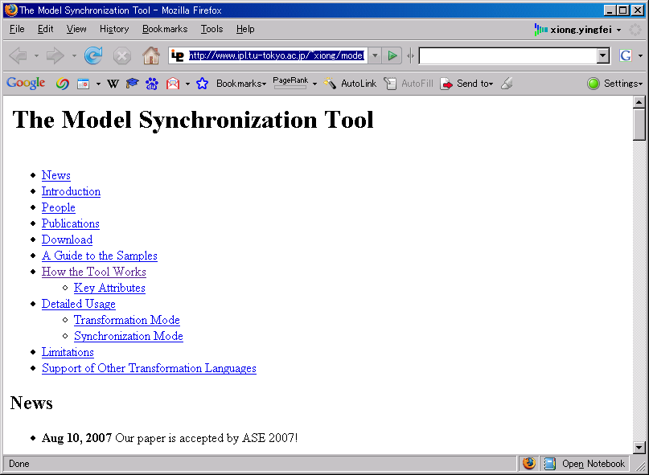
Implementation
A prototype tool
  Synchronizing EMF models
  Using an ATL byte-code program
  Requiring no extra code
Available at:
  http://www.ipl.t.u-tokyo.ac.jp/~xiong/modelSynchronization.html
Notes:
Examples
LOC

Slide 42
Evaluation
Name | Source | ATL Code Lines | Bytecode Lines
UML2Java | The running example in the paper | 22 | 501
Make2Ant | Examples obtained from the ATL web site | 89 | 1180
Class2 Relational |  | 127 | 1576
Book2 Publication |  | 51 | 566
BibTeXML2 DocBook |  | 262 | 3198

Slide 43
Content
Background and Motivation
Outline of our work
Details of our work
  A clear semantics
  An automated approach
  A prototype tool
Conclusion

Slide 44
Conclusion and Future Work
We propose a new approach to automatic model synchronization from model transformation with
  Clear semantics
  A general automatic approach
  A prototype tool
    http://www.ipl.t.u-tokyo.ac.jp/~xiong/modelSynchronization.html
One problem is that we cannot deal with all types of insertions in the target side. We are working on that and hope to solve it in near future

Slide 45
Distinguish existing work with our work
Connect the first two parts with related work
Add an outline of how we trace items

