Slide 1
Beanbag: A Framework for On-Site Synchronization
Yingfei Xiong (speaker), University of Tokyo
Zhenjiang Hu, National Institute of Informatics / University of Tokyo
Song Hui, Peking University
Masato Takeichi, University of Tokyo
Haiyan Zhao, Peking University
Hong Mei, Peking University

Slide 2
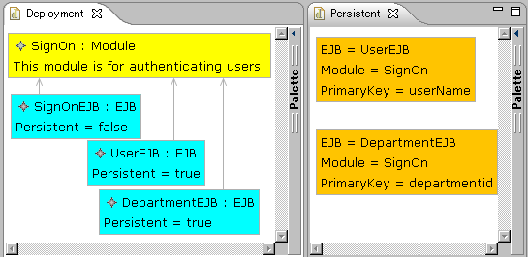
Example: An EJB Modeling Tool
(Enterprise JavaBeans)
SignModule
User
SignModule
User
SignModule

Slide 3
On-Site Synchronization
We call such synchronization “On-Site Synchronization”.
Characteristics
  Synchronization need to be completed in a short time constraint
  No predefined synchronization direction

Slide 4
Existing Approaches on
Off-Site Synchronization
Synchronizing between applications
Manipulating data on external copies
Application A
Synchronizer
Application B
------------
------------
------------
------------
------------
------------
------------
------------
Data of
Application A
XML
XML
Data of
Application B

Slide 5
Not Enough for On-Site Synchronization
Importing and exporting degrades system performance
No clear separation of data

Slide 6
No clear separation of data
User
User

Slide 7

Our Contribution: Beanbag
Beanbag is a framework for supporting on-site synchronization.
Beanbag(お手玉，沙包) is also a traditional Asian game for keeping several beanbags consistent
  The actor must response in a short time or the bag will fall to the ground
  The bags can be thrown in any directions
The picture is obtained from
www.city.kodaira.tokyo.jp
Notes:
time limit – on site

Slide 8
An Overview of Beanbag
Users
Updates
On-Site
Synchronizer
Compile
------------
------------
------------
------------
Application Data
Beanbag Program
Updates
Notes:
after this show EJB again

Slide 9
Beanbag Program for the EJB
main(ejbs, modules, entitybeans) {
containmentRefs<attr="Module">(ejbs, modules);
for [ejb, entitybean] in [ejbs, entitybeans] {
persistent(ejb, entitybean, modules) |
nonPersistent(ejb, entitybean) |
{ejb = null; entitybean = null}
}
}
Notes:
change to the new version

Slide 10
Beanbag Program for the EJB
persistent(ejb, entitybean, modules) {
var moduleRef, moduleName;
ejb."Persistent" = true;
entitybean."EJBName" = ejb."Name";
moduleRef = ejb."Module";
!modules.moduleRef = module;
entitybean."ModuleName" = module.”Name”;
}
nonPersistent(ejb, entitybean){
ejb."Persistent" = false;
entitybean = null;
}

Slide 11
Describing Updates
Assign a unique id for each object
4
5
1
6
2
3

Slide 12
Describing Updates
Describing attribute modification
4
5
1
User
6
2
3
ejbs: {2->{“Name”->!”User”}}
modules: void
entityBeans: void

Slide 13
Describing Updates
Describing deletion
4
5
1
6
2
3
ejbs: void
modules: {4->!null}
entityBeans: void

Slide 14
Describing Updates
Describing Insertion
4
5
1
6
2
7
3
AccessRight : EJB
Persistent = true
ejbs: {7->{“Name”->!”AccessRight”,“Persistent”->!true}}
modules: void
entityBeans: void

Slide 15

An Update Propagation of EJB Tool
ejbs: {2->{“Name”->!”User”}}
modules: void
entityBeans: void
EJB Program
------------
------------
------------
------------
User
Compile
Synchronizer
User
ejbs: {2->{“Name”->!”User”}}
modules: void
entityBeans: {5->{“Name”->!”User”}}

Slide 16
How we compile a Beanbag program
Basic relations (like a=b, a.”name”=b) | Primitive synchronizers
Gluing constructs (like conjunction “;”) | gluing their inner synchronizers into a bigger synchronizer
Consider an example:
  { var c;
  c=a.”Name”;
  c=b.”Name”;
  }

Slide 17
c=a.“Name”
a: {“Name”->!”X”}
c: nomod
c=a.“Name”
a: {“Name”->!”X”}
c: !”X”

Slide 18
c=a.“Name”
a: {“Persistent”->!true}
c: !”X”
c=a.“Name”
a: {“Persistent”->!true, “Name”->!”X”}
c: !”X”

Slide 19
c=a.“Name”
a: {“Name”->!”Y”}
c: !”X”
c=a.“Name”
Failure!

Slide 20
Conjunction
a: nomod
b: {“name”->!”x”}
b: {“name”->!”x”}
c: nomod
a: nomod
c: !x
{var c;
c=a.”name”;
c=b.”name”}
c=b.”name”
c=a.”name”
a: {“name”->!”x”}
b: {“name”->!”x”}
b: {“name”->!”x”}
c: !”x”
a: {“name”->!”x”}
c: !”x”

Slide 21
Primitive Relations and Combinators in BeanBag
In Beanbag, we define six types of primitive relations
  a=b
  a=“x”
  a.”Name”=c
  !a.b=c
  a==b
  a<>b
three gluing constructs
  conjuction “;”
  disjunction “|”
  the for statement
and some other constructs defined as syntax sugar of the above
Refer to our paper and the website for more details

Slide 22
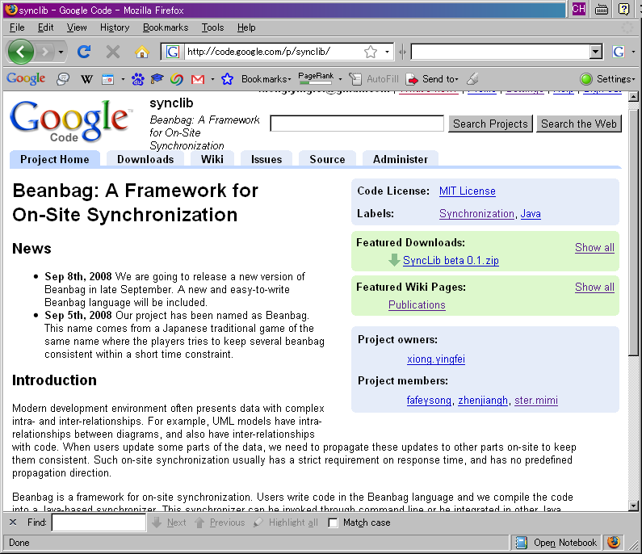
Implementation
We have implemented Beanbag in Java
The implementation is published under MIT license
Url: http://code.google.com/p/synclib/

Slide 23
Conclusion
We have proposed a synchronization language, Beanbag, for users to describe consistency relations over data
We have given execution semantics for Beanbag to turn a program into a synchronizer. The main input and output of the synchronizer are updates
We have implemented Beanbag and tested its practicability by applying it to several applications

Slide 24
Old and New Version of Beanbag
New | Old
void | nomod
a=b | Id
a.”name”=b | SGet<key=“name”>
a=“x” | Equal<value=“x”>
{ var c; a.”name”=b; b.”name”=c; } | graph(a, b){ var = c; SGet<key=“name”>(a, c); SGet<key=“name”>(b, c); }
{a=“x” | a=“y”} | switch { Equal<value=“x”>; Equal<value=“y”>; }
for [a, b] in [dictA, dictB] {a = b} | smap { sync = Id; dicts = 2; }

Slide 25
Appendix Index
Semantics Details
  data type and updates
  a=b, a=“x”, !d.k=v
  disjunction, for
State of Synchronizer
Comparison with constraint solvers

Slide 26
Constraint Solvers
Constraint solvers try to find a set of values satisfying a logic expression
Beanbag is not as declarative as constraint solvers,
but every construct declared in Beanbag has a clear execution semantics, which
  ensures a short synchronization time
  provide precise control over behavior
back

Slide 27
State of Synchronizer
Synchronizers are stateful. Some synchronizers need to store some information in their states.
  !a.b=c need to store the current values of a, b
  disjunction needs to store the index of the last succeeded inner synchronizer
Every synchronizer contains to procedures
  “initialize” to provide some initial values to initialize the state
  “synchronize” to synchronize the updates we have seen
back

Slide 28
Primitives Update
An update is a function mapping from some data from other data
An update on primitives is just a replacing of the old value with the new value
  !c(a)=c

Slide 29
Dictionaries
Real world data is more complex than primitive values
Beanbag uses dictionaries to describe complex data structures
A dictionary maps keys to values
  {1->”a”, 2->”b”, 3->”c”}
Many data structures can be mapped to dictionaries

Slide 30
Describe data using dictionaries
{1->{“Name”->"SignOnEJB",
“Persistent”->false,
“Module”->4},
2->{“Name”->"UserEJB",
“Persistent”->true,
“Module”->4},
3->{“Name”->"DepartmentEJB",
“Persistent”->true,
“Module”->4}
},
{4->{“Name”->"SignOn",
“Description”->"This module is for authenticating users"
}

Slide 31
Updates on Dictionary
An update on dictionary is also a dictionary mapping from keys to updates
  ,4->”y”
  “x”
  {1->”a”, 2->”b”, 3->”c”}
{1->!”x”, 2->!null, 4->!”y”}

Slide 32
Nested Updates
{1->{“Name”->"SignOnEJB",
“Persistent”->false,
“Module”->1},
2->{“Name”->"UserEJB",
“Persistent”->true,
“Module”->1},
3->{“Name”->"DepartmentEJB",
“Persistent”->true,
“Module”->1}
}
  “User”
{2->{“Name”->!”User”}}
back

Slide 33
Equal
A basic synchronizer: a = b
Keeps two variables equal
a: !3
b: nomod
3
a=2
a=b
3
b=2
a: !3
b: !3
Notes:
A big picture before languages

Slide 34
Equal
A basic synchronizer: a = b
Keeps two variables equal
a: nomod
b: !3
3
a=2
a=b
3
b=2
a: !3
b: !3

Slide 35
Equal
A basic synchronizer: a = b
Keeps two variables equal
a: nomod
b: nomod
a=2
a=b
b=2
a: nomod
b: nomod

Slide 36
Equal
A basic synchronizer: a = b
Keeps two variables equal
a: !3
b: !3
3
a=2
a=b
3
b=2
a: !3
b: !3

Slide 37
Equal
A basic synchronizer: a = b
Keeps two variables equal
a: !3
b: !4
3
a=2
a=b
4
b=2
Failure!

Slide 38
Equal on Dictionaries
a: {1->!”a”}
b: {2->!”b”}
a=b
a: {1->!”a”, 2->!”b”}
b: {1->!”a”, 2->!”b”}

Slide 39
Equal on Dictionaries
a: {1->!”a”}
b: {1->!”b”}
a=b
Failure!
back

Slide 40
a=“x”
a: !”x”
a: !”y”
a=“x”
a=“x”
a: !”x”
Failure!
back

Slide 41
a==b
a: !”x”
b: !”x”
a: !”y”
b: !”x”
a=“x”
a=“x”
a: !”x”
b: !”x”
Failure!
back

Slide 42
d.“k”=v
  4
d: {“k”->!4}
v: nomod
d={“i”->1, “j”->5, “k”->3}
equal
d.“k”=v
v=3
  4
d: {“k”-!4}
v: !4

Slide 43
d.“k”=v
  3
  4
d: {“i”->!3}
v: !4
d={“i”->1, “j”->5, “k”->3}
equal
d.“k”=v
v=3
  4
d: {“i”->3, “k”-!4}
v: !4
back

Slide 44
!d.k=v
Current values:
d: {}
k: “x”
v: null
Current values are stored in the state of the synchronizer.
d: {“i”->!3}
v: !4
!d.k=v
d: {“i”->3, “x”-!4}
v: !4
back

Slide 45
Disjunction
a: !”y”
a: !”y”
a: !”y”
{a=“x” | a=“y”}
a=“x”
a=“y”
a: !”y”
Failure!
a: !”y”
back

Slide 46
The “for” Statement
dictA: {1->!”x”}
dictB: {2->!”y”}
a: !”x”
b: nomod
a: nomod
b: !”y”
for [a, b] in
[dictA, dictB]
{a = b}
a=b
a=b
dictA: {1->!”x”, 2->!”y”}
dictB: {1->!”x”, 2->!”y”}
a: !”x”
b: !”x”
a: !”y”
b: !”y”
for key 1
for key 2
back

Slide 47
Program for the EJB
main(ejbs, modules, entitybeans) := {
containmentRefMaintainer<attr="Module">(ejbs, modules);
for [ejb, entitybean] in <ejbs, entitybeans> (
persistent(ejb, entitybean, modules) |
nonPersistent(ejb, entitybean) |
{ejb = null; entitybean = null;});
}
Notes:
change to the new version

Slide 48
Program for the EJB
persistent(ejb, entitybean, modules) := {
var moduleRef, moduleName;
ejb."Persistent" = true;
entitybean."EJBName" = ejb."Name";
entitybean."ModuleName" = moduleName;
moduleRef = ejb."Module";
findBy<attr="Name">(modules, moduleName, moduleRef);
}
nonPersistent(ejb, entitybean) := {
ejb."Persistent" = false;
entitybean = null;
}

