Slide 1

CCC: An Aspect-Oriented Intermediate Language on .Net Platform
Yingfei Xiong and Feng Wan
University of Electronic Science and Technology of China, China

Slide 2

Organization
The motivation of the system
The simple Hello-world program
The workflow of the system
The language features
Future work

Slide 3
Motivation
AOP develops slowly on .Net platform.
language-independent tools
  Aspect-oriented code and non-aspect-oriented code are separated
  No inter-type declaration
Language-specific tools
  Too much duplicated work to do in weaver implementation

Slide 4
Motivation
Our solution: Intermediate language
  provide an aspect-oriented intermediate language to which the aspect-oriented code can be easily transformed.
  Other high-level languages first transfer to the intermediate language and then weave by the intermediate language weaver
  Avoid all problems above
CCC: Cross language Cross Cutter

Slide 5
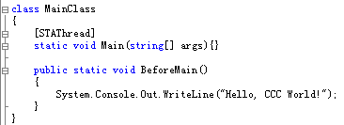
A Hello World Sample

Slide 6
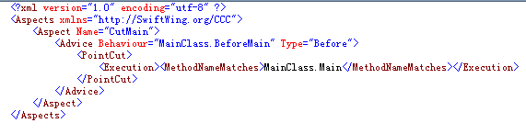
A Hello World Sample

Slide 7
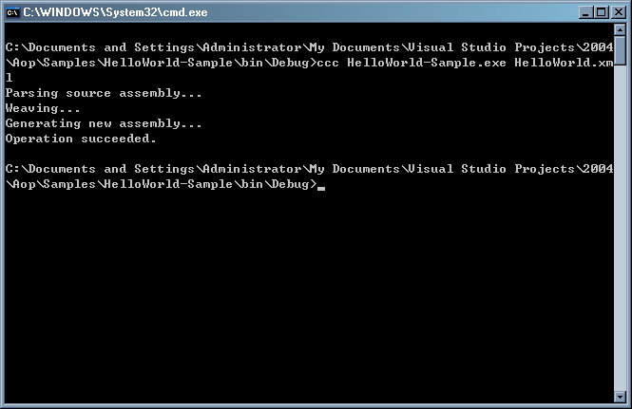
A Hello World Sample

Slide 8
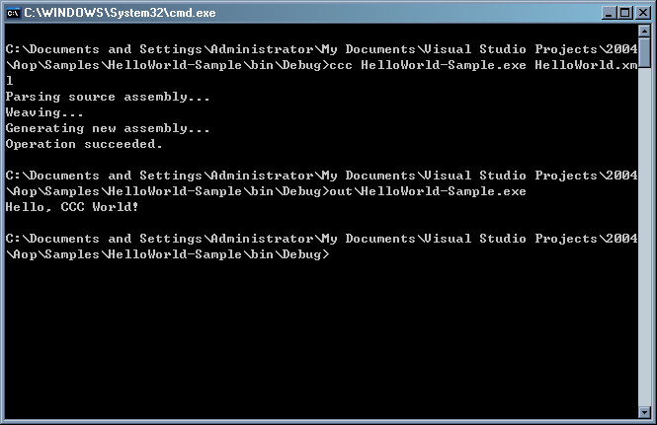
A Hello World Sample

Slide 9
The workflow of the system
The compiler reads the source code, separating them into aspect-oriented part and non-aspect-oriented part.
The non-aspect-oriented part is compiled into MSIL in a temporary assembly.
The aspect-oriented part is compiled into an XML file according to CCC syntax.
The CCC compiler reads the temporary assembly and the xml file, generating the final assembly.

Slide 10
The language features
Primitive pointcuts
Static join point model
Context binding specified by advice.

Slide 11
Primitive Pointcuts
In many aspect-oriented languages, pointcuts are not primitive.
  Call(int *.print*(String, ..))
  Easy to write, but not suitable for an intermediate language
Every pointcut defined in CCC is primitive
  Convient for transforming multiple languages
  <Call>, <MethodNameMatches>, <DeclaringTypeIs>, <ParameterTypeIs>, <ParameterCountIs>, <ReturnTypeIs>

Slide 12
Static Join Point Model
Dynamic Join Point Model
  some properties of the join point can only be determined at run-time.
    pointcut a() : args(String)
    selects not only the method whose first formal parameter type is String, but also the method which will be called with String argument at runtime.
  has significant effect towards system performance.
    the system has to type-check the arguments of methods
  programmers are unlikely to realize this overhead.

Slide 13
Static Join Point Model
Static Join Point Model
  all properties of the join point can be statically determined at compile-time.
    <PointCut Name="a">
    <And>
    <ParameterTypeIs>
    <ParameterIndex>1</ParameterIndex>
    <Type>
    <TypeNameMatches>System.String</TypeNameMatches>
    </Type>
    </ParameterTypeIs>
    <ParameterCountIs>1</ParameterCountIs>
    </And>
    </PointCut>
  No overheads
  programmers have more control over the system’s behavior.
  one can easily simulate the dynamic join point model by writing a little code.

Slide 14
Context Binding Specified by Advice
Specifying context binding by pointcuts
  pointcut a(int arg1) : call(* print(...)) && args(arg1);
  The binding declaration is separated from the parameter declaration
  Parameter binding must be explicitly checked
    Parameter Unbound: pointcut a(int arg1) : call(* print(…))
    binding arguments not provided: pointcut a() : args(arg1)
  Ambiguous expression could be formed
    pointcut a(int arg1) : call(* SomeMethod(..)) || args(arg1);

Slide 15
Context Binding Specified by Advice
CCC specifies context binding by advice
  <Advice Behaviour="SomeBehaviorMethod"
  Type="Before">
  <PointCut>
  <MethodNameMatches>print</MethodNameMatches>
  </PointCut>
  <Parameters>
  <Parameter Name="arg1">
  <Type><Direct>System.Int32</Direct></Type>
  <Binding Type="Argument" Index="0"/>
  </Parameter>
  </Parameters>
  </Advice>

Slide 16
Future Work
Binary form of CCC language
Aspect reuse on binary level

