Slide 1
用Spring Boot编写RESTful API
Mybatis进阶
ResultMap中的一对一和一对多

Slide 2
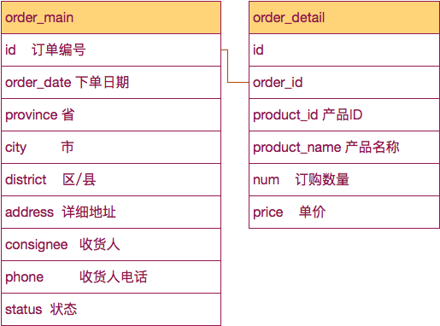
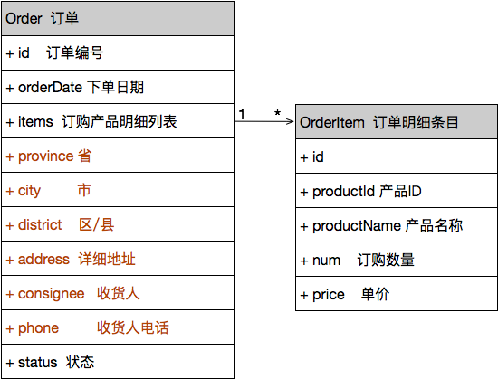

Slide 3
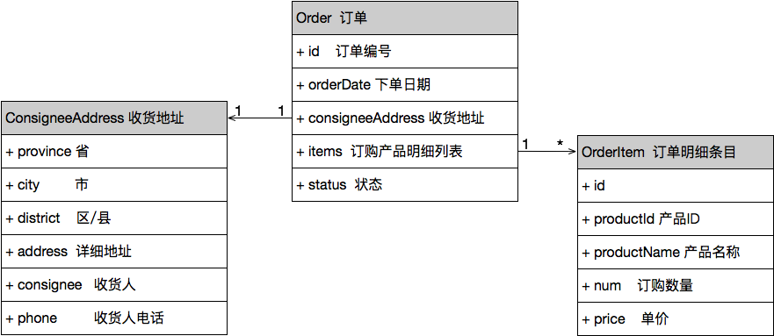

Slide 4
package cn.devmgr.tutorial;
import org.apache.ibatis.annotations.Mapper;
import org.apache.ibatis.annotations.Select;
import cn.devmgr.tutorial.model.Order;
@Mapper
public interface OrderDao {
@Select("select id, consignee, phone, province, city, district, " +
" address, order_date, status " +
" from order_main where id=#{id}")
public Order getOrderById(int id);
}

Slide 5
@Mapper
public interface OrderDao {
public Order getOrderById(int id);
}
/src/main/resources/cn/devmgr/tutorial/OrderDao.xml
<?xml version="1.0" encoding="UTF-8" ?>
<!DOCTYPE mapper PUBLIC "-//mybatis.org//DTD Mapper 3.0//EN"
"http://mybatis.org/dtd/mybatis-3-mapper.dtd" >
<mapper namespace="cn.devmgr.tutorial.OrderDao" >
<select id="getOrderById" resultType="cn.devmgr.tutorial.model.Order">
select id, consignee, phone, province, city, district,
address, order_date, status
from order_main where id=#{id}
</select>
</mapper>

Slide 6
<?xml version="1.0" encoding="UTF-8" ?>
<!DOCTYPE mapper PUBLIC "-//mybatis.org//DTD Mapper 3.0//EN"
"http://mybatis.org/dtd/mybatis-3-mapper.dtd" >
<mapper namespace="cn.devmgr.tutorial.OrderDao" >
<resultMap id="wholeOrderMap" type="cn.devmgr.tutorial.model.Order">
<id property="id" column="id" />
<result property="orderDate" column="order_date" />
… … … 这里省略了些字段 … … …
</resultMap>
<select id="getOrderById" resultMap="wholeOrderMap">
select id, consignee, phone, province, city, district,
address, order_date, status
from order_main where id=#{id}
</select>
</mapper>

Slide 7
<resultMap id="wholeOrderMap" type="cn.devmgr.tutorial.model.Order">
<id property="id" column="id" />
<result property="orderDate" column="order_date" />
<association property="consigneeAddress" resultMap="orderAddress"
javaType="cn.devmgr.tutorial.model.ConsigneeAddress"/>
</resultMap>
<resultMap id="orderAddress" type="cn.devmgr.tutorial.model.ConsigneeAddress">
<result property="consignee" column="consignee" />
… … … 这里省略些字段 … … …
<result property="address" column="address" />
</resultMap>
<select id="getOrderById" resultMap="wholeOrderMap">
select id, consignee, phone, province, city, district,
address, order_date, status
from order_main where id=#{id}
</select>

Slide 8
<resultMap id="wholeOrderMap" type="cn.devmgr.tutorial.model.Order">
<id property="id" column="id" />
<result property="orderDate" column="order_date" />
<association property=“consigneeAddress"
javaType="cn.devmgr.tutorial.model.ConsigneeAddress"
resultMap="orderAddress" />
<collection property="orderItems" column="id"
ofType="cn.devmgr.tutorial.model.OrderItem"
select="selectOrderItem">
</collection>
</resultMap>
<resultMap id="orderAddress" type="cn.devmgr.tutorial.model.ConsigneeAddress">
<result property="consignee" column="consignee" />
… … … 这里省略些字段 … … …
<result property="address" column="address" />
</resultMap>
<select id="getOrderById" resultMap="wholeOrderMap">
select * from order_main where id=#{id}
</select>
<select id="selectOrderItem" resultType="cn.devmgr.tutorial.model.OrderItem">
select id, order_id, product_id, product_name, num, price
from order_detail
where order_id=#{id}
</select>

Slide 10
@Mapper
public interface OrderDao {
public int insertOrder((@Param("order") Order order);
}
/src/main/resources/cn/devmgr/tutorial/OrderDao.xml
<?xml version="1.0" encoding="UTF-8" ?>
<!DOCTYPE mapper PUBLIC "-//mybatis.org//DTD Mapper 3.0//EN"
"http://mybatis.org/dtd/mybatis-3-mapper.dtd" >
<mapper namespace="cn.devmgr.tutorial.OrderDao" >
<insert id="insertOrder"
useGeneratedKeys="true" keyProperty="order.id" keyColumn="id"
parameterType="cn.devmgr.tutorial.model.Order">
insert into order_main (order_date, consignee, phone, province, city,
district, address, status)
values(#{order.orderDate},
#{order.consigneeAddress.consignee}, #{order.consigneeAddress.phone},
#{order.consigneeAddress.province}, #{order.consigneeAddress.city},
#{order.consigneeAddress.district}, #{order.consigneeAddress.address},
0)
</insert>
</mapper>

Slide 11
<insert id="insertOrder" useGeneratedKeys="true" keyProperty="order.id" keyColumn="id"
parameterType="cn.devmgr.tutorial.model.Order">
insert into order_main (order_date, consignee, phone, province, city,
district, address, status)
values(#{order.orderDate},
#{order.consigneeAddress.consignee}, #{order.consigneeAddress.phone},
#{order.consigneeAddress.province}, #{order.consigneeAddress.city},
#{order.consigneeAddress.district}, #{order.consigneeAddress.address},
0)
<foreach collection="order.orderItems" item="item" index="index"
open="" separator=";" close="">
insert into order_detail(order_id, product_id, product_name, num, price)
values(currval('order_main_id_seq'), #{item.productId}, #{item.productName},
#{item.num}, #{item.price});
</foreach>
</insert>
<selectKey keyProperty="order.id" resultType="int">
select currval('order_main_id_seq');
</selectKey>

Slide 12
include
<sql id="orderMainColumnsWithoutId">
consignee, phone, province, city, district, address,
order_date, order_type, status
</sql>
<select id="getOrderById" resultMap="wholeOrderMap">
select id, <include refid="orderMainColumnsWithoutId" />
from order_main
where id=#{id}
</select>

