Slide 1
用Spring Boot编写RESTful API
Websocket & JMS
在Spring项目中使用Websocket

Slide 2
Websocket
全双工通道，数据双向传输
浏览器和服务器之间的建持久性的连接
比轮询/长轮询大幅节省资源
使用80 443等HTTP端口
ws://example.com/wsapi wss://secure.example.com/
IE 10以上浏览器支持

Slide 3
websocket
Client Server
websocket

Slide 4
Websocket, SockJS & STOMP
STOMP
SockJS
websocket

Slide 5
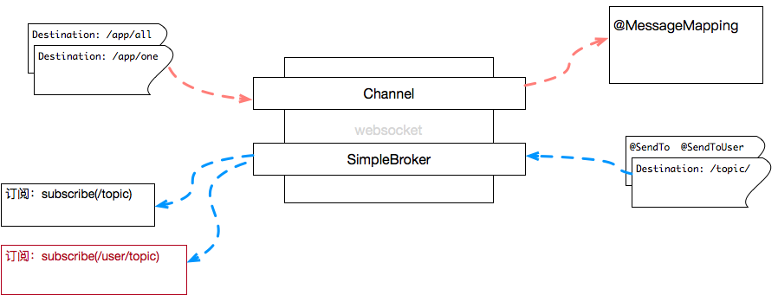
STOMP over Websocket
@MessageMapping("/all")
@SendTo("/topic")
public ClockMessage toAll(ClockMessage message, Principal principal)
stompClient.send("/app/all", {}, "JSON");
Client Server
public class WebSocketConfig implements WebSocketMessageBrokerConfigurer {
@Override
public void configureMessageBroker(MessageBrokerRegistry config) {
config.setApplicationDestinationPrefixes("/app");
config.enableSimpleBroker("/topic");
}
@Autowired private SimpMessagingTemplate template;
...
template.convertAndSend("/topic", message);
template.convertAndSentToUser(...)
stompClient.subscribe('/topic', function (msg) {
// 处理消息
});

Slide 6
配置
后面按照源代码讲解

Slide 7
package cn.devmgr.tutorial;
import org.apache.commons.logging.Log;
import org.apache.commons.logging.LogFactory;
import java.security.Principal;
import org.springframework.context.annotation.Configuration;
import org.springframework.messaging.Message;
import org.springframework.messaging.MessageChannel;
import org.springframework.messaging.simp.config.ChannelRegistration;
import org.springframework.messaging.simp.config.MessageBrokerRegistry;
import org.springframework.messaging.simp.stomp.StompCommand;
import org.springframework.messaging.simp.stomp.StompHeaderAccessor;
import org.springframework.messaging.support.ChannelInterceptorAdapter;
import org.springframework.messaging.support.MessageHeaderAccessor;
import org.springframework.web.socket.config.annotation.EnableWebSocketMessageBroker;
import org.springframework.web.socket.config.annotation.StompEndpointRegistry;
import org.springframework.web.socket.config.annotation.WebSocketMessageBrokerConfigurer;
@Configuration
@EnableWebSocketMessageBroker
public class WebSocketConfig implements WebSocketMessageBrokerConfigurer {
private Log log = LogFactory.getLog(WebSocketConfig.class);
@Override
public void configureMessageBroker(MessageBrokerRegistry config) {
// 只有用enableSimpleBroker打开的地址前缀才可以在程序中使用，使用没设置enable的前缀时不会出错，但无法传递消息
config.enableSimpleBroker("/queue");
// @MessageMapping注解的设置的地址的会和这个前缀一起构成客户端需要声明的地址(stompClient.send()方法的第一个参数）
config.setApplicationDestinationPrefixes("/app");
}
@Override
public void registerStompEndpoints(StompEndpointRegistry registry) {
//客户端new SockJS时需要这个地址；
registry.addEndpoint("/socket/sample").withSockJS();
}
@Override
public void configureClientInboundChannel(ChannelRegistration registration) {
// 注册一个自定义的拦截器
registration.interceptors(new MyChannelInterceptorAdapter());
}
/**
* 自定义拦截器，实现识别用户的功能
*/
public class MyChannelInterceptorAdapter extends ChannelInterceptorAdapter {
@Override
public Message<?> preSend(Message<?> message, MessageChannel channel) {
StompHeaderAccessor accessor = MessageHeaderAccessor.getAccessor(message, StompHeaderAccessor.class);
if (log.isTraceEnabled()) {
log.trace("拦截器截获命令:" + accessor.getCommand());
}
if (StompCommand.CONNECT.equals(accessor.getCommand())) {
// websocket连接刚刚建立起来，需要验证用户身份；根据token识别用户
String token = null;
String requestHeader = accessor.getNativeHeader("Authorization").get(0);
if (requestHeader != null && requestHeader.startsWith("Bearer ")) {
token = requestHeader.substring(7);
}
if (log.isTraceEnabled()) {
log.trace("MyChannelInterceptorAdapter->preSend() ... " + requestHeader + "; token=" + token);
}
User user = null;
if (token == null) {
user = new User("GUEST");
} else {
// 把token转变为用户
user = new User(token);
}
accessor.setUser(user);
}
return message;
}
}
public class User implements Principal {
private String name;
public User(String name) {
this.name = name;
}
@Override
public String getName() {
//往特定用户发消息时，会依赖这个名字，因此不要重名
if (log.isTraceEnabled()) {
log.trace("Principal.getName() return " + name);
}
return name;
}
}
}

