Slide 1
Opus, the Swiss Army Knife of Audio codecs
Jean-Marc Valin
Koen Vos
Timothy B. Terriberry
Gregory Maxwell
Mozilla, Xiph.Org Foundation

Slide 2
What Is the Opus Codec?
IETF standard under development
Targets interactive audio over the Internet
Aims to be royalty-free: BSD code with free license to all patents
Effort involves: Xiph.Org, Mozilla, Skype, Octasic, Broadcom and more
Combination of the SILK and CELT codecs
Notes:
The C-E-L-T in CELT stands for "constrained energy lapped transform".
CELT is a conventional transform codec, that's the "LT" part.
It uses the modified discrete cosine transform, just like MP3 and Vorbis, but it uses much smaller block sizes.
The downside is that you have much poorer frequency resolution, which I'll explain more precisely in a moment.
But the big idea that really makes CELT work is the "constrained energy" part.
We chop the signal up into bands and then explicitly code how much energy is in each one.
Then, whatever else the codec does, we constrain the output to have exactly that much energy in it.
This is an extremely powerful technique for avoiding the kind of blatantly obvious artifacts that you can get out of MP3 or other codecs.
Then there's a couple of other pieces to CELT that didn't make it into the name.
We use a special kind of vector quantization to code the details within each band, and a "pitch predictor", a technique we adapted from speech codecs.
This works a lot like motion compensation in a video codec, and helps compensate for the poor frequency resolution of our small transform size.

Slide 3
History
January 2007: SILK codec gets started at Skype
November 2007: CELT codec gets started
January 2009: CELT presented at LCA
March 2009: Skype asks IETF to create a WG to standardize an “Internet wideband audio codec” (SILK)
February 2010: After heated debate, IETF codec working group created
July 2010: First prototype of a SILK+CELT hybrid codec
March 2011: Opus beats HE-AAC and Vorbis in HA test
Nov 2011: WGLC, last minor bitstream changes
Notes:
The C-E-L-T in CELT stands for "constrained energy lapped transform".
CELT is a conventional transform codec, that's the "LT" part.
It uses the modified discrete cosine transform, just like MP3 and Vorbis, but it uses much smaller block sizes.
The downside is that you have much poorer frequency resolution, which I'll explain more precisely in a moment.
But the big idea that really makes CELT work is the "constrained energy" part.
We chop the signal up into bands and then explicitly code how much energy is in each one.
Then, whatever else the codec does, we constrain the output to have exactly that much energy in it.
This is an extremely powerful technique for avoiding the kind of blatantly obvious artifacts that you can get out of MP3 or other codecs.
Then there's a couple of other pieces to CELT that didn't make it into the name.
We use a special kind of vector quantization to code the details within each band, and a "pitch predictor", a technique we adapted from speech codecs.
This works a lot like motion compensation in a video codec, and helps compensate for the poor frequency resolution of our small transform size.

Slide 4
Characteristics
Sampling rate: 8 – 48 kHz (narrowband-fullband)
Bitrates: 6 – 510 kb/s
Frame sizes: 2.5 – 20 ms
Mono and stereo support
Speech and music support
Seamless switching between all of the above
It just works for everything
Notes:
The C-E-L-T in CELT stands for "constrained energy lapped transform".
CELT is a conventional transform codec, that's the "LT" part.
It uses the modified discrete cosine transform, just like MP3 and Vorbis, but it uses much smaller block sizes.
The downside is that you have much poorer frequency resolution, which I'll explain more precisely in a moment.
But the big idea that really makes CELT work is the "constrained energy" part.
We chop the signal up into bands and then explicitly code how much energy is in each one.
Then, whatever else the codec does, we constrain the output to have exactly that much energy in it.
This is an extremely powerful technique for avoiding the kind of blatantly obvious artifacts that you can get out of MP3 or other codecs.
Then there's a couple of other pieces to CELT that didn't make it into the name.
We use a special kind of vector quantization to code the details within each band, and a "pitch predictor", a technique we adapted from speech codecs.
This works a lot like motion compensation in a video codec, and helps compensate for the poor frequency resolution of our small transform size.

Slide 5

Codec Landscape
Bitrate (kbps/channel)
40
80
0
Opus
G.729
Real-time (live)
20
AAC-LD
Delay (ms)
Speex (NB, WB)
40
G.722.1C
≈
G.729.1
80
AMR-WB+
Storage
≈
200
Vorbis, AAC, MP3
Phone quality
High fidelity
narrowband
wideband
> wideband
Notes:
The C-E-L-T in CELT stands for "constrained energy lapped transform".
CELT is a conventional transform codec, that's the "LT" part.
It uses the modified discrete cosine transform, just like MP3 and Vorbis, but it uses much smaller block sizes.
The downside is that you have much poorer frequency resolution, which I'll explain more precisely in a moment.
But the big idea that really makes CELT work is the "constrained energy" part.
We chop the signal up into bands and then explicitly code how much energy is in each one.
Then, whatever else the codec does, we constrain the output to have exactly that much energy in it.
This is an extremely powerful technique for avoiding the kind of blatantly obvious artifacts that you can get out of MP3 or other codecs.
Then there's a couple of other pieces to CELT that didn't make it into the name.
We use a special kind of vector quantization to code the details within each band, and a "pitch predictor", a technique we adapted from speech codecs.
This works a lot like motion compensation in a video codec, and helps compensate for the poor frequency resolution of our small transform size.

Slide 6
Applications
VoIP and videoconference
Music/video streaming and storage
Remote music jamming
Wireless speakers/headphones/mic
Audio books
Virtualization/sound servers
Everything except:
  Lossless (use FLAC)
  Ultra low bitrate satellite/ham radio (use codec2)

Slide 7
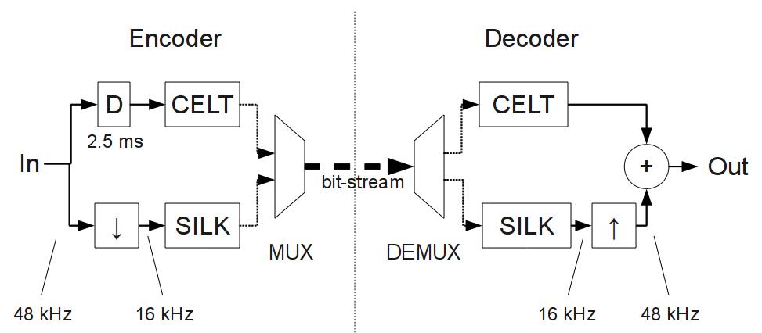
Architecture
Three operating modes:
  SILK-only (speech up to wideband)
  Hybrid (super-wideband/fullband speech
  CELT-only (music)
Notes:
The C-E-L-T in CELT stands for "constrained energy lapped transform".
CELT is a conventional transform codec, that's the "LT" part.
It uses the modified discrete cosine transform, just like MP3 and Vorbis, but it uses much smaller block sizes.
The downside is that you have much poorer frequency resolution, which I'll explain more precisely in a moment.
But the big idea that really makes CELT work is the "constrained energy" part.
We chop the signal up into bands and then explicitly code how much energy is in each one.
Then, whatever else the codec does, we constrain the output to have exactly that much energy in it.
This is an extremely powerful technique for avoiding the kind of blatantly obvious artifacts that you can get out of MP3 or other codecs.
Then there's a couple of other pieces to CELT that didn't make it into the name.
We use a special kind of vector quantization to code the details within each band, and a "pitch predictor", a technique we adapted from speech codecs.
This works a lot like motion compensation in a video codec, and helps compensate for the poor frequency resolution of our small transform size.

Slide 8
Technology (SILK)
Speech codec
Based on linear prediction (LPC)
  A bit like Speex, but much better
Very good at coding narrowband and wideband speech
  Up to ~32 kb/s
Not very good on music
Heavily modified to integrate within Opus
  Not compatible with the original SILK codec
Notes:
The C-E-L-T in CELT stands for "constrained energy lapped transform".
CELT is a conventional transform codec, that's the "LT" part.
It uses the modified discrete cosine transform, just like MP3 and Vorbis, but it uses much smaller block sizes.
The downside is that you have much poorer frequency resolution, which I'll explain more precisely in a moment.
But the big idea that really makes CELT work is the "constrained energy" part.
We chop the signal up into bands and then explicitly code how much energy is in each one.
Then, whatever else the codec does, we constrain the output to have exactly that much energy in it.
This is an extremely powerful technique for avoiding the kind of blatantly obvious artifacts that you can get out of MP3 or other codecs.
Then there's a couple of other pieces to CELT that didn't make it into the name.
We use a special kind of vector quantization to code the details within each band, and a "pitch predictor", a technique we adapted from speech codecs.
This works a lot like motion compensation in a video codec, and helps compensate for the poor frequency resolution of our small transform size.

Slide 9
Technology (CELT)
“Constrained-Energy Lapped Transform”
Speech+music codec
  Can work with very low delay
Uses modified discrete cosine transform (MDCT)
Most efficient on fullband (48 kHz) audio
  Useful for 40 kb/s and above
Not very good on low bit-rate speech
Notes:
The C-E-L-T in CELT stands for "constrained energy lapped transform".
CELT is a conventional transform codec, that's the "LT" part.
It uses the modified discrete cosine transform, just like MP3 and Vorbis, but it uses much smaller block sizes.
The downside is that you have much poorer frequency resolution, which I'll explain more precisely in a moment.
But the big idea that really makes CELT work is the "constrained energy" part.
We chop the signal up into bands and then explicitly code how much energy is in each one.
Then, whatever else the codec does, we constrain the output to have exactly that much energy in it.
This is an extremely powerful technique for avoiding the kind of blatantly obvious artifacts that you can get out of MP3 or other codecs.
Then there's a couple of other pieces to CELT that didn't make it into the name.
We use a special kind of vector quantization to code the details within each band, and a "pitch predictor", a technique we adapted from speech codecs.
This works a lot like motion compensation in a video codec, and helps compensate for the poor frequency resolution of our small transform size.

Slide 10
CELT Overview
Transform codec (MDCT)
  Long blocks up to 20 ms, short blocks of 2.5 ms
Key is preserving the energy in each Bark band
Algebraic VQ for band “details”
Minimal side information
Encoder
Decoder
Band
energy
Q1
band energy
Input
Pre-
filter
Window
MDCT
/
Q2
residual
x
MDCT⁻¹
WOLA
Post-
filter
Output
Side information
(period and gain)

Slide 11
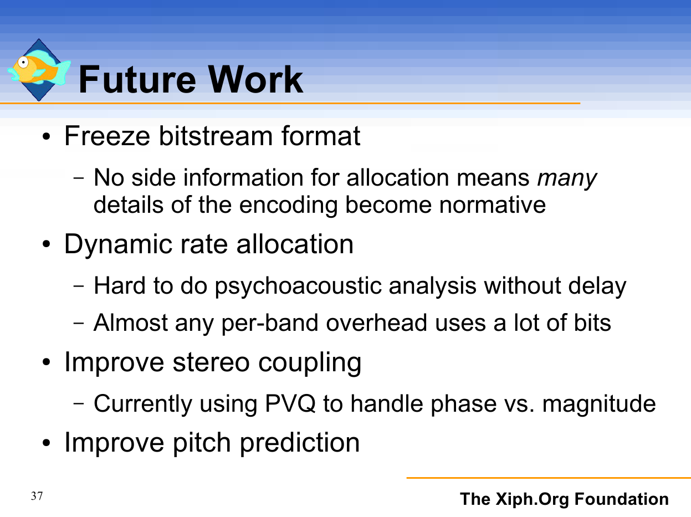
CELT Presentation, LCA 2009

Slide 12
CELT Presentation, LCA 2009

Slide 13
Bitstream Changes
Many changes required by Opus
  Changes to band layout
  20 ms frames
Static bit allocation tuning
  Stop starving the high frequencies

Slide 14
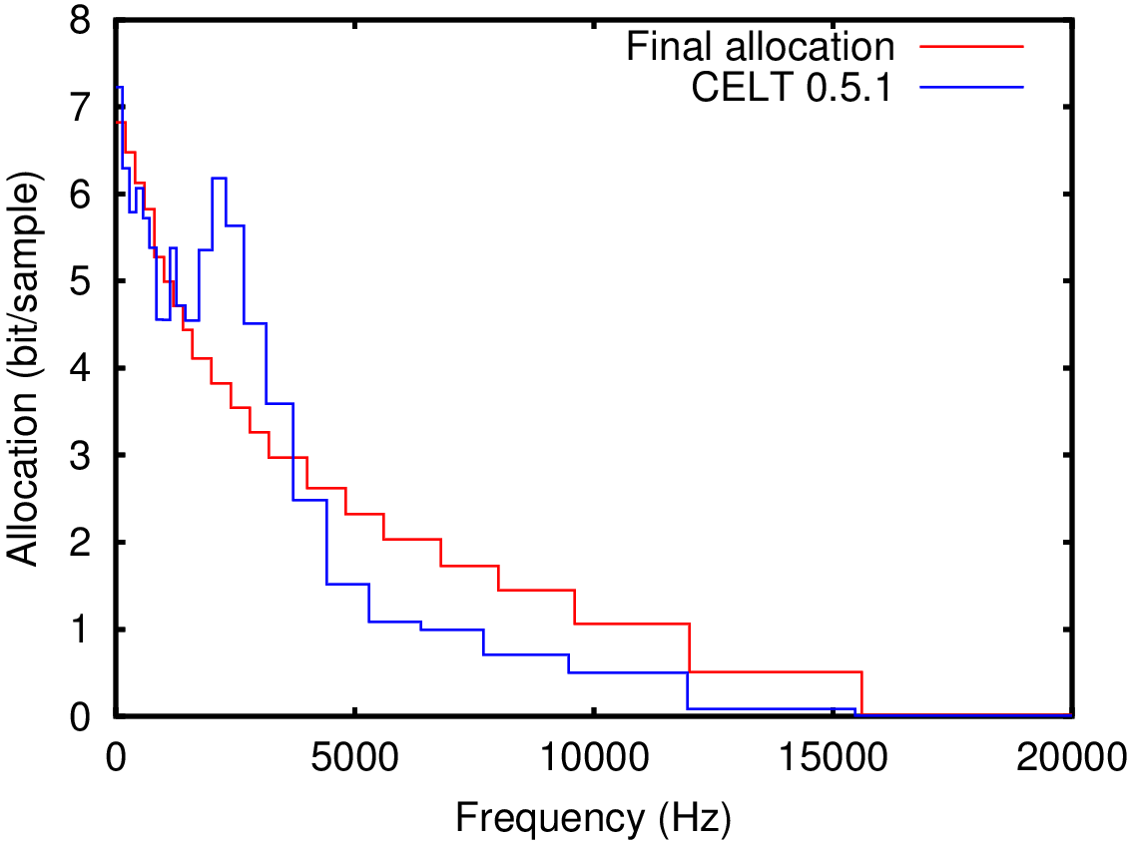
Static Bit Allocation Tuning
Comparison for 64 kb/s stereo

Slide 15
Bitstream Changes
Many changes required by Opus
  Changes to band layout
  20 ms frames
Static bit allocation tuning
  Stop starving the high frequencies
Anti-collapse

Slide 16
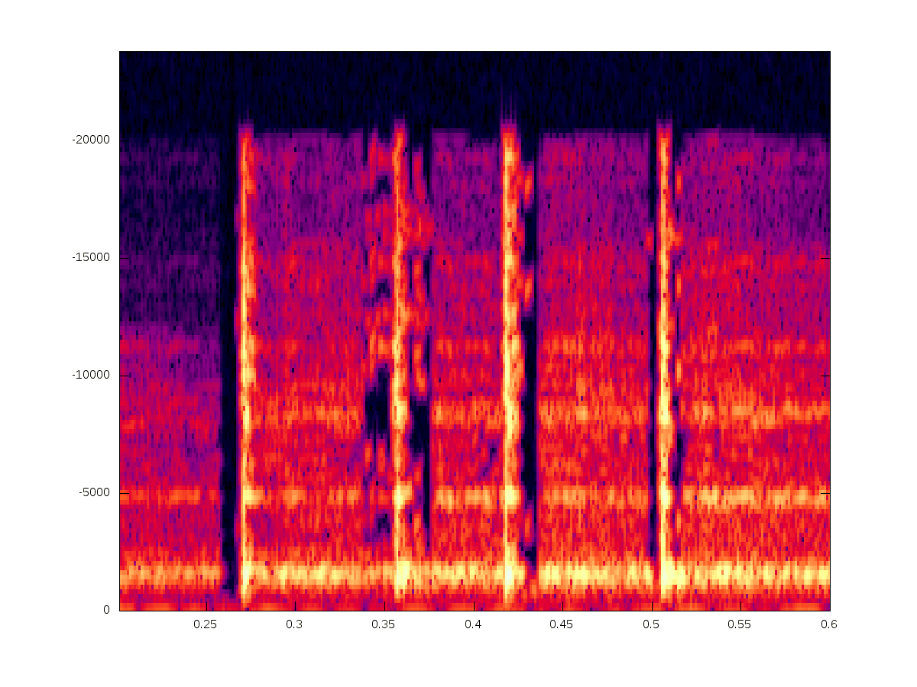
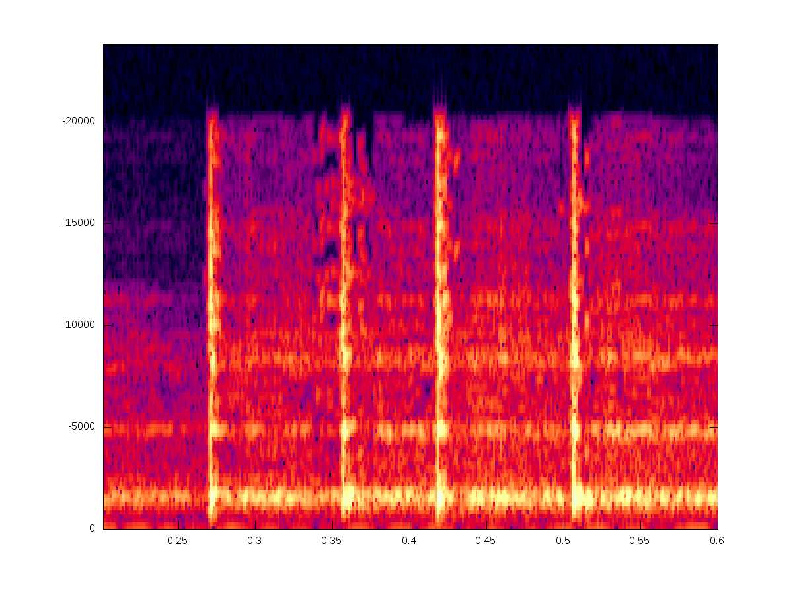
Anti-Collapse
Pre-echo avoidance can cause collapse
  Solution: fill holes with noise
No anti-collapse
With anti-collapse

Slide 17
Bitstream Changes
Many changes required by Opus
  Changes to band layout
  20 ms frames
Static bit allocation tuning
  Stop starving the high frequencies
Anti-collapse
Per-band time-frequency modifications
  Long vs short blocks on a per-band basis

Slide 18
Time-Frequency Resolution
Tones and transients can happen simultaneously
Standard short
blocks
per-band TF
resolution
Good frequency
resolution
Good time
resolution
frequency
frequency
ΔT*Δf ≥ constant
(also known as Heisenberg's
uncertainty principle)
Time
Time

Slide 19
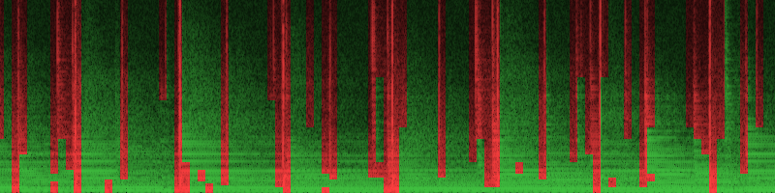

Time-Frequency Resolution Example
=
=
Frequency
Time

Slide 20
CELT Presentation, LCA 2009

Slide 21
CELT Presentation, LCA 2009

Slide 22
Dynamic Allocation
CELT still has mostly static allocation
  Part of the bit-stream, tuned since 2009
Now two ways to deviate from static allocation
  Allocation tilt
    Controls HF vs LF allocation trade-off
  Band boost
    Gives more bits to a band in particular
    WIP: Use for leakage compensation

Slide 23
CELT Presentation, LCA 2009

Slide 24
CELT Presentation, LCA 2009

Slide 25
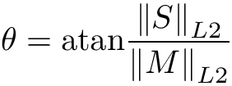
Stereo Coupling
Three modes: Dual, mid-side, intensity
Mid-side in the normalized domain
  Safe, cannot cause cross-talk or bad artefacts
  Based on preservation of the mid/side magnitude ratio
  Bit allocation depends on theta
Same mechanism now used to split bands with more bits than largest codebook

Slide 26
CELT Presentation, LCA 2009

Slide 27
CELT Presentation, LCA 2009

Slide 28
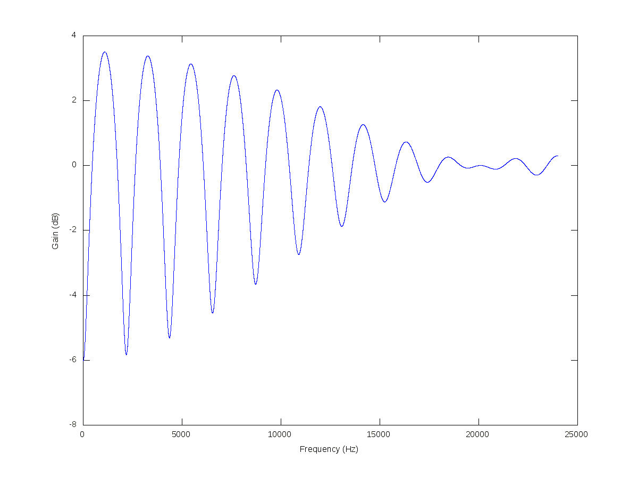
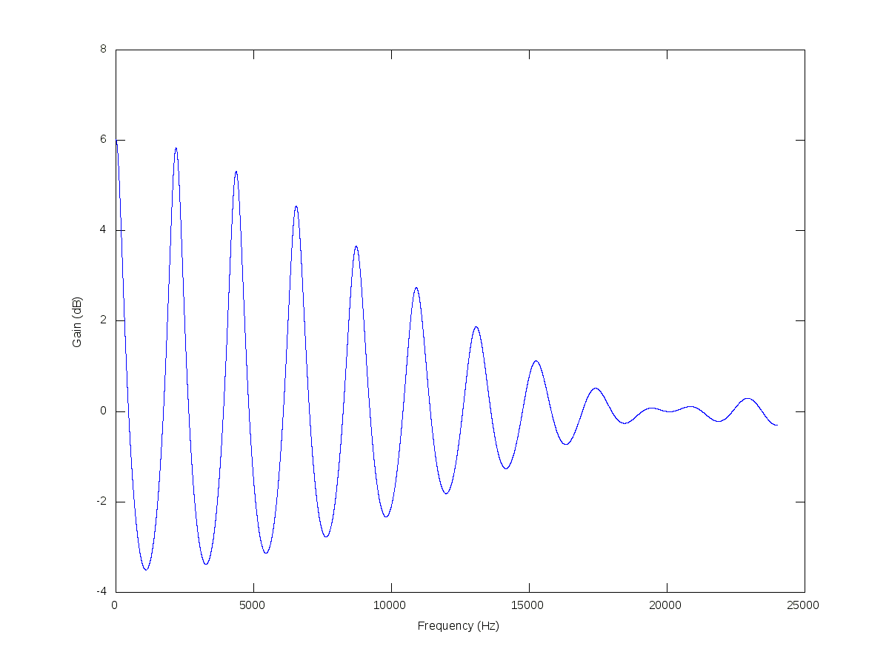
Pitch prefilter/postfilter
Contributed by Broadcom
Shapes noise for highly harmonic content
Prefilter
Postfilter

Slide 29
Subjective Testing
Comparison with other codecs
  AMR-NB, AMR-WB, Speex, Vorbis, AAC, ...
Many tests performed during development
Tests on the final version:
  Google (7 MUSHRA tests)
  Nokia (2 MOS tests)
  HydrogenAudio (ABC/HR test)

Slide 30
Google Tests
Narrowband tests (English+Mandarin)
  Opus clearly better than Speex and iLBC
  Opus better than AMR-NB at 12 kb/s
Wideband/fullband tests (English+Mandarin)
  Opus clearly better than Speex, G.722.1, G.719
  Opus better than AMR-WB at 20 kb/s
Opus clearly better than MP3 on music, inconclusive with AAC
No transcoding issues with AMR-NB/AMR-WB

Slide 31
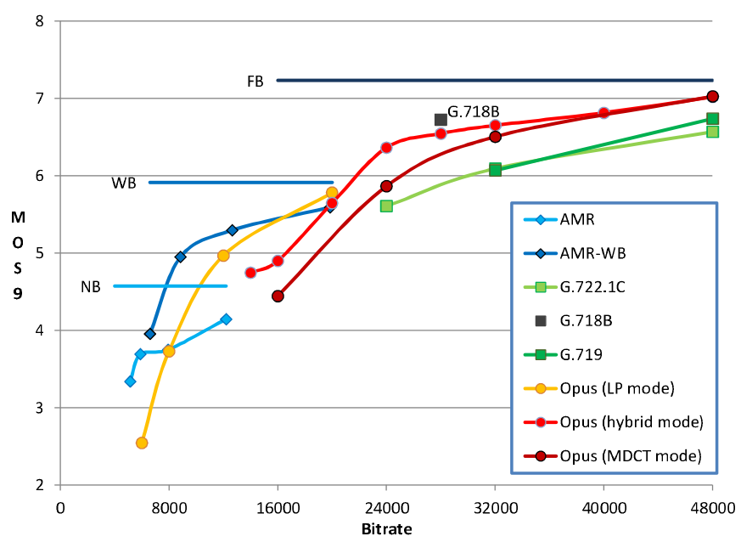
Nokia (clean+noisy speech)
Narrowband – fullband MOS speech test
Anssi Rämö, Henri Toukomaa, "Voice Quality Characterization
of IETF Opus Codec", Proc. Interspeech, 2011.

Slide 32
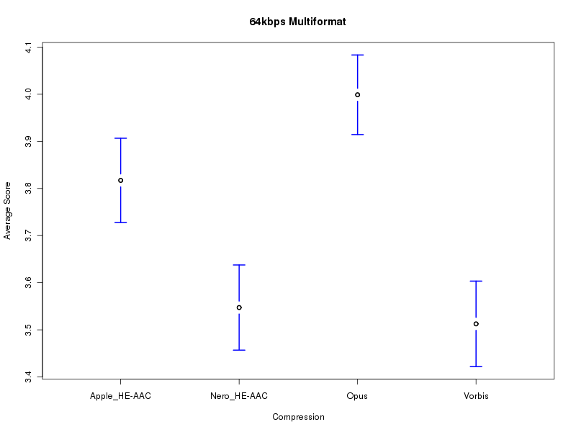
HydrogenAudio
64 kb/s stereo music ABC/HR test

Slide 33
Demo
Music at 64 kb/s
  u-law (G.711)
  Opus
  Reference
  MP3
Bitrate sweep
  8 kb/s to 64 kb/s

Slide 34
Current Development
Tools
  Ogg encoder/decoder
  Matroska encoder/decoder
  Firefox support
Quality improvements
  Better tuning of encoder decisions
  Improved unconstrained VBR
  Automatic speech/music detection

Slide 35
Coming Up
IETF process
  IETF Last call
  RFC
Industry adoption
  RTCWeb
  Browser support (streaming/HTML5)
  Skype
  World domination

Slide 36
Resources
Website: http://www.opus-codec.org/
Git repository: git://git.opus-codec.org/opus.git
Mailing list: codec@ietf.org
IETF website: http://www.ietf.org/
IRC: #opus on irc.freenode.net

Slide 37
Questions?
Notes:
So this is the end.
I hope you've enjoyed the presentation.
Are there any questions?

