Slide 1
GADGET - Globally applicable Area Disaggregated General Ecosystem Toolbox, www.hafro.is/gadget
Bjarte Bogstad, Institute of Marine Research,
Bergen, Norway
bjarte@imr.no

Slide 2
History & relation to other models
Models for boreal systems:
MULTSPEC (IMR, Norway, 1980s-1990s)
BORMICON (MRI, Iceland, 1990s) – New code
Gadget (ca. 2000 and onwards)- Extension of BORMICON code
Essentially same concept
Gadget may be thought of as an extension of Stock synthesis method (Methot)

Slide 3
Gadget
Forward simulation model
Create a virtual population within the model
Follow the fish through their lives
  Fishing, mortality, growth, maturation, etc.
Process driven
  E.g. percentage becoming mature, not percentage mature at age

Slide 4
Gadget
Age&length based
State variables: Number of fish and mean weight by age and length group
Multiple: species, stocks, fleets, areas
May divide a stock in e.g. mature/immature, female/male, each with different population dynamics
Coarse resolution in time and space (month/quarter/yearly time step, few areas)
Separation of model and data
  No data required for the simulation run

Slide 5
Applications of Gadget
Used both as a research tool and for practical stock assessment
Single and multispecies models, as well as single-species and mixed fisheries
Used both for fish, marine mammal and shellfish stocks
Barents Sea, Iceland, Celtic Sea, Bay of Biscay, Mozambique

Slide 6
Publications
Stefansson and Palsson 1998- why are Gadget-type models suitable for boreal systems?
Stefansson et al. – Statistical issues in such models
Bjørnsson and Sigurdsson 2003 – Redfish application - Iceland
Lindstrøm et al. Submitted – Whale-cod herring-capelin model – Barents Sea
EU project reports – dst2 (2004), BECAUSE (2007)

Slide 7
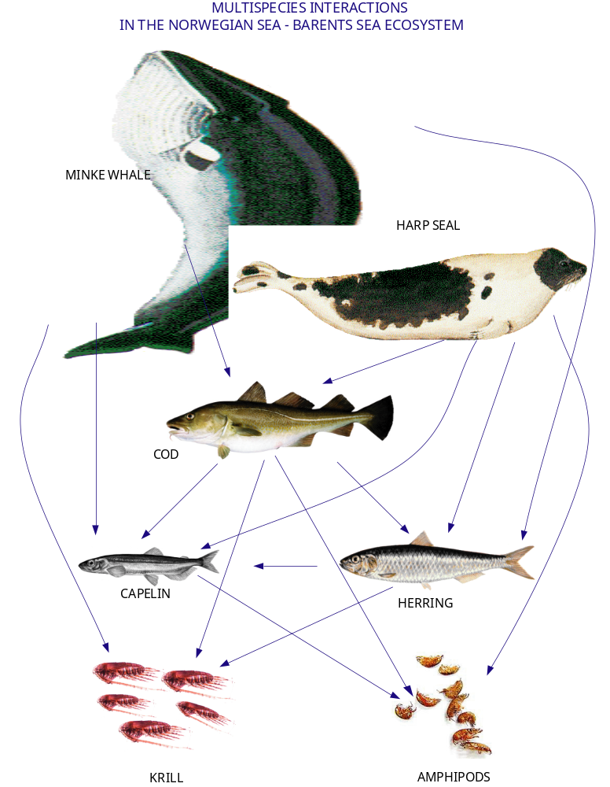

Slide 8
Fitting model to data
Statistical functions used to compare model and data - assign a numerical score to each data set
Combined in a weighted sum to give a single likelihood score
Repeat runs are made using different values of key parameters
Optimisation algorithm used to find best fit of model to data
Typically ~ 100 parameters in many Gadget models

Slide 9
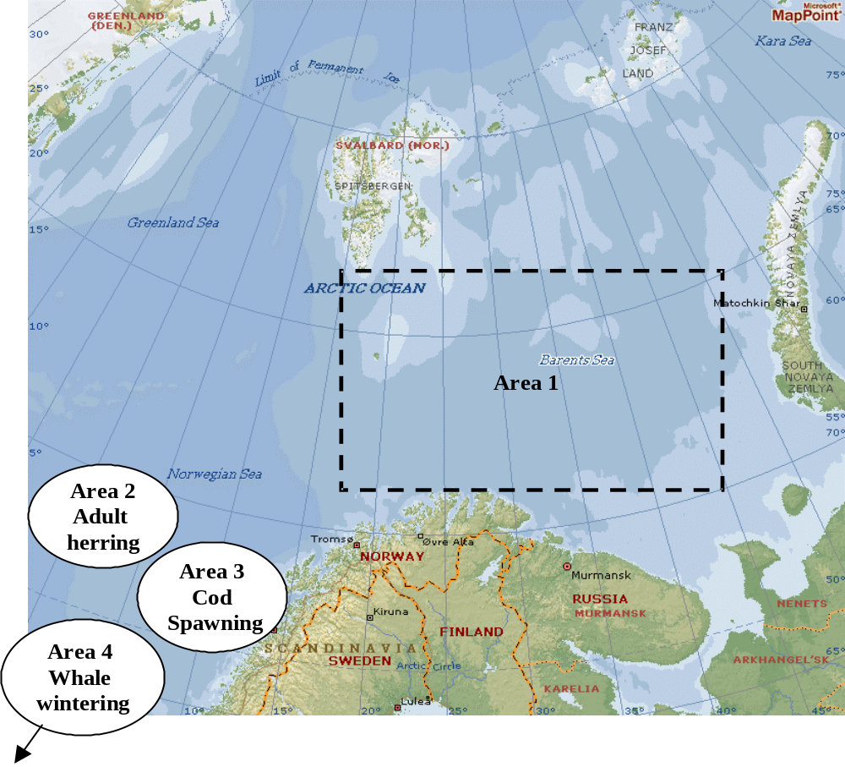
Area division - example

Slide 10
Which data may be used in Gadget?
Scientific survey data
Commercial catch data
Stomach content data
Mark/recapture data
Data and model resolution may be different

Slide 11
Software
Written in C++
Can be run under UNIX/Linux and PC (using cygwin)
Source code has to be downloaded, and then compiled on local computer
Code has been used for many years – well tested
Documentation and examples available on-line
Graphics not included in package – only numerical output
Further development of code not decided at the moment – main programmers have got new jobs

Slide 12
Strengths
Flexible tool
May integrate a wide variety of information on different resolution (biological/spatial/temporal)
Model and data independent
Well documented
Suitable for modelling systems with a few main species/interactions (e.g. boreal ecosystems)
Age data not needed
Gaps in data/knowledge may be identified – no hidden assumptions

Slide 13
Weaknesses
Some threshold to get started
Computer-intensive
Not the right tool if you have no data on length distributions

Slide 14
ICES Multispecies WG in October
The Study Group on Multispecies Assessments in the North Sea [SGMSNS] will be renamed the Working Group on Multispecies Assessment Methods [WGSAM] (Co-Chairs: John Pinnegar, UK and Bjarte Bogstad, Norway) and will meet at AZTI, San Sebastian, Spain from 15–19 October 2007 to:
examine the status of multispecies modelling efforts throughout the ICES region, i.e. Bay of Biscay, Mediterranean Sea, Iceland, Barents Sea, Baltic Sea, North Sea (based on results from EU-funded BECAUSE), and consider the feasibility of using the various methods across regions;
evaluate region-specific stomach sampling survey designs and preparation of guidelines and operation manuals;
investigate the potential implications of a decline in forage fish for dependent wildlife, and the implications for prey stocks of recovering fish predator populations;
investigate the relation between weight at age in the predator species and the abundance of prey species;
compare forward projections from ecosystem models such as Ecopath with Ecosim (EwE) and multispecies assessment models.

